Slide 1
What is in a 12-layer Butter Egg taRT?
自然語言模型(BERT)視覺化
40847041S 朱自宇 指導教授：王科植 老師

Slide 2
Outline
Before beginning:
Why doing this?
BERT 是什麼
動機發想
What to do
How to do
專題內容
流程說明
Notes:
大綱：簡報架構

Slide 3
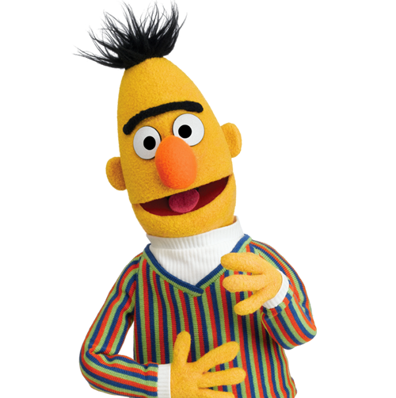
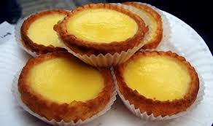
What is BERT?
Bidirectional Encoder Representation from Transformers
第一個雙向文意理解的的語言代表模型
Self-Attention Mechanism
Butter Egg taRT

Slide 4
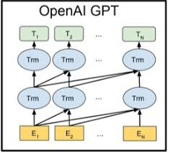
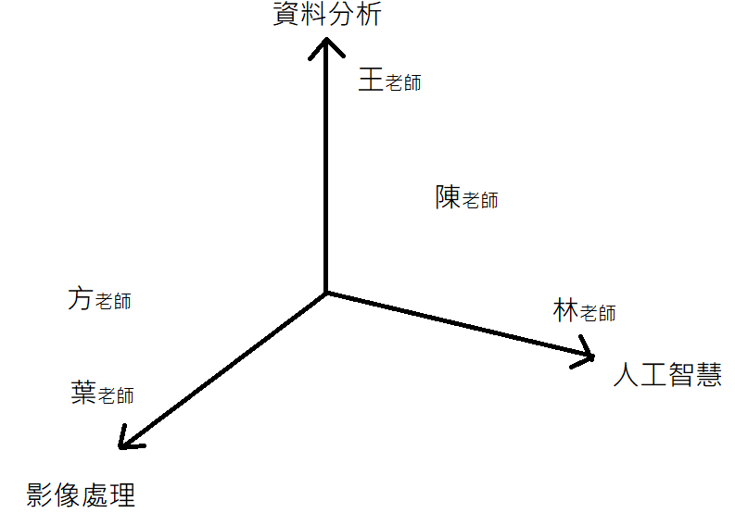
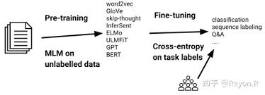
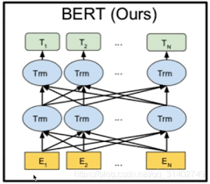
Language Model
每個詞彙皆代表一個詞空間中的 「連續向量」（在 BERT 中為 768 維）
兩階段遷移式學習 ( Pre-training ←→ Fine-tuning )
Self-Attention Mechanism
Me
Bidirectional

Slide 5

Why choose the BERT?
BERT is very new
BERT is a good model
Pre-training ←→ Fine-tuning
We don’t understand it yet
No need to worry about it
Easy to compare & adjust

Slide 6

What can we get from BERT?
在充分了解 BERT 的運作機制後，我們便能在 fine-tune 階段時使用更好的方式去調整、優化模型，讓 BERT 能更精確地達成我們給定的目標
視覺化

Slide 7

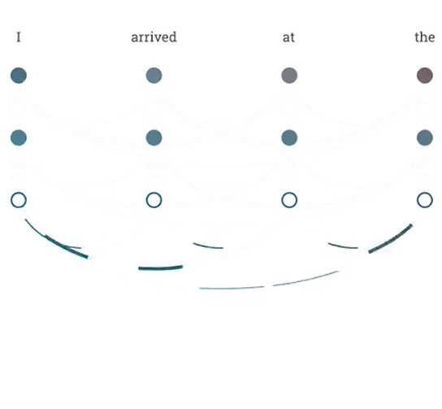

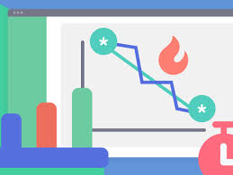
Visualizing the BERT model
Analyze
Organize
Visualize
分析 BERT 的 12 layers 和 768 維的詞向量，從中整理出其關聯性或規則
將前面所得之資訊整合，規劃出一種好呈現、可讀性較高的表現形式
把 BERT 模型中的資訊運用表格，分格圖等方式呈現，方便日後資料科學家分析資訊

Slide 8
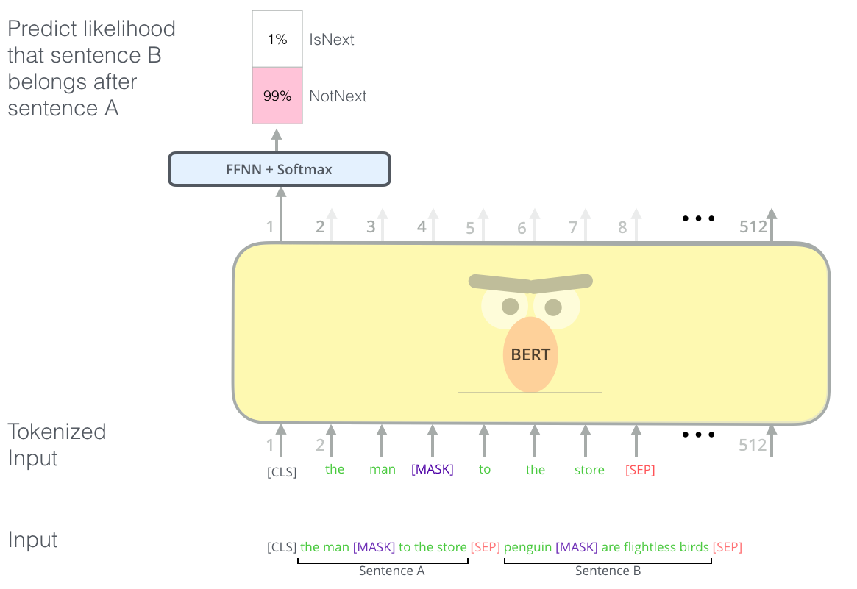
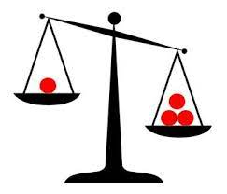
What can we do next?
With the tool, we can compare every layer of a word or sentence, get to know how each part of the BERT model works ( embedding, encoding, etc.)
NLP Scientists can use the tool to help comparing from model to model
Pre-train vs. Fine-tune
Fine-tune vs. Fine-tune

Slide 9
References and Papers
Transformers official website https://huggingface.co/transformers/
Attention is all you need https://arxiv.org/pdf/1706.03762.pdf
BERT: Pre-training of Deep Bidirectional Transformers for Language Understanding https://arxiv.org/pdf/1810.04805
Ian Tenny https://iftenney.github.io/projects/bertology/
A Multiscale Visualization of Attention in the Transformer Model https://aclanthology.org/P19-3007.pdf
Embedding Projector: Interactive Visualization and Interpretation of Embeddings https://arxiv.org/pdf/1611.05469.pdf

Slide 10
THANK YOU!
Presenter: 40847041S 朱自宇

