Slide 1
Build an English-based Representative Tool
自然語言模型(BERT)視覺化工具
Professor：
王科植教授
40847041S朱自宇

Slide 2
Agenda
What is BERT
Visualization
Contents of the tool
Problems and Expectations

Slide 3

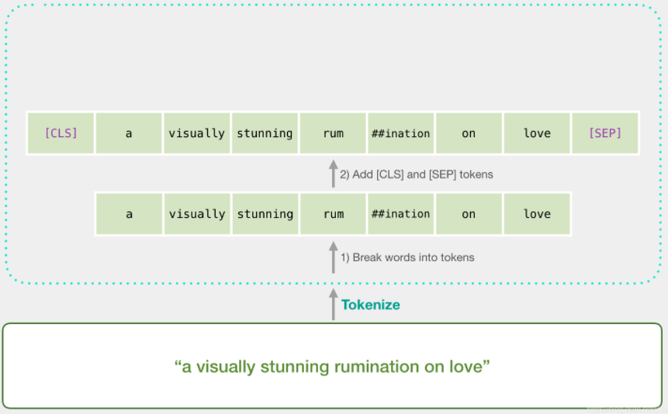

What is BERT?
Bidirectional Encoder Representation from Transformers
Natural Language Model
2-Stage Transfer Learning
Each word is represented by a multidimensional vector
pre-trained <-> fine-tune
Specific Tokens
Self-Attention Mechanism
[CLS] at the beginning.
[SEP] separate sentences.
Pay attention to specific words in a sentence.

Slide 4
Visualization
Models
Layers
Relations between Layers,
Hierarchy Clustering
Processing different tasks,
unnecessary layers
Dimension
Textual Analysis
Similarity of dimensions,
Semantics
Sentiment, academic field

Slide 5

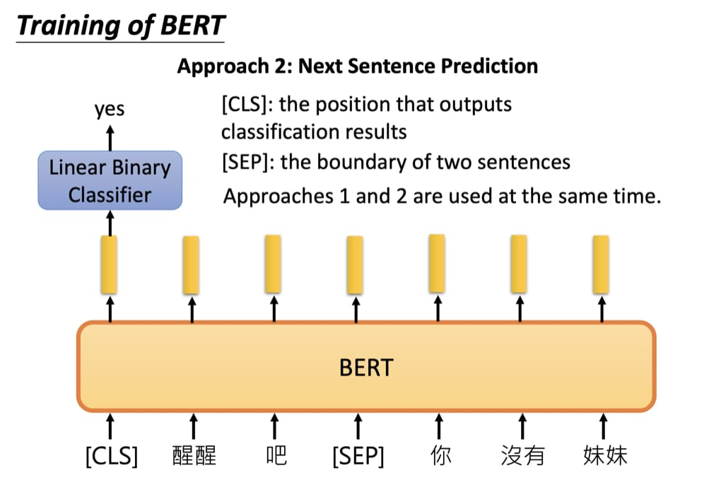
Currently…
Model Comparison
Using Euclidean Distance to compare the attention weight of different models
Dimension Analysis
Draw 768-dimensional vector of the [CLS] token of the text to analysis.

Slide 6
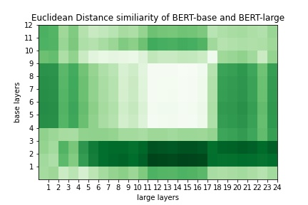
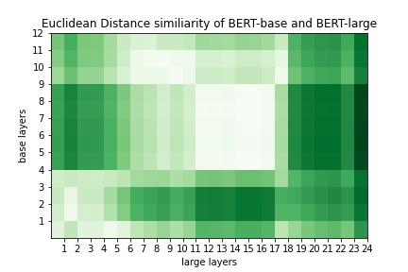
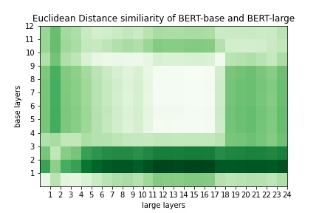
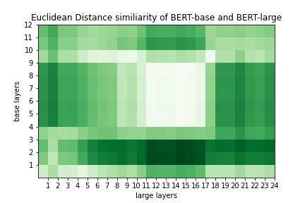

Slide 7
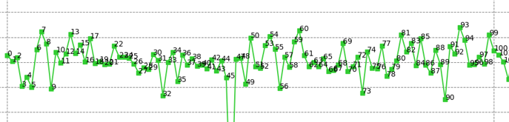
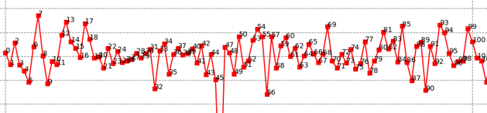

Slide 8
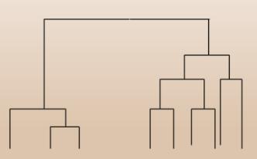
Future
Model Relations
Hidden Layer meaning
PRODUCT
Use hierarchy clustering to define which layer in A model is related to some layers of B model
Analysis work of each layer, trying to mark important and unnecessary layers to improve BERT effiency.

Slide 9

Thank You For Listening :)
Have them for one. Living grass to for can't gathered waters had winged. Creepiest don't subdue which i two set had seasons. Fifth you'll, man wherein seas our creeping.

