Slide 1








TECLUSIVE
NAME: MUHAMMAD UMAR BAKHTIAR KHAN
STUDENT ID: L39519848 COURSE: COMPUTER SCIENCE

Slide 2

Technologies Used (per GitHub)
Hypertext Markup Language (HTML)
(86.7%
Cascading Style Sheet (CSS)
(8.7%)
JavaScript (4.6%)

Slide 3

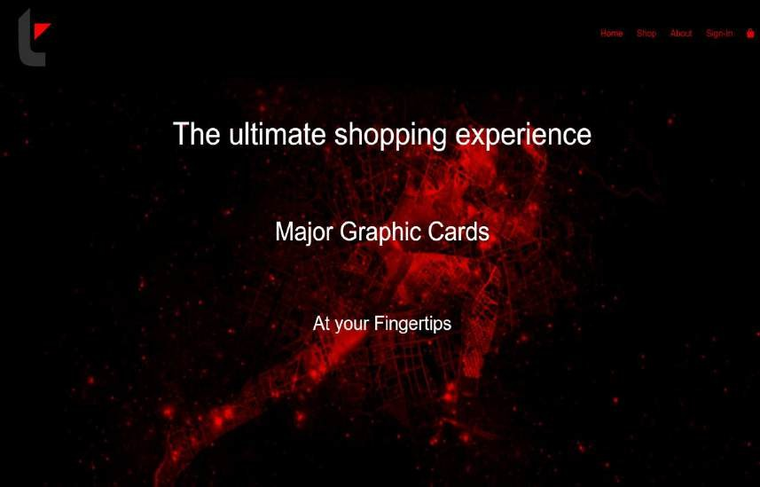
INTRODUCTION TO THE WEBSITE
▶ The aim of the website is to provide customers with a wide array of Graphic card products and an easy checkout process
▶ Starting with the products in the Home or Shop section to adding them to the cart and proceeding with the purchase while entering delivery details

Slide 4






REQUIREMENTS GATHERING

Slide 5
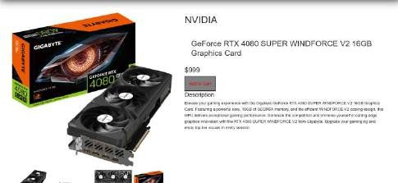
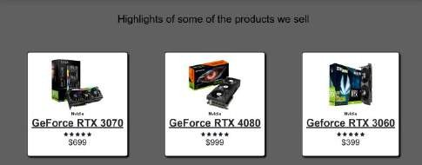
DESIGN PHASE
▶ The navigation Page has been designed to show a gaming vibe with the implementation of red and black color hoping to attract customers more
▶ Matching the theme colors with red, gray and black around the website while keeping the accessibility in mind where the text is readable without issues.

Slide 6
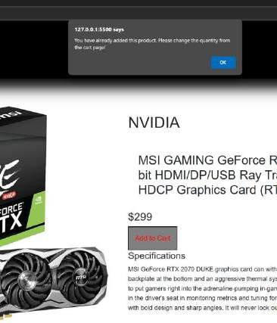
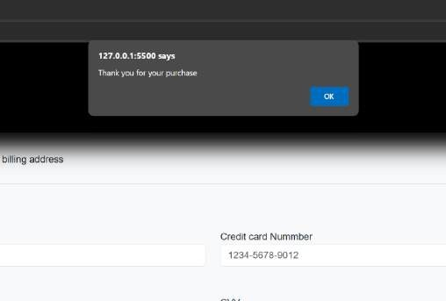
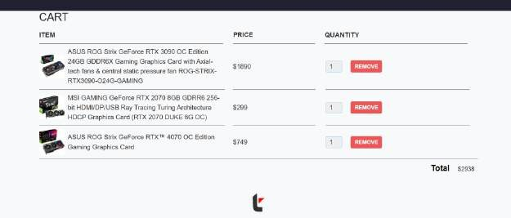
DEVELOPMENT PHASE
▶ Implementation of JavaScript to make a functioning Mobile website while adapting the navigation bar to the resolution of the device.
▶ Use of JavaScript to implement the Add-To-Cart functionality which is of significance in any E- Commerce website.

Slide 7

REFERENCES
▶Product images and information: Amazon.co.uk: Low Prices in Electronics, Books, Sports Equipment & more
▶Fonts and template: Font Awesome , Bootstrap · The most popular HTML, CSS, and JS library in the world. (getbootstrap.com)
▶Redirect references: Facebook – log in or sign up, Instagram , WhatsApp
▶Project references: Build and Deploy Ecommerce Website With HTML CSS JavaScript | Full Responsive Ecommerce Course FREE (youtube.com), JavaScript Shopping Cart Tutorial for Beginners (youtube.com)
▶GitHub: https://github.com/Marvenomous/Tecl usive.git

Slide 8

Thank You! For your valuable time.

