Slide 1
Debugging With Behavioral Watchpoints
Akshay Kumar
M.A.Sc Project Presentation
Advisors: Prof. Ashvin Goel, Prof. Angela Demke Brown

Slide 2
Dynamic Binary Translation
Powerful infrastructure for building program analysis and debugging tools.
E.g. Memcheck, Helgrind, Program shepherding
Operates at instruction granularity, providing complete control over program execution; No source code required
DBT Tool
Original
Binary
Translated
Binary
DBT Framework

Slide 3
Challenges with DBT Systems
Hard to develop tools, DBT abstractions are too low-level
Operates at instruction granularity; no options to specialise instruction level instrumentation with high-level abstractions.
Instruments program code, where as application prefer data centric instrumentation
E.g. Data race detection, Memory access bugs
Provides comprehensive coverage, no support for selective instrumentation
E.g. Data corruption bugs in an object such as inode

Slide 4
Watchpoints
Watchpoint provides an efficient facility to monitor all the memory references
Existing solutions:
Hardware Watchpoints
Advantage : very fast
Disadvantages : few watchpoints, limited size (not adequate for developing large program analysis tools )
Software Watchpoints
Different techniques: binary instrumentation, using mprotect, VM watchpoints
Unlimited watchpoints, unlimited size

Slide 5
Limitations of Existing System
Watchpoint contains no contextual information about the memory block it is watching
Can`t specialise instrumentation with the contextual information.
Provides support for data-centric instrumentation at page granularity
Pages containing watchpoints are protected; Not very useful when you want to track the accesses of an object
No support for selective or on-demand instrumentation
Comprehensive instrumentation is required to track all the memory updates

Slide 6
Behavioral Watchpoints
We propose a software based watchpoint framework that simplifies the implementation of DBT-based program analysis tools
Main characteristics
Context speciﬁc information about the memory block is embedded in each watchpoint which is directly available when a watched address is accessed.
A behavioral watchpoint watches a range of addresses, enabling object granularity watchpoints
Provides support for selective instrumentation by enabling or disabling binary translation on demand

Slide 7
Design: Behavioural Watchpoints
Relying on 48 bit implementation of 64-bit architecture
Both AMD64 and Intel x86-64 processor uses 48-bit implementation
High-order bits are converted into non-canonical values, that helps identify context specific information about the memory block
Counter Index
0xFFFF FFFFA0092600
Index in global descriptor table
0x7654 FFFFA0092600

Slide 8
Design: Behavioural Watchpoints(1)
Inherited index extends the number of supported watchpoints to 8M
0x000000
Descriptors
Base Address
Virtual Table
Meta-info
Context specific-info
……..
0x7653FF
0x765400
Counter Index
Inherited Index
0xFFFF FFFFA 00 92600
0x7654 FFFFA 00 92600
0x7FFFFF
Watched Address
Descriptor table

Slide 9
Implementation
Behavioral watchpoints are implemented using Granary, a DBT system for kernel modules
How to perform memory operation at non-canonical address?
Watchpoint instrumentation is added before every load and store instruction that performs memory operations
What if the watched addresses are accessed directly?
Hardware traps which processor needs to handle
lea (%r13),%rsi
bt $0x30,%rsi
jb addr_not_watched
bt $0x2f,%rsi
jae addr_not_watched
bswap %rsi
mov $0xffff,%si
bswap %rsi
LABEL: addr_not_watched
mov %rbx,(%rsi)
0x7654FFFFA0092600
mov %rbx,(%r13)
0xFFFFFFFFA0092600
Hardware traps when accessed
Implement behavioral watchpoints in trap handler
0x7654FFFFA0092600
Watched Address

Slide 10
Approaches
Code-centric instrumentation
Follows execution path and dynamically adds watchpoint instrumentation at each memory operation.
Has low-overhead when watchpoints are expected to be triggered frequently
Data-centric instrumentation
Triggered by hardware traps when watched addresses are dereferenced
Enables on-demand instrumentation, low overhead when watchpoints are less likely to be dereferenced
Three detach policies:
basic block
function-only
transitive detach policy.
Hardware Trap

Slide 11
How are Behavioural Watchpoints solution used?
An application developer must:
Identify the objects of interest and their source(allocators)
A behavioural watchpoint is added at the source of object
Update descriptors with context specific data and write the function to be execute when watched object is accessed.
FUNCTION_WRAPPER(__kmalloc,(size_t size, gfp_t gfp), {
void *ret(__kmalloc(size, gfp));
if(is_valid_address(ret)) {
add_watchpoint(ret);
}
return ret;
})
0xFFFFFFFFA0092600
Behavioral Watchpoint Client
ADD_WATCHPOINT
0x7654FFFFA0092600

Slide 12
How are Behavioural Watchpoints solution used? (1)
What our Behavioural Watchpoints runtime does:
load A
load B
load X
load C

Slide 13
How are Behavioural Watchpoints solution used? (1)
What our Behavioural Watchpoints runtime does:
Identify memory read/write operations and insert watchpoint instrumentation before them to identify watched objects
load A
load B
--------
load X
load C

Slide 14
How are Behavioural Watchpoints solution used? (1)
What our Behavioural Watchpoints runtime does:
Identify memory read/write operations and insert watchpoint instrumentation before them to identify watched objects
Call the watchpoint handling function when watched object is accessed
load A
load B
--------
load X
load C
wp_vtable_callback(address:X, descriptor:ds)
{
…..your memory analysis code
}

Slide 15
How are Behavioural Watchpoints solution used? (1)
What our Behavioural Watchpoints runtime does:
Identify memory read/write operations and insert watchpoint instrumentation before them to identify watched objects
Call the watchpoint handling function on the access of watched objects
Emulate the original instruction to perform read/write operations
load A
load B
--------
load X
load C
wp_vtable_callback(address:X, descriptor:ds)
{
…..your memory analysis code
}
Replace load X with emulated instruction

Slide 16
Evaluation
~5-13 instructions to instrument load/store for watched addresses
Microbenchmarks
Memory operation in a tight loop
Iozone file system benchmarks:
Ext3 file system module was mounted on a RAMDisk of size 1GB
Measured the throughput of file system operations
Approach | Native | Watch Null | Watch All
Code-centric | 1x | 2.7x | 3.8x
Data-centric | 1x | 1x | 283x

Slide 17
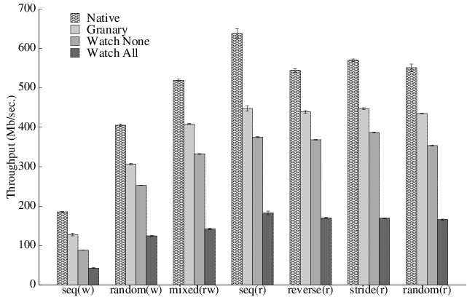
Evaluation: Code-centric Instrumentation
~50% Watch None
~76% Watch All
 | Watch None | Watch All
Nr of executed basic blocks | 238782485 | 825836778 | ~3.5x
Nr of hardware traps | 0 | 12630779

Slide 18
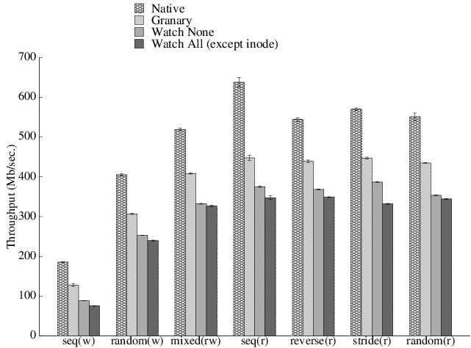
Evaluation: Code-centric Instrumentation(1)
File inode objects are not watched
~50% Watch None and Watch All
 | Watch none inode | Watch All
Nr of executed basic blocks | 266083908 | 825836778 | ~3.1x
Nr of hardware traps | 5285701 | 12630779 | ~2.4x

Slide 19
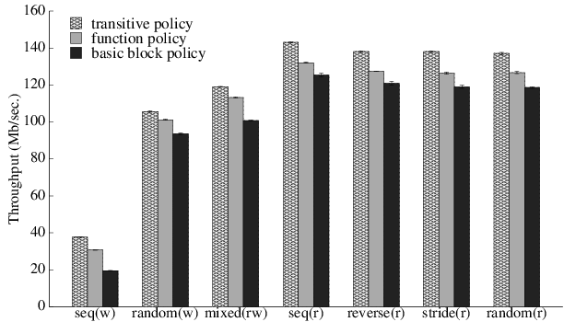
Evaluation: Data-centric approach
Transitive detach policy instruments code aggressively and experiences less hardware traps.
 | Basic block | Function only | Transitive
Nr of basic blocks | 1144 | 3335 | 5755
Nr of executed basic block | 37378155 | 108965164 | 833167407
Nr of hardware traps | 140421285 | 65755752 | 13515835

Slide 20
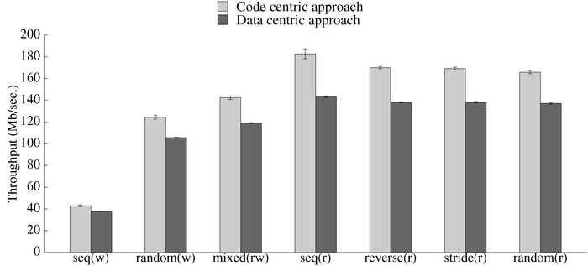
Evaluation: Code Vs Data
All allocated objects by the module are watched
The code-centric instrumentation performs better than the data centric instrumentation; this is because of the less number of hardware traps encountered and the less number of executed basic blocks

Slide 21
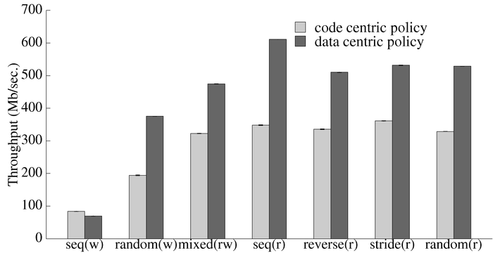
Evaluation: Selective Instrumentation
Only module accessed objects are watched
Data centric instrumentation is performing near Native when watchpoints are added selectively only on the module accessed objects (~70% improvements from code centric approach).

Slide 22
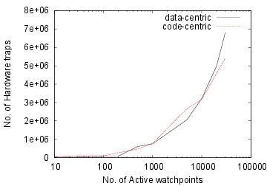
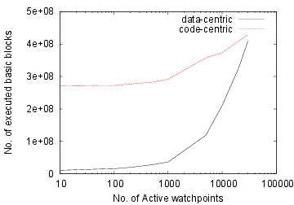
Evaluation: Macrobenchmark
Macrobenchmark : System utilities operation on source tree of openssh-6.2 and gcc-4.8
Benchmark uses cp and tar system utility.

Slide 23
Applications of Behavioral Watchpoints
Prototyped three applications using Behavioral watchpoints:
Buffer overflow detector
Selective Memory Shadowing
Memory Leak Detector
Other applications:
Detect misuses of Read-Copy-Update in Linux kernel and its modules.
Enforcing read/write access control and control-flow integrity in Linux kernel modules.

Slide 24
Conclusion
Introduced Behavioral Watchpoints that simplify the implementation of DBT based program analysis tools
Behavioral watchpoints maintain the contextual information about the memory being watched
Described two approaches which is used for implementing behavioral watchpoints.
Introduces selective instrumentation a key feature of data-centric instrumentation.
Evaluated the two approaches of implementing behavioral watchpoints and shows how selective instrumentation improves the performance of traditional debugger.
Developed three applications which detects memory access bugs in the kernel modules

Slide 25
Thank you

Slide 27
Memory Leak Detector
Why module only leak detector:
Whole kernel leak detector reduces the performance of memory allocation and freeing
False positive, if the pointer alias is calculated using operations other than container_of
Stop-the-world collector makes the pointer collection costly
Reduces the performance of whole kernel when only analysing module code

Slide 28
Challenges
All module owned objects are not allocated directly by the module.
Module loses internal references of the objects allocated in the module context. Having limited knowledge of the kernel, it is difficult to find leaks of such objects.
It is difficult to track memory allocation and pointer aliasing.

Slide 29
Why Behavioral Watchpoints?
Behavioral watchpoints ensure that all the memory allocated in the module context are watched.
Provides complete visibility when allocated memory is accessed thus solves the problem of loosing internal references.
Associates each memory block with a descriptor which stores the state of memory.
Behavioral watchpoints are also viral and every address derived from a watched address (e.g., through copying or offsetting) is also watched.

Slide 30
Object Liveness Analysis
Three policies
Scanning of module accessed memory
Mark all the objects accessed between two scans as live.
Consider all accessed object in last epoch as live and perform reachability analysis considering them as “root-sets”.
Scanning of module reachable objects
Stores all the kernel objects passed to the module during course of execution.
Type scan all the objects reachable from the module.
Scanning of kernel heaps and static data
Fallback approach, uses kernel page table to walk all the kernel pages
Scan all the allocated kernel pages looking for watchpoints

Slide 31
Evaluation
Cost of scanning policies:
Leak detection accuracy:
Policies | Scanning of Accessed objects | Scanning of module reachable objects | Scanning of kernel heaps and static data
CPU cycles | 591822 (0.23ms) | 3000269 (1.15ms) | 18859648171 (7.20sec)
Policies | Leak detected | False positive | False negative
Scanning of Accessed objects | 59.43% | 1.87% | 38.70%
Scanning of module reachable objects | 98.12% | 0.98% | 0.9%
Scanning of kernel heaps and static data | 41.64% | 0% | 58.36%

Slide 32
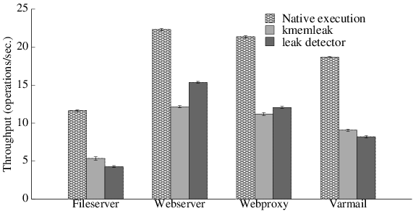
Evaluation(1)
Filebench Server benchmarks:
Ext3 file system module was mounted on a ramdisk of 1GB
Filebench server benchmark is used to evaluate leak detector
Workload | Setting | Data Size
Fileserver | nfiles=10K | 1.2GB
Webserver | nfiles=1K | 14.76MB
Webproxy | nfiles=10K | 154MB
Varmail | nfiles=1K | 14.76MB

Slide 34
Existing Watchpoints Solutions
Hardware Watchpoints
Advantage : very fast
Disadvantages : few watchpoints, limited size, unaware of threads (not adequate for developing large program analysis tools )
ISA | # | Known As | Possible Size
X86[-64] | 4 | Debug Register | 1, 2, 4, [8] bytes
ARMv7 | 16 | Debug Register | 1-8 bytes of up to 2GB using low order masking
ePower | 2 | Dart Address Compare | 1 byte or 64-bit address with any bit masked
Itanium | 4 | Data Breakpoint Register | 1 byte to 64PB using low order masking
MIPS | 8 | Watch Lo/Hi | 8 byte naturally aligned

