Slide 1
OCR Post-Processing
Applied Data Science
Group 6

Slide 2
Detection
Labelling
Feature engineering
Support Vector Machine (SVM) training
Classification
Evaluation

Slide 3
Detection
Labelling
Pre-processing the data
Files with different number of lines
Line with different number of words

Slide 4
Detection
Feature engineering
Length of the word
Number of vowels and consonants
Number of non-alphanumerical symbols
Number of digits
Number of lower/upper cases
Consecutive appearance of the symbol
Infix (after deleting the first/last character)
Letter-bigram
Levenshtein Distance (did not implement)

Slide 5

Detection
Letter-bigram

Slide 6
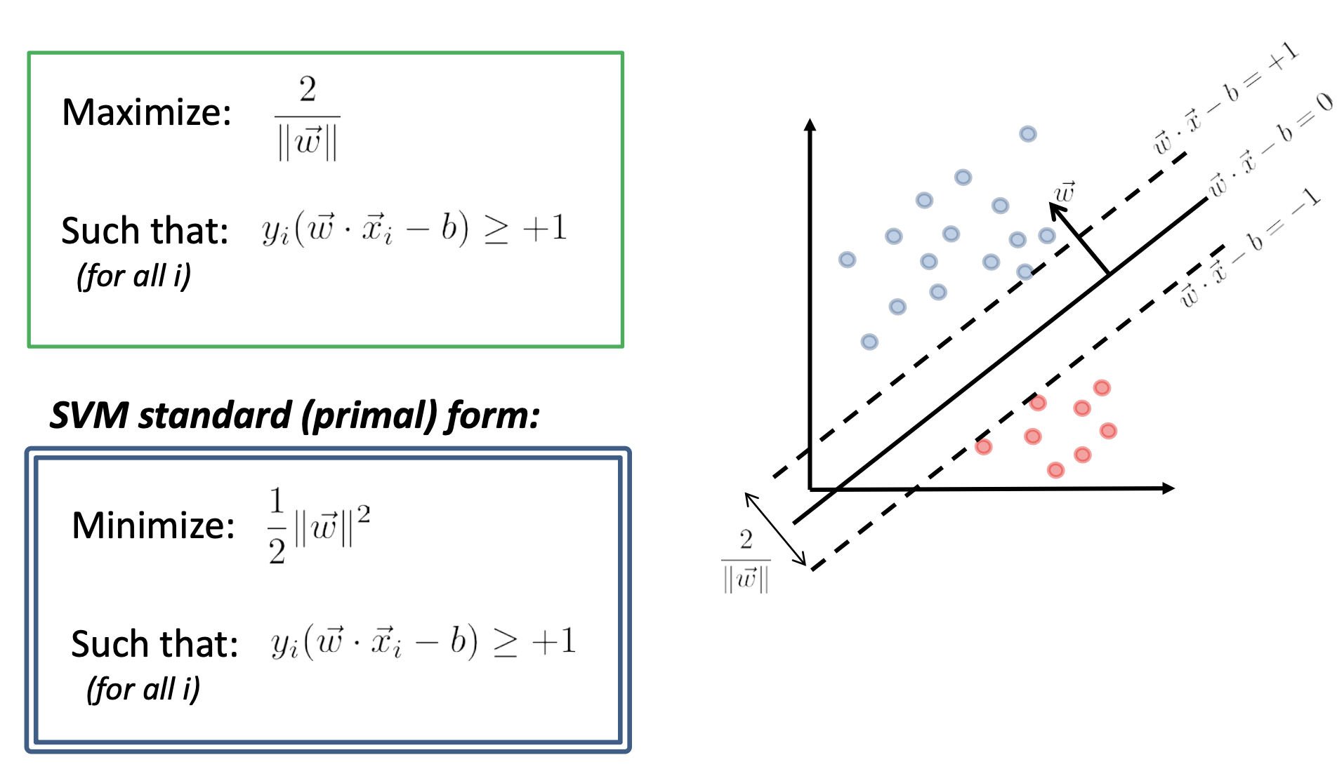
Detection
Support Vector Machine (SVM)

Slide 7
Correction
Load data from detection
Clean number/punctuation
Find candidates
Calculate all the probability
prior (ELE method) and likelihood
Maximum probability
Evaluation

Slide 8

Correction
Probability Calculation
Prior using ELE
ELE: Expected Likelihood Estimate

Slide 9
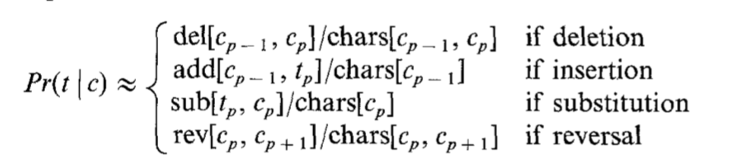
Correction
Probability Calculation
Likelihood (Pr[t|c])

Slide 10
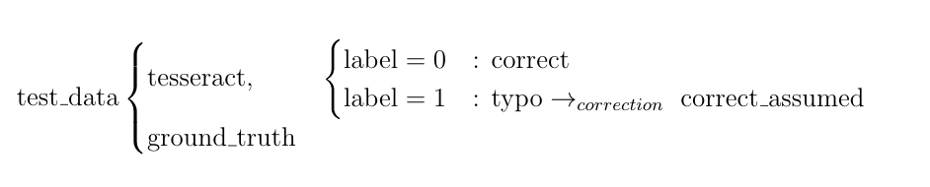
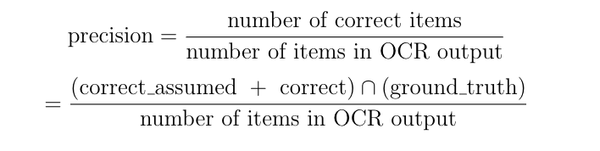
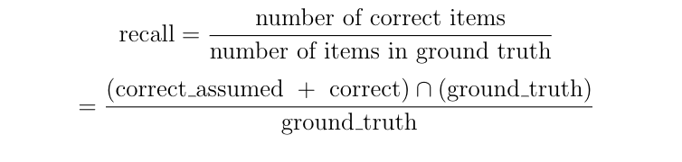
Correction
Evaluation
Precision
Recall

Slide 11
Any Questions?

