Slide 1


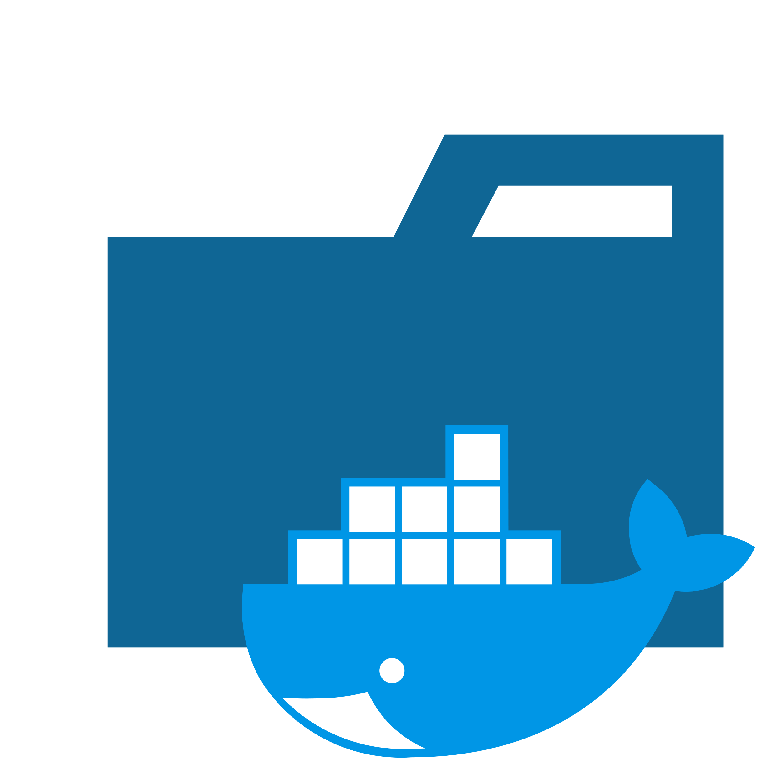













PoC
Windows ®
WSL Instances
Base
Docker Base
Test
Development
Kubernetes
Registry
Docker
Docker Containers
Other containers
Web Server
Maria DB
Tomcat
Oracle

Slide 2
PoC
Windows ®
WSL Instances
Base
Docker Base
Test
Development
Kubernetes
Registry
Docker
Docker Containers
Other containers
Web Server
Maria DB
Tomcat
Oracle

Slide 3





Virtual Disks

