Slide 1
Training data-efficient image transformers
& distillation through attention.
Hugo et al
ICML 2021.
Reproducing key ideas from Training data-efficient image Transformers & distillation through attention (DeiT) and deploying a tiny ViT backbone for real-time scene understanding.
Faculty of Computer Science.
Presented by Billa Lewis Lesigha

Slide 2
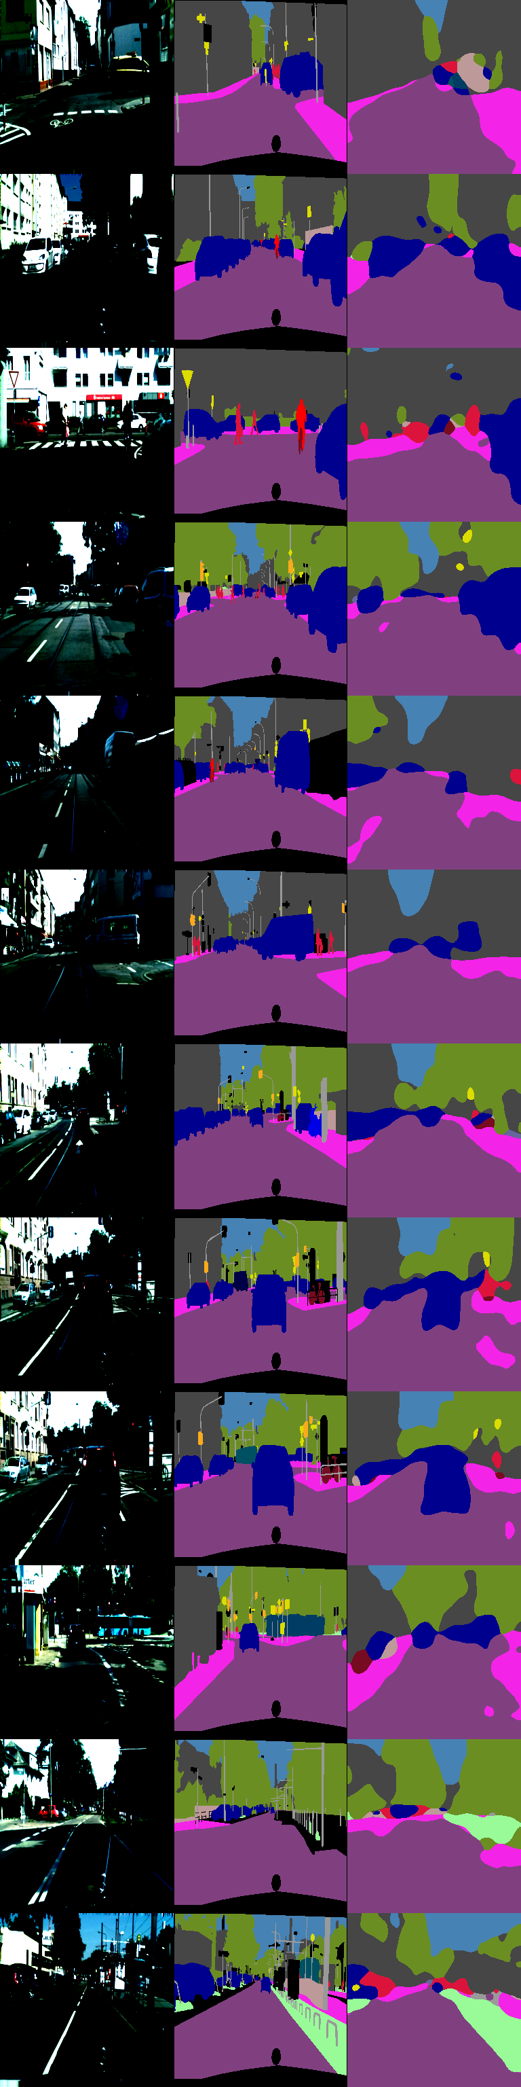
Problem Statement
Faculty of Computer Science.
2/15
Goal: Turn every pixel in a street scene into a class (road, car, person, sky, etc).
Why it matters: Perception for robots/AR/ADAS needs segmentation that’s accurate and fast.
Constraint: Run on modest hardware (edge CPU/GPU) → tiny, efficient backbones.

Slide 3
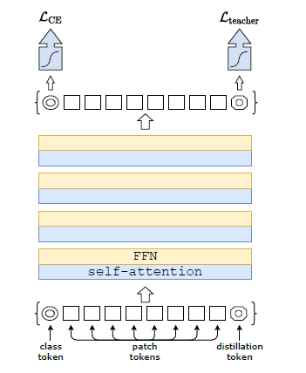
Paper I Build On (DeiT)
Faculty of Computer Science.
3/15
Paper: Training data-efficient image Transformers & distillation through attention (DeiT; Touvron et al., 2020).
Core idea: make Vision Transformers trainable efficiently via strong regularization and a distillation token so a student ViT learns from a teacher.
DeiT is published for classification (ImageNet), not segmentation, my work adapts the backbone to segmentation.

Slide 4

Faculty of Computer Science.
4/15
Research Question.
Can a DeiT-Tiny backbone (3 heads, 12 layers, 192-dim) drive a lightweight segmentation head that is:
sufficiently accurate on Cityscapes, and
real-time on commodity hardware,
while keeping the pipeline simple enough for deployment (ONNX)?

Slide 5
Dataset & Labels.
Faculty of Computer Science.
5/15
Dataset: Cityscapes (train/val), 19 classes, urban street scenes.
Prep: scripts/prepare_cityscapes.py → standardized images/ and masks/, square-pad/resize.
Training size: 256×256 (fast) ; I also profiled 160/192/224.
Splits discovered by loader: 2,975 train pairs, 500 val pairs.

Slide 6
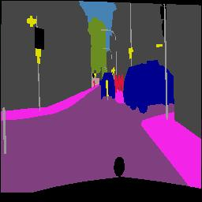
Model & Training.
Faculty of Computer Science.
6/15
Backbone: DeiT-Tiny (patch=16, dim=192, depth=12, heads=3).
Head: minimal 1×1 conv → upsample to input size.
Loss: CrossEntropy with ignore-index for unlabeled pixels.
Config (final run): img_size=256, epochs=20, batch=8
Code: train.py, dataset in datasets/tiny_seg.py.

Slide 7
What was Implemented (beyond just running code)
Faculty of Computer Science.
7/15
From scratch implementation of dataset, loader, tiny segmentation head, training & eval loops.
Cityscapes prep script + sanity checks of pair counts.
ONNX export (scripts/export_onnx.py) with dynamic shapes and opset handling.
Deployment utilities: streaming inference + metrics (deploy/), overlay video maker.
Profiling: automated FPS/latency sweep across input sizes.

Slide 8
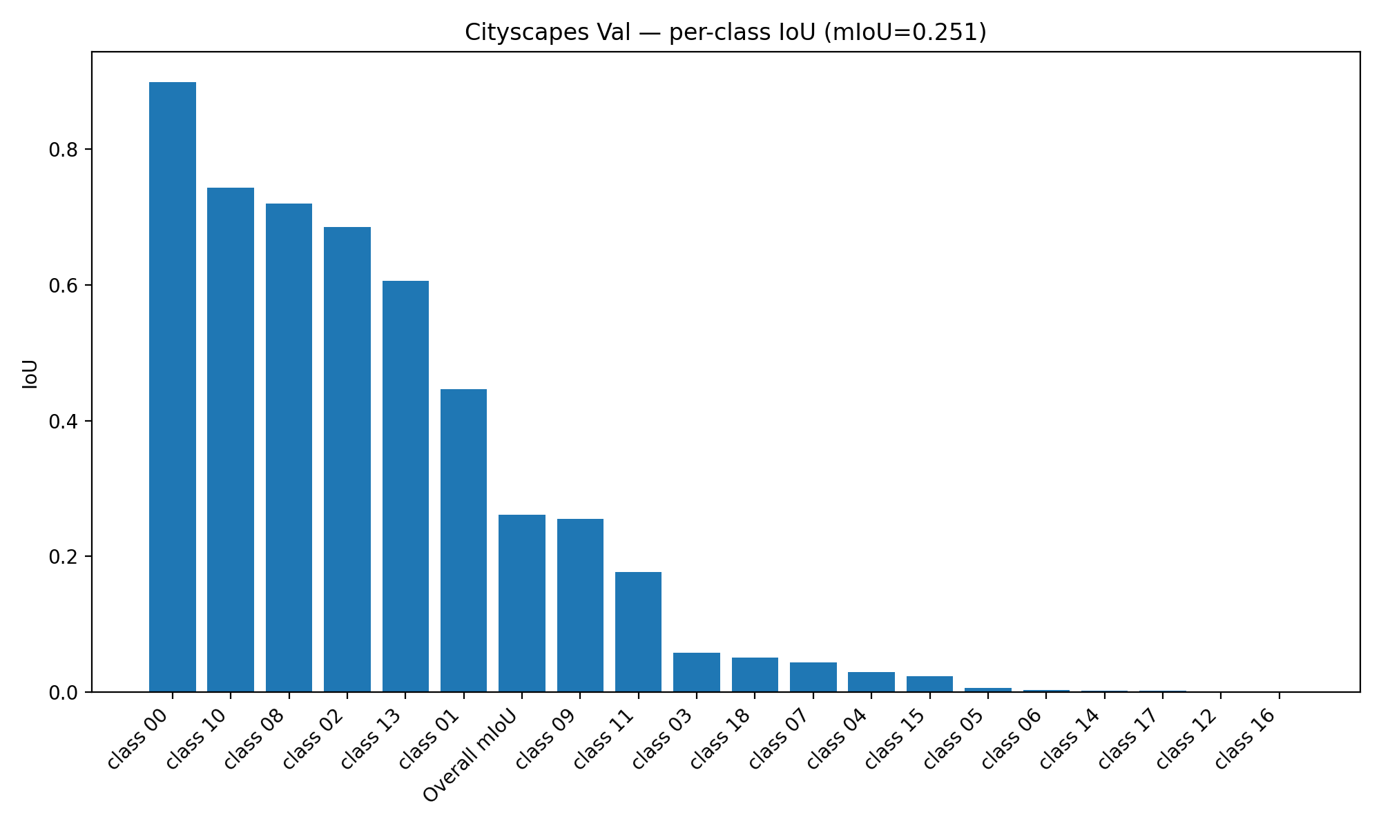
Validation Results (Accuracy)
Faculty of Computer Science.
8/15
mIoU (val, 19 classes): 0.2616 @ 256×256, DeiT-Tiny + simple head, 20 epochs.
This is expectedly modest (tiny model, short schedule, no heavy augmentations/decoders).
Still, masks are coherent in many regions; serves as a fast baseline for robotics demos.

Slide 9
Runtime Results (Speed vs Size)
Faculty of Computer Science.
9/15
Video inference (stream):
P95- 95th percentile inference time.
FPS_Frames per second
ms – milliseconds.
Size | Speed(FPS) | Speed(ms)
160x160 | 158 | 6.73
192x192 | 122 | 9.43
224x224 | 99 | 11.24
256x256 | 43 | 25.35

Slide 10
Paper vs. my results (How to Compare Fairly).
Faculty of Computer Science.
10/15
The DeiT paper reports ImageNet-1K classification accuracy (Top-1/Top-5), while I report Cityscapes segmentation accuracy (mIoU). Different tasks ⇒ different metrics.

Slide 11
Paper vs. my results (How to Compare Fairly).
Faculty of Computer Science.
11/15
DeiT proves efficiency for classification; I transfer that efficiency to segmentation and show real-time deployment with a tiny backbone. My accuracy is a baseline (short training, light head) that can be improved with longer training and a stronger decoder.
Metric / Setting | DeiT (paper) | This project
Task | Image classification (ImageNet-1K, 224×224) | Semantic segmentation (Cityscapes, 256×256)
Backbone | DeiT-Tiny (ViT-Ti/16) | DeiT-Tiny + 1×1 conv head + upsample
Accuracy | Top-1 = 72.2% (DeiT-Tiny) / 74.5% (DeiT-Tiny distilled) | mIoU ≈ 0.262 (validation, 19 classes)
Top-5 | 91.1% (Tiny) / 91.9% (Tiny-distilled) | n/a (segmentation)
Training budget | Full ImageNet schedule | ~20 epochs, 256 px, quick baseline
Deployment | Not the paper’s focus | ONNX Runtime, FPS & p95 latency profiled

Slide 12
Deployment: What’s Ready
Faculty of Computer Science.
12/15
Export: artifacts/deit_tiny_dynamic.onnx (dynamic H×W)
Stream demo: scripts/make_video_from_sample.py → artifacts/urban_overlay.mp4.
Latency/throughput CSVs for sizing decisions.
ONNXRuntime on CPU already runs ≥99 FPS at 224×224 (real-time).

Slide 13
Key Takeaways.
Faculty of Computer Science.
13/15
Problem: fast, lightweight semantic segmentation for robotics/edge.
What I did: adapted DeiT-Tiny to segmentation, built full train/eval/vis/deploy stack, exported ONNX, and profiled speed/latency.
Results: mIoU 0.262 @256; real-time at 160–224; ONNX model + overlay video ready.
DeiT’s efficiency carries over to dense tasks as a practical backbone; accuracy can be scaled with richer heads/training.
Application.
Robotics navigation & tele-op overlays
ADAS / autonomy prototyping (non-safety-critical)
Traffic-camera analytics
Smart-city asset mapping

Slide 14
Limitations and Future Improvement
Faculty of Computer Science.
14/15
Limitations:
Focused baseline: DeiT-Tiny + minimal 1×1 conv head.
Short training: ~20 epochs at 256×256 for speed.
Evaluation breadth: validation split only; limited per-class analysis & ablations.
Future Improvement.
Accuracy: add a light decoder (PPM/ASPP or SegFormer-style), train longer (80–160 epochs), larger input (512×1024), cosine/OneCycle LR, class weighting / focal loss.
Robustness & data: stronger augmentations, domain adaptation, evaluate night/rain; add datasets (BDD100K, Mapillary Vistas)
Key message: this is a fast, working baseline; the path to higher accuracy and production readiness is clear and incremental

Slide 15
1

