Slide 1
Database
Station
Database Systems Fall 2024
Justin Nguyen & John Tran
Lab 02

Slide 2
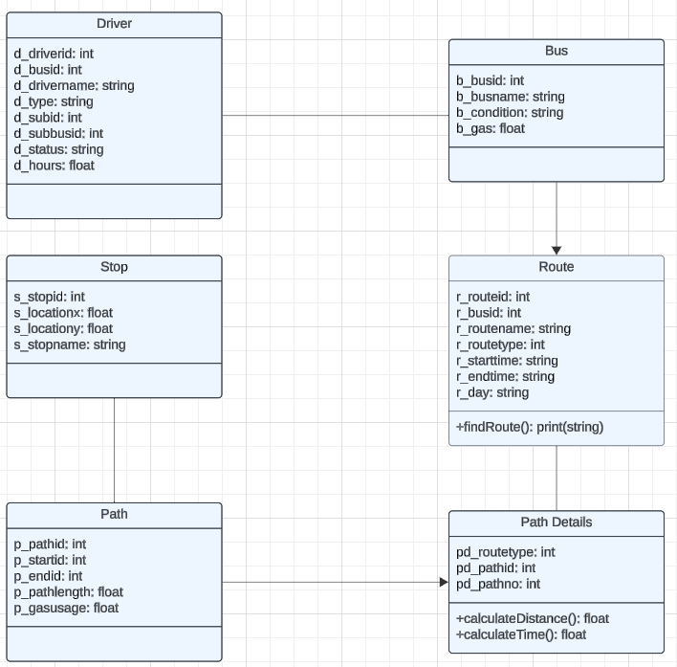
UML Diagram

Slide 3
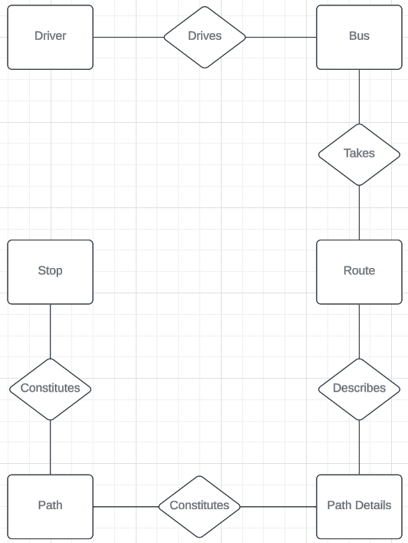
ER Diagram

Slide 4
System Description
Find the right bus for your travels with Database Station!
Public users can see when a bus will arrive at their stop and when it will reach their destination.
Drivers can update themselves and their buses.
Administrators can make direct changes to the database and approve requests made by drivers.

Slide 5
Early Database Implementation Details
The bus schedule would show users the fastest route from one stop to another.
Bus drivers were assigned to a single bus, and each bus was assigned to a route.
Both drivers and buses had variables that would control if they were able to drive or not.
Each stop and path had an ID that was tied to the order they were visited in a route.
Road conditions were a concept that would require drivers to take alternate paths.
Many of the functions other than findRoute were not thought of yet.

Slide 6
Finalized Database Implementation Details
The bus schedule was changed to tell users when a bus will arrive at their current stop, and when it would arrive at their destination, accomplished through the findRoute function.
The station operates from 6:00 AM to 12:00 AM with 2 hour shifts. The full route cycle takes 15 minutes to complete, but the last 15 minutes in a shift have downtime.
findRoute accounts for these factors.
The pathdetails table was created to prevent duplicate paths. It includes the order of paths on each route, instead of this information being in the path table.
Road conditions was scrapped due to the linear nature of the map.
Most of the other functions are to update drivers and buses.
The queries are run on the console and will take user inputs.
There is also a set of test queries that will showcase some important features.

