Slide 1
Stackoverflow and scrapy
My Opinions
    Community/audience
    Common issues
Some stats with notebooks
  \o/

Slide 2
Community
Scrapy makes hard to ask generic questions
But community is kinda ok with it
Lots of new programmers, students
Quite a bit low quality questions
Friendly and active people

Slide 3
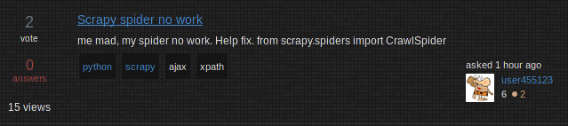
Bad Question quality
Has a lot to do with the nature of the tag
A lot of new users not familiar with question guidelines or how to log
it’s ok - everyone starts like this

Slide 4
Common Issues
Dealing with AJAX and javascript
  http://stackoverflow.com/questions/8550114
CrawlSpider is confusing
Selenium is too popular
Installing on mac os/windows
  Mostly lxml and cryptography
Lack of community to discuss web-crawling topics

Slide 5
Links
Scrapy on stackoverflow
https://stackoverflow.com/questions/tagged/scrapy
How to get scrapy questions:
http://granitosaurus.rocks/scrapy-help.html
Source:

