Slide 1
An introduction to using Kubernetes with Minishift and OpenShift Grant Steinfeld, Developer Advocate – Blockchain/JVM/NodeJS IBM Cognitive Applications @gsteinfeld

Slide 2

What are Containers?
Similar to VMs but managed at the process level
"VM-like” isolated achieved by set of kernel "namespaces" (isolated view)
PID –isolated view of process IDs
USER- user and group IDs
UTS - hostname and domain name
NS - mount points
NET - Network devices, stacks, ports
IPC - inter-process communications, message queues
cgroups - controls limits and monitoring of resources
The key statement: A container is a process(es) running in isolation

Slide 3

What is Kubernetes?
Container Orchestrator
Provision, manage, scale applications
Manage infrastructure resources needed by applications
Volumes
Networks
Secrets
And many many many more...
Declarative model
Provide the "desired state" and Kubernetes will make it happen
What's in a name?
Kubernetes (K8s/Kube): "Helmsman" in ancient Greek
Image: https://www-03.ibm.com/press/us/en/attachment/51715.wss?fileId=ATTACH_FILE2&fileName=Blockchain_Maersk-social_tile2a.jpg

Slide 4
Containers – not exactly new…
Containers – not a new idea
chroot ('80s) process spawned in isolated file space
FreeBSD jails
OS-level virtualization (user-mode-linux, virtuozzo)
Solaris Containers
LinuX Containers (LXC)
Cloud Foundry (Warden, Garden)
More efficient than VMs but less mindshare...
Docker – ecosystem approach transformed perception
Building application-centric containers
Mechanism for sharing images (Registry)
Open-source enabled
Isolation
Isolation
process 1
process 2
OS / kernel
hardware

Slide 5
Open Source for Containerized Apps
Minikube -> Run Kubernetes in a single VM – based on upstream Kubernetes
Minishift -> Run OpenShift Container Platform in a single VM – based on OKD (upstream for OpenShift 3.x)
Production-Grade Open Source Project
quarterly minor releases, no Long Term Support
community support
platform certification: (AKS, EKS, GKE, IKS)
core framework / limited security
platform or user responsible to integrate beyond core
Production-Grade Open Source based Product
quarterly releases, support for major release 3+ years
enterprise support
ecosystem certification: platform and app containers
k8s core plus abstractions / dashboard / security
opinions and integration of common features

Slide 6

Projects – extends k8s namespaces
projects isolate apps across environments, teams, groups and departments
PAYMENT DEV
CATALOG
POD
POD
POD
❌
POD
POD
POD
C
C
C
C
C
C
PAYMENT PROD
INVENTORY
POD
POD
POD
❌
❌
POD
POD
POD
C
C
C
C
C
C
Notes:
A user can only access projects that they have created or explicitly given access to

Slide 7
Red-Hat Openshift developing ( MiniShift ) ( OpenShift ) building deploying, intelligently managing
Notes:
is a complete platform for Kubernetes applications in production.

Slide 8
Minishift details
Installs without an Identity Provider
No user passwords needed – local development use cases
Add-on available to implement htpasswd identity provider
Add-ons
Extends the vanilla OKD installation – default + community
anyuid, admin-user*, registry-route, htpasswd-identity-provider, …
Pre-provisioned Persistent Volumes
Automatically mapped when Persistent Volume Claims are made!
Internal docker registry created without route
retrieve URL: minishift openshift registry
docker login -u developer -p $(oc whoami -t) $(minishift openshift registry)
VM default config:
2 VCPU
4 GB memory
20 GB disk image
IPAddr.nip.io base domain

Slide 9
Workshop
https://github.com/Grant-Steinfeld/minishift101

Slide 10







Source-to-Image using git repo
COMMIT APP
(User)
code
Git Repository
Developer
BUILD IMAGE
(OpenShift)
Source-to-Image (S2I)
Builder Image
Image Registry
DEPLOY
(OpenShift)
Application Container
deploy
User/Tool Does
OpenShift Does
Notes:
Blue: OpenShift does Green: User does
Developers write code using existing development tools such as Maven, NPM, Bower, PIP, Dockerfile and Git and then access the OpenShift Web, CLI or IDE to create an app from the code
S2I combines source code with a builder image (language and application runtimes) and stores the resulting application image in the image registry
This image registry by default is the OpenShift integrated docker registry however users can configure S2I to push the built images to third-party registries such as Docker Hub, Nexus, Artifactory, Amazon ECR, Quay, etc.
OpenShift monitors the builder images in the image registry and can automatically rebuild the application images if the language (e.g. Java, Ruby, etc) or application runtime (JBoss EAP, JBoss Web Server, Tomcat, etc) image is updated for example due to security patches.
OpenShift automates the deployment of application containers across multiple hosts via the Kubernetes. Users can trigger deployments, rollback, configure A/B or other custom deployments

Slide 11
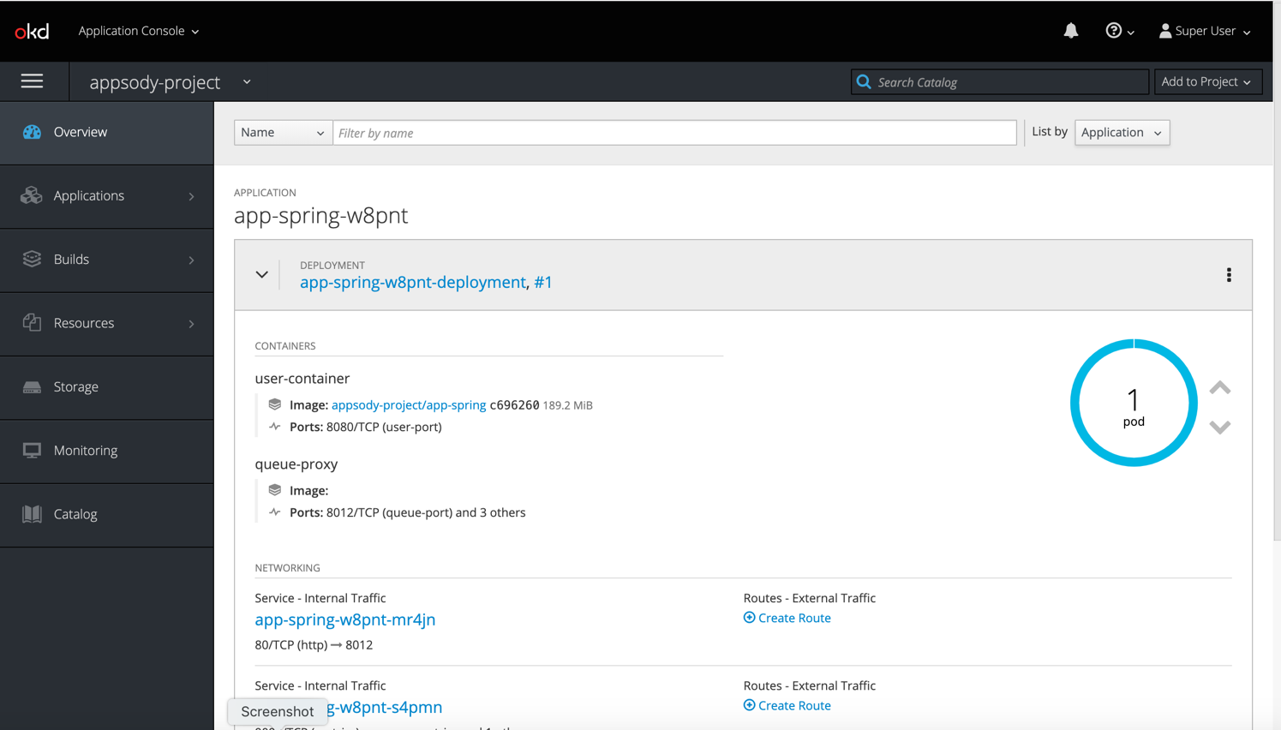
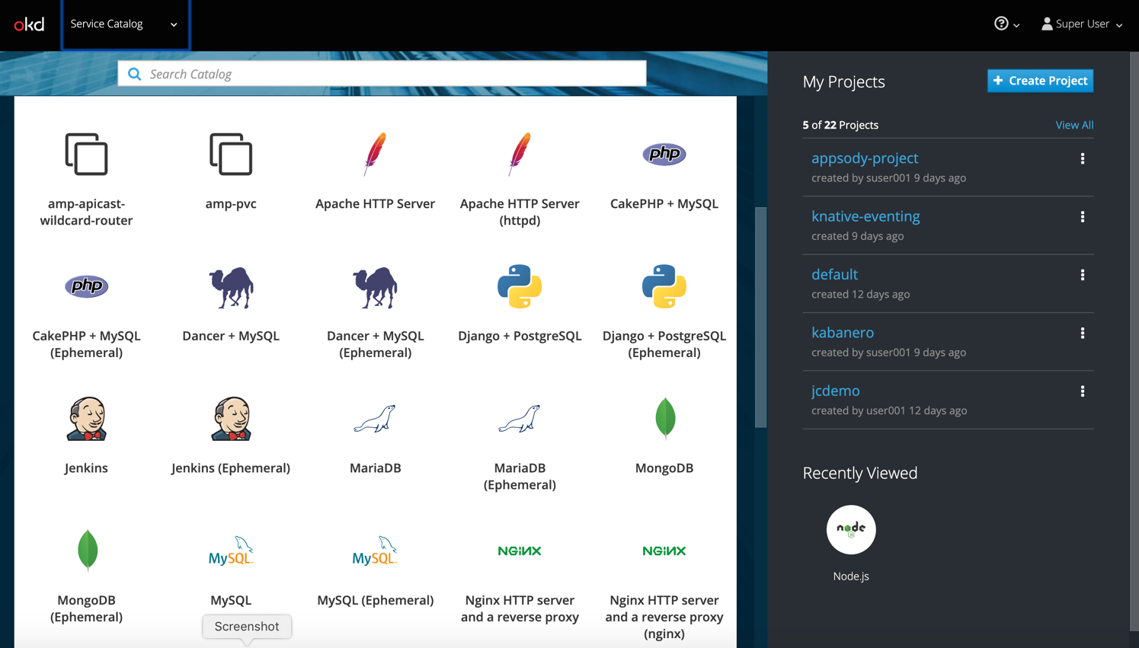
Web Console
Application dashboard
Service Catalog

