Slide 1


Smart Contracts A primer on their design, development and deployment
Presentation
Grant Steinfeld IBM Developer Advocate – Blockchain and JVM
@gsteinfeld
https://www.linkedin.com/in/grant-steinfeld/

Slide 2
In early 2016, the project began accepting proposals for incubation of codebases and other technologies as core elements. One of the first proposals was for a codebase combining previous work by Digital Asset, Blockstream's libconsensus and IBM's OpenBlockchain.^{[6]} This was later named Fabric
Origins - HLF

Slide 3
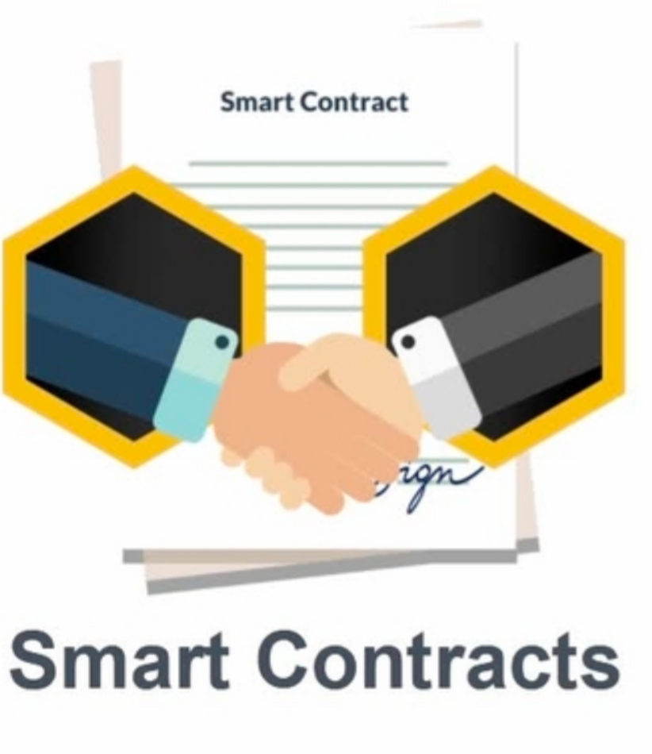
Smart Contracts
Simple!
If/Then logic
On or off/side chain
Executed by triggers or conditions
Notes:
haincode is a program, written in Go, node.js, or Java that implements a prescribed interface. Chaincode runs in a secured Docker container isolated from the endorsing peer process. Chaincode initializes and manages the ledger state through transactions submitted by applications.
A chaincode typically handles business logic agreed to by members of the network,

Slide 4
Smart Contracts
Automatic and trustless
Logic to be exectuted is vetted
By all interested parties
Value/Asset can be controlled by the contract itself

Slide 5
DESIGN

Slide 6
Smart Contract Design
DDD / Agile / Design thinking
Align business goals
Functional Programming => Deterministic
TDD
Security
Muliple implementations
Escape Hatches
Throttle

Slide 7
DEVELOP

Slide 8
Language Choices in Hyperledger Fabric
Scripting
JavaScript
TypeScript
Compiles
Go
Java
Scala
Solidity
Vyper
Transpiled DSL
DAML
Custom
Add your own
Notes:
Given these choices consider when choosing what language you’d
that don’t have lazy evalution.
mature and proven
maintaibility Testabitily
Lifecycle system chaincode (LSCC) runs in all peers to handle package signing, install, instantiate, and upgrade chaincode requests. You can read more about the LSCC implements this process.
Configuration system chaincode (CSCC) runs in all peers to handle changes to a channel configuration, such as a policy update. You can read more about this process in the following chaincode topic.
Query system chaincode (QSCC) runs in all peers to provide ledger APIs which include block query, transaction query etc. You can read more about these ledger APIs in the transaction context topic.
Endorsement system chaincode (ESCC) runs in endorsing peers to cryptographically sign a transaction response. You can read more about how the ESCC implements this process.
Validation system chaincode (VSCC) validates a transaction, including checking endorsement policy and read-write set versioning. You can read more about the LSCC implements this process.

Slide 9
Hyperledger Fabric API
Every chaincode program must implement the Chaincode interface - response to received transactions
Instantiate
Upgrade
Invoke
Shim API ChaincodeStubInterface: which is used to access and modify the ledger, and to make invocations between chaincodes.
PutState
GetState

Slide 10
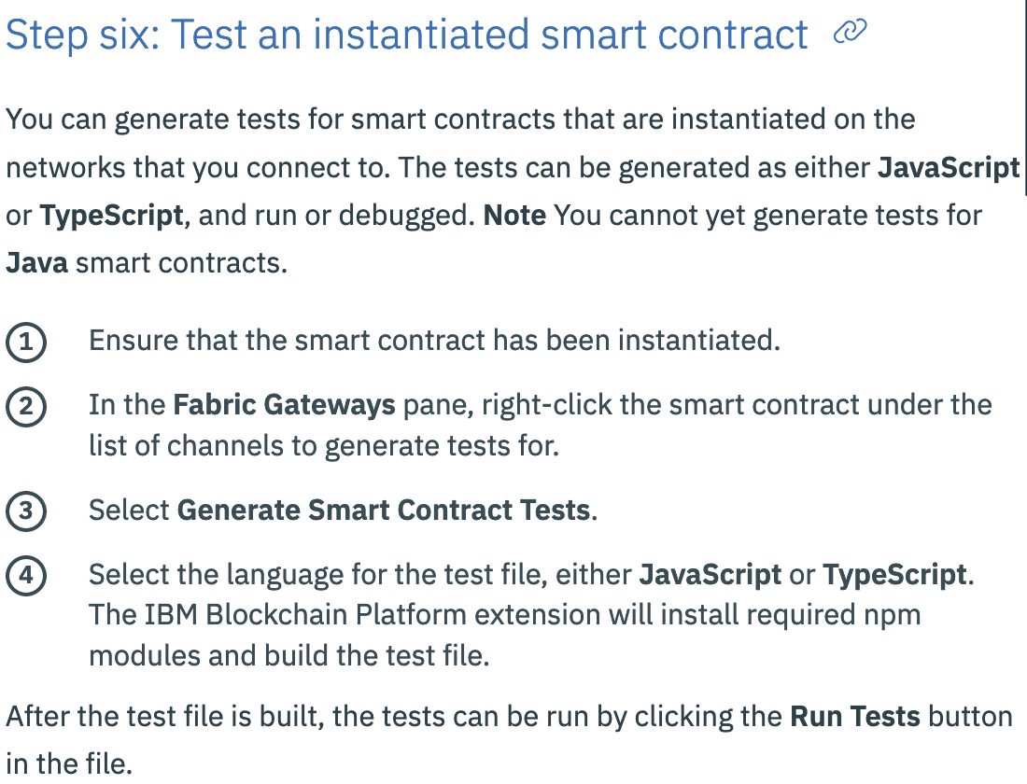
Debugging instantiated smart contract √√√√

Slide 11
Testing
Unit
Smoke
End-End on local / test networks first!!

Slide 12
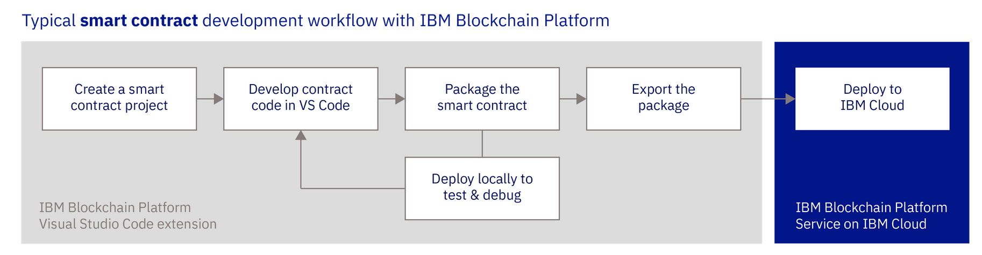
Smart Contract development Cycle

Slide 13
Alternatives
DAML- Digital Asset Modeling Language
compiles down to Rust/ocaml [security / performance / reliability reasons ]

Slide 14
DEPLOY
Binaries from HLF
Containers / k8s or OpenShift
IBM Cloud Blockchain Platform v2

Slide 15
REFERENCES
Fair Trade Code pattern – IBPv2 on cloud
https://github.com/IBM/blockchainbean2
But can also run locally! https://github.com/IBM/blockchainbean2/blob/master/docs/run-local.md
Debug locally
https://cloud.ibm.com/docs/services/blockchain/howto?topic=blockchain-develop-vscode#develop-vscode-testing-instantiated-smart-contract

Slide 16
REFERENCES
Ethereum Vyper
https://vyper.readthedocs.io/en/latest/compiling-a-contract.html
Digital Asset
https://daml.com/
Digital Asset Modeling Language Use Case Demo
https://www.youtube.com/watch?v=cSix4exCh0g#action=share

Slide 17
Blog references
Hyperledger Fabric chaincode test driven development (TDD) with unit testing
https://medium.com/coinmonks/test-driven-hyperledger-fabric-golang-chaincode-development-dbec4cb78049
How to start testing your Hyperledger Fabric Nodejs chaincode
https://medium.com/wearetheledger/how-to-start-testing-your-hyperledger-fabric-nodejs-chaincode-229453c3c214
Tutorial Chaincode Unit Testing on Hyperledger Fabric
https://medium.com/coinmonks/tutorial-on-hyperledger-fabrics-chaincode-testing-44c3f260cb2b

Slide 18
Thank You! Stay tuned @gsteinfeld
Sign up today for a free IBM Cloud Account https://ibm.biz/Bdzbbu
Upcoming events:
Saturday, September 28, 2019
Akka Actors - https://www.vtcodecamp.org/
Oct 2nd, 2019
An intro to predictive big data analysis using Apache Kafka, Spark and Zeppelin on the JVM
https://www.meetup.com/ibmcodenyc/events/264557948
@gsteinfeld
More? Browse to https://www.meetup.com/ibmcodenyc

