Slide 1



CV & Deep learning on RedHat OpenShift
Yoga Pose Estimation
Grant Steinfeld
IBM Model Asset Exchange
Technical Introduction
Using IBM CODAIT
Modeling Human Poses
Tensor Flow
How does OpenShift help?
March 4 2020

Slide 2
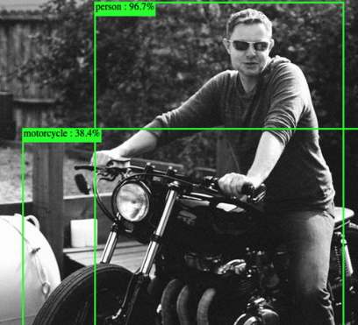
Object Detection made easy!!
Notes:
Previously – past workshop we worked in this Minishift application

Slide 3
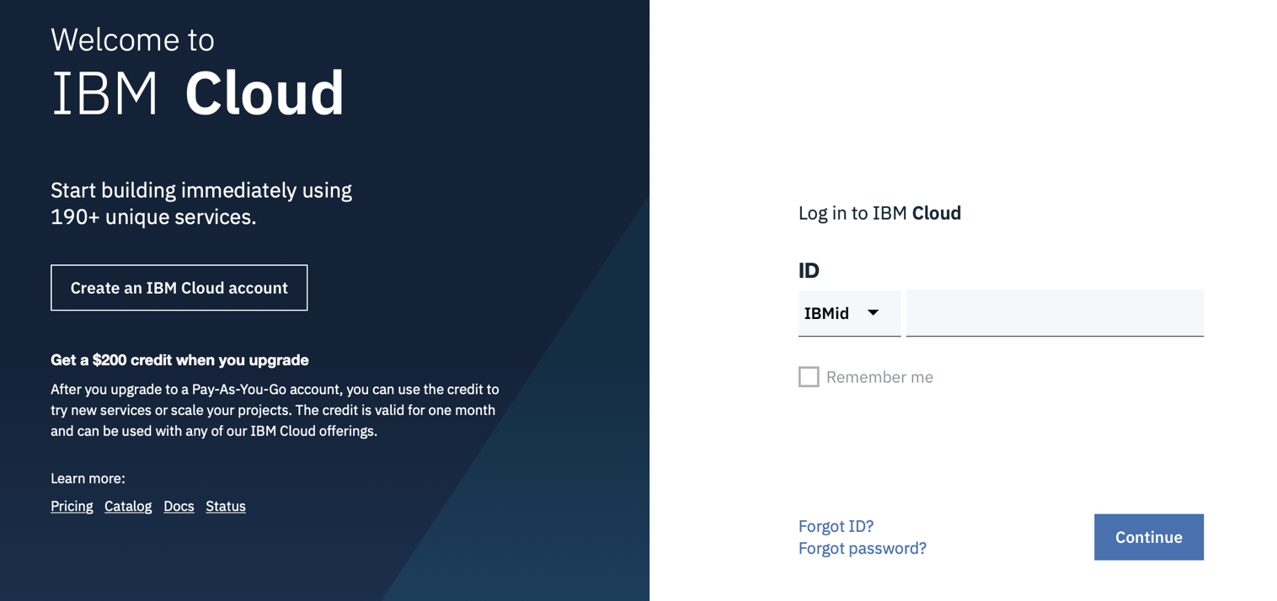
Sign up to a free IBM Cloud Account
https://ibm.biz/BdqDWA

Slide 4
The Model Asset eXchange (MAX) on IBM Developer is a place for developers to find and use free, open source, state-of-the-art deep learning models for common application domains, such as text, image, audio, and video processing. The curated list includes a broad selection of deployable (ready-to-use) models and trainable (customize-before-use) models.

Slide 5
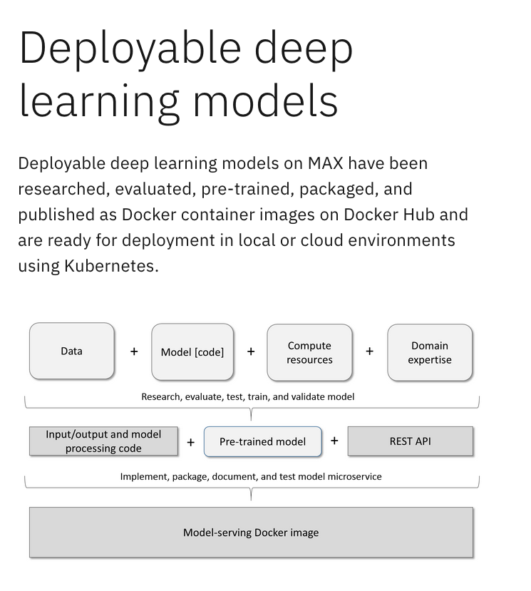

Slide 6
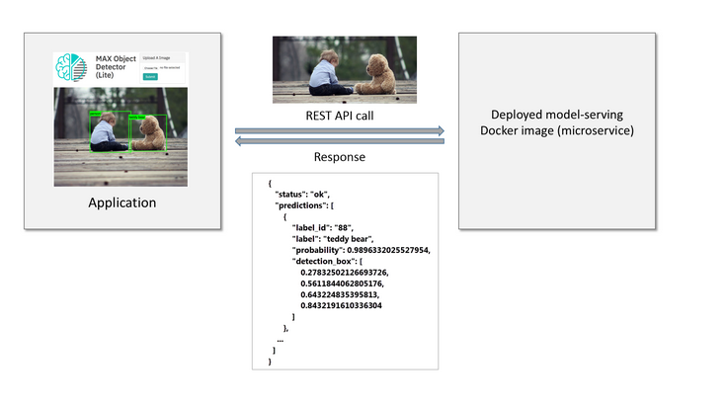
Black box
Notes:
The caller does not need to know anything about the deep learning model that powers the service, the framework that was used to implement and run the model, or the native model inputs or outputs because these details are hidden by the microservice.

Slide 7
Exploring deployable models
IoT
Serverless
Object Detection
Audio
Video
Posture
Yoga Poses
Exercise mentoring ( Mirror )

Slide 8
Thank you
Grant Steinfeld
@gsteinfeld
www.ibm.com/blockchain
developer.ibm.com/blockchain
www.hyperledger.org
© Copyright IBM Corporation 2019. All rights reserved. The information contained in these materials is provided for informational purposes only, and is provided AS IS without warranty of any kind, express or implied. Any statement of direction represents IBM's current intent, is subject to change or withdrawal, and represents only goals and objectives. IBM, the IBM logo, and other IBM products and services are trademarks of the International Business Machines Corporation, in the United States, other countries or both. Other company, product, or service names may be trademarks or service marks of others.

