Slide 1
KV4001 Week 4
Subtyping and Polymorphism

Slide 2
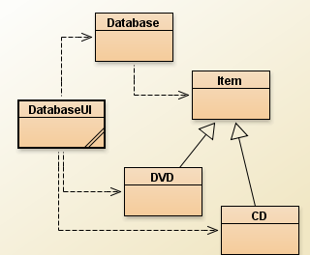
DOME

Slide 3
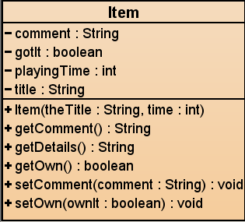
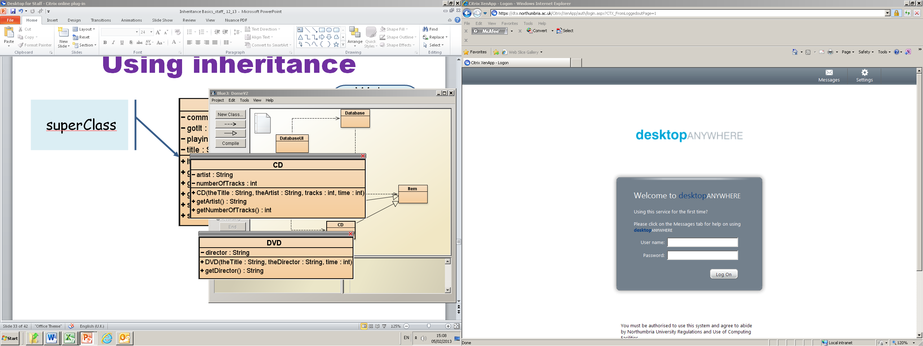
Using inheritance
We’ve placed the common attributes and methods in Item
superClass
Notes:
solution: inheritance. make superclass with common attributes, make subclasses

Slide 4
Last weeks question
public void addItem( Item theItem )
{
items.add(theItem);
}
...
}
items / CD / DVD ???
how does this work?

Slide 5
Subtyping
First, we had:
public void addCD(CD theCD)
public void addDVD(DVD theDVD)
Now, we have:
public void addItem(Item theItem)
We call this method with:
DVD myDVD = new DVD(...);
database.addItem( myDVD );

Slide 6
Subclasses and subtyping
Classes define types.
Subclasses define subtypes.
Objects of subclasses can be used where objects of supertypes are required.
This is called substitution .

Slide 7
Subtyping and parameter passing
public class Database
{
public void addItem(Item theItem)
{
...
}
}
DVD dvd = new DVD(...);
CD cd = new CD(...);
database.addItem(dvd);
database.addItem(cd);
subclass objects may be passed to superclass parameters

Slide 8
Exercise 1
Create a project DomeV2.
Add the relevant classes from Blackboard.
Create instances of Database, CD and DVD (NOT an instance of DatabaseUI).
Confirm that what was said on the previous side is correct (add both the CD and DVD objects to the ArrayList).

Slide 9
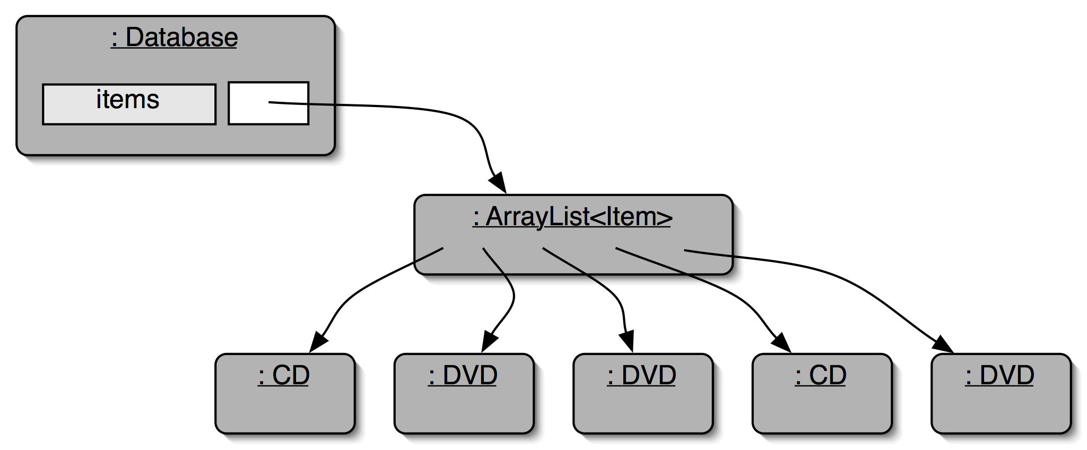
Object diagram
Notes:
database object will hold two collections: one for CDs, one for videos

Slide 10
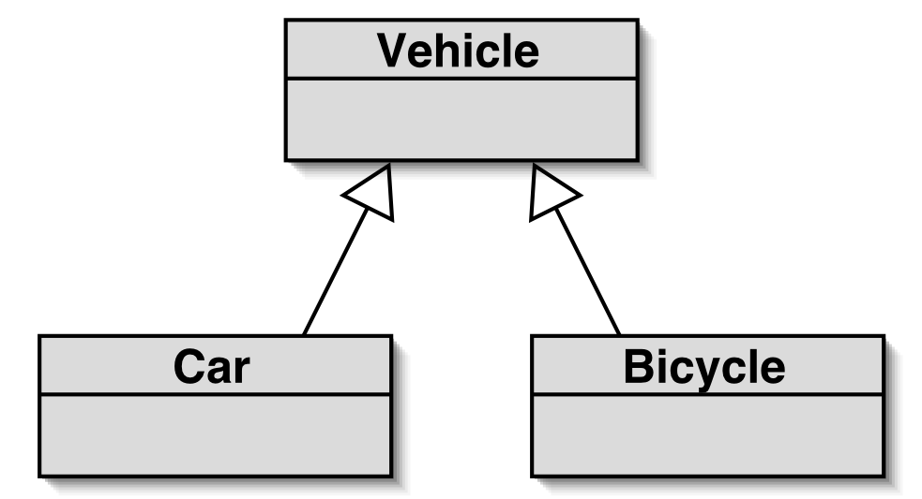
Subtyping and assignment
Vehicle v1 = new Vehicle();
Vehicle v2 = new Car();
Vehicle v3 = new Bicycle();
subclass objects may be assigned to superclass variables

Slide 11
Exercise 2
Create a project Vehicle.
Add the files
Vehicle.java
Car.java
Bicycle.java
Compile these.
Test the correctness of the three declarations on the previous slide in the Code PAD.
(If not there then View -> Show CodePad)
Make sure you understand what is happening.

Slide 12
Constructor Calls
public class Vehicle
{
public Vehicle()
{
System.out.println("I'm a Vehicle");
}
public Vehicle(String name)
{
System.out.println("I'm a Vehicle called "
+ name);
}
}
public class Car extends Vehicle
{
private int year;
public Car()
{
System.out.println("I'm a Car");
}
public Car(String name)
{
super();
System.out.println("I'm a Car called "
+ name );
}
public Car(String name, int year)
{
super(name);
System.out.println("I'm a Car called "
+ name );
this.year = year;
}
}

Slide 13
The view of the world for Vehicles, V1, V2, V3
Vehicle
V1
(Vehicle)
Vehicle
Car
V2
(Car)
Vehicle
Bicycle
V3
(Bicycle)

Slide 14
Casting
Vehicle
Can not
V1
(Vehicle)
Vehicle
Car
V2
(Car)
(Car)V2
Vehicle
Bicycle
V3
(Bicycle)
(Bicycle)V3

Slide 15
Casting ERROR
Vehicle
Car
V2
(Car)
(Bicycle)V2
Vehicle
Bicycle
V3
(Bicycle)
(Car)V3

Slide 16
Subtyping and assignment
superclass objects may NOT be assigned to subclass variables
The following is illegal:
Car c = new Vehicle(); // error
Similarly the following is illegal:
Car c = new Bicycle(); //error
Verify this using Code Pad

Slide 17
Polymorphic variables
Object variables in Java are polymorphic. (They can hold objects of more than one type.)
They can hold:
objects of the declared type and
subtypes of the declared type.
And subtypes of the subtype of the declared type!
Object o = new Car();

Slide 18
Casting
Can assign (‘=‘) subtype to supertype.
Cannot assign supertype to subtype! Vehicle v; Car c = new Car(); v = c; c = v;
Casting fixes this: c = (Car) v; (only ok if the vehicle really is a Car!)
// correct
// compiler error!

Slide 19
Casting
An object type in parentheses.
Used to overcome 'type loss'.
The object is not changed in any way.
A runtime check is made to ensure the object really is of that type:
ClassCastException if it isn't!
Use it sparingly.

Slide 20
Exercise 3
Return to the DomeV2 project
Create a DatabaseUI object.
Run the menu()
add a CD
add a DVD
select option 2 to list all items.
What is the problem?
Remember the DatabaseUI’s addItem() method asks you to specify CD or DVD (case specific).

Slide 21
Conflicting output
What we want
CD: A Swingin' Affair (64 mins)*
Frank Sinatra
tracks: 16
my favourite Sinatra album
DVD: O Brother, Where Art Thou? (106 mins)
Joel & Ethan Coen
The Coen brothers’ best movie!
title: A Swingin' Affair (64 mins)*
my favourite Sinatra album
title: O Brother, Where Art Thou? (106 mins)
The Coen brothers’ best movie!
What we have

Slide 22
The problem
The getDetails method in Item only gives the common fields.
Inheritance is a one-way street:
A subclass inherits the superclass fields.
The superclass knows nothing about its subclass’s fields.

Slide 23
The list method in Database
public String list()
{
String theList = "";
for (Item item : items )
{
theList = theList + item.getDetails() +"\n";
}
return theList;
}

Slide 24
The getDetails Method in Item
public String getDetails()
{
String details = title + " (" + playingTime + " mins)";
if(gotIt)
details = details + "*" + "\n";
else
details = details + "\n";
details = details + " " + comment + "\n";
return details;
}

Slide 25
Attempting to solve the problem
Place getDetails() where it has access to the information it needs?
Give each subclass its own version.
Problem 1: Item’s fields are private.
If we want to access the private fields we need to provide public accessor and mutator methods.
(no methods exist for playingTime or title).
Problem 2:
Database cannot now find a getDetails() method in Item.

Slide 26
Solution: Overriding
Can have a method in superclass with same signature as in subclass
This is known as overriding
Java has ways of working out which method should be invoked

Slide 27
Overriding
Superclass and subclass define methods with the same signature.
Each has access to the fields of its class.
Superclass satisfies static type check.
Subclass method is called at runtime – it overrides the superclass version.
What becomes of the superclass version?

Slide 28
Exercise 4
Create a new project DomeV3.
Add the files from DomeV2.
Add getTitle() & getPlayingTime() accessor methods to Item.
Add a getDetails() method to DVD (code on next slide).
Test the new method.

Slide 29
getDetails() for DVD
public String getDetails()
{
String details = director + "\n ";
details = details + getTitle() + " (" + getPlayingTime()
+ " mins)";
if(getOwn())
details = details + "*" + "\n";
else
details = details + "\n";
details = details + " " + getComment() + "\n";
return details;
}

Slide 30
Exercise 5: Add a getDetails method for CD

Slide 31
Method lookup
The variable is accessed.
The object stored in the variable is found.
The class of the object is found.
The class is searched for a method match.
If no match is found, the superclass is searched.
This is repeated until a match is found, or the class hierarchy is exhausted.
Overriding methods take precedence.

Slide 32
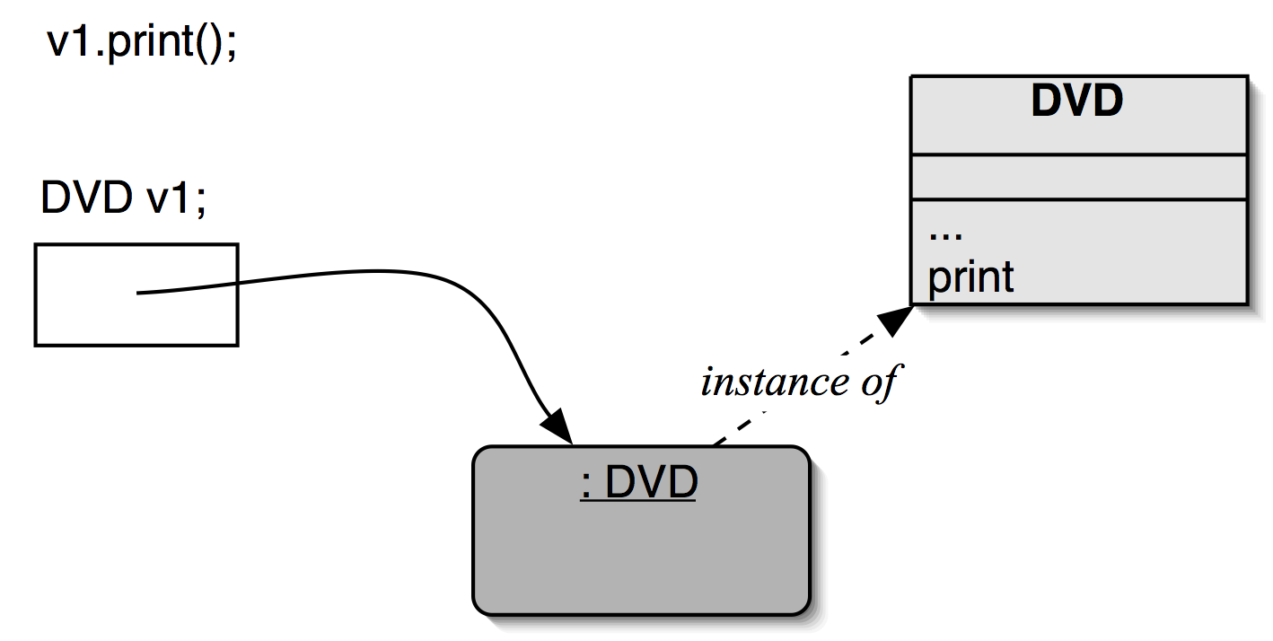
Method lookup
No inheritance or polymorphism.
The obvious method is selected.

Slide 33
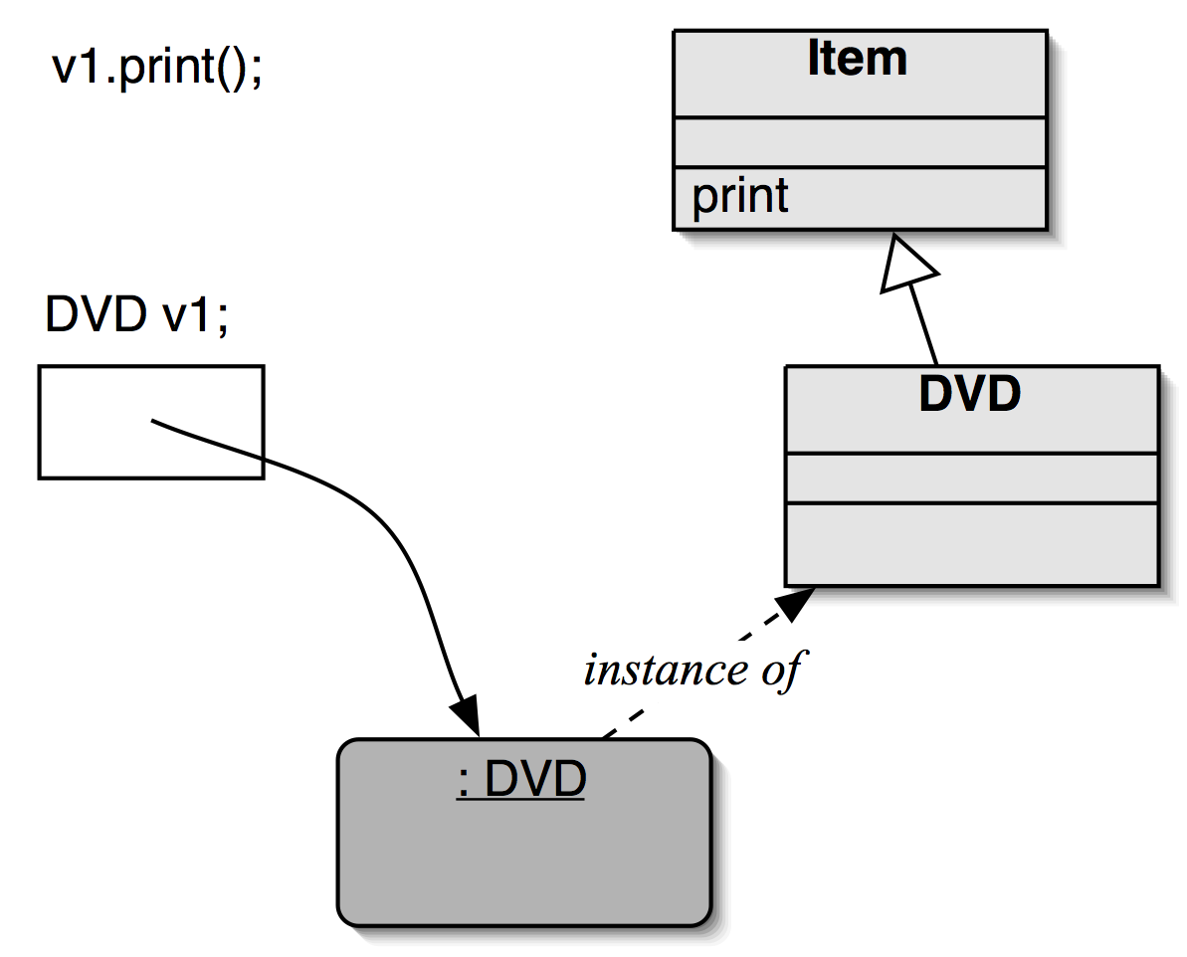
Method lookup
Inheritance but no overriding. The inheritance hierarchy is ascended, searching for a match.

Slide 34
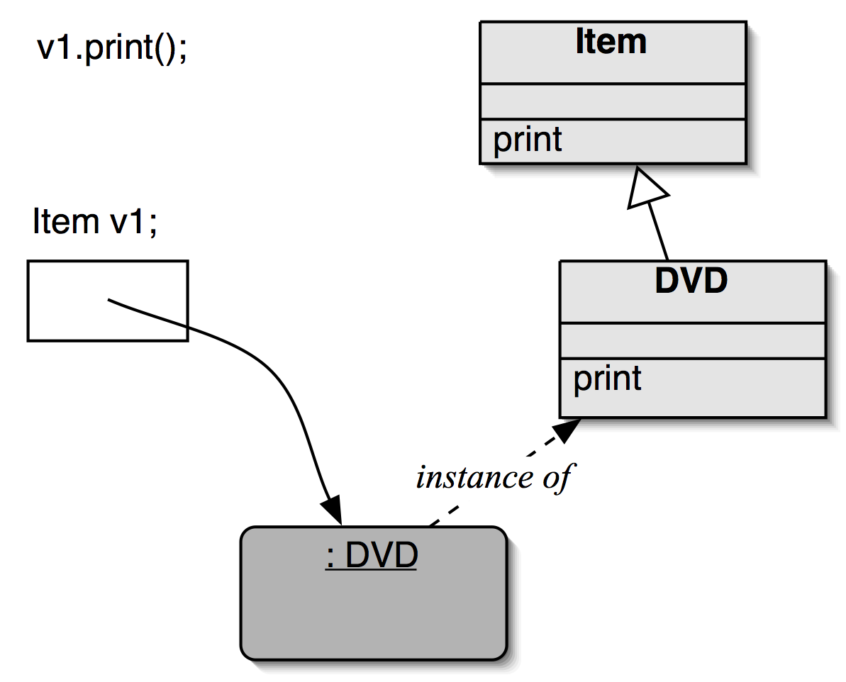
Method lookup
Polymorphism and overriding. The ‘first’ version found is used.

Slide 35
Demonstration of Overridding
Create a project Vehicle2
Add Vehicle, Car and Bicycle from Vehicle.
Add the following methods to Vehicle:
public void print()
{
System.out.println("I am print in Vehicle");
}
public void print1()
{
System.out.println("I am print1 in Vehicle");
}

Slide 36
Demo continued
I’m a Vehicle
I’m a Vehicle
I’m a Car
I’m a Vehicle
I’m a Bicycle
Add the following to Car:
public void print1()
{
System.out.println("I am print1 in Car");
}
Instantiate a Vehicle, a Car and a Bike
Then
Invoke print and print1 from your Vehicle object
Invoke print1 from your Car object
Note the output.
I am print in Vehicle
I am print1 in Vehicle
I am print1 in Car

Slide 37
Demo continued
In your Car object select the print1 method inherited from Vehicle.
What is the output?
Repeat this for your Bicycle object
Do you understand why the output is different?
I am print1 in Car
I am print1 in Vehicle
Because print1() in Vehicle is OVERRIDDEN by print1() in Car
But not in Bicycle (on subclass version of print1)

Slide 38
Overriding Solved the problem in Dome
We are back to code duplication!

Slide 39
Super call in methods
Overridden methods are hidden ...
but we often still want to be able to call them.
An overridden method can be called from the method that overrides it.
super.methodName(...)
In fact super.methodName() can be used in any method when it is the superclass method you want to invoke.
public void print1a()
{
super.print1();
}
I am print1 in Vehicle

Slide 40
Calling an overridden method
public class CD
{ ...
public String getDetails() //CD
{
String details = artist;
details = details +”tracks: " +
numberOfTracks;
details = details +super.getDetails(); //Item
return details
}
...
}

Slide 41
getDetails() method for CD
was
now
public String getDetails()
{
String details = artist + "\n ";
details = details + “ tracks: "
+ numberOfTracks;
details = details + getTitle() + " (" + getPlayingTime() + " mins)";
if(getOwn())
details = details + "*" + "\n";
else
details = details + "\n";
details = details + " " + getComment() + "\n";
return details;
}
public String getDetails()
{
String details = artist;
details = details +”tracks: "
+ numberOfTracks;
details = details
+ super.getDetails();
return details
}

Slide 42
Static type and dynamic type
A more complex type hierarchy requires further concepts to describe it.
Some new terminology:
static type
dynamic type
method dispatch/lookup

Slide 43
Static and dynamic type
What is the type of c1?
Car
Car c1 = new Car();
Vehicle but stores a
Car
What is the type of v1?
Vehicle v1 = new Car();

Slide 44
Static and dynamic type
The declared type of a variable is its static type.
The type of the object a variable refers to is its dynamic type.
The compiler’s job is to check for static-type violations.

Slide 45
polymorphic method dispatch.
A polymorphic variable can store objects of varying types.
Method calls are polymorphic.
The actual method called depends on the dynamic object type.

Slide 46
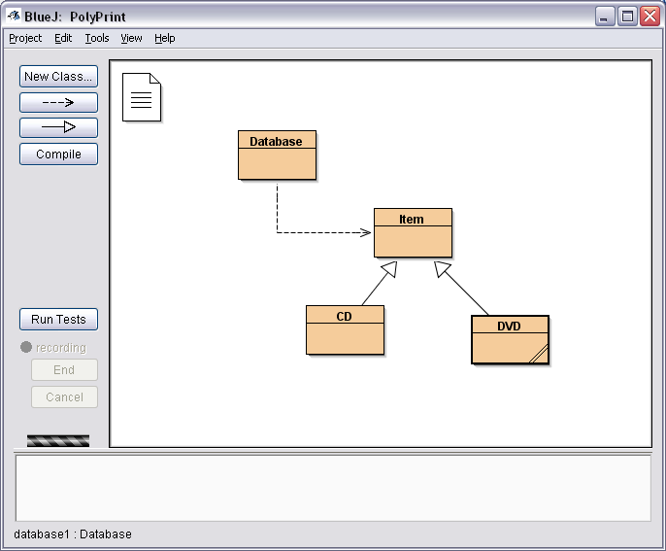
Example:

Slide 47
Code for Item
public class Item
{
private String message = "I am an item";
public Item()
{
}
public void print()
{
System.out.println(message); // prints Item message
}
}

Slide 48
Code for CD
public class CD extends Item
{
private String message = " I am a CD";
public CD()
{
}
public void print()
{
super.print(); // prints Item message
System.out.println(message); // prints CDmessage
}
}

Slide 49
Code for DVD
public class DVD extends Item
{
private String message = " I am a DVD";
public DVD()
{
}
public void print()
{
super.print(); // prints Item message
System.out.println(message); // prints DVD message
}
}

Slide 50
import java.util.ArrayList;
public class Database
{
private ArrayList <Item> items;
public Database()
{
items = new ArrayList<Item>();
}
public void add(Item item)
{
items.add(item);
}
public void list()
{
for ( Item item : items)
item.print();
}
}
Code for Database
Polymorphic method dispatch
JVM selects method based on Dynamic type
Item must have a print method

