Slide 1
Data Visualization Using Elder Scrolls Map Sizes
Grant Carey

Slide 2
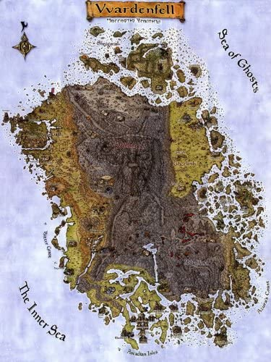
Kilobyte: Morrowind = 16km

Slide 3

Megabyte: 1/10th of Daggerfall = 16,160km

Slide 4
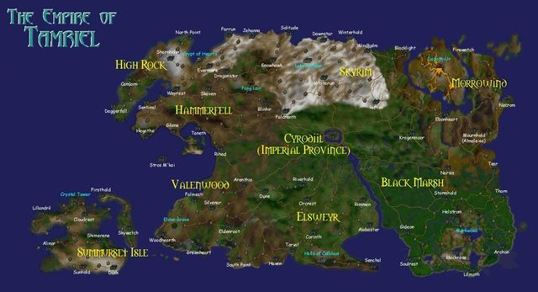
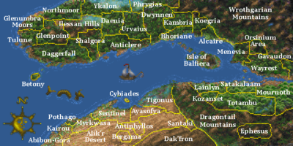
Gigabyte: 2 Arenas = 16,160,000km

