Slide 1
DirectTranscription.jl : A Julian Approach to Multi-Phase Trajectory Optimization
Grant R. Hecht

Slide 2
Overview
Introduction and motivation
Optimal control and nonlinear programming
Direct transcription with Lobatto IIIA Collocation
Overview of DirectTranscription.jl design
A simple example : The Brachistochrone
Conclusion

Slide 3
Why another trajectory optimization tool?
Existing multi-phase trajectory optimization tools
GPOPS-II → Requires license and written in pure MATLAB
Dymos → User provided functions written in Python
CSALT → No AD and poor documentation, requires SNOPT
None of these tools are extensible!
You’re stuck with the transcription methods you’re given
Limits research on new transcription methods
Many specialized tools developed from scratch

Slide 4
Goals of DirectTranscription.jl
Use not limited by paywall
Fast performance
This is HPC II after all…
Fast user development
Options for computing Jacobians of user functions
Source-to-source, forward, and reverse mode AD
User provided analytical Jacobians
Finite difference
Extensible

Slide 5
Why Julia?
High-level dynamic language with JIT compilation
Syntax similar to MATLAB and Python
Speed that nearly rivals C/Fortran
Multiple dispatch paradigm
Extensibility of nearly all Julia packages
Many differentiation libraries
Zygote.jl and Enzyme.jl (Source-to-source AD)
ForwardDiff.jl and ReverseDiff.jl (Forward and reverse mode AD)
FiniteDiff.jl (Sparse Jacobians via coloring vectors)

Slide 6
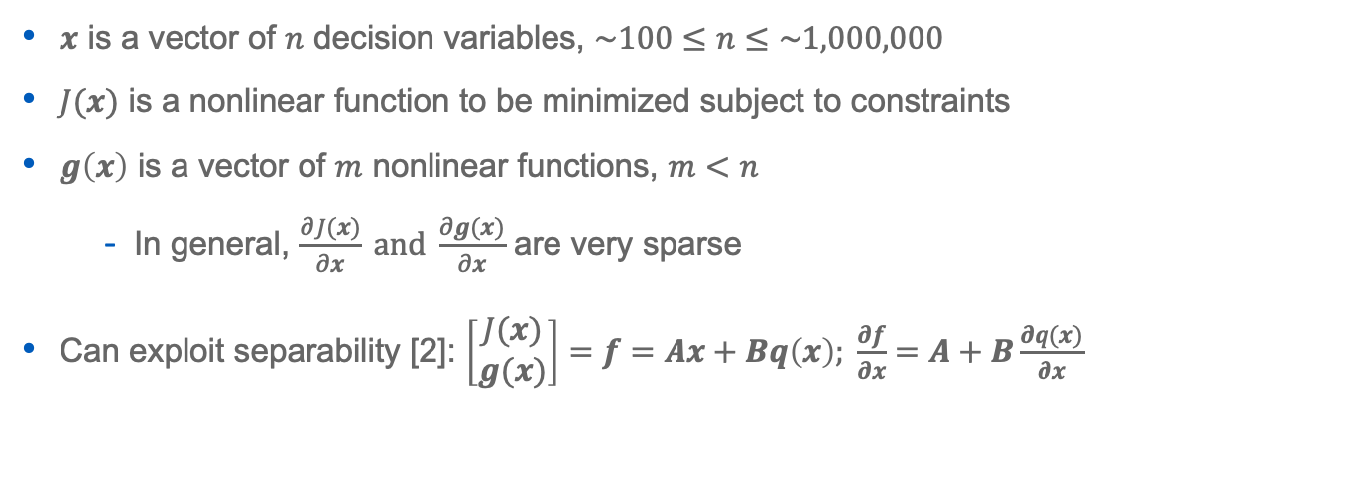


Sparse Nonlinear Programming
Minimize: | $$J(x)$$
Subject to: | $$x_{LB}≤x≤x_{UB}$$
 | $$g_{LB}≤g\left(x\right)≤g_{UB}$$
$x$ is a vector of $n$ decision variables, $\sim 100≤n≤\sim 1,000,000$
$J(x)$ is a nonlinear function to be minimized subject to constraints
$g\left(x\right)$ is a vector of $m$ nonlinear functions, $m<n$
In general, $\frac{∂J(x)}{∂x} and \frac{∂g(x)}{∂x}$ are very sparse
Can exploit separability [2]: $\left[\begin{matrix}J(x) \\ g(x)\end{matrix}\right]=f=Ax+Bq\left(x\right); \frac{∂f}{∂x}=A+B\frac{∂q(x)}{∂x}$
NOTE: Only need to differentiate $q(x)$

Slide 7
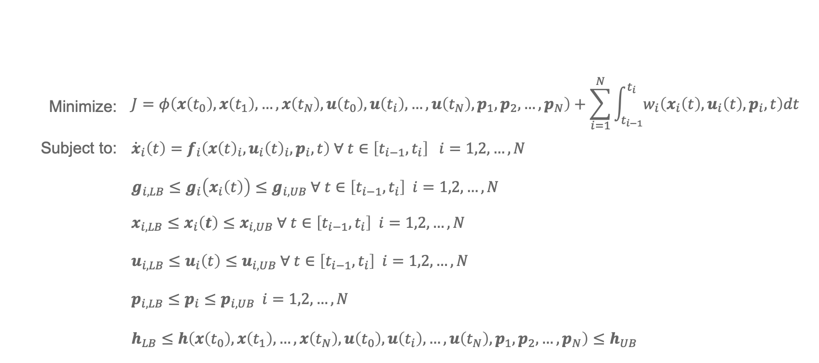
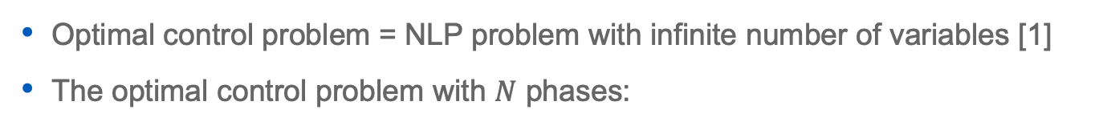
The multi-phase optimal control problem
Optimal control problem = NLP problem with infinite number of variables [1]
The optimal control problem with $N$ phases:
Minimize: | $$J=φ\left(x\left(t_{0}\right), x\left(t_{1}\right), …, x\left(t_{N}\right),u\left(t_{0}\right), u\left(t_{i}\right), …, u\left(t_{N}\right), p_{1}, p_{2}, …, p_{N}\right)+\sum_{i=1}^{N}{\int_{t_{i−1}}^{t_{i}}{w_{i}\left(x_{i}\left(t\right),u_{i}\left(t\right),p_{i},t\right)dt}}$$
Subject to: | $${\dot{x}}_{i}\left(t\right)=f_{i}\left({x\left(t\right)}_{i},{u_{i}\left(t\right)}_{i},p_{i},t\right) ∀ t∈\left[t_{i−1}, t_{i}\right] i=1,2,…,N$$
 | $$g_{i,LB}≤g_{i}\left(x_{i}\left(t\right)\right)≤g_{i,UB} ∀ t∈\left[t_{i−1}, t_{i}\right] i=1,2,…,N$$
 | $$x_{i,LB}≤x_{i}\left(t\right)≤x_{i,UB} ∀ t∈\left[t_{i−1}, t_{i}\right] i=1,2,…,N$$
 | $$u_{i,LB}≤u_{i}\left(t\right)≤u_{i,UB} ∀ t∈\left[t_{i−1}, t_{i}\right] i=1,2,…,N$$
 | $$p_{i,LB}≤p_{i}≤p_{i,UB} i=1,2,…, N$$
 | $$h_{LB}≤h\left(x\left(t_{0}\right), x\left(t_{1}\right), …, x\left(t_{N}\right),u\left(t_{0}\right), u\left(t_{i}\right), …, u\left(t_{N}\right), p_{1}, p_{2}, …, p_{N}\right)≤h_{UB}$$

Slide 8
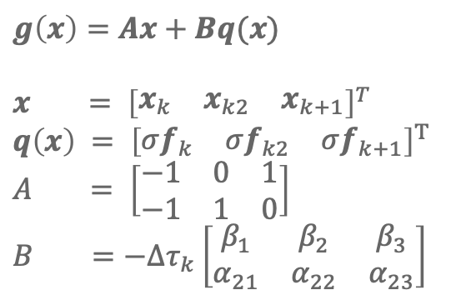
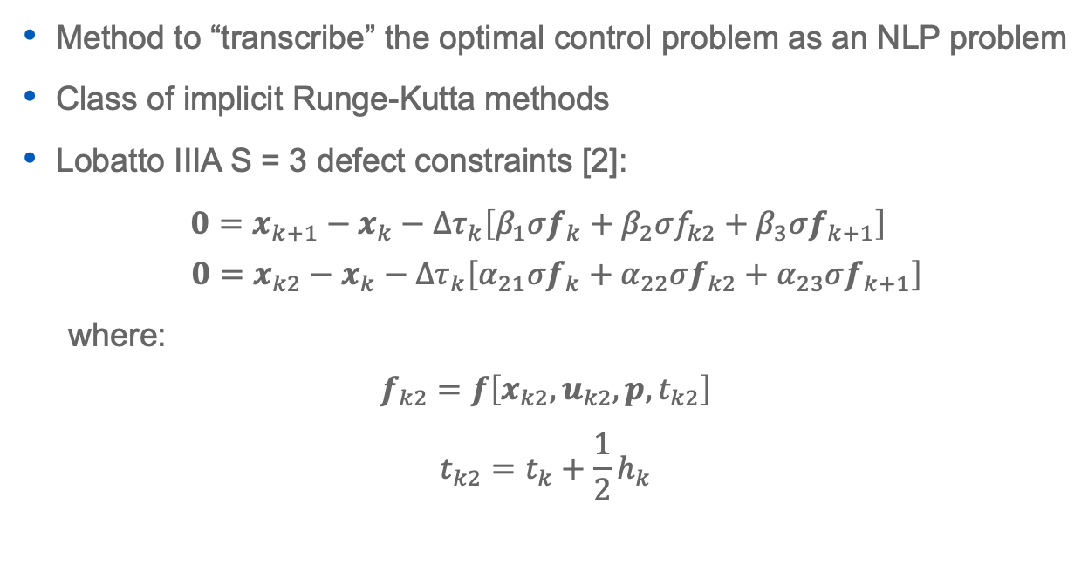
Lobatto IIIA Collocation
Method to “transcribe” the optimal control problem as an NLP problem
Class of implicit Runge-Kutta methods
Lobatto IIIA S = 3 defect constraints [2]:
$0=x_{k+1}−x_{k}−Δτ_{k}\left[β_{1}σf_{k}+β_{2}σf_{k2}+β_{3}σf_{k+1}\right]$
$$0=x_{k2}−x_{k}−Δτ_{k}\left[α_{21}σf_{k}+α_{22}σf_{k2}+α_{23}σf_{k+1}\right]$$
where:
$$f_{k2}=f\left[x_{k2},u_{k2},{p,t}_{k2}\right]$$
$$t_{k2}=t_{k}+\frac{1}{2}h_{k}$$
$$g\left(x\right)=Ax+Bq(x)$$
$$x = {\left[\begin{matrix}x_{k} & x_{k2} & x_{k+1}\end{matrix}\right]}^{T}$$
$$q\left(x\right) = {\left[\begin{matrix}σf_{k} & σf_{k2} & σf_{k+1}\end{matrix}\right]}^{T}$$
$$A = \left[\begin{matrix}−1 & 0 & 1 \\ −1 & 1 & 0\end{matrix}\right]$$
$$B =−Δτ_{k}\left[\begin{matrix}β_{1} & β_{2} & β_{3} \\ α_{21} & α_{22} & α_{23}\end{matrix}\right]$$

Slide 9
DirectTranscription.jl Design

Slide 10
High Level Overview
Trajectory “struct” is the highest-level data structure
Contains NLP solver wrapper
Set of point functions and phases
Phase is abstract type with subtypes which apply various transcriptions
Subtypes of Phase must define
EvaluateFunctions,EvaluateJacobians,GetNLPMatricies, etc
Users can implement their own subtypes of Phase
Allows for quick implementation of new transcriptions
UserFunction is abstract type with subtypes to wrap various user funcs.
ADPointFunction, AnalyticPathFunction, etc… wrap user functions and evaluate Jacobians with their unique method(s)

Slide 11
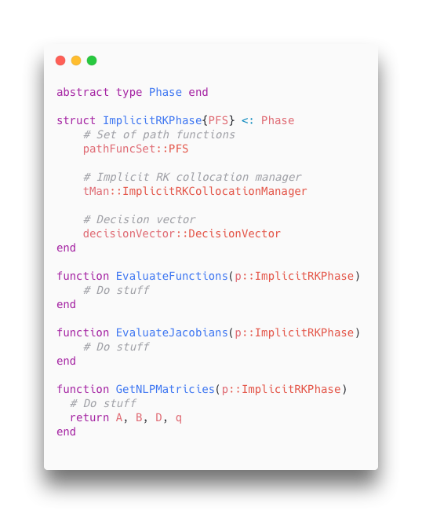
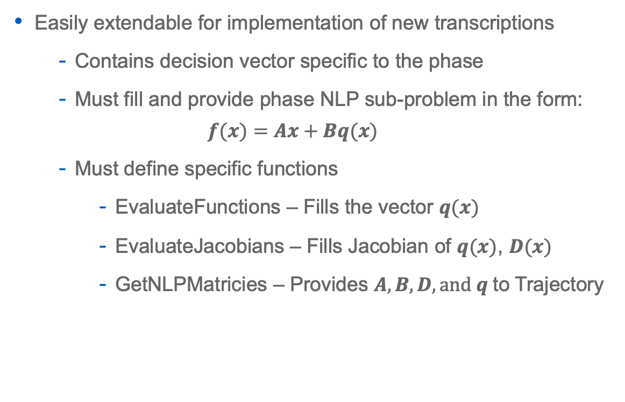
The Phase Abstract Type
Easily extendable for implementation of new transcriptions
Contains decision vector specific to the phase
Must fill and provide phase NLP sub-problem in the form:
$$f(x)=Ax+Bq(x)$$
Must define specific functions
EvaluateFunctions – Fills the vector $q(x)$
EvaluateJacobians – Fills Jacobian of $q(x)$, $D(x)$
GetNLPMatricies – Provides $A, B, D, and q$ to Trajectory

Slide 12
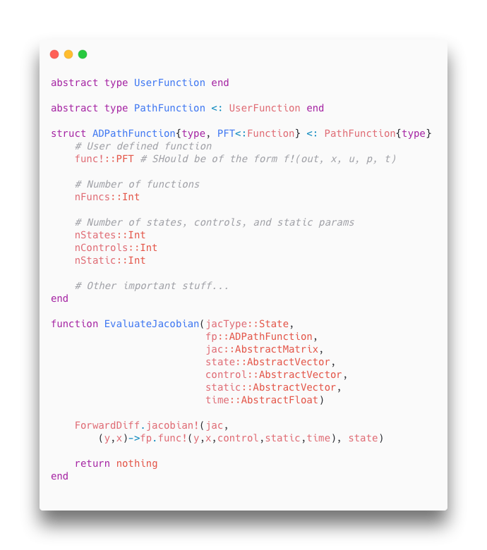
The UserFunction Abstract Type
Subtypes of UserFunction wrap user provided functions
Must define EvaluateJacobian functions to evaluate the state, control, static parameter, and time Jacobians
Must define GetSparsityPattern functions to provide sparsity of each Jacobian
Can be extended to employ any Jacobian evaluation method user needs

Slide 13
DEMO: The Brachistochrone

Slide 14
Summary
Can use Ipopt (free) or Snopt (paid)
Already quite fast but much room for performance optimizations
Better management of sparse matrices
Parallel evaluation of user functions and Jacobians
Clean user interface
Written with extensibility in mind
User defined domain specific transcriptions
User defined UserFunction’s
Jacobian evaluation methods not implemented in package
Non-standard user function form

Slide 15
References
[1] Betts, J.T. Practical Methods for Optimal Control and Estimation using Nonlinear Programming, 2nd edn. Society for Industrial and Applied Mathematics, Philadelphia (2010)
[2] Betts, J.T. Using Direct Transcription to Compute Optimal Low Thrust Transfers Between Libration Point Orbits. In: Fasano, G., Pintér, J.D. (eds) Space Engineering. Springer Optimization and Its Applications, vol 114. Springer, Cham. (2016) https://doi.org/10.1007/978-3-319-41508-6_2

