Slide 1
Overview of SPICE
Chris Gnam
crgnam@buffalo.edu

Slide 2
SPICE Overview
Developed by the Navigation and Ancillary Information Facility (NAIF) at JPL
SPICE data sets are known as “kernels”.
Some are in a binary format, while others are in a text format
S = Spacecraft Ephemeris
P = Planet, Satellite, Comet, or Asteroid ephemerides
I = Instrument information
C = Orientation information (Attitude or “C-Matrix”)
E = Event information
SPICE Download Available here: https://naif.jpl.nasa.gov/naif/toolkit.html
Great overview documentation can be found at: https://naif.jpl.nasa.gov/pub/naif/toolkit_docs/Tutorials/pdf/individual_docs/

Slide 3
Kernel Types
Kernel | Description | Text/Binary | Extension
SPK | Ephemeris for vehicles, planets, satellites, comets, or asteroids | Binary | .bsp
CK | Orientation (attitude) for spacecraft or other structure | Binary | .bc
EK | Mission events | Binary
DSK | Digital Shape kernel | Binary | .bds
PCK | Planetary Constants kernel | Both | .tpc/.bpc
LSK | Leap Seconds kernel | Text | .tls
SCLK | Spacecraft Clock kernel | Text | .tsc
IK | Instrument kernel | Text | .ti
FK | Frames kernel | Text | .tf
MK | Meta Kernel | Text | .tm

Slide 4
What do the Kernels store?
The text based kernels explain themselves reasonably well if you simply open them up to read them.
It is even possible to manually update a text kernel to fit your specific needs (such as updating an IAU rotation model definition for a planet, or adding a leap second correction.
Binary kernels are much more opaque and require special software to produce.
Ephemerides are stored as a Chebyshev Polynomial
From some software (orbit determination software such as GEODYN or Monte, or mission design software such as STK or GMAT), a Chebyshev polynomial can be fit to a high fidelity trajectory
The resulting polynomial is large, but can be efficiently evaluated to obtain states from anytime in the “coverage period”

Slide 5
Where can you get kernels?
Generic kernels can be found at: https://naif.jpl.nasa.gov/pub/naif/generic_kernels/
Operational flight project kernels can be found at: https://naif.jpl.nasa.gov/naif/data_operational.html
Many data products (especially images and LiDAR data) will come with associated SPICE kernels. For example any NAC images from the LRO have an associated SPICE kernel defining where the camera was and how it was pointed while capturing the image.

Slide 6
Basic Functions Reviewed today
furnsh(): https://naif.jpl.nasa.gov/pub/naif/toolkit_docs/FORTRAN/spicelib/furnsh.html
cspice_kclear(): https://naif.jpl.nasa.gov/pub/naif/toolkit_docs/IDL/icy/cspice_kclear.html
str2et(): https://naif.jpl.nasa.gov/pub/naif/toolkit_docs/FORTRAN/spicelib/str2et.html
et2utc(): https://naif.jpl.nasa.gov/pub/naif/toolkit_docs/FORTRAN/spicelib/et2utc.html
bodvrd(): https://naif.jpl.nasa.gov/pub/naif/toolkit_docs/FORTRAN/spicelib/bodvrd.html
spkpos(): https://naif.jpl.nasa.gov/pub/naif/toolkit_docs/FORTRAN/spicelib/spkpos.html
spkezr(): https://naif.jpl.nasa.gov/pub/naif/toolkit_docs/FORTRAN/spicelib/spkezr.html
pxform(): https://naif.jpl.nasa.gov/pub/naif/toolkit_docs/FORTRAN/spicelib/pxform.html
NOTE: Because SPICE was originally written in FORTRAN, the naming conventions are odd as FORTRAN limits function names to 6 characters.
In MATLAB the equivalent functions simply have a “cspice_” appended to the start
In C the equivalent functions simply have a “_c” added to the end
In python, the equivalent functions are in the namespace “spiceypy” (e.g. spiceypy.furnsh)
A list of all SPICE routines can be found at: https://naif.jpl.nasa.gov/pub/naif/toolkit_docs/IDL/cspice/index.html

Slide 7
furnsh and cspice_kclear
furnsh():
Short for “furnish”
Adds kernel to the “pool” (that is, loads it such that it can be used)
If a meta kernel is provided, then all of the kernels provided by the meta kernel are furnished.
MATLAB Example: cspice_furnsh(‘de430.bsp’)
cspice_kclear():
Clears the kernel pool (unloads all previously loaded kernels)
This is important when you might want to use conflicting kernels. Such as running two analyses using two different sets of kernels that overlap in their coverage period.

Slide 8
str2et() and et2utc()
str2et():
Used to convert a datetime string to an “ephemeris time” (Barycentric Dynamical Time)
MATLAB Example: et = cspice_str2et('15-Nov-2022 13:35:19')
et2utc():
Used to convert an ephemeris time into a string in UTC
MATLAB Example: cspice_et2utc(7.2179e+08, ’C’, 1)
NOTE: Both of these (and any time conversions) require the loading of a leap seconds kernel!

Slide 9
bodvrd()
Gets constants provided by PCK kernels
Things such as GM, Radii, higher order gravity terms, etc.
MATLAB Example: earth_gm = cspice_bodvrd('EARTH’, 'GM’, 1);
NOTE: This requires loading of a PCK kernel

Slide 10
spkpos() and spkezr()
Both follow the same argument format:
MATLAB Example: position = cspice_spkpos(TARGET, et, FRAME, Abcorr, ORIGIN)
TARGET = Object whose position you wish to determine
et = The ephemeris time of the position you wish to determine
FRAME = The reference frame you wish to determine the position in
Abcorr = “Aberration Correct”. For now you can essentially assume it should always be “NONE”
ORIGIN = The origin with which you want to determine the position relative to
spkezr has the exact same format but instead of returning just the position, it also returns the velocity

Slide 11
pxform()
Obtains the rotation from one frame/attitude to another
MATLAB Example: earth_rotation = cspice_pxform('J2000','IAU_EARTH',et);
This requires that the relevant rotation information (either frames kernels for instruments/spacecraft or PCK kernels for planets) have been furnished

Slide 12
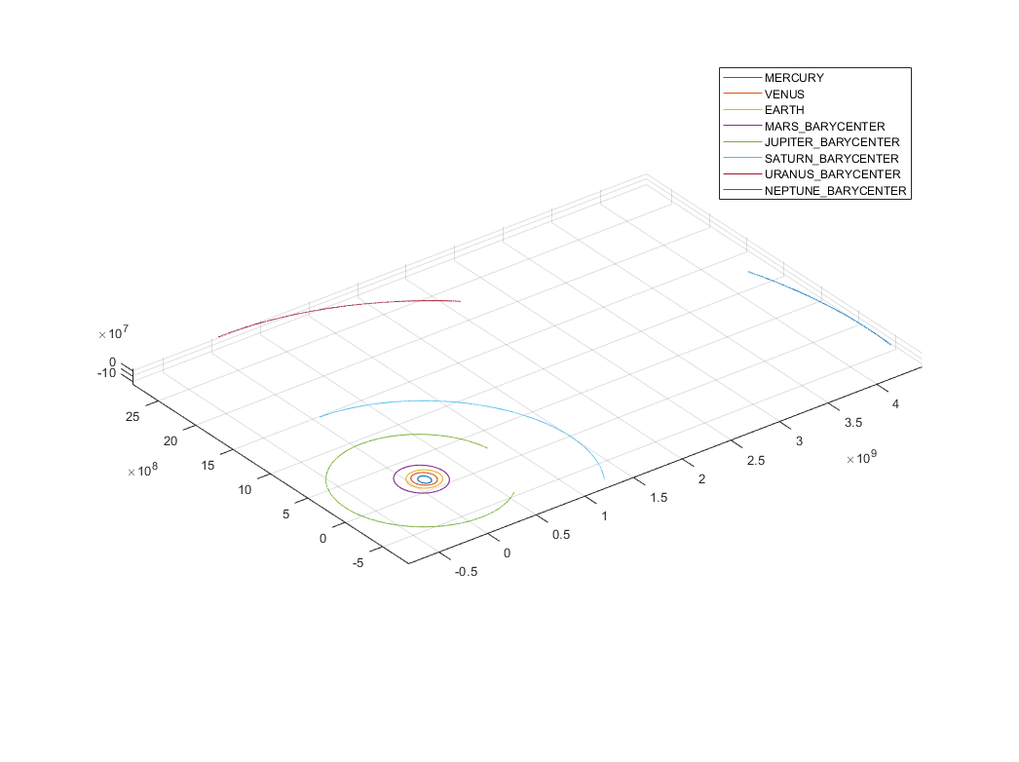
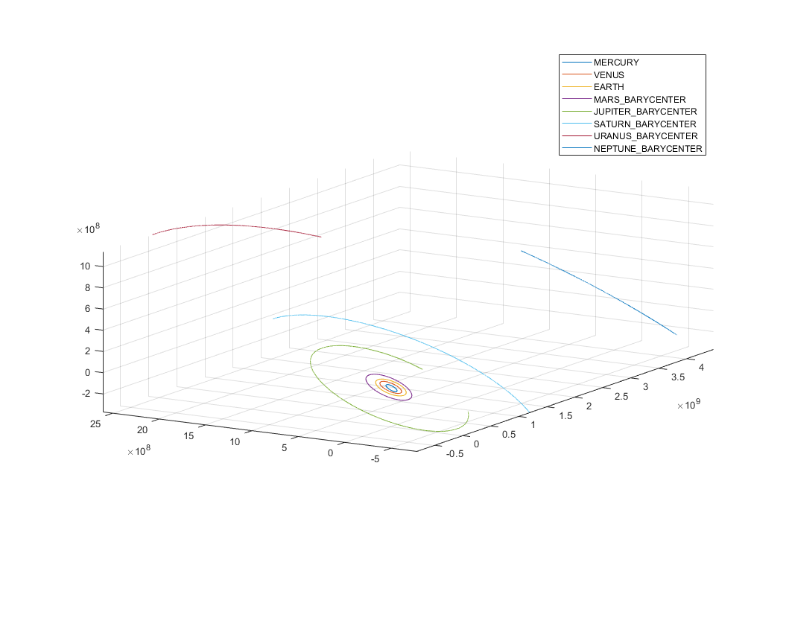
MATLAB Solar System Example
Ecliptic Inertial Frame
J2000 Inertial Frame

Slide 13
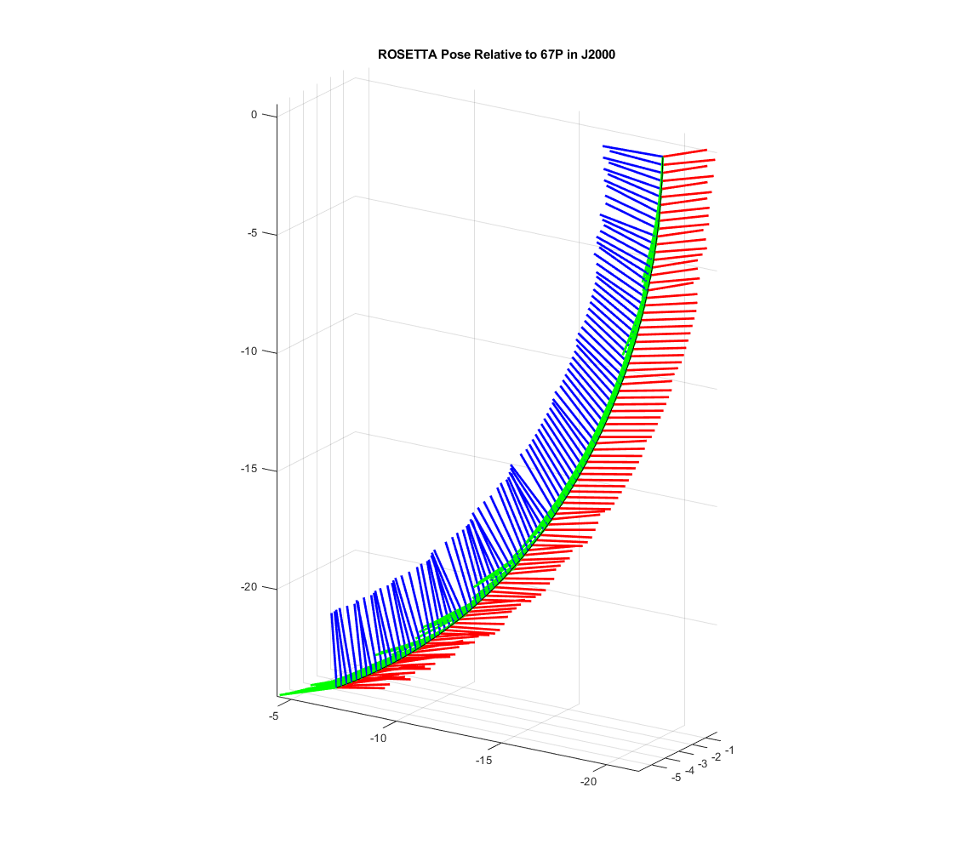
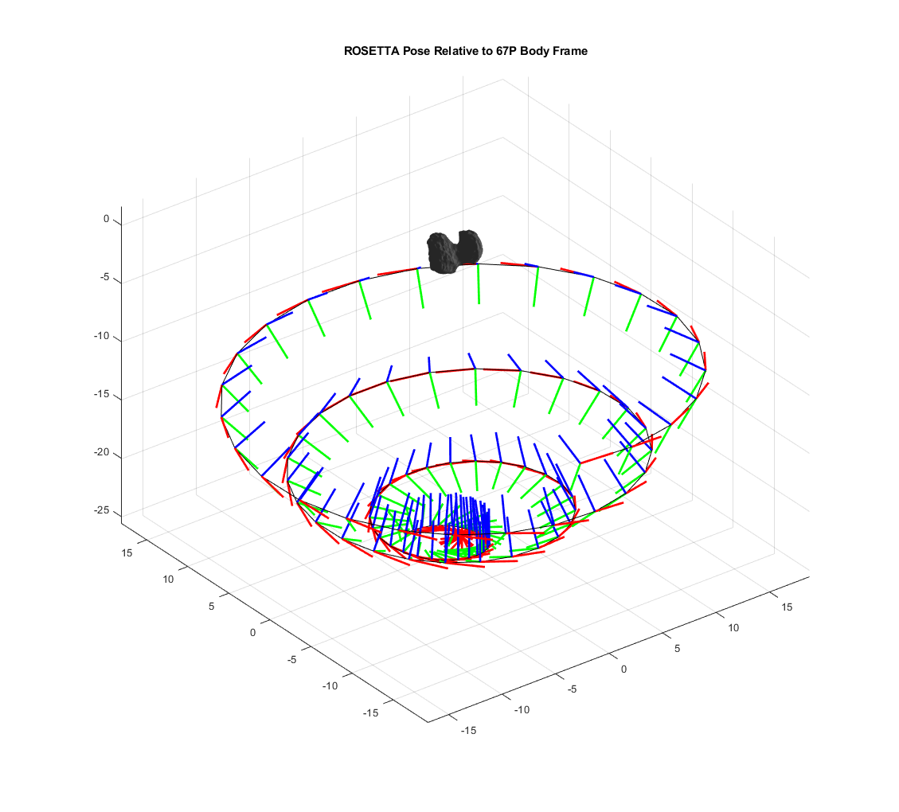
MATLAB Rosetta Example
Inertial Frame
Comet 67P Frame

