Slide 1
Check presentation notes for in depth explanations.
= hosts
= Send JSON data
Sharuya’s app
Web page
Run Data (TBD)
Source plate #
Trilution Webclient
Source plate #
NPSG Database
Scan GUI
Worklist
Worklist one at a time
Run Data
Gilson
Notes:
This is a diagram of what interfaces with the webclient.
What the webclient sends and receives is highlighted in the webclient documentation located at http://localhost:5000/gilson_REST/doc. To access this make sure the webclient is running first then go to the url. Brief explanation of endpoints below:
Sampledata – receives trilution data in Json format from Gilson. Highlighted by “Run Data” coming from Gilson above.
Samplelist - /samplelist and /samplist/{id} are urls within this endpoint. They both do relatively the same thing. All they do is take the give the JSON formatted method to Gilson when it asks for it. Highlighted above with “worklist one at a time”.
QCrecive – this endpoint does “source plate #” from scan gui to webclient, “source plate number” from webclient to NPSG database, and “worklist” from npsg to weblicent, “source plate #” highlighted above. QCrecieve will get the sourceplate number from the scan gui and send it to the npsg database to get a complete worklist. It will also format the worklist received from the database into a JSON file and save it in samplelistqueue.json.
Webfront – these http requests are used to host the webfront and make the webfront buttons work because I was too lazy to figure out how to use javascript to send http requests.
Sharuya’s app does not have endpoints in the documentation because it is hosted without swagger (the library that makes the documentation) knowing.

Slide 2
Gilson Webclient Communication
*samplelistqueue.json is created from database worklist
Webclient (after scan GUI)
Gilson
Receive Request
Request Sample List
Send method in samplelist.json
Receive method
Run method
Receive Data
Send Data
Pressure Check
Bad
OK
Send Shutdown Method
Receive Shutdown method
Shutdown
Standard Check
Bad
OK
Find next method in samplelistqueue.json
Save method in samplelist.json
Notes:
This is what happens between the webclient and Gilson when the run is actively going.
The pressure check right know just goes through the pressure and checks if any of them are above 700 psi. This can be improved with some sort of logic that could take the pressure data from the previous method and find the difference between methods.
Standard check will give a warning if FWHM of height parameters are off and shut down the Gilson if the position of the peaks are off.

Slide 3
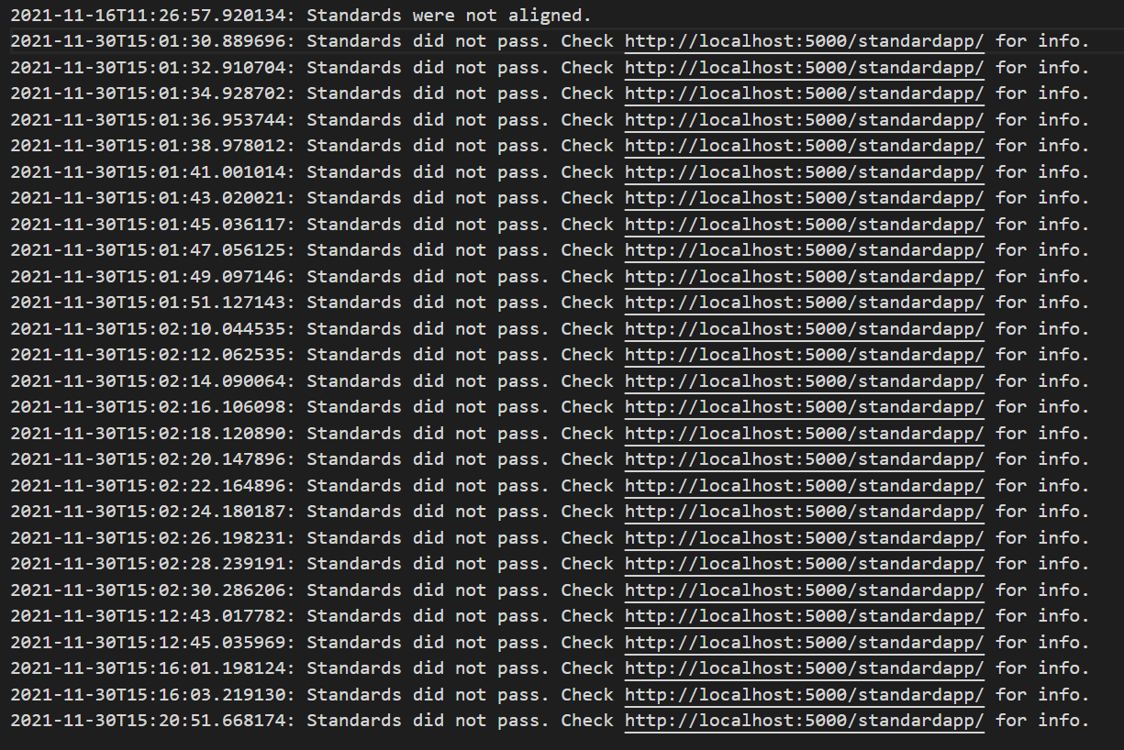
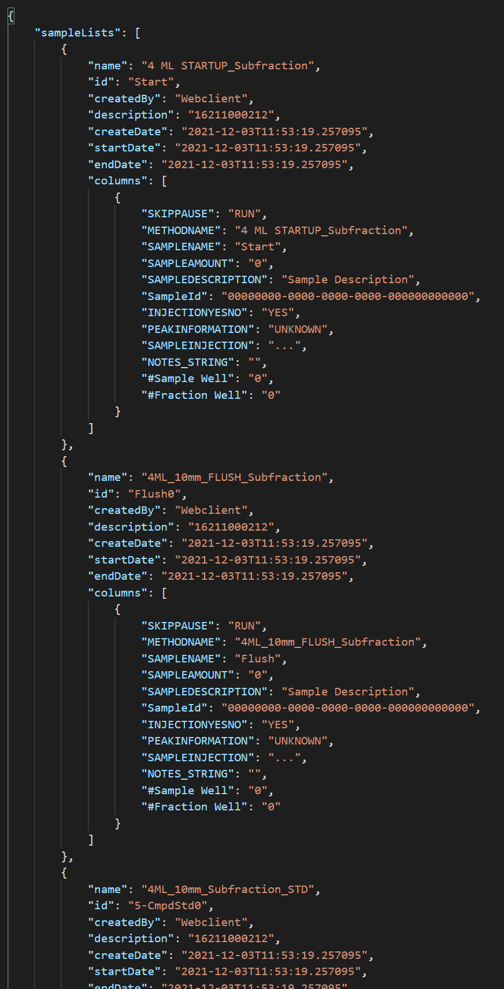
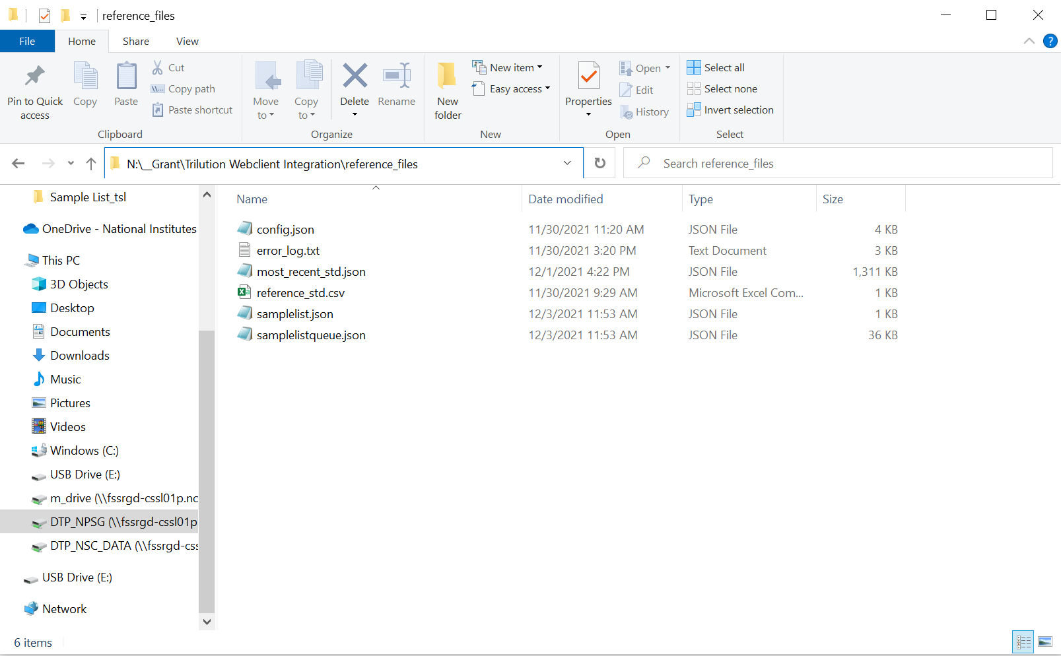
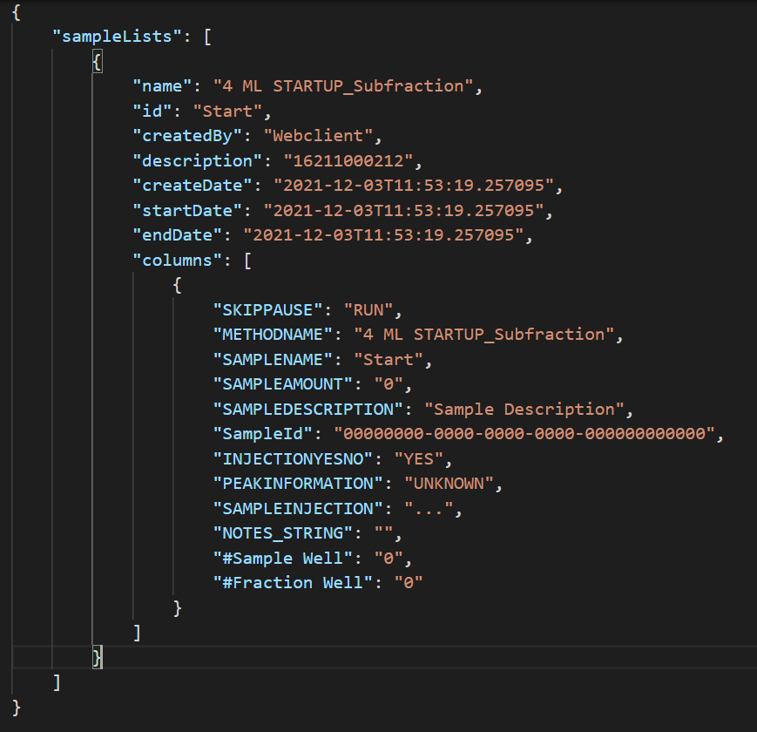
Reference Files
error_log.txt: Error log for the webpage. Deletes itself after it reaches 10000MB. Only ever really logs if pressures or standards are off.
samplelistqueue.json: The entire worklist that is going to get sent to trilution.
samplelist.json: The current method that is going to get imported into Trilution and run or the method that is currently running.

Slide 4
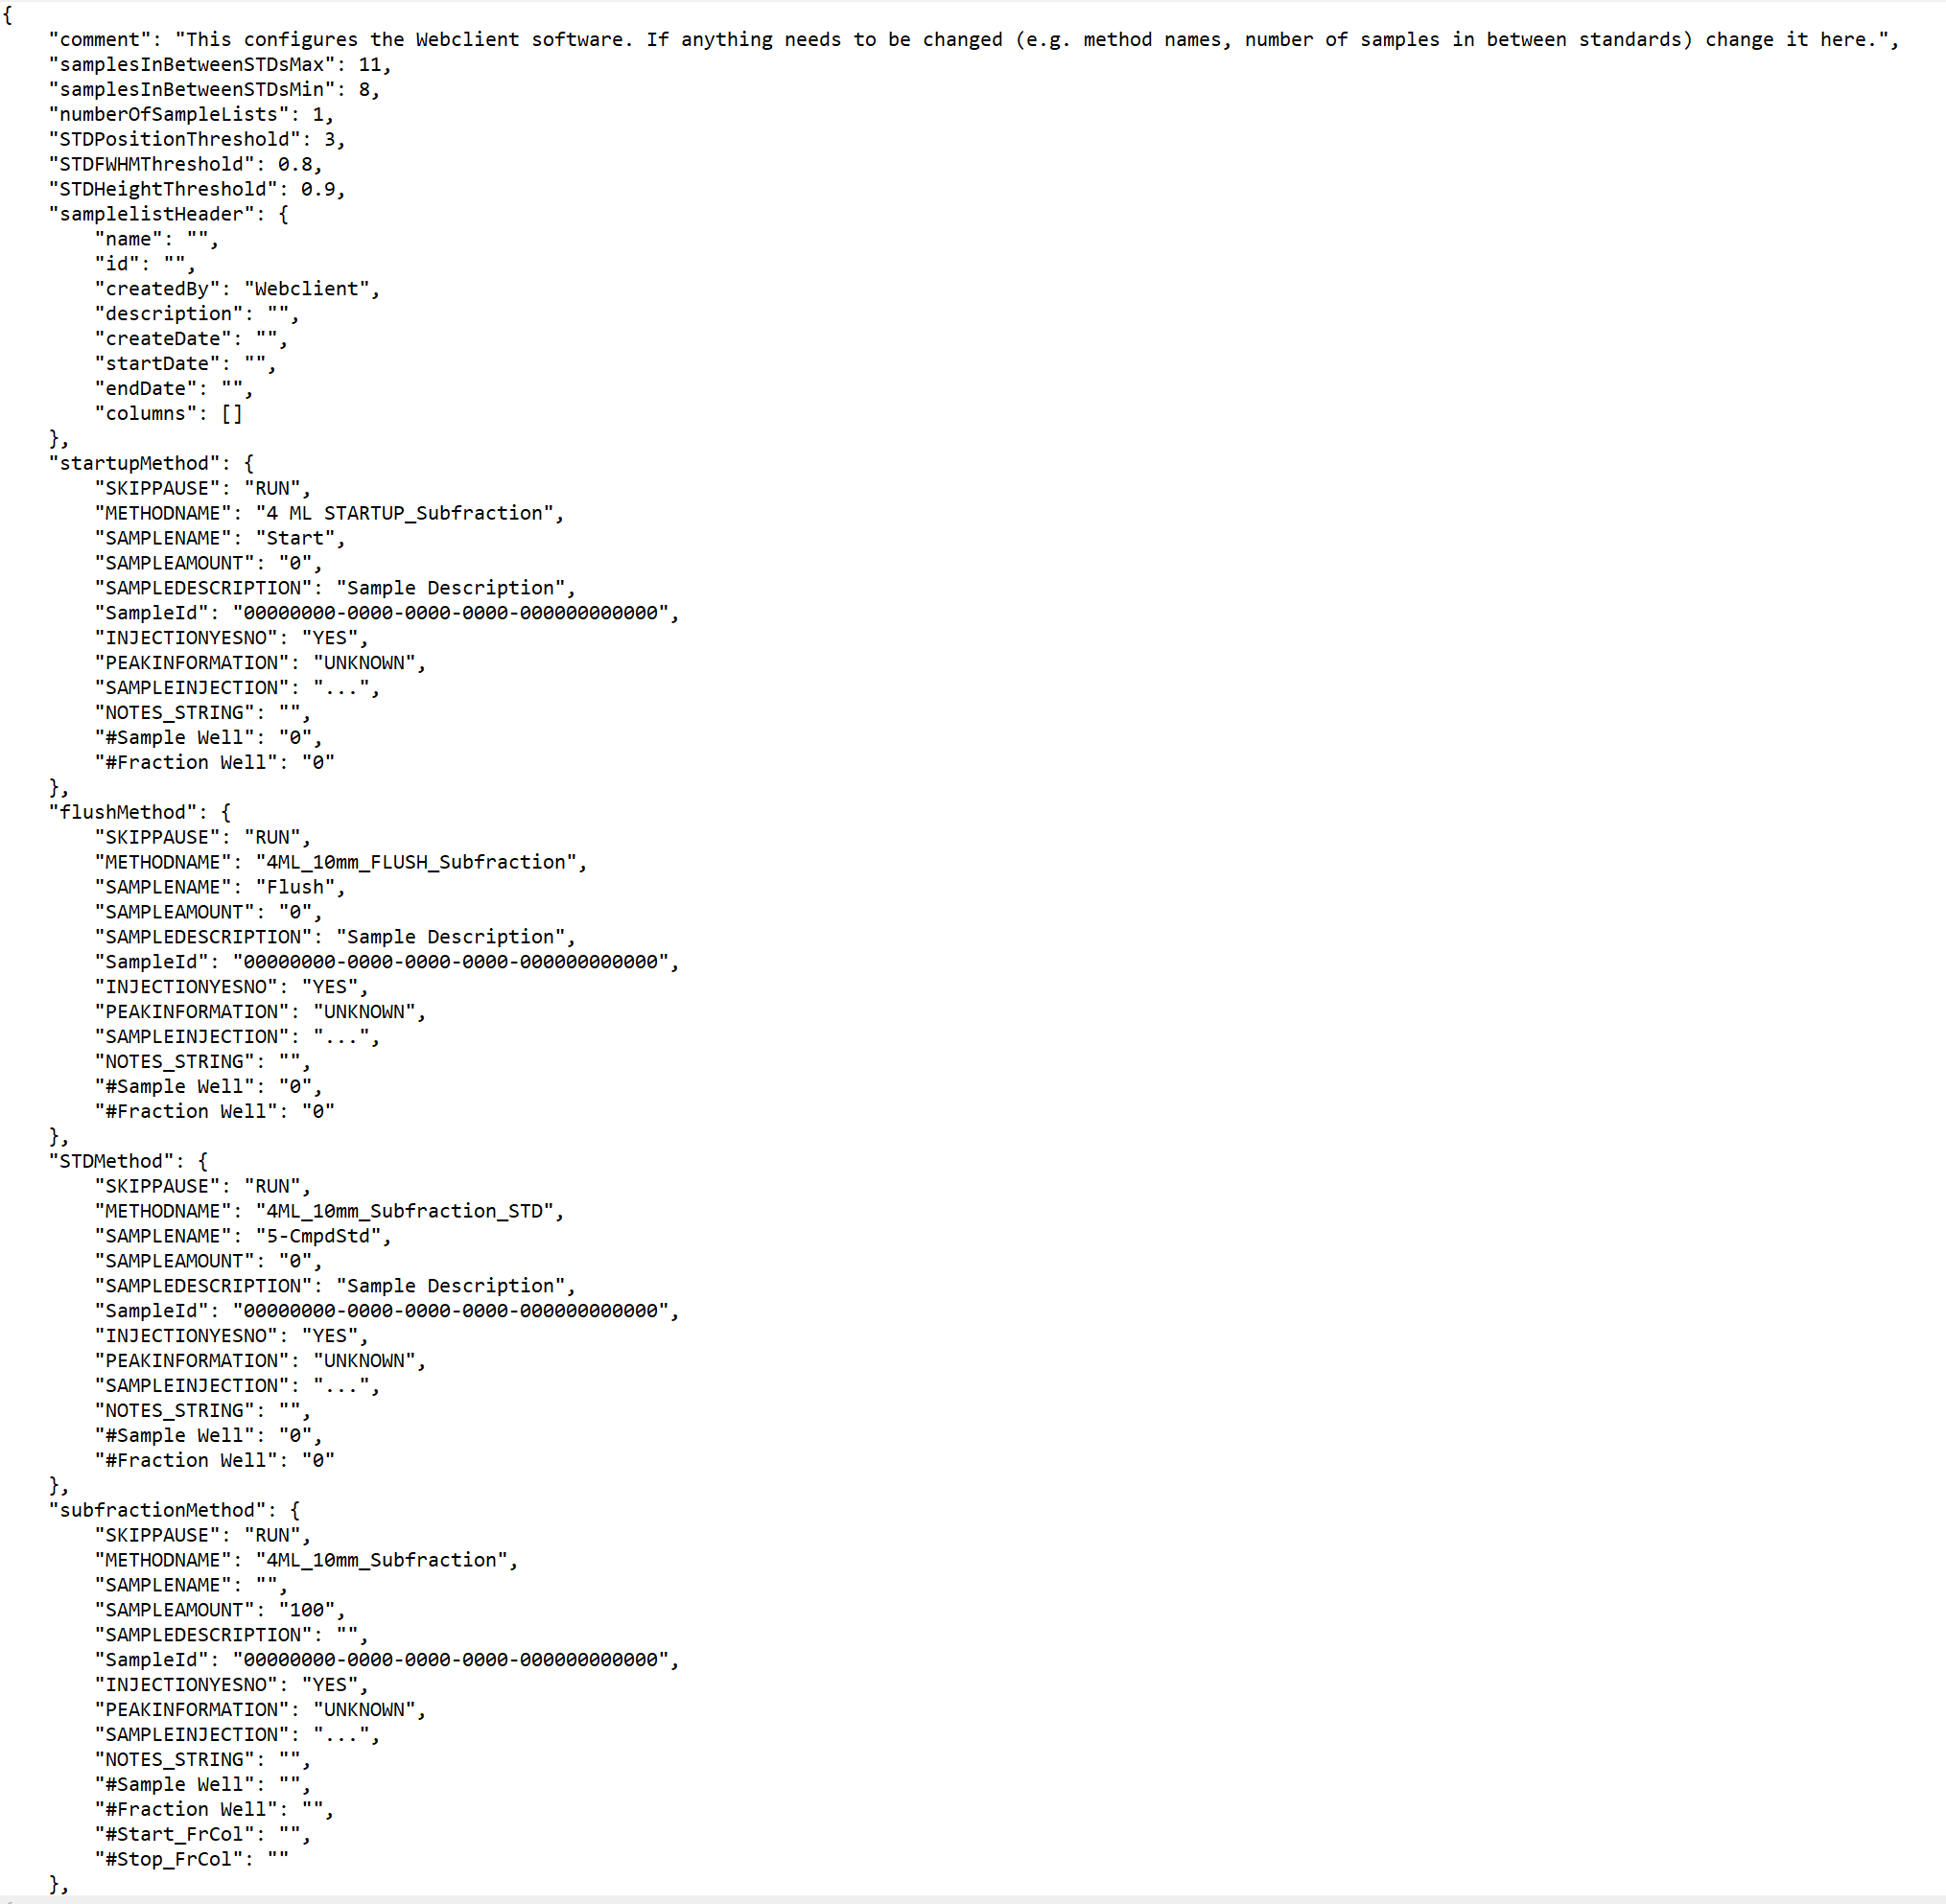
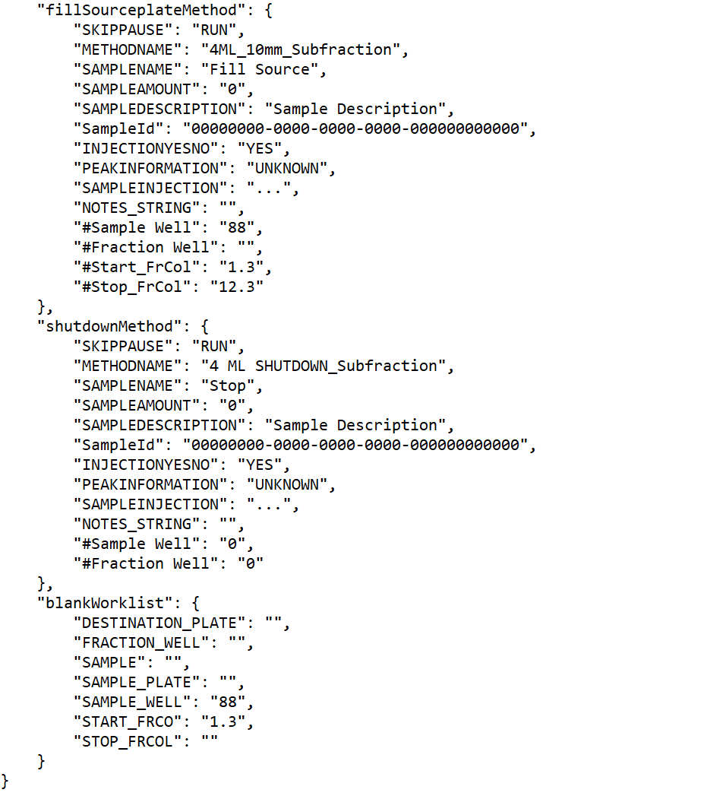
config.json
Important things you can change
Range of samples you want in between standards
Range of how far standard peaks need to be off before it throws an error.
Method names if changed.
Don’t change anything with “” because it is likely something that gets added the code later on.

Slide 5
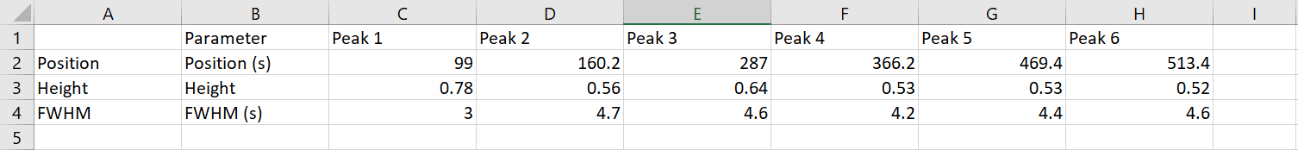
reference_std.csv
This is the standard that all standards during the run get compared to.
Can change any of the numbers on here.
Height and FWHM calculated by script. (tolerance = max value / 10)
most_recent_standard.json is the standard from the Gilson run most recently that is getting compared with this standard

Slide 6
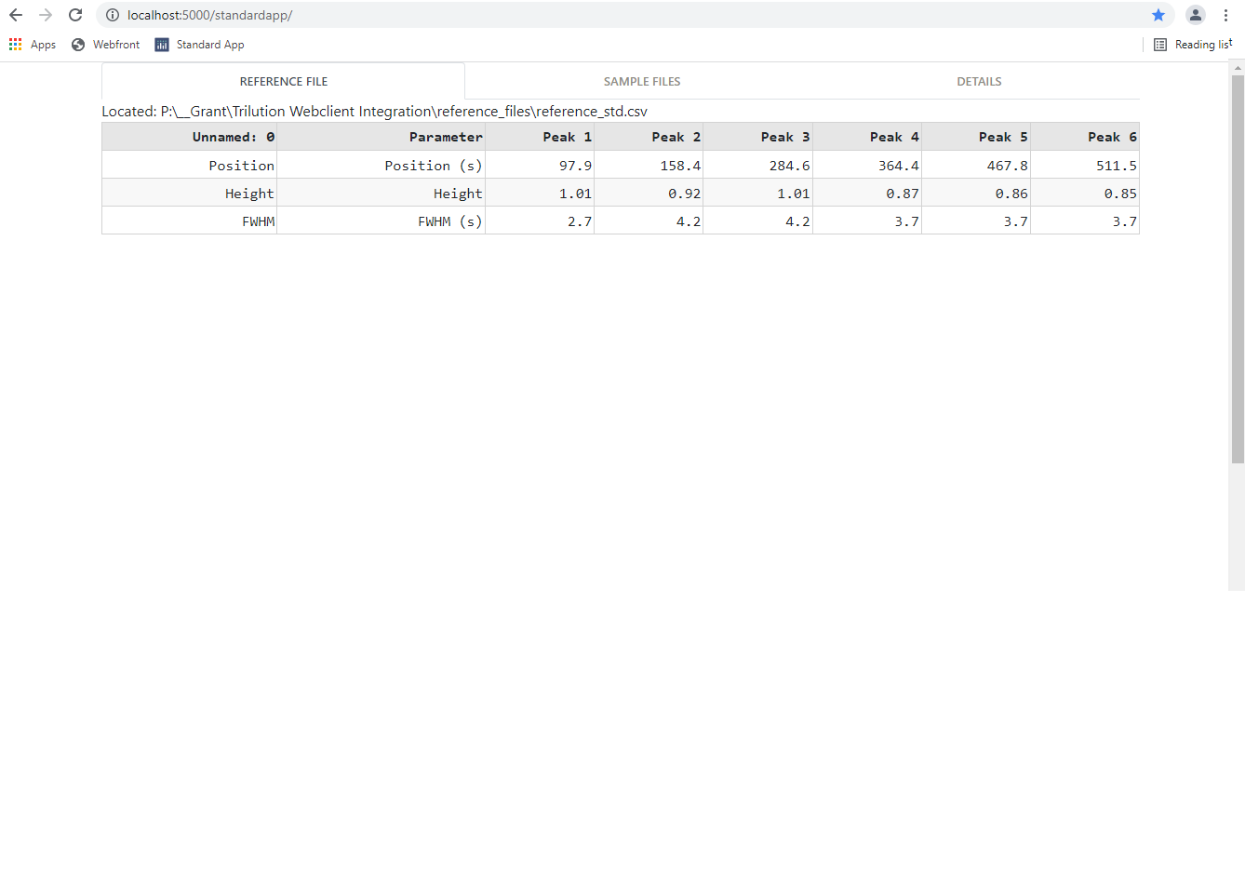
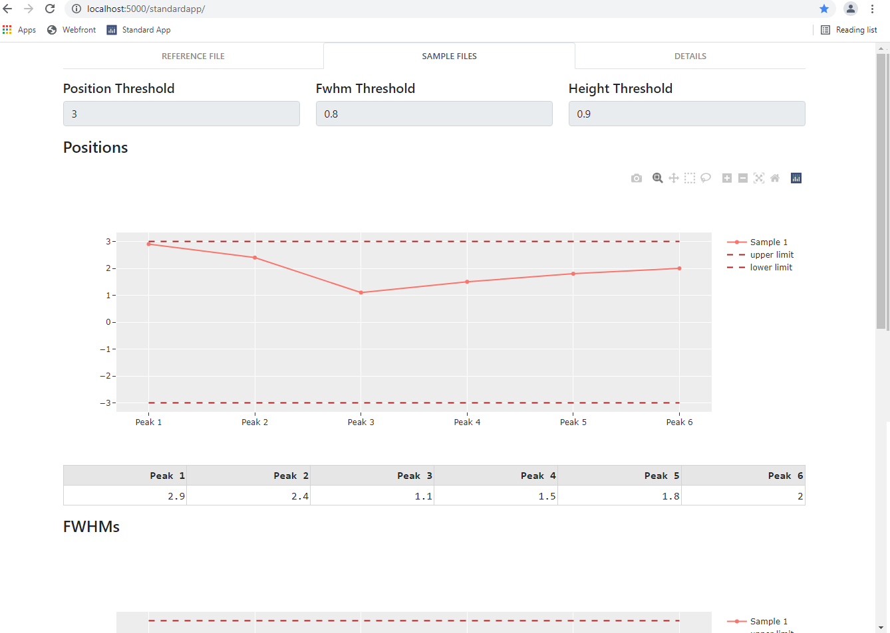
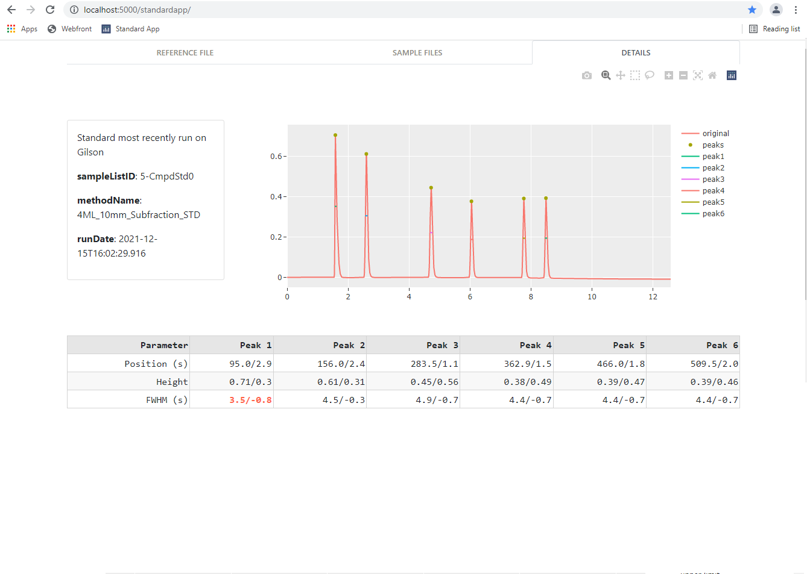
Sharuya’s App
First page is reference_std.csv
Updates automatically every 10 seconds
Automatically imports the most recent standard
Only position is what it checks as of right now

Slide 7
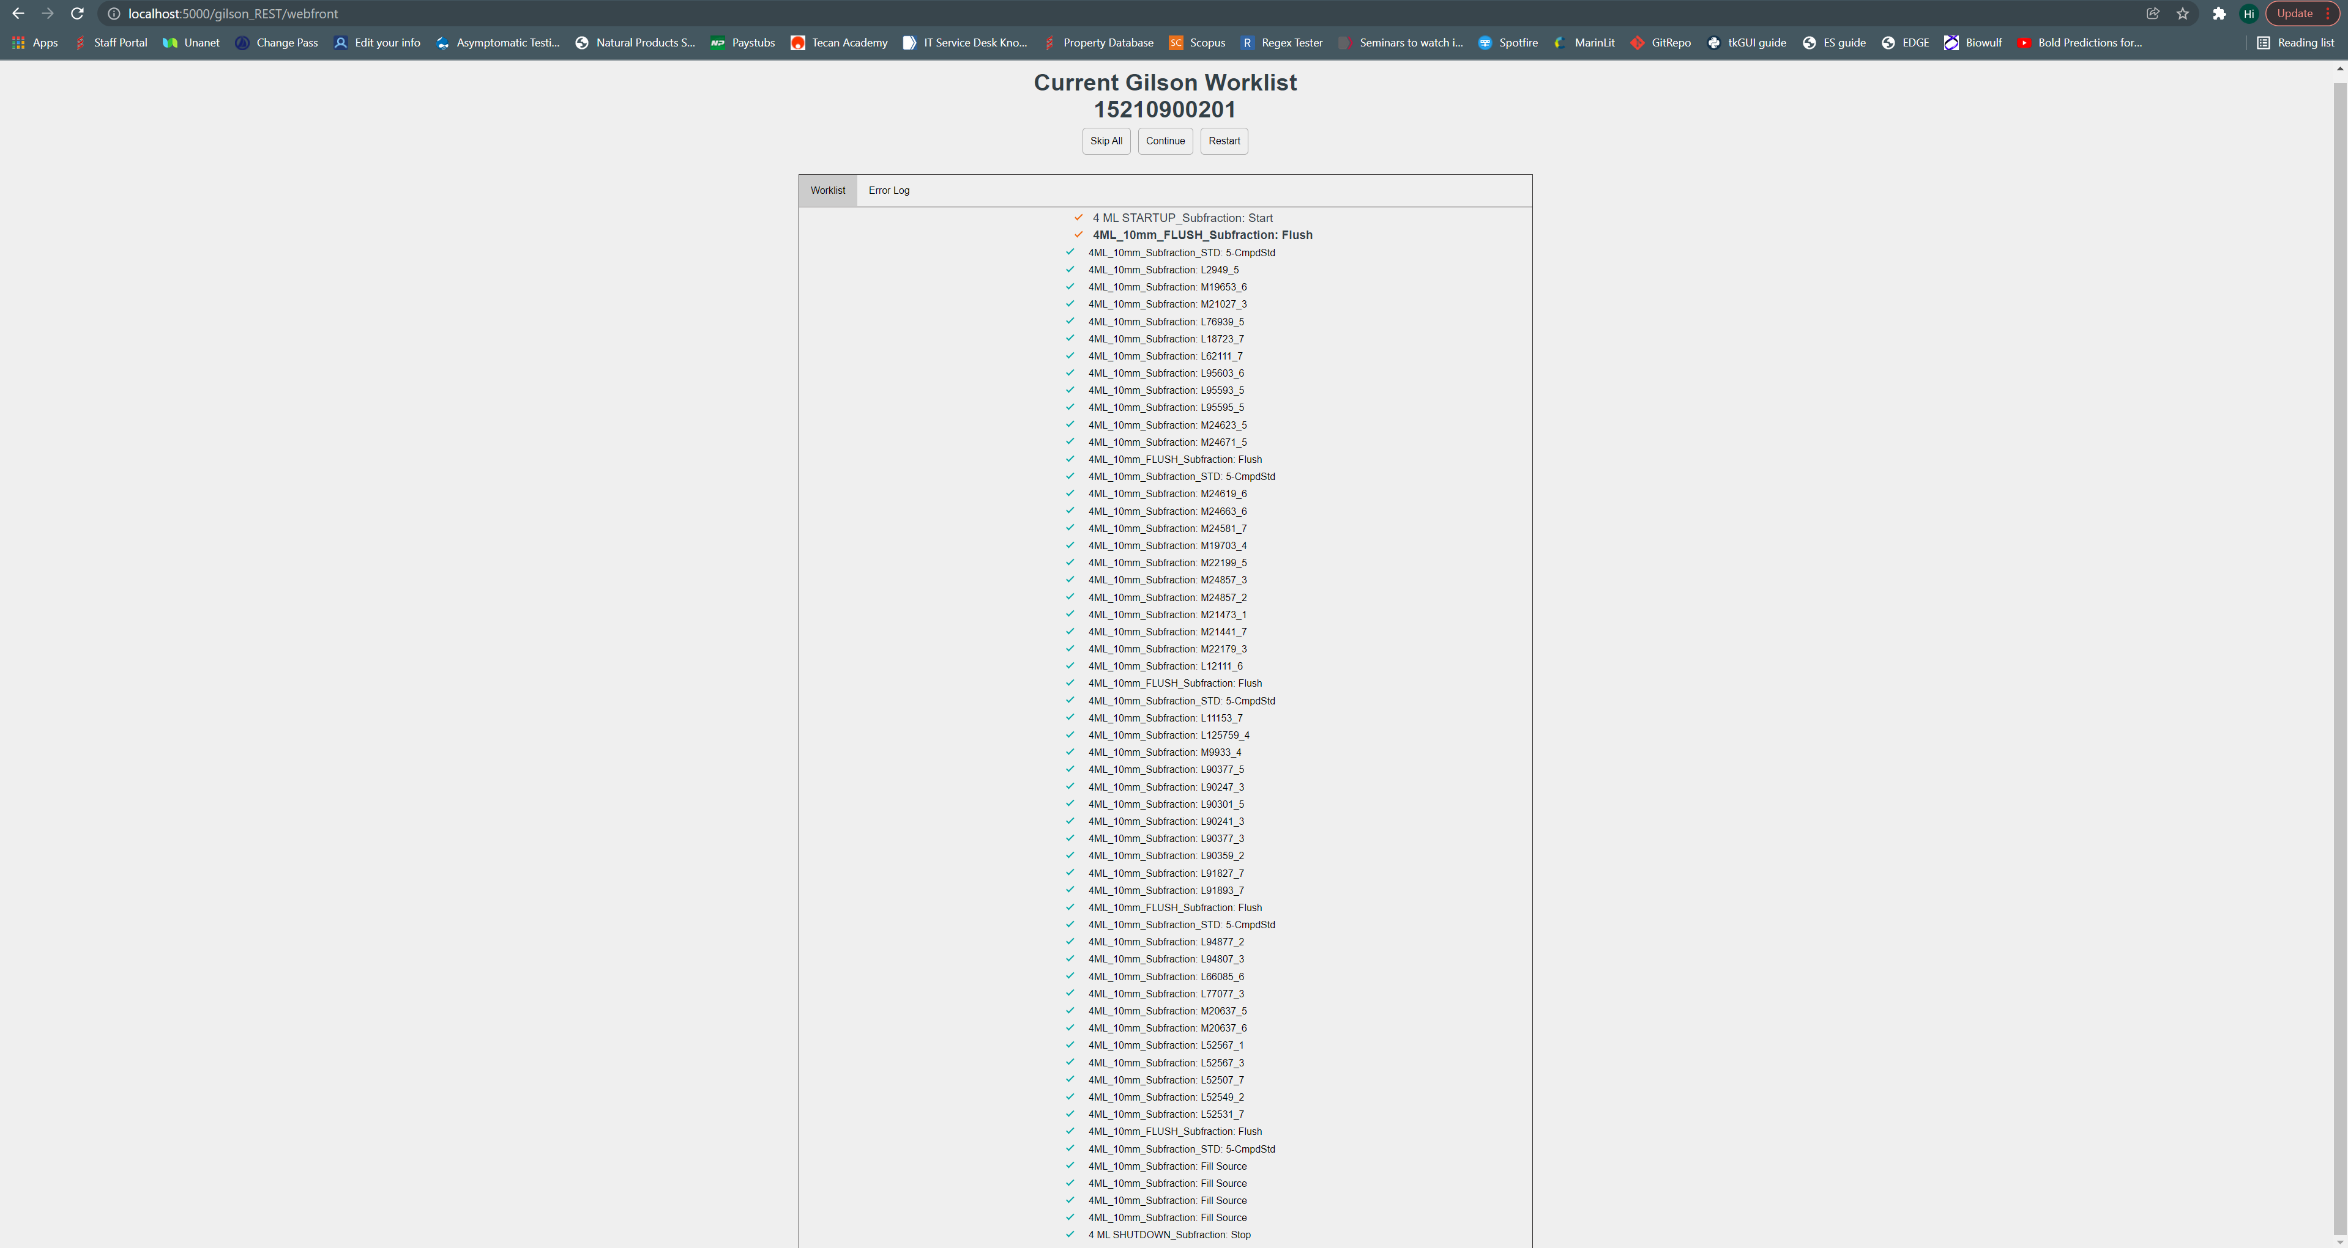
Web Page
**Refresh needed for accurate list
Handy Buttons
Source Plate
URL
Error Log
List of Methods (each a button)
Notes:
The Error log is formatted like this: Date|Soure plate: -Error/Warning- description
Example:
Fri Feb 4 09:51:29 2022|15210900201: -WARNING- FWHM for Peak 3 not within threshold.
The warnings are non fatal and will not result in a shutdown of the system. Any “ERROR” will result in a shutdown method and shutdown the Gilson.

Slide 8
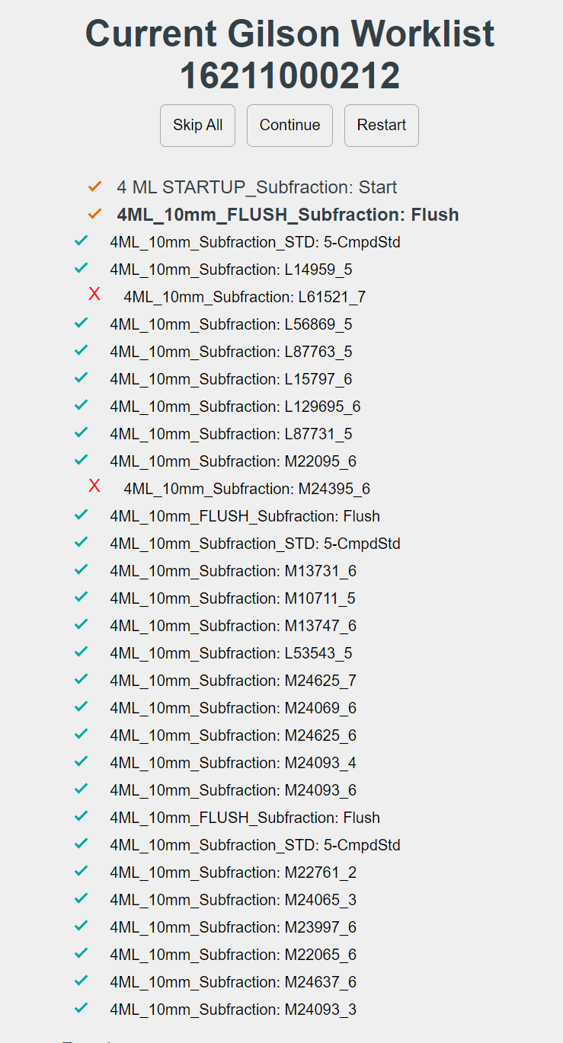
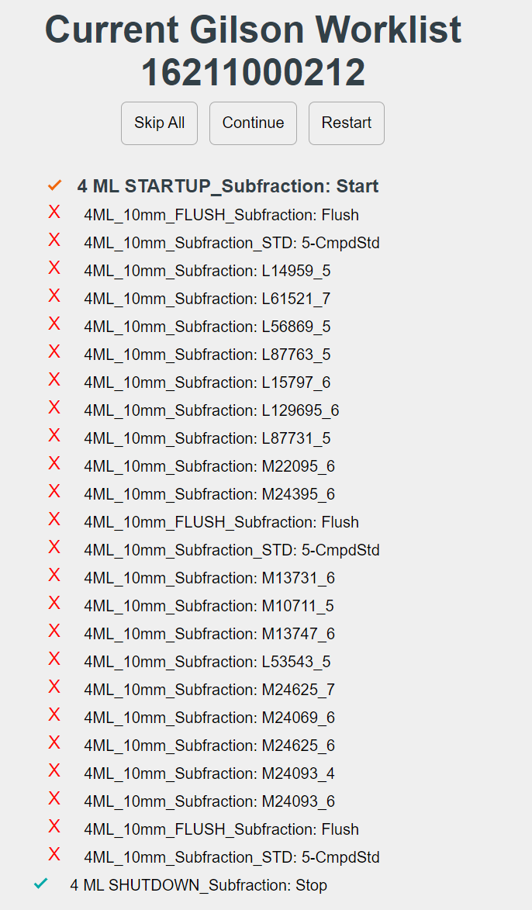
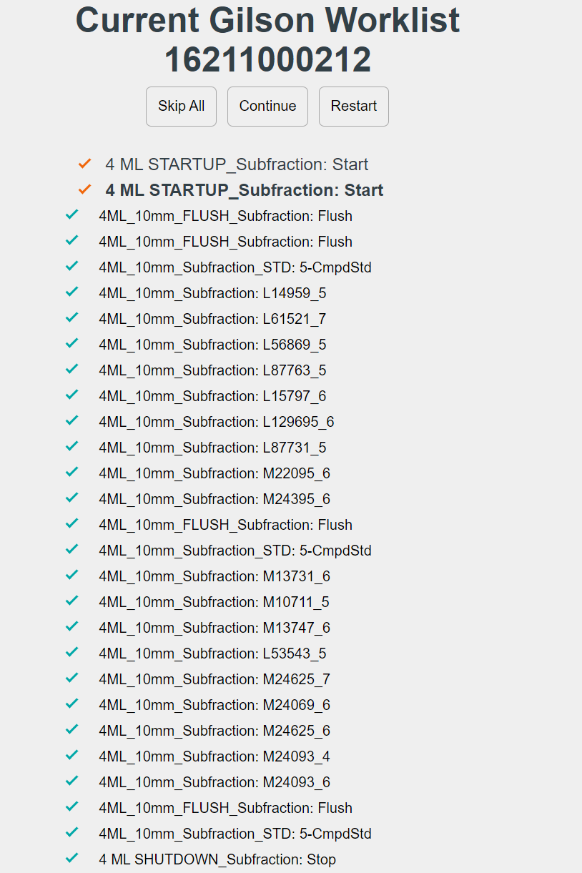
Web Page
Skip Some
Skip All
Continue
Notes:
Skip Some: You can click on any of the methods in the list and the program will skip them. This could be useful if a run errors and you need to recover, or if you just want to run a few methods.
Skip all: You can press this button to throw a shutdown method and skip the remaining methods. The method that the Gilson is currently on will finish, and then it will run a shutdown method.
Continue: Use this button if there was an error in the run and you want to pick up where you left off. The continue button will find the last method that was run, add in another Start and Flush method, then continue on with the rest of the worklist. The picture under “continue” is a result of me pressing the continue button when the worklist looked like the picture under “skip all”. You can see that the continue button added another start and flush method and then continues on with the rest of the worklist (in this case another flush method).
Restart: The restart button will start the worklist from scratch. This button deletes the queue in samplelist.json and fetches the worklist from the NPSG database again.

Slide 9
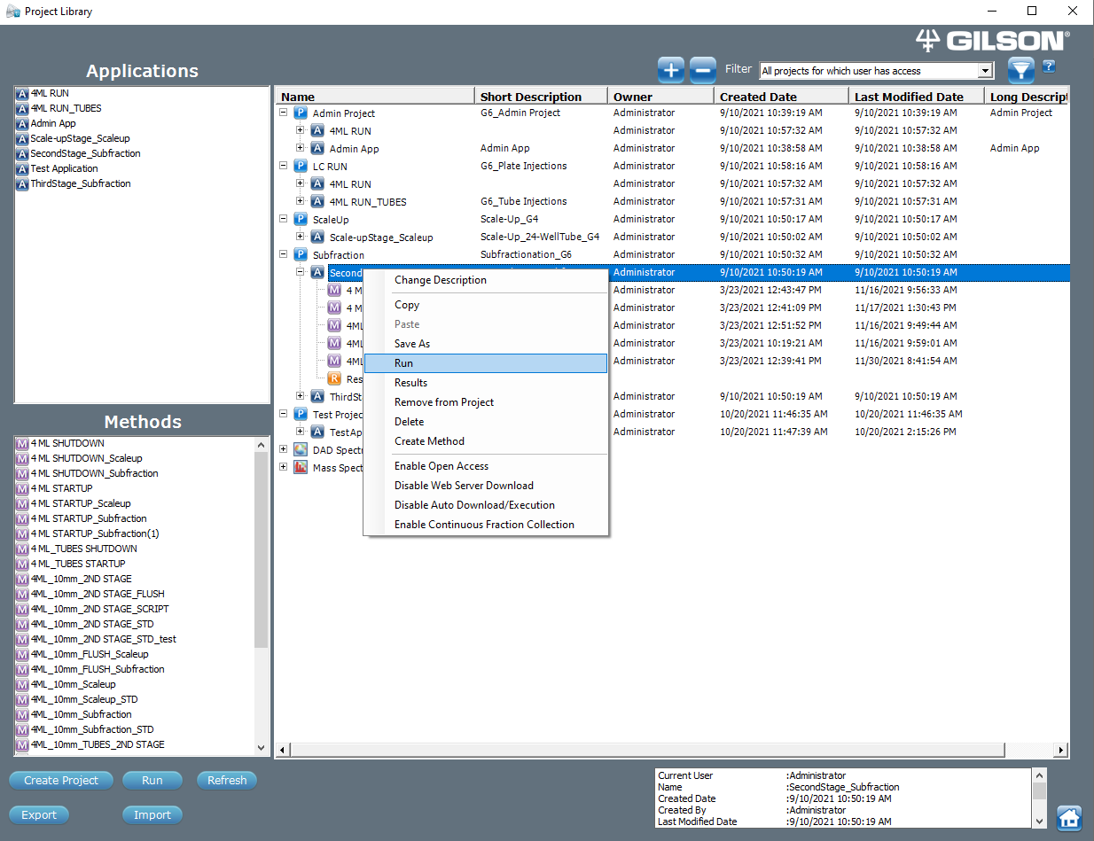
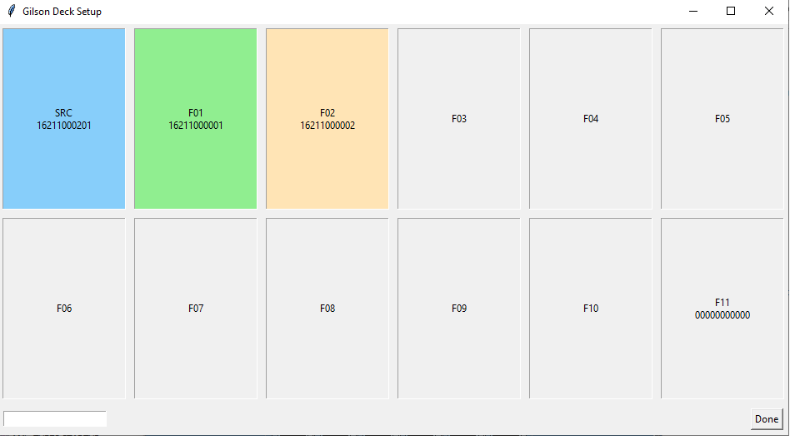
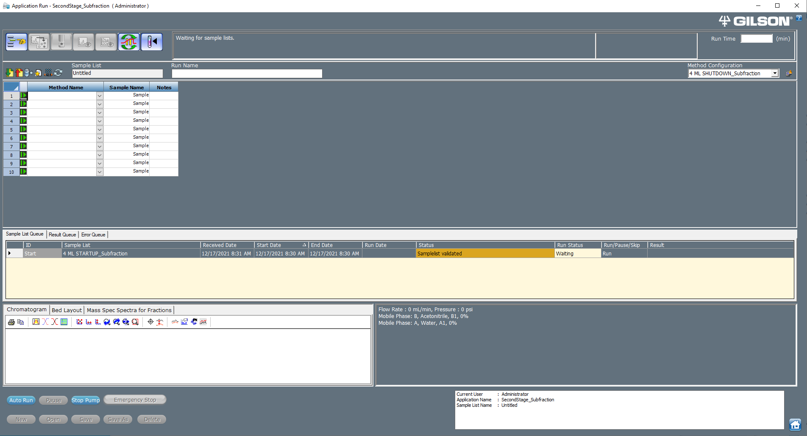
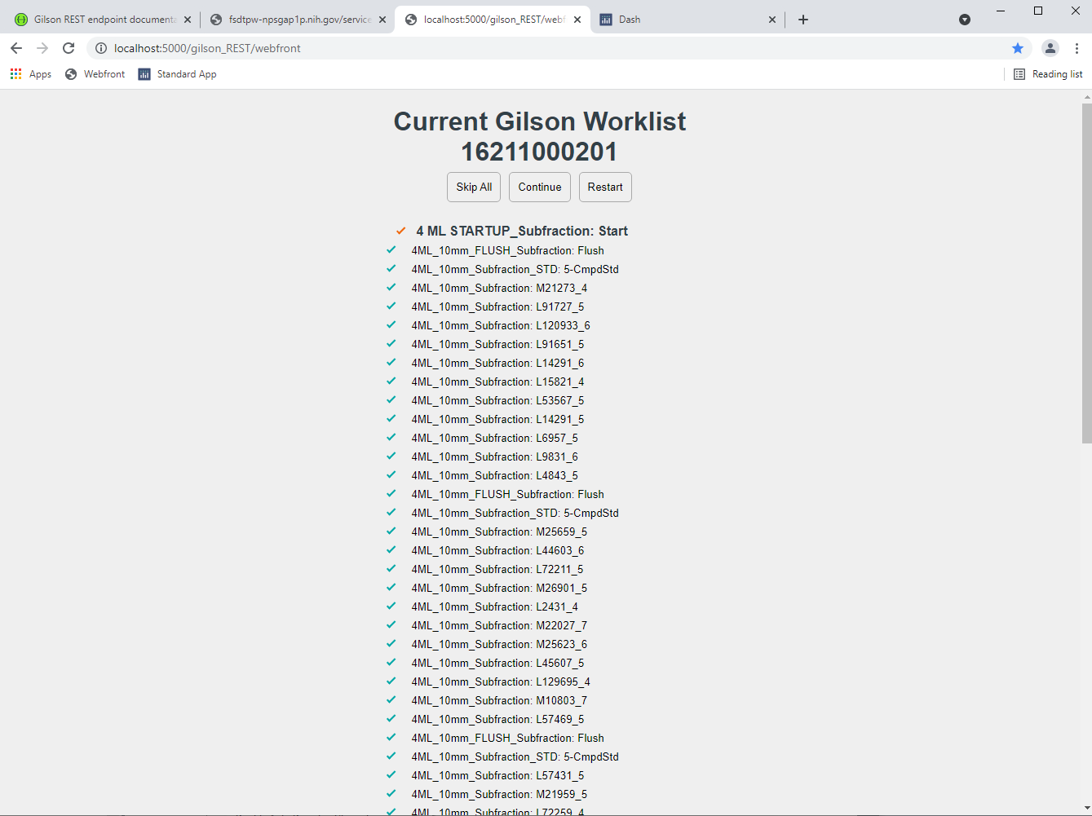
To Run
Notes:
Steps:
Use the scan GUI app called “master_app.exe” to open the Gilson deck setup app.
Scan in plates
Check the webfront at http://localhost:5000/Gilson_REST/webfront to see if the sourceplate at the top of the page matches the source plate you scanned. (optional but recommended)
Go to trilution and run second stage
Click Auto run

Slide 10
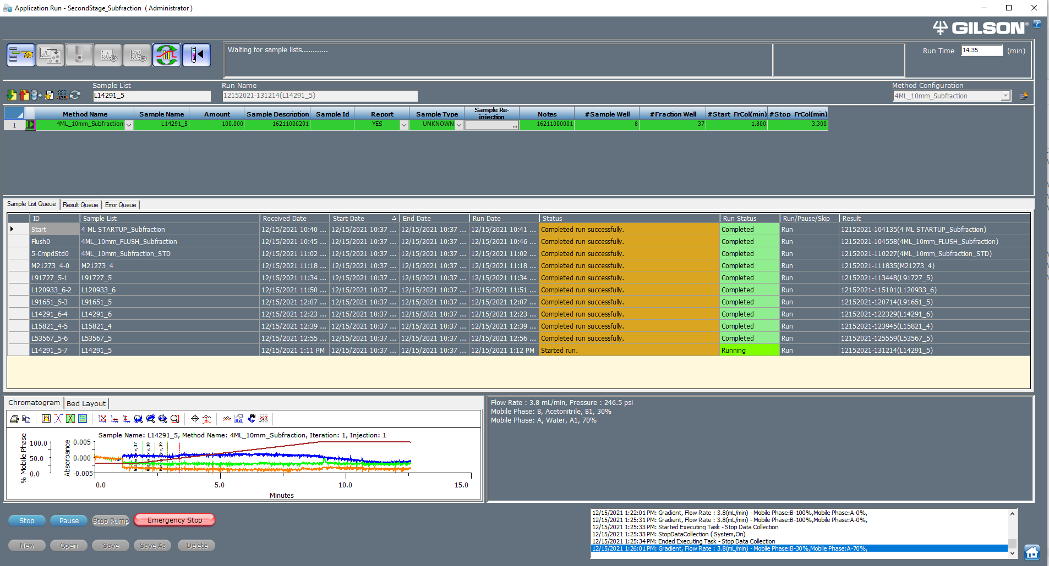
Notes:
This is just an example of the webclient running smoothly.

Slide 11
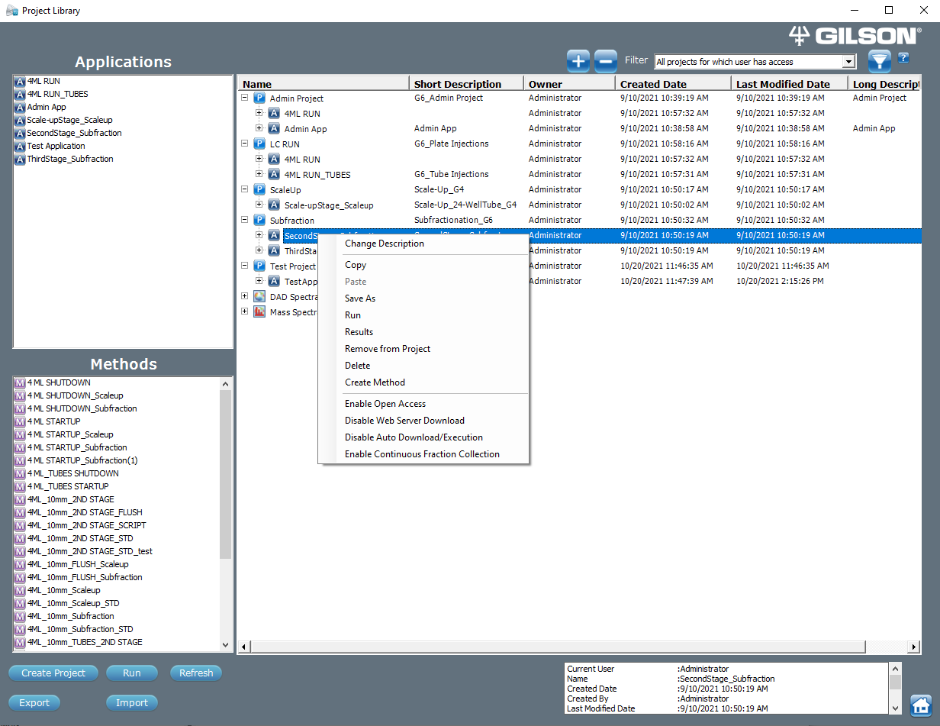
Gilson Webclient Communication
Disable/Enable Auto Download/Execution: Stops the webclient. Data still gets sent from runs.
Disable/Enable Web Server Download: Disables data being sent automatically to the webclient after each run

Slide 12

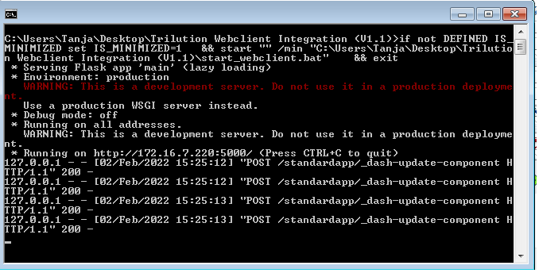

Webclient Running
Running
Not Running
This Command prompt icon should be open and minimized. If you click it, it should look similar (but probably not the same) as the command prompt above
Click on this file to start the webclient if it is not running. The file is called “start_webclient.bat – Shortcut”.
**The webclient should automatically run on startup.

