Slide 1

Meltdown and Spectre Investigation
April 25, 2019
Devish Mundra / Nischith Nanjundaswamy / Grant Pedersen
Notes:
TITLE SLIDE:
Change background as needed; more images available at http://ucdenver.webdamdb.com
Change Title and Subtitle as needed
Date updates automatically

Slide 2
Table of Contents
Review of Meltdown
Simulation of Spectre
Simulation of Meltdown
How to run our simulations
Conclusions
Notes:
CONTENT SLIDE (2-COLUMN)

Slide 3
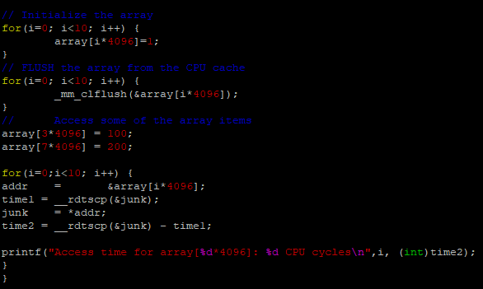
Side Channel Attack via CPU Cache

Slide 4
probe_array = [256 *4K ]
kernel_memory = *(kernel_address)
temp = probe_array [ kernel_memory * 4K ]
User Memory Space
Kernel Memory
Space
Processor
Main Memory
R1
Cache
*kernel_address
*kernel_address
*kernel_address
probe_array
[kernel_memory * 4K]
probe_array
[kernel_memory * 4K]
R2
probe_array
[kernel_memory * 4K]

Slide 5
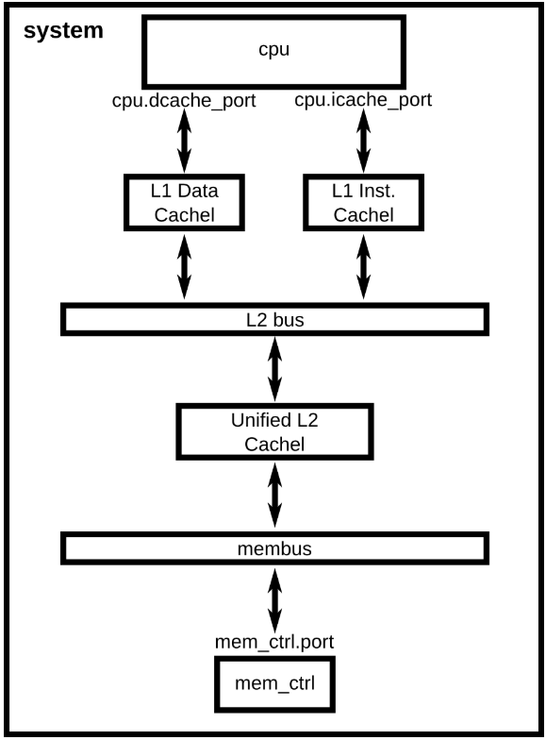
Meltdown Implementation
Python builds CPU NOT MULTICORE
2 Level Cache
Full VM “bare metal”
Kernel Vanilla Linux 2.6.22.9
64 bit OS support
Notes:
CONTENT SLIDE (2-COLUMN)

Slide 6
Meltdown Demo
sudo build/X86/gem5.opt configs/example/fs.py --kernel /dist/m5/system/binaries/x86_64-vmlinux-2.6.22.9.smp

Slide 7

Meltdown Demo

Slide 8
Spectre Implementation
Python builds CPU NOT MULTICORE
2 Level Cache
LTGE Branch Predictor
O3PipeView debug tool
O3-pipeview.py tracer
Notes:
CONTENT SLIDE (2-COLUMN)

Slide 9
Spectre Demo
Notes:
CONTENT SLIDE (2-COLUMN)

Slide 10
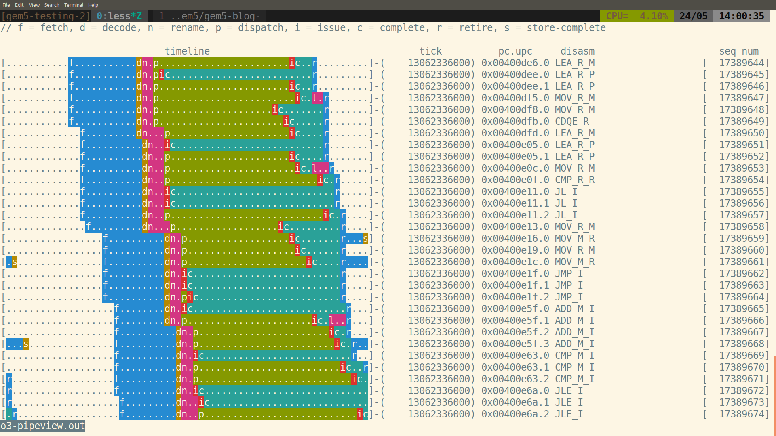
Spectre Demo
Notes:
CONTENT SLIDE (2-COLUMN)

Slide 11
Questions?
??
Notes:
CONTENT SLIDE (2-COLUMN)

