Slide 1
Box Jellyfish

Slide 2
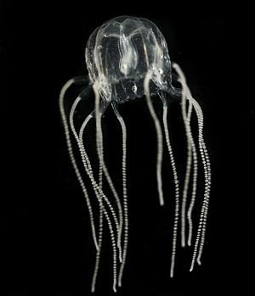
Common Name: Box Jellyfish
Genus species: Cubozoa

Slide 3
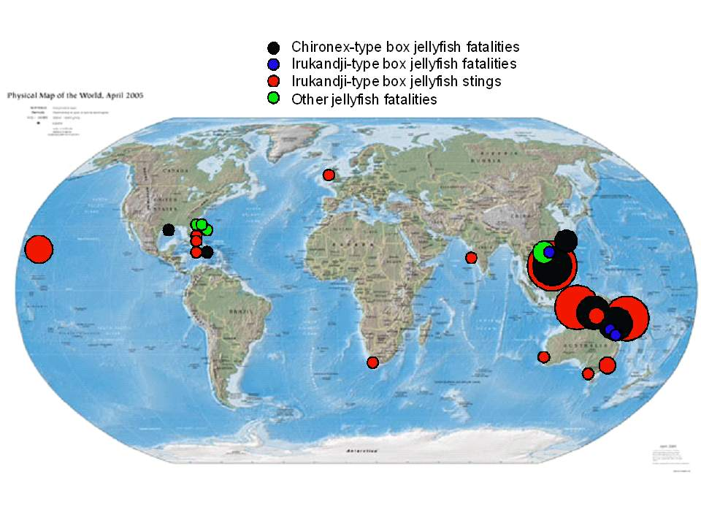
Habitat
The Box Jellyfish are usually found in warm waters of many coastlines across the world, the most lethal variety are usually found in the Indo-Pacific region and northern australia.

Slide 4
Adaptations
They have stinging cells in their tentacles to capture prey and defend themselves from predators.
Their transparent body makes them almost invisible to predetors.
Their radial symmetry design makes them able to capture food in all directions.

Slide 5
Facts
The most venomous jellyfish, and one of the most venomous beings on earth.
Turtles are the only jellyfish predators.
Jellyfish live for about three months.
Jellyfish shrink if they don’t eat.

