Slide 1
The Black Widow
Latrodectus

Slide 2
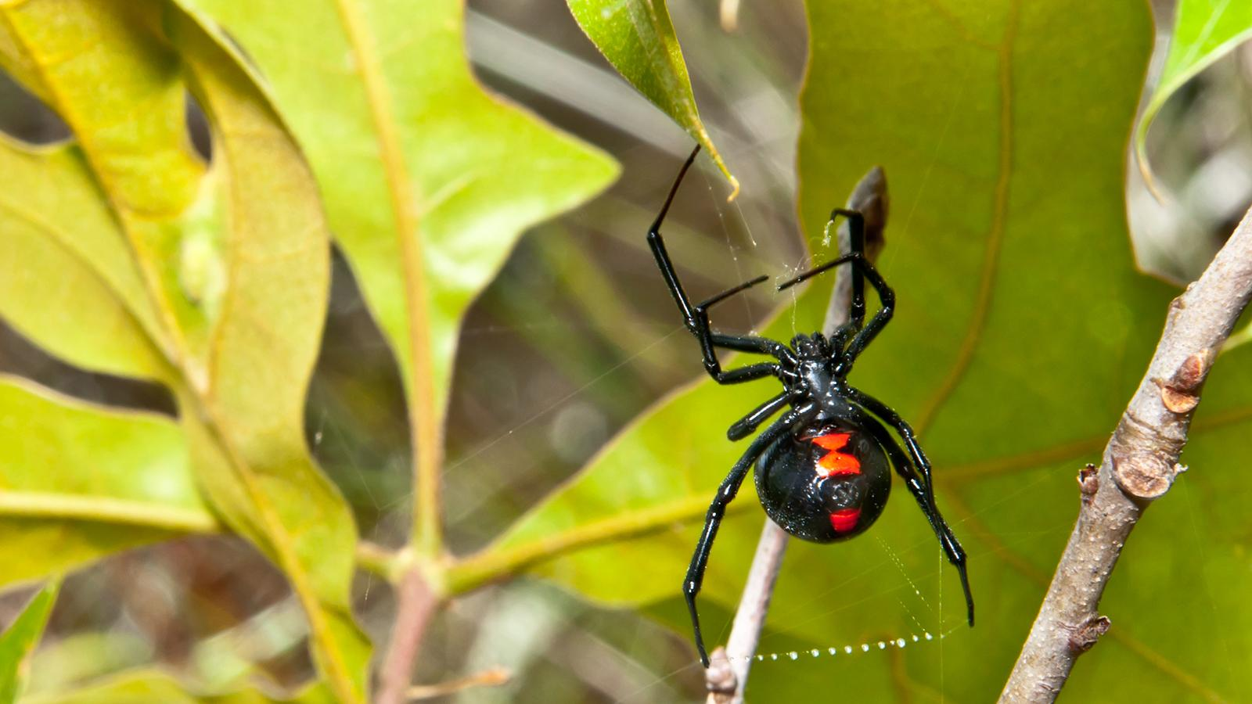
Habitat
The Black Widow Spider is found in warm, dry places all around the world

Slide 3
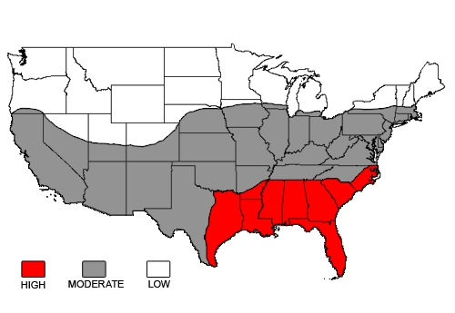
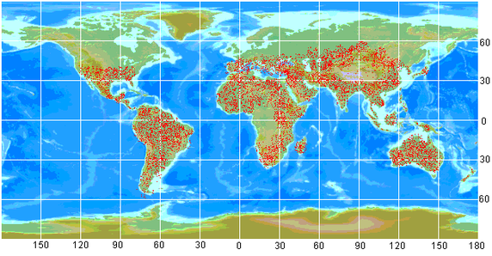
Region
Black Widows usually are found in Southern North America, South America, some parts of Africa, and almost all of Europe, Asia, and Australia. It’s not found in Antarctica and Northern North America, and Russia.

Slide 4
Adaptation #1
The Black Widow's’ Venom is 15 times stronger than a regular rattlesnake, making it the most venomous spider in the world.

Slide 5
Adaptation #2
Black Widow’s have strong enough venom to kill insects with one bite.

Slide 6
Adaptation #3
Every spider has an oil at the end of their feet to keep themselves from sticking to their own web.

Slide 7
Fact #1
Even though the Black Widow’s venom is 15 times more potent than a rattlesnakes, no one has died from a Black Widow bite in the last 10 years.

Slide 8
Fact #2
The Black Widow spins irregular webs.

Slide 9
Fact #3
Female Black Widows sometimes eat the male after sex to get nutrients for the eggs.

