Slide 1

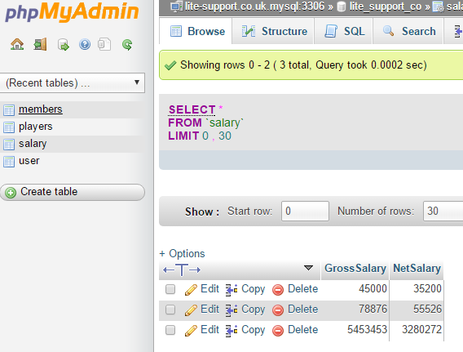
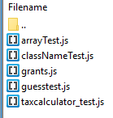
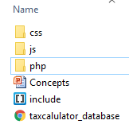
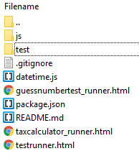

CSS
URL to file
Send Request
Pass Parameters as (Name / Value Pairs in url string
Write variables to DB
HTML
JS
AJAX
PHP
DB
Response
taxcalculator.js
addrecord.js
addrecord.php
TDD Development
Testrunner_tax.html
Include .php file points to addrecord.php
JS TEST RUNNER
JS TESTS
Testrunner_tax.js
Client
Server

