Slide 1
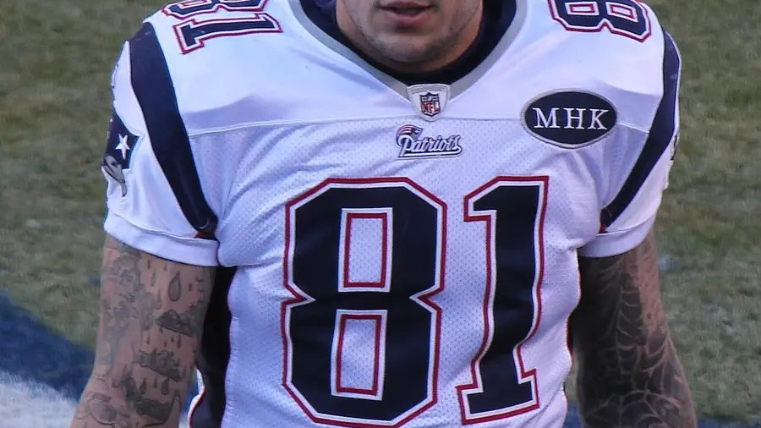
BEYOND THE SCOREBOARD · 2007 TO 2019
Number 81
Aaron Hernandez went from the 113th pick to a $40 million contract to a life sentence for murder. Who saw it coming, and what did football owe the truth?
Aaron Hernandez in Denver, December 18, 2011. Photo by Jeffrey Beall, CC BY 3.0.
Notes:
Aaron Hernandez was born November 6, 1989 in Bristol, Connecticut, home of ESPN. He starred at Bristol Central High School and graduated a semester early and enrolled at Florida in January 2007 at 17. The Patriots drafted him in 2010 with the 113th pick. On August 27, 2012 he signed a five year extension worth about $40 million with a $12.5 million signing bonus. He was arrested June 26, 2013, convicted of the murder of Odin Lloyd on April 15, 2015 and died in prison on April 19, 2017 at age 27. The photo shows the MHK patch the Patriots wore in 2011 for Myra Kraft, the owner’s wife, who died of cancer in July 2011.

Slide 2
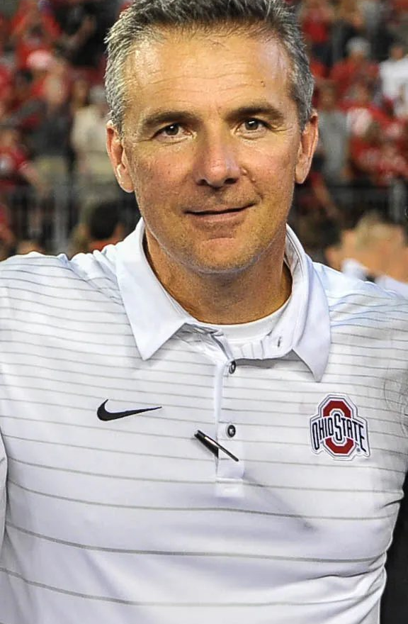
BRISTOL TO GAINESVILLE
A star who left home at 17
His father Dennis, a former UConn player, ran his football life. In January 2006 Dennis died after a routine hernia surgery. Aaron was 16, and people close to him said he changed after that.
A year later he enrolled at the University of Florida, where Tim Tebow was the quarterback and Urban Meyer was the coach. Florida won the national title in January 2009. That December he won the Mackey Award as the best tight end in college football.
3 seasons
at Florida before he declared for the 2010 NFL draft at age 20
Urban Meyer, his coach at Florida. Photo 2017, US Army, public domain
Notes:
Dennis Hernandez died January 6, 2006 of complications from hernia surgery at age 49. Aaron’s older brother Jonathan, known as DJ, played quarterback at UConn and later wrote a memoir, The Truth About Aaron, in 2018. At Florida Hernandez had 111 catches over three seasons. Florida beat Oklahoma 24 to 14 in the BCS title game on January 8, 2009. Urban Meyer coached Florida from 2005 to 2010 and won titles after the 2006 and 2008 seasons. Reporting by the Boston Globe and others later found that about 31 Florida players were arrested during Meyer’s six seasons. Hernandez admitted failing one drug test at Florida. In July 2013, after his arrest, the university removed his All-America brick from outside the stadium.

Slide 3
APRIL 2010
What the scouting file said
The talent
Mackey Award winner. Catches like a receiver, blocks like a tight end. Only 20 years old.
The drug tests
He admitted failing a test for marijuana at Florida. Reports said more than once.
April 2007
At 17 he punched a restaurant worker in Gainesville and burst his eardrum. Police sought a felony charge. He was never formally charged.
September 2007
Police questioned him after a double shooting in Gainesville. He was never charged.
The profile
A scouting service profile sent to teams said he lived “on the edge of acceptable behavior.”
The verdict
The Colts and Bengals took him off their boards. Teams projected as a first rounder let him slide.
Notes:
The restaurant was The Swamp, near campus. The police report dated April 28, 2007 says Hernandez, 17, drank two drinks and refused to pay, then punched worker Michael Taphorn as Taphorn walked away. Tim Tebow was there and tried to calm things down. Gainesville police took out a sworn complaint for felony battery, but Hernandez was never formally charged. On September 30, 2007 two men, Randall Cason and Justin Glass, were shot at a Gainesville intersection. Police questioned Hernandez and teammates Maurkice and Mike Pouncey and Reggie Nelson. No one was charged. The Wall Street Journal reported in 2013 on the pre-draft psychological profile from a scouting service. Two of his Florida teammates, Tim Tebow and Maurkice Pouncey, went in round one of that same draft.

Slide 4
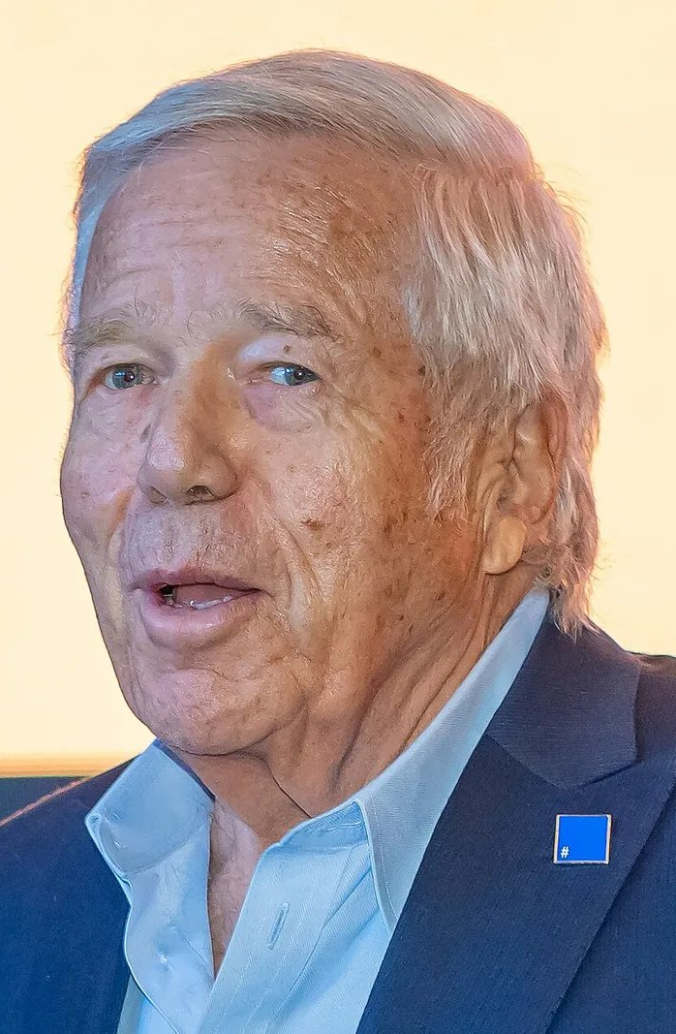
THE LETTER
“
I will willfully submit to a bi-weekly drug test throughout my rookie season.
Aaron Hernandez to Patriots executive Nick Caserio, April 16, 2010
Six days later the Patriots took him with pick 113 in round four. A team adviser later said the thinking was simple: a first round talent at a fourth round price.
Robert Kraft, Patriots owner. Photo 2023, public domain
Notes:
The letter, on the letterhead of his agency Athletes First, offered tests every two weeks, eight during the 2010 season, and promised to tie any guaranteed rookie money to passing them and repay a share for any failure. Kraft released the letter at a press conference on July 8, 2013, where he said that if the allegations were true he had been duped. Hernandez was drafted April 24, 2010, one day after the Patriots took tight end Rob Gronkowski in round two. His rookie deal carried a signing bonus of $200,000. Former Patriots adviser Floyd Reese said later the team knew he had issues but believed the contract would keep him in line or cost them nothing. Reports say Hernandez sent similar letters to many teams.

Slide 5
THE STAR YEARS
From pick 113 to $40 million
113
910
XLVI
$40M
overall pick, April 24, 2010
receiving yards in 2011, on 79 catches with 7 touchdowns
Super Bowl in February 2012. He scored the Patriots’ first touchdown
five year extension, August 27, 2012, with a $12.5 million signing bonus
Notes:
Hernandez and Rob Gronkowski formed a two tight end offense that defenses could not match. In 2011 Gronkowski set a tight end record with 17 touchdown catches while Hernandez had 79 catches for 910 yards. Hernandez also lined up as a running back in the playoffs. In Super Bowl XLVI on February 5, 2012 in Indianapolis, he caught a 12 yard touchdown in the third quarter, but the Giants won 21 to 17. His extension in August 2012 ran through 2018. After it was announced, he donated $50,000 to the Myra Kraft Giving Back Fund. He played only 10 games in 2012 because of an ankle injury. At the time of his arrest he was 23.

Slide 6
THE VICTIM
Odin Lloyd
“Odin was the man of the house. Odin was his sisters’ keeper.”
Ursula Ward, his mother, to the court, April 15, 2015
After the verdict she said she forgave everyone who had a hand in her son’s death.
November 14, 1985 to June 17, 2013
Born in St. Croix in the Virgin Islands, raised in the Dorchester neighborhood of Boston. He worked for a landscaping company in Norwood and often rode his bike there. He played linebacker for the Boston Bandits, a semi-pro team, from 2007 on.
He was dating Shaneah Jenkins, the sister of Hernandez’s fiancée. That is how the two men knew each other.
Notes:
Lloyd was 27. His family moved from St. Croix to Antigua and then to Boston. He joined the Boston Bandits of the New England Football League in 2007. Coach Olivier Bustin said he took care of his mother and two sisters. On the night of June 16, 2013 he wished his mother a happy Father’s Day, because she had raised him alone. Around 2:30 a.m. on June 17, Hernandez and two associates, Ernest Wallace and Carlos Ortiz, picked him up in Dorchester in a rented Nissan Altima and drove to an industrial park in North Attleborough. A jogger found his body that evening. Wallace was convicted of accessory to murder. Ortiz pleaded guilty to accessory charges in 2016. His mother wore purple, Odin’s favorite color, through the trial.

Slide 7
JUNE 2013 TO APRIL 2015
Ten days, then two years
June 17, 2013
June 26, 2013
July 6 to 7, 2013
Jan to Apr 2015
April 15, 2015
A body in an industrial park
Lloyd is shot in North Attleborough, about a mile from Hernandez’s home.
Arrest
Police lead Hernandez out in handcuffs. About 90 minutes later the Patriots release him.
The exchange
Fans trade in about 2,500 number 81 jerseys at the team store, free.
Trial in Fall River
More than 130 witnesses. Prosecutors never prove a motive.
Guilty
First degree murder. Life in prison without parole. He is 25.
Notes:
Investigators found surveillance video from Hernandez’s own home security system showing him holding what appeared to be a gun minutes after the killing. Police said his cell phone had been destroyed and his home video system wiped. The Patriots released him while he was still being arraigned. The jury deliberated about 36 hours over seven days. Judge Susan Garsh presided. Because first degree murder in Massachusetts carries an automatic sentence of life without parole, the sentence came the same day. Hernandez was also charged in 2014 with the July 2012 killings of Daniel de Abreu and Safiro Furtado in Boston.

Slide 8
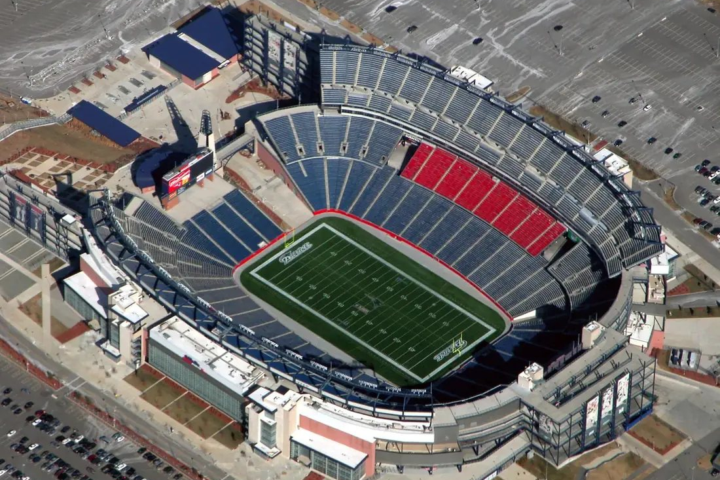
ERASING NUMBER 81
A team buys back its own jerseys
No NFL team had done it before. For two days fans could swap any Hernandez jersey from the team store for any other player’s, no charge. The line started at 7:30 a.m.
About 30 percent were kids’ sizes. The team said it wanted parents to avoid explaining to children why they could not wear number 81 anymore.
Gillette Stadium, Foxborough. Photo Art N., CC BY 2.0
2,500 jerseys
about $250,000, ground up and recycled
Notes:
The exchange ran Saturday July 6 and Sunday July 7, 2013 at the Patriots ProShop. More than 500 were exchanged by 11 a.m. Saturday and nearly 1,200 by the end of the first day, including nearly 300 youth sizes. Robert Kraft told reporters on July 8 that the final count was about 2,500 and the cost about $250,000. The most requested replacement was defensive tackle Vince Wilfork, then Tom Brady. EA Sports removed Hernandez from Madden NFL 25. The University of Florida removed his All-America brick. Outside the official exchange, Hernandez jerseys sold online for close to $300.

Slide 9
THE RECORD
Guilty, erased, guilty again
Apr 15, 2015
Apr 14, 2017
Apr 19, 2017
May 9, 2017
Mar 13, 2019
Guilty
Life without parole for the murder of Odin Lloyd. He appeals.
Not guilty
A second jury acquits him of the 2012 Boston shootings.
Death in prison
He dies by suicide in his cell at 27, the day his old team visits the White House.
Erased
A judge wipes out the conviction because his appeal was never heard.
Guilty again
The state’s highest court ends that rule and restores the verdict.
Notes:
The rule was called abatement ab initio, Latin for from the beginning. Massachusetts courts had applied it since 1975. When a defendant died before his appeal was decided, the conviction was erased as if the trial never happened. Judge Susan Garsh applied it on May 9, 2017. Prosecutors argued it rewarded a deliberate act. On March 13, 2019 the Supreme Judicial Court, in an opinion by Justice Elspeth Cypher, called the doctrine outdated and reinstated the conviction, noting in the record that the appeal was neither affirmed nor reversed. Hernandez died at Souza-Baranowski Correctional Center in Shirley, Massachusetts. If this part of the story is heavy for anyone, the 988 Suicide and Crisis Lifeline takes calls and texts at any hour.

Slide 10
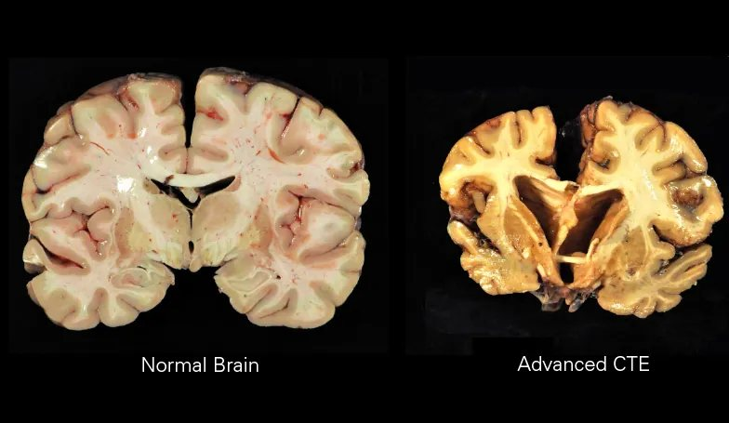
BOSTON UNIVERSITY, 2017
Stage 3 at age 27
His family donated his brain. Doctors found chronic traumatic encephalopathy, a disease linked to repeated hits to the head. It can only be confirmed after death.
They rated it Stage 3 of 4, with damage to the frontal lobe, which handles judgment and impulse control, and to the hippocampus, which handles memory.
Normal brain beside advanced CTE. Not Hernandez. Boston University CTE Center, CC BY-SA 4.0
27 vs. 46
his age, and the age of the youngest Stage 3 case the lab had seen in 468 brains
Notes:
Boston University announced the Stage 3 diagnosis on September 21, 2017. Dr. Ann McKee presented the full findings at a medical conference on November 9, 2017. She showed slides of his brain next to a typical 27 year old’s. The outside looked normal. Inside she found shrinking in the hippocampus, small old hemorrhages, holes in the membrane between the brain’s halves and heavy deposits of a protein called tau. She said Hernandez carried a gene variant that may make people more vulnerable. On the day of the diagnosis his lawyer, Jose Baez, filed a $20 million suit against the NFL and the Patriots on behalf of his daughter. It was dropped in 2018. Hernandez never raised CTE at either trial.

Slide 11
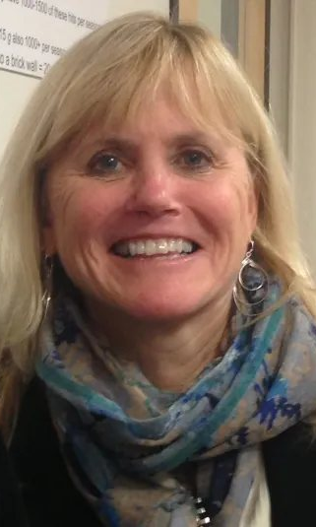
THE DOCTOR’S LIMIT
“
We’ve never seen this in our 468 brains, except in individuals some 20 years older.
Dr. Ann McKee, Boston University CTE Center, November 9, 2017
She also said she could not “connect the dots” between the disease and his crimes. A brain scan can show damage. It cannot show why a person pulled a trigger.
Dr. Ann McKee. Photo Bob Young, CC BY-SA 4.0
Notes:
Ann McKee is a neuropathologist and directs the Boston University CTE Center, which works with the VA Boston Healthcare System. Her team published a study in JAMA in July 2017 that found CTE in 110 of 111 brains of former NFL players donated to the brain bank. Because families who donate often suspect a problem, that sample is not random, and the share of all players with CTE is not known. McKee said that in her team’s collective experience, people with CTE this severe often have trouble with impulse control, decision making and rage. She added that the lab rarely receives brains from people as young as Hernandez, so it could not say whether his case was typical. The NFL’s concussion settlement with former players, first announced in 2013, was later valued at over $1 billion.

Slide 12
THE ARGUMENT
Does the brain change the story?
The case that it matters
Stage 3 damage in the parts of the brain that control judgment and impulses. A gene that raised his risk. Years of tackle football starting as a kid.
The case that it does not
Thousands of former players with brain injuries never hurt anyone. The red flags started at 17. McKee herself would not connect the dots.
What the courts decided
CTE was never raised at trial. The conviction stands. Massachusetts holds him fully responsible for killing Odin Lloyd.
What football decided
Concussion rules, a settlement for former players, and new limits on contact in youth practices. The game itself kept going.
Notes:
This is a debate slide with no single answer. Facts to bring in: CTE has been found in boxers since the 1920s, when it was called punch drunk syndrome. Pittsburgh pathologist Bennet Omalu first described it in a former NFL player, Mike Webster, in 2005. Pop Warner banned kickoffs for its youngest divisions in 2016 and limited contact in practice starting in 2012. The NFL moved kickoffs to the 35 yard line in 2011 and changed the kickoff again in 2024. Several states have debated bills to ban tackle football before age 12.

Slide 13
WORDS TO KNOW
Terms from the case
Red flag
A warning sign about a player’s character or behavior that scouts record before the draft.
Due diligence
Checking a person carefully before making a big investment. Hernandez’s letter used the phrase.
First degree murder
A killing planned in advance. In Massachusetts it carries life in prison without parole.
Abatement ab initio
A rule that erased a conviction if the defendant died before the appeal. Ended in Massachusetts in 2019.
CTE
Chronic traumatic encephalopathy. Brain disease tied to repeated head hits, confirmed only after death.
Frontal lobe
The front of the brain. It controls planning, judgment and the brakes on impulses.
Notes:
These terms come up in the ByteSize hub and the exit ticket. Due diligence appears in the first line of Hernandez’s April 2010 letter, which said NFL teams wanted to conduct thorough due diligence before a significant financial investment. The abatement rule still applies in some states. When the Supreme Judicial Court ruled in 2019, it noted that 18 states and the District of Columbia still used it.

Slide 14
EXIT TICKET
Before you leave
1
Which red flag in the 2010 file should have mattered most, and why?
NEXT UP
ByteSize: Number 81
Run the 2010 draft yourself, step through the court record and decide where you land on grant-desk.com.
2
Why did the Patriots spend $250,000 to take back 2,500 jerseys?
3
Does a Stage 3 CTE diagnosis change how you see Hernandez, or football?
Notes:
Strong answers tie each claim to a fact: the dates of the Gainesville incidents, pick 113, the 2,500 jerseys and about 30 percent youth sizes, the ages 27 and 46, and McKee’s statement that she could not connect the dots. Students who argue CTE matters should still account for the court’s judgment and for Odin Lloyd. Students who argue it does not should explain what, if anything, football owes players whose brains are damaged by the game.

