Slide 1
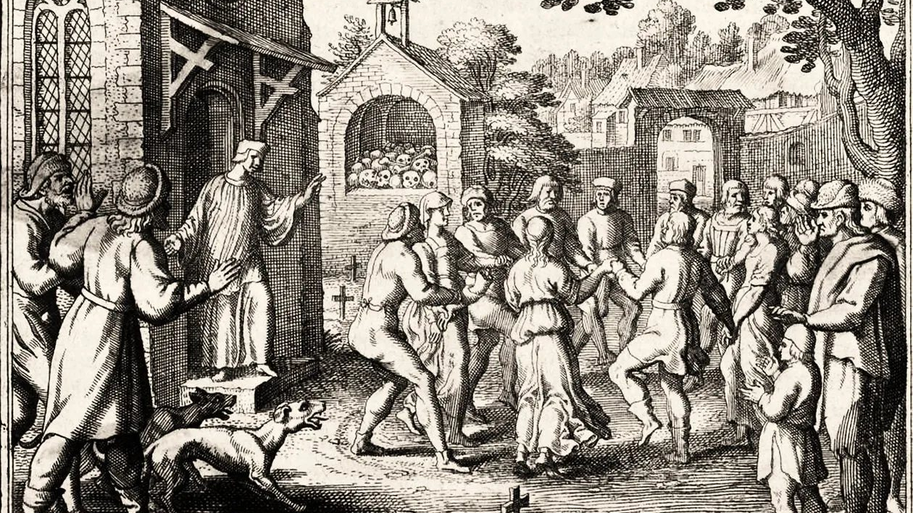
HIDDEN HISTORY · MIND GAMES · DOWN THE RABBIT HOLE
They Couldn’t Stop
A city that danced for weeks. A town that smelled gas that was never there. A school that could not stop laughing. Can fear spread from one mind to the next like a disease?
Dancers among the graves. Engraving, about 1600, artist unknown. Public domain.
Notes:
This lesson follows five outbreaks across five centuries: Strasbourg in 1518, Mattoon, Illinois in 1944, Kashasha in Tanganyika in 1962, the social media tic outbreak of 2019 to 2021, and Havana Syndrome from 2016 to today. Psychologists call the pattern mass psychogenic illness or mass sociogenic illness. The older name was mass hysteria, which most researchers now avoid because it sounds like an insult and because the word hysteria comes from the Greek word for womb. The engraving shows the kind of dancing outbreak recorded along the Rhine between 1374 and 1518. Medieval writers called it Saint Vitus’ dance or Saint John’s dance.

Slide 2
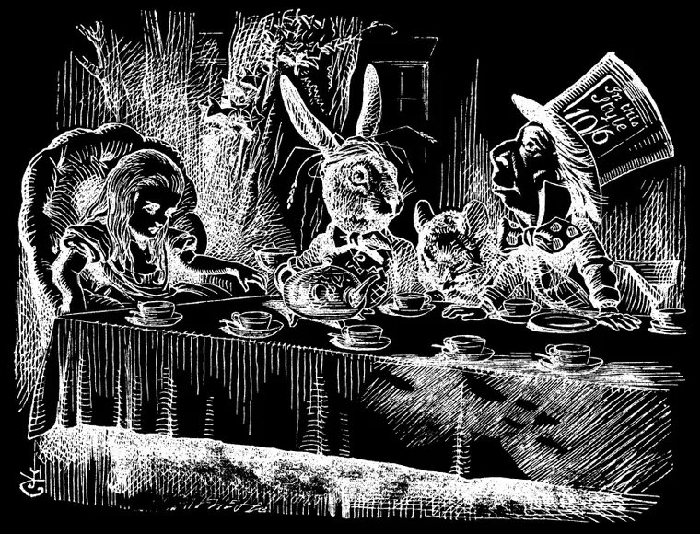
THE RULE FOR TODAY
Real symptoms, no germ
Mass psychogenic illness is a group of people who get real physical symptoms at the same time with no germ, poison or injury to explain them. It spreads by sight, sound and belief.
Nobody in this lesson was faking. Their bodies really twitched, danced, fainted and laughed. The question is what made it happen and why it jumped from one person to the next.
The Mad Tea Party, John Tenniel, 1865. Time stopped at six o’clock and they could not leave the table.
Mostly young
and mostly girls and women, in tight groups under shared stress with little power over their lives
Notes:
Robert Bartholomew and Simon Wessely reviewed hundreds of outbreaks and found common features: a closed group such as a school, factory or convent, a shared stress, a trigger such as a smell or a first case, symptoms that spread by line of sight, and a quick end once the group is separated or calmed. Outbreaks hit girls and women far more often than boys and men. Researchers argue this tracks who has the least control in a setting, not any weakness. The nocebo effect is the dark twin of the placebo effect. In studies, people warned of side effects from a sugar pill report those side effects. Tenniel drew the original illustrations for Lewis Carroll’s Alice’s Adventures in Wonderland, published in 1865.

Slide 3
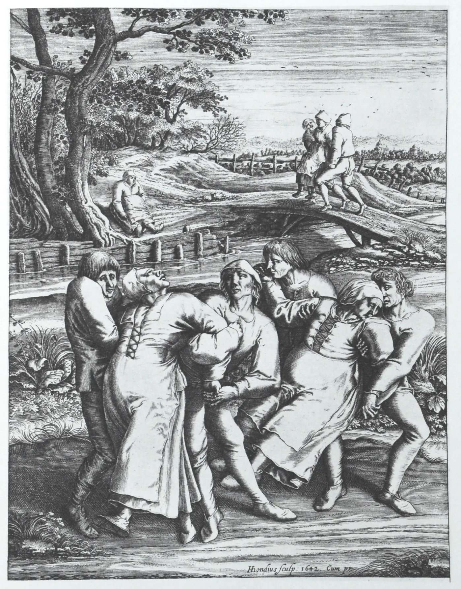
LEVEL ONE · STRASBOURG, JULY 1518
The summer the city danced
In mid July 1518 a woman began dancing in a narrow street in Strasbourg, with no music and no festival. Chroniclers later named her Frau Troffea. She kept going for days, and her neighbors joined.
The city was starving. Years of bad harvests had pushed up bread prices, and smallpox and syphilis were spreading. Many people believed Saint Vitus could curse sinners with a dance they could not stop.
50 to 400
dancers, the range historians give today. Later chronicles claimed 400.
Hendrik Hondius, 1642, after Pieter Bruegel, 1564
Notes:
Strasbourg was a free imperial city of the Holy Roman Empire, now in France. The main modern study is John Waller’s A Time to Dance, a Time to Die, 2008. The dancing started around July 14, 1518. The Imlin family chronicle says 400 were dancing within a month. Later chronicles claimed as many as 15 deaths a day, but the earliest records, including city council notes, do not record deaths. For the 500th anniversary in 2018, Strasbourg museum historian Georges Bischoff argued that Frau Troffea may be a literary invention: the name comes from the physician Paracelsus and first appears in print in 1565. Earlier dancing outbreaks hit Aachen and towns along the Rhine in 1374.

Slide 4
THE CURE THAT MADE IT WORSE
The city prescribed more dancing
July 14
Late July
The cure
August
September
One dancer
A woman dances alone for four to six days, then is sent by wagon to a Saint Vitus shrine at Saverne.
Dozens
Later accounts say 34 joined within a week. The council asks the city doctors what to do.
A stage and a band
Doctors blame hot blood. The city clears the grain market, builds a stage and pays musicians.
Reverse course
Crowds grow. The council bans public dancing and music and tears the stage down.
Red shoes
The worst cases go to the shrine. Priests give them crosses and red shoes. It fades.
Notes:
The physicians of the time followed the theory of the four humors, so too much hot blood called for sweating it out. The council opened guild halls and hired pipers and drummers. A chronicle by Daniel Specklin records the council’s later decision to send dancers to the shrine of Saint Vitus in a grotto near Saverne, about 30 miles away. There the dancers were given small crosses and red shoes marked with holy oil and led around the altar. The point to notice is that making the dancing public and official made it spread, and treating it as forgiven and finished helped end it.

Slide 5
THREE THEORIES
What made them dance?
Poisoned bread
Ergot is a mold on damp rye that can cause spasms and hallucinations. But ergot also cuts off blood to the arms and legs. Its victims could barely walk, let alone dance for days.
A saint’s curse
People in the Rhine region believed Saint Vitus punished sinners with a dance. That belief is real evidence, but of what people expected, not of a supernatural cause.
Mass psychogenic illness
Hunger, disease and fear of the curse gave stressed people a script. Seeing others dance spread it. Being forgiven at the shrine ended it. This fits every clue.
Notes:
Waller argues the dancers were in a trance state that their culture had taught them to expect. Ergot poisoning, called Saint Anthony’s fire, caused gangrene and convulsions, and it does not explain coordinated movement lasting days or spread by watching. Every recorded European dancing outbreak between 1374 and 1518 happened along the Rhine and Moselle, where the Saint Vitus belief was strongest. Paracelsus visited Strasbourg in 1526, eight years later, and wrote about the outbreak, blaming imagination and the will. His account is where the name Frau Troffea comes from.

Slide 6
LEVEL TWO · MATTOON, ILLINOIS, SEPTEMBER 1944
The headlines made the gasser
Sept. 3
Sept. 7
Sept. 9
Sept. 10
Sept. 13
“Anesthetic Prowler” on Loose
Aline Kearney is called the first victim. The word first tells readers to expect more.
“Mad Anesthetist” Strikes Again!
State police arrive. Chicago papers pick up the story.
“Mad Gasser” Adds Six Victims!
Armed men patrol the streets. The police chief warns about stray gunfire.
Many Prowler Reports; Few Real
The paper doubts its own story for the first time.
“Gas Calls” at Vanishing Point
Nearly thirty reports in about twelve days, then almost none. No gas, no gasser.
Notes:
Mattoon was a railroad town of about 15,000 in central Illinois. On the night of September 1, 1944, Aline Kearney smelled a sweet odor, felt her legs go numb and her throat burn. Her husband Bert later saw a tall figure at the window. The Mattoon Daily Journal-Gazette, read by nearly every family in town, ran the story on September 2 and 3. Reports followed nearly every night. On September 12 Police Chief C. E. Cole said every case had been checked and there was no evidence of gas. Psychologist Donald Johnson studied the town for his 1945 paper The Phantom Anesthetist of Mattoon, now a textbook case. A few writers still argue there was a real prowler.

Slide 7
LEVEL THREE · KASHASHA, TANGANYIKA, 1962
The school that could not stop laughing
3
95 of 159
14
≈1,000
girls at a mission boarding school start laughing on January 30, 1962
students affected within weeks. Attacks last hours or days, with crying and fainting
schools closed after girls sent home carried it to their villages
people affected over about 18 months near Lake Victoria
Notes:
Tanganyika became independent from Britain on December 9, 1961, seven weeks before the outbreak. The school at Kashasha was run by missionaries near Bukoba on Lake Victoria. Teachers were never affected. The school closed on March 18, 1962. Within ten days the laughing appeared in Nshamba, a village where several of the girls lived, and 217 people there had attacks in April and May. It reached the Ramashenye girls’ school in June. Doctors A. M. Rankin and P. J. Philip found no fever, no poison and normal blood tests and published their report in 1963. Linguist Christian Hempelmann argues the stress of new expectations at school and home, with no other outlet, is the best explanation.

Slide 8
LEVEL FOUR · 2019 TO 2021
The first outbreak spread by screen
In 2019 a German YouTuber launched a channel about his Tourette syndrome. It passed two million subscribers. During the pandemic, doctors in Germany, Britain, Canada and the US saw teenagers arrive with sudden tics that matched the influencers they watched, down to the same odd phrases.
In August 2021 Dr. Kirsten Müller-Vahl’s team in Hannover named it mass social media induced illness.
1962: person to person
2021: one screen to all
Each case has to see the last one.
One channel reaches millions at once.
Notes:
The channel was Gewitter im Kopf, Thunderstorm in the Head, launched in February 2019 by Jan Zimmermann with his friend Tim Lehmann. Zimmermann has Tourette syndrome. Müller-Vahl’s team published Stop that! It’s not Tourette’s but a new type of mass sociogenic illness in the journal Brain in August 2021. In a 2021 study of 32 patients in Hannover, patients ranged from 11 to 53 years old. Similar clusters were linked to TikTok creators in English speaking countries. Researchers stress that the patients were not pretending and that most had anxiety or depression beforehand. Many improved after a clear diagnosis and time away from the videos. Tourette patient groups pushed back on social media portrayals that did not match real Tourette syndrome.

Slide 9
NOT FAKING
Real does not mean physical
Faking
A person chooses to act sick and can stop whenever they want. The symptoms disappear when nobody is watching.
Functional disorder
The brain’s structure is healthy but its signals go wrong. The person cannot simply stop. Brain scans can even show the different pattern.
The hardware and the software
Doctors compare it to a computer with nothing broken inside that is running the wrong program. The cause is in the software.
What helps
A clear explanation, calm adults, time apart from the trigger and treatment for stress. Shame and suspicion make it worse.
Notes:
Functional neurological disorder is one of the most common reasons people see a neurologist. Its older name was conversion disorder. Studies using brain imaging show people with functional movements have different activity in regions that link emotion and movement, which is part of why doctors no longer treat it as imaginary. The tic outbreak taught doctors that social media can spread functional symptoms across countries in weeks instead of across a school in days. The same rules from 1962 still applied: separation from the trigger and a calm, clear diagnosis helped the most.

Slide 10
LEVEL FIVE · HAVANA, 2016 TO TODAY
The case that is still open
Late 2016
Jan 2019
March 2024
Jan 2025
June 12, 2026
A sound in Havana
US diplomats report piercing sounds, then dizziness and trouble thinking.
Crickets
Biologists match the AP recording to the Indies short tailed cricket.
Brain scans
NIH studies of about 80 patients find no difference from healthy volunteers.
A split
Five agencies call a weapon very unlikely. Two rate it roughly even.
Reopened
The intelligence director rescinds both reports. A new review begins.
Notes:
The State Department pulled most staff from Havana in September 2017. Hundreds of US personnel later reported incidents in more than a dozen countries, and in 2021 Congress passed the HAVANA Act to pay victims. A 2018 JAMA study by University of Pennsylvania doctors described concussion like symptoms in 21 embassy workers with no head impact. The March 2024 NIH studies in JAMA found no significant brain injury on MRI, though patients still reported real symptoms. The National Intelligence Council judged a foreign weapon very unlikely in March 2023 and repeated that in January 2025, with two agencies dissenting. On June 12, 2026 Director of National Intelligence Tulsi Gabbard rescinded both assessments, citing analysts leaving out evidence and relying on an ethically flawed study. As of November 2026 no new cause has been announced.

Slide 11
THE EVIDENCE BOTH WAYS
Weapon, or the same old mind?
Points toward a weapon
Some patients had lasting, measurable problems. Cases cluster around spies and diplomats in rival countries. Two agencies saw a roughly even chance in 2025.
Points toward the mind
The recording was crickets. The 2024 scans found no brain damage. Symptoms spread as the story spread, like Mattoon’s gasser.
What is still hidden
Much of the intelligence is classified. The 2026 order said earlier analysts left evidence out.
The trap on both sides
Confirmation bias. Believe in a weapon and every headache is proof. Believe in hysteria and every patient is imagining it.
Notes:
This is the one case in the lesson with no settled answer, which makes it a good test of the skills from the earlier levels. Strong reasoning separates what is known from what is claimed. Known: the AP recording matches a cricket, the 2024 NIH scans did not find structural injury, many patients report real and lasting symptoms, and official judgments have changed three times. Claimed but not shown in public: a specific weapon or a specific attacker. Mass psychogenic illness and a real attack are not the only choices. Some researchers suggest a few real incidents may have triggered many psychogenic ones.

Slide 12
NAME THE TRAP
The thinking traps under every level
Nocebo effect
1518. Expecting harm causes harm. Fear of Saint Vitus told bodies what to do.
Availability
1944. What is on every front page feels more likely. Every smell became the gasser.
Bandwagon effect
1962. We copy the people around us. In a boarding school, that is everyone.
Social proof
2021. Unsure what is happening to us, we copy what we see others do online.
Confirmation bias
Today. We read new evidence as proof of what we already believe.
The fix
Slow down, separate the claim from the evidence, and ask what would change your mind.
Notes:
These connect to the cognitive bias unit from economics. The availability heuristic was described by Amos Tversky and Daniel Kahneman in 1973. The bandwagon effect and social proof are close cousins: the first is about joining what is popular, the second about using others’ behavior as evidence when we are unsure. Confirmation bias was demonstrated in Peter Wason’s experiments in the 1960s. The nocebo effect was named in 1961 by Walter Kennedy. None of these make a person stupid. They are shortcuts every brain uses, and outbreaks happen when many brains take the same shortcut at once.

Slide 13
EXIT TICKET
Climb out
1
In Strasbourg and Mattoon, how did the people in charge make it worse?
NEXT UP
StoryHub: They Couldn’t Stop
Run the 1518 cure, read the Mattoon front pages, start the Tanganyika outbreak yourself and open the Havana files on grant-desk.com.
2
Explain why mass psychogenic illness is not faking, using one case.
3
What one piece of evidence would change your mind about Havana Syndrome?
Notes:
Strong answers for the first question name the stage and musicians of 1518 and the Journal-Gazette headlines of 1944, then what calmed each one: the shrine and the ban on public dancing, and the police chief’s statement with the paper’s change of tone. For the second, students should use the idea that the symptoms are real and involuntary even without a germ or injury. For the third, any answer works if it names evidence that could actually be checked, such as a declassified intelligence finding or new medical data.

