Slide 1
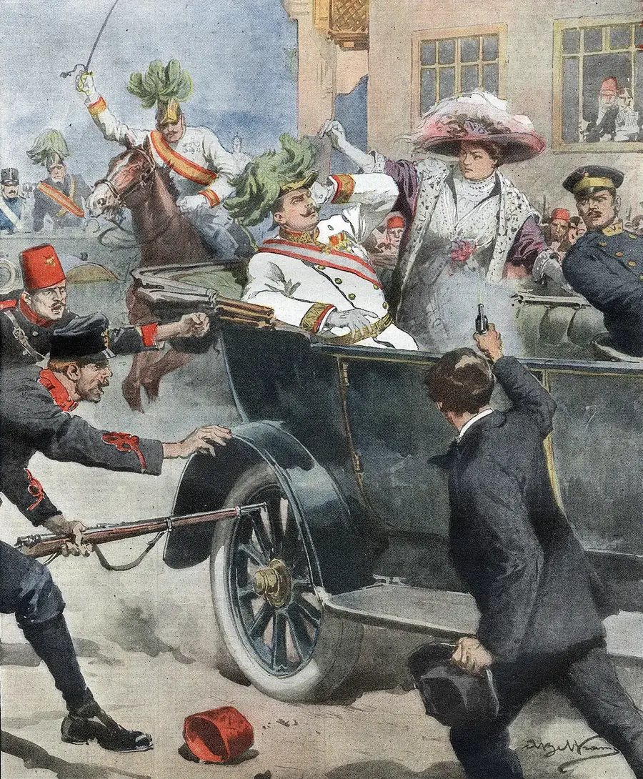
US HISTORY · WORLD WAR I · 1914 TO 1917
Why They Fought
One assassination in Sarajevo pulled nine countries into war. Each one went in afraid of losing something and hoping to win something else.
Achille Beltrame, La Domenica del Corriere, July 12, 1914. Public domain.
Notes:
The illustration ran on the cover of the Italian weekly La Domenica del Corriere on July 12, 1914, two weeks after the killing. Nobody photographed the shooting itself. The famous photo of a young man being dragged away by police shows a bystander named Ferdinand Behr, not Gavrilo Princip. Between June 28 and November 1914, Serbia, Austria-Hungary, Germany, Russia, France, Britain, Belgium, Japan and the Ottoman Empire all entered the war. Italy followed in May 1915 and the United States in April 1917. About 65 million men were mobilized and roughly 9 to 10 million soldiers died by November 11, 1918.

Slide 2
EUROPE IN 1914
Two armed camps, one continent
For thirty years the great powers signed treaties promising to protect each other. By 1914 the treaties had split Europe in two. Most of these promises were defensive. They said what a country would do if an ally were attacked, which left plenty of room to argue about who attacked first.
The Allies, or Entente
The Central Powers
France allied with Russia since 1894
Germany allied with Austria-Hungary since 1879
Russia protector of Serbia and the Slavs
Austria-Hungary needed Germany behind it
Britain Entente with France 1904, Russia 1907
Italy signed the Triple Alliance in 1882, stayed out
Serbia no treaty, counted on Russia
Ottoman Empire secret deal with Germany, August 2, 1914
Notes:
The Dual Alliance between Germany and Austria-Hungary dates to 1879. Italy joined in 1882 to make the Triple Alliance, renewed several times up to 1912. France and Russia signed a military convention in 1892 that took effect as an alliance in 1894. Britain settled colonial quarrels with France in the Entente Cordiale of April 1904 and with Russia in the Anglo-Russian Convention of August 1907. Neither entente required Britain to go to war. Serbia had no treaty with Russia at all. Italy declared neutrality on August 2, 1914, arguing that Austria had started the war and the alliance only covered defense. The Ottoman Empire signed a secret alliance with Germany the same day, August 2, 1914.

Slide 3
SARAJEVO · JUNE 28, 1914
A wrong turn and two shots
Archduke Franz Ferdinand, heir to the throne of Austria-Hungary, came to Sarajevo in Bosnia with his wife Sophie. Austria had taken Bosnia in 1908, and many Bosnian Serbs wanted it joined to Serbia instead.
A bomb missed the couple that morning. Later their driver took a wrong turn and stopped to reverse a few feet from Gavrilo Princip, a 19 year old Bosnian Serb. Princip fired twice. Both died within the hour.
37 days
from the shots in Sarajevo to Britain declaring war on August 4, 1914
Italian magazine cover, July 1914
Notes:
Franz Ferdinand was 50. Sophie Chotek was 46, and the couple had three children. Seven young conspirators lined the route, armed by the Black Hand, a secret Serbian nationalist society led by Colonel Dragutin Dimitrijević, known as Apis, head of Serbian military intelligence. Nedeljko Čabrinović threw a bomb around 10:10 a.m. It bounced off the car and wounded people in the car behind. After a reception at the town hall, the driver, Leopold Lojka, turned onto Franz Joseph Street by mistake. Princip shot Sophie in the abdomen and Franz Ferdinand in the neck. Princip was under 20, too young for the death penalty, and got 20 years. He died of tuberculosis in prison in April 1918.

Slide 4
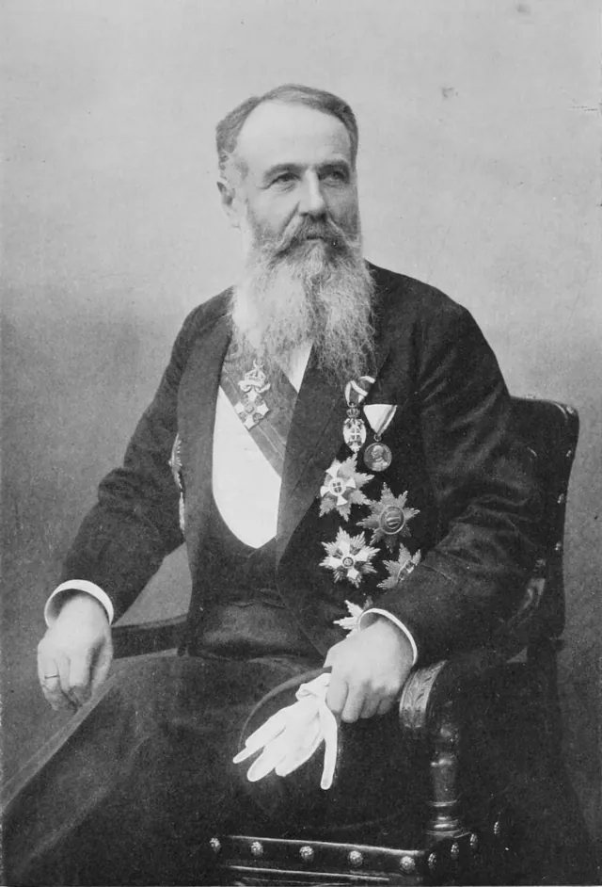
THE SMALL KINGDOM
Serbia
Decided by Prime Minister Nikola Pašić
FEARED
WANTED
Austria-Hungary had already grabbed Bosnia in 1908. Serbs feared their kingdom would be the next thing the empire swallowed.
One country for all South Slavs. Millions of Serbs, Croats and Bosnians lived under Austrian rule, and Serbian nationalists wanted them free.
ALLIES
Serbia agreed to most of Austria’s ten demands. It refused to let Austrian officials run an investigation on Serbian soil.
Serbian reply to the ultimatum, July 25, 1914
At war July 28, 1914, when Austria-Hungary declared war on it
Notes:
Serbia won large territories in the First Balkan War of 1912 to 1913 and the Second Balkan War of 1913, nearly doubling its land area. Prime Minister Nikola Pašić had probably heard rumors of a plot but did not stop it, and the Serbian government did not order the killing. The Austro-Hungarian ultimatum arrived on July 23 with a 48 hour deadline. Serbia’s answer, delivered minutes before 6 p.m. on July 25, accepted most points, softened others and rejected point six, which would have let Austro-Hungarian officials take part in the investigation inside Serbia. Serbia had already ordered mobilization of its own army three hours before replying. Serbia lost a larger share of its population in the war than any other country, with estimates running from 15 to 25 percent when civilians and disease are counted.

Slide 5
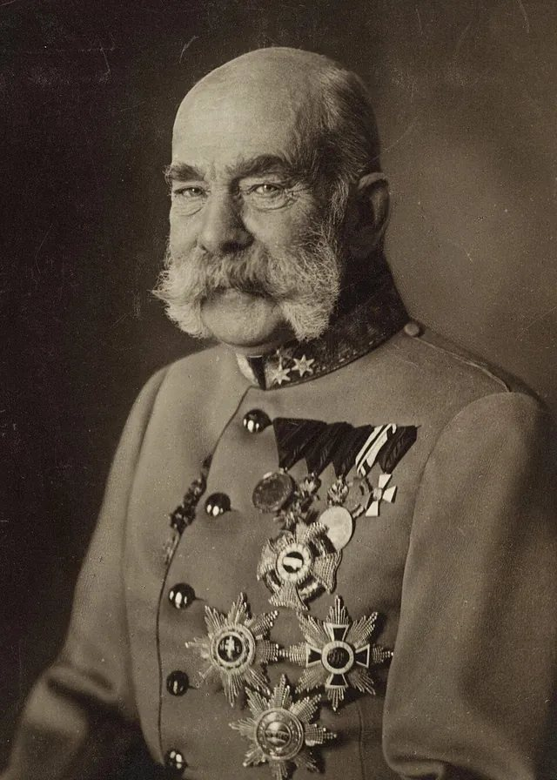
THE OLD EMPIRE
Austria-Hungary
Decided by Emperor Franz Joseph, 83, and Foreign Minister Leopold Berchtold
FEARED
WANTED
Eleven major nationalities lived under one emperor. If the Serbs broke away, Czechs, Poles and others could follow and the empire would crack apart.
Crush Serbia hard enough to end Serbian nationalism and prove the empire was still a great power, with Germany standing behind it.
CENTRAL POWERS
Germany promised Vienna its full support on July 5 and 6, 1914. Historians call that promise the blank check.
Report of the Austro-Hungarian ambassador in Berlin, July 1914
Declared war on Serbia July 28, 1914
Notes:
Franz Joseph took the throne in 1848 and ruled for 68 years. His brother Maximilian was executed in Mexico in 1867, his son Rudolf died by suicide in 1889 and his wife Elisabeth was murdered in 1898, so Franz Ferdinand, his nephew, became heir. The empire held Germans, Hungarians, Czechs, Slovaks, Poles, Ukrainians, Romanians, Croats, Serbs, Slovenes and Italians. Chief of Staff Franz Conrad von Hötzendorf had pushed for a war against Serbia for years. On July 5, Count Hoyos carried a letter to Berlin, and Ambassador Szögyény reported that Kaiser Wilhelm promised Germany’s full support. The ultimatum of July 23 was drafted to be refused. Vienna broke relations on July 25 and declared war by telegram on July 28.

Slide 6
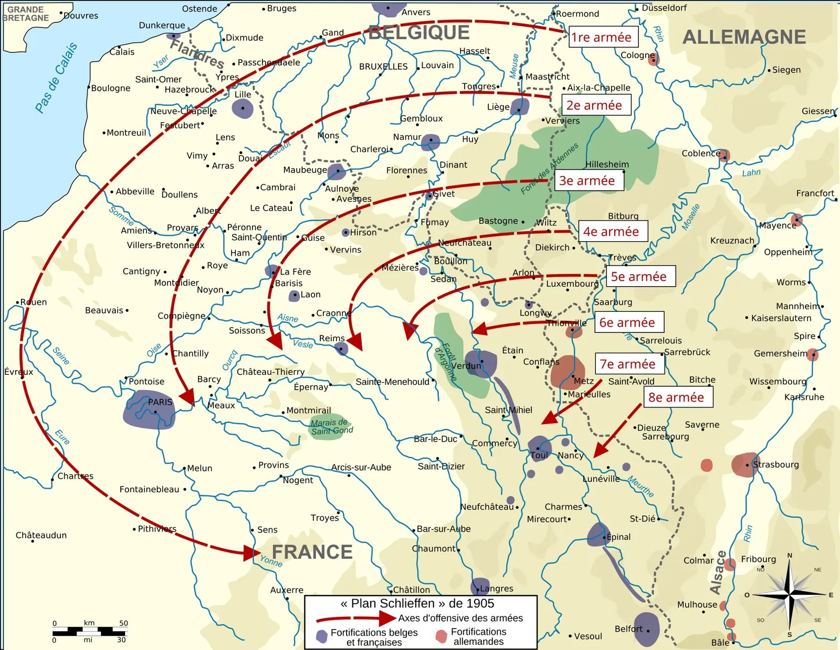
GERMANY
Afraid of two fronts at once
Germany sat between France and Russia, both allied against it. Its generals feared that by about 1917 Russia’s army and new railroads would be too strong to beat.
Their answer was the Schlieffen Plan. Knock France out in about six weeks by marching through neutral Belgium, then rush east to fight Russia. Once Russia mobilized, Germany felt every hour counted.
“A place in the sun”
Bernhard von Bülow, 1897, on the empire and navy Germany wanted
The 1905 Schlieffen Plan. German armies swing through Belgium and around Paris.
Notes:
Germany was unified in 1871 after defeating France. By 1913 it produced 17.6 million tons of steel, more than Britain and France combined. Kaiser Wilhelm II came to the throne in 1888 and dropped Bismarck in 1890. In December 1897 Foreign Secretary Bernhard von Bülow told the Reichstag that Germany wanted its own place in the sun. Count Alfred von Schlieffen, chief of the general staff until 1906, wrote the plan in 1905. His successor Helmuth von Moltke the Younger changed it but kept the route through Belgium. At a war council on December 8, 1912, Moltke said a war was unavoidable and the sooner the better. Germany declared war on Russia on August 1, on France on August 3, and invaded Belgium on August 4, 1914.

Slide 7
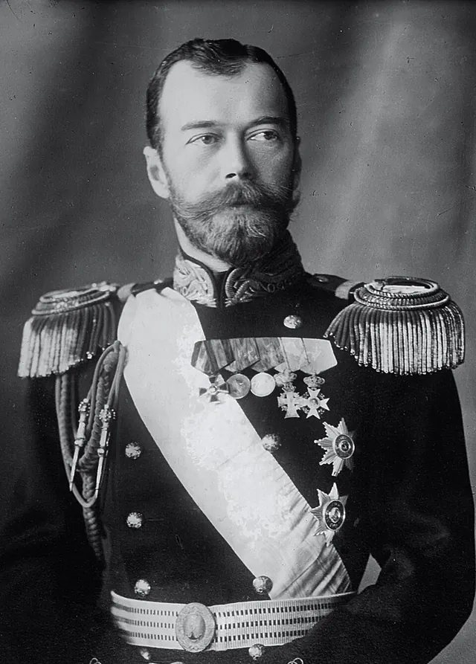
THE GIANT
Russia
Decided by Tsar Nicholas II and Foreign Minister Sergei Sazonov
FEARED
WANTED
A third humiliation. Japan beat Russia in 1905 and Russia backed down over Bosnia in 1908. Backing down again could cost the tsar his power at home.
Protect Serbia and the Slavs of the Balkans, and keep the sea route from the Black Sea open through the straits at Constantinople.
ALLIES
“I beg you in the name of our old friendship to do what you can to stop your allies from going too far.”
Nicholas II to his cousin Wilhelm II, telegram, July 29, 1914
Germany declared war on Russia August 1, 1914, after Russia mobilized
Notes:
Nicholas II and Wilhelm II were cousins through Queen Victoria and wrote each other in English, signing as Nicky and Willy. Russia lost the Russo-Japanese War in 1905, which set off the Revolution of 1905. In the Bosnian crisis of 1908 to 1909 Germany forced Russia to accept Austria’s annexation of Bosnia. Russia’s Council of Ministers agreed on July 24, 1914 to back Serbia. Nicholas approved general mobilization on July 30 after Sazonov argued that partial mobilization against Austria alone would wreck the railway timetables. About 12 million Russians served during the war. Defeat and hunger led to the revolutions of March and November 1917, and Nicholas and his family were shot in July 1918.

Slide 8
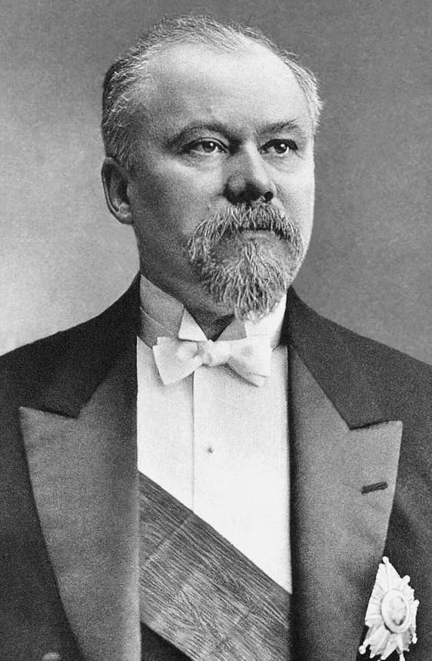
FRANCE
“
France will be heroically defended by all her sons, joined in a sacred union that nothing will break.
Raymond Poincaré, message to parliament, August 4, 1914
France had about 39 million people. Germany had about 65 million. Alone, France could not win, so it bound itself to Russia. It also wanted back Alsace and Lorraine, the two provinces Germany took in 1871.
President Raymond Poincaré
Notes:
Prussia and the German states defeated France in the Franco-Prussian War of 1870 to 1871. The peace treaty handed Alsace and most of Lorraine to the new German Empire and charged France five billion francs. On the Place de la Concorde in Paris, the statue representing the city of Strasbourg was draped in black and covered with wreaths until 1918. Raymond Poincaré, born in Lorraine in 1860, became president in 1913. He visited St. Petersburg from July 20 to 23, 1914 and assured Russia of French support. French war Plan XVII aimed at a direct attack into Lorraine. In the Battle of the Frontiers in August 1914 the French army lost about 27,000 men killed on August 22 alone. The phrase union sacrée meant every party, including socialists, would back the war.

Slide 9
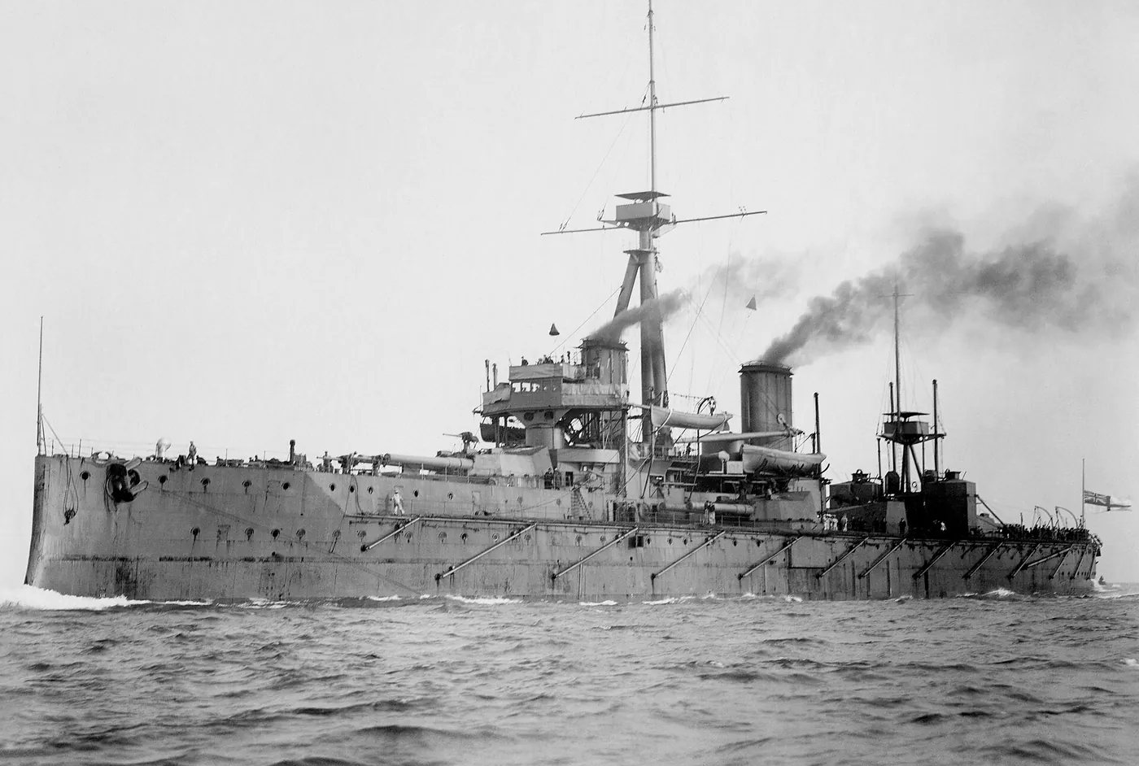
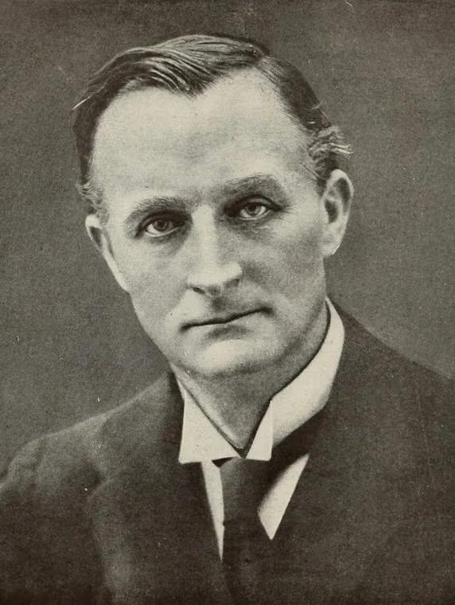
BRITAIN
Scrap of paper, ruler of the waves
No alliance forced Britain to fight. What Britain feared was one power ruling the coast across the English Channel with a navy big enough to threaten its own.
In 1839 Britain had signed a treaty protecting Belgium. When German troops crossed into Belgium on August 4, Britain declared war that night. Germany’s chancellor scoffed that Britain was going to war over a scrap of paper.
HMS Dreadnought, 1906. It made every older battleship obsolete.
29 to 17
Sir Edward Grey
Foreign secretary. “The lamps are going out all over Europe.”
big modern battleships and battlecruisers, Britain to Germany, by 1914
Notes:
Britain launched HMS Dreadnought in February 1906 with ten 12 inch guns and turbine engines. Every navy then raced to build ships like it, and Germany’s Admiral Alfred von Tirpitz had been building a fleet since the Navy Laws of 1898 and 1900. The British public chanted We want eight and we won’t wait in 1909. The British Empire covered about a quarter of the world’s land and population. Foreign Secretary Sir Edward Grey told Parliament on August 3 that Britain could not stand aside if Belgium were invaded. That evening, by his own later account, he said the lamps were going out all over Europe. The British ultimatum expired at 11 p.m. London time on August 4. Chancellor Bethmann Hollweg’s scrap of paper remark was reported by British ambassador Sir Edward Goschen.

Slide 10
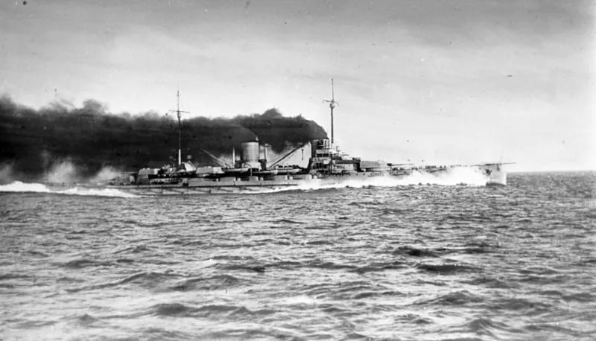
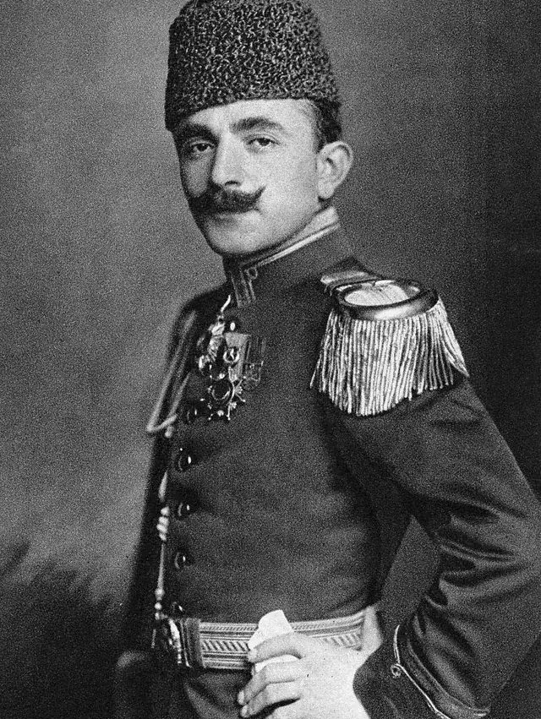
THE OTTOMAN EMPIRE
Two stolen battleships
The Ottoman Empire had lost nearly all its land in Europe in the Balkan Wars, and Russia wanted Constantinople. War Minister Enver Pasha looked for a strong protector.
In August 1914 Britain seized two battleships the Ottomans had already paid for, partly with money donated by ordinary people. Germany sent its warships Goeben and Breslau instead. On October 29 they shelled Russian ports.
The German battlecruiser Goeben. Bundesarchiv, CC BY-SA 3.0 DE
Enver Pasha
War minister at 32. He signed the secret deal with Germany.
August 2, 1914
the Ottoman Empire signs a secret alliance with Germany
Notes:
The two battleships were Reşadiye and Sultan Osman I, built in British yards. Ottoman citizens had contributed to a public fund, with donation boxes in towns and schools. First Lord of the Admiralty Winston Churchill ordered them taken over on August 1 and 2, 1914, and they became HMS Erin and HMS Agincourt. The Goeben and Breslau escaped British ships across the Mediterranean and reached the Dardanelles on August 10. They were transferred to the Ottoman navy with their German crews still aboard, wearing fezzes. Under Admiral Wilhelm Souchon they bombarded Odessa and Sevastopol on October 29. Russia declared war on November 2, Britain and France on November 5. The Ottoman war led to Gallipoli in 1915 and the Armenian Genocide, which began in April 1915.

Slide 11
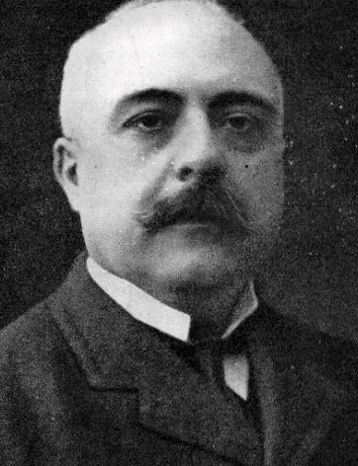
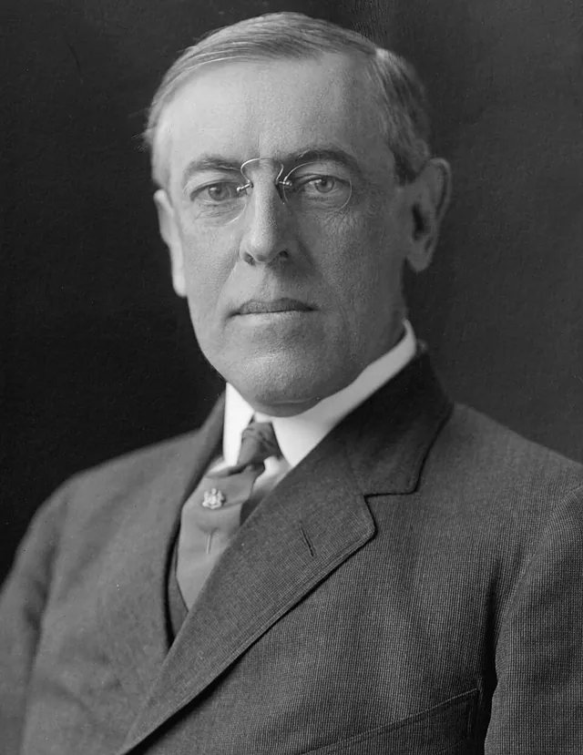
THE LATECOMERS
One ally switched sides. One country waited three years
Italy
Joined the Allies May 23, 1915
United States
Declared war April 6, 1917
Italy belonged to the Triple Alliance but stayed out in 1914. It wanted Trento and Trieste, Italian speaking lands ruled by Austria. Britain and France promised them in the secret Treaty of London.
Submarines sank the Lusitania in 1915, killing 128 Americans. In 1917 Germany resumed sinking ships without warning and offered Mexico Texas, New Mexico and Arizona in the Zimmermann Telegram.
“Sacred selfishness.” Prime Minister Antonio Salandra, October 1914
“The world must be made safe for democracy.” Woodrow Wilson, April 2, 1917
Notes:
Italy signed the Treaty of London on April 26, 1915. It promised Trentino, South Tyrol, Trieste, Istria and much of the Dalmatian coast. Salandra used the phrase sacro egoismo in October 1914. Italy declared war on Austria-Hungary on May 23, 1915 and on Germany only in August 1916. The Lusitania was sunk by U-20 off Ireland on May 7, 1915. 1,198 people died, 128 of them American. Germany announced unrestricted submarine warfare on February 1, 1917. British codebreakers in Room 40 decoded the Zimmermann Telegram, and American papers printed it on March 1, 1917. Wilson spoke to Congress on April 2. The Senate voted 82 to 6 on April 4 and the House 373 to 50 on April 6. About 4.3 million Americans were mobilized and 116,516 died.

Slide 12
SIZE THEM UP
Who could put the most men in uniform?
Russia’s huge army is why Germany feared waiting. Serbia’s small number hides a big share. About one Serb in six put on a uniform.
65 million
soldiers mobilized by all countries, 1914 to 1918
Source: Encyclopaedia Britannica, World War I casualty table. British Empire includes colonies and dominions.
Notes:
These are totals for the whole war, not the armies of August 1914. In 1914 Russia could field about 1.4 million men in peacetime and over 5 million after mobilization. Germany mobilized about 3.8 million in the first weeks. Military deaths by country: Germany about 1,773,700, Russia about 1,700,000, France about 1,357,800, Austria-Hungary about 1,200,000, the British Empire about 908,371, Italy about 650,000, the Ottoman Empire about 325,000, the United States 116,516, Serbia about 45,000 soldiers. Serbia’s civilian losses from typhus, famine and occupation were far larger. France lost about one in four men aged 18 to 30.

Slide 13
THE DOMINOES
Every domino was a decision
July 5 to 6
July 23
July 28
July 30
Aug 1 to 3
August 4
The blank check
Germany promises Austria-Hungary full support against Serbia.
The ultimatum
Ten demands with a 48 hour deadline. Serbia accepts most, refuses one.
War on Serbia
Austria-Hungary declares war. Belgrade is shelled the next night.
Russia mobilizes
The tsar calls up his whole army to back Serbia.
Germany strikes
War on Russia August 1, then on France August 3.
Belgium, then Britain
German troops enter Belgium. Britain declares war at 11 p.m.
Notes:
Kaiser Wilhelm and Chancellor Bethmann Hollweg gave the blank check at Potsdam on July 5 and confirmed it July 6, then Wilhelm left on his summer cruise. Vienna waited until July 23, partly so the ultimatum would not land while French President Poincaré was in Russia. Wilhelm read Serbia’s reply on the morning of July 28 and wrote that every reason for war was gone, the same day Austria declared war. Russia announced partial mobilization on July 29 and general mobilization on July 30. Germany demanded Russia stop within 12 hours on July 31. France mobilized on August 1. Germany occupied Luxembourg on August 2 and demanded passage through Belgium the same evening. Belgium refused on August 3. Japan joined the Allies on August 23, 1914.

Slide 14
WORDS YOU JUST USED
The vocabulary of 1914
Nationalism
Pride in your nation and the belief that your people should rule themselves. It pushed Serbia forward and threatened Austria-Hungary.
Alliance
A promise between countries to help each other in war. France and Russia, 1894. Germany and Austria-Hungary, 1879.
Militarism
Building up armies and navies and letting generals shape policy. The dreadnought race and the Schlieffen Plan.
Imperialism
Building an empire by taking control of other lands. Germany wanted a place in the sun. Britain held a quarter of the world.
Ultimatum
A final set of demands with a deadline and a threat. Austria gave Serbia 48 hours.
Mobilization
Calling up soldiers and moving them into position for war. Russia mobilized on July 30, and Germany treated it as war.
Notes:
Historians often group the long term causes as MAIN: militarism, alliances, imperialism and nationalism. The trigger was the assassination. Recent historians such as Christopher Clark, in The Sleepwalkers, stress that leaders made choices at each step and that no single country carries all the blame. The Treaty of Versailles in 1919 placed responsibility on Germany and its allies in Article 231, the war guilt clause. Fritz Fischer, a German historian, argued in 1961 that Germany’s leaders sought a war of conquest. That debate is still open.

Slide 15
EXIT TICKET
Before you leave
1
Pick one country. What did it fear and what did it want in 1914?
NEXT UP
ByteSize: Why They Fought
Open the files for all nine countries, predict the next domino, and size up the powers on grant-desk.com.
2
Why did Russia mobilizing push Germany to attack France?
3
No alliance forced Britain to fight. Why did it go to war on August 4?
Notes:
Strong answers name a country, a fear and a want, and give a date. For the second question, the Schlieffen Plan required Germany to defeat France before Russia finished mobilizing, so Russian mobilization started the clock. For the third, the 1839 Treaty of London guaranteed Belgian neutrality, and Britain feared a single power controlling the Channel coast and outbuilding its navy. The ByteSize hub covers all nine countries, a seven step prediction game from June 28 to the Ottoman entry in November 1914, and four data boards: population, steel, soldiers mobilized and soldiers killed.

