Slide 1



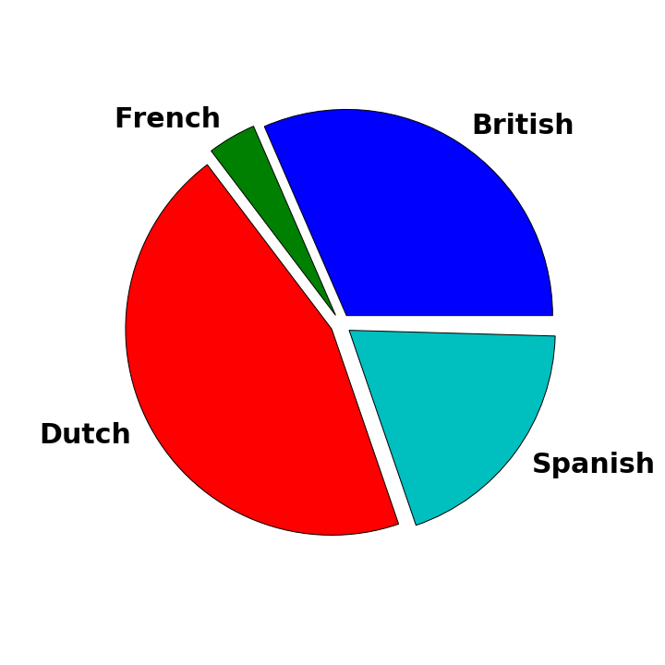
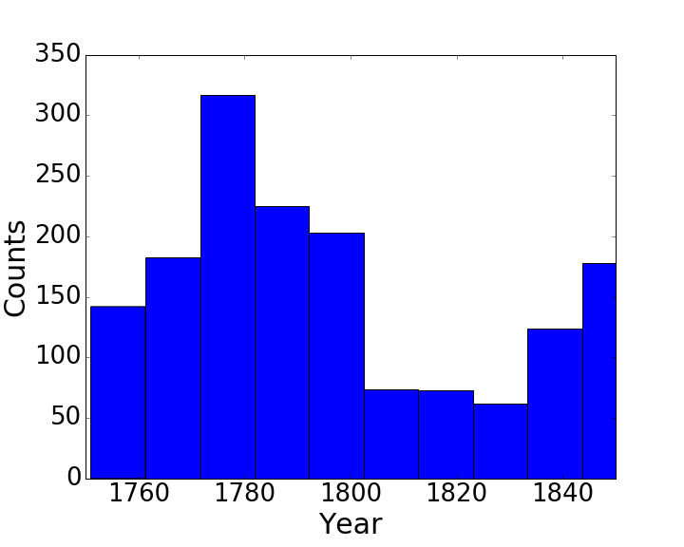
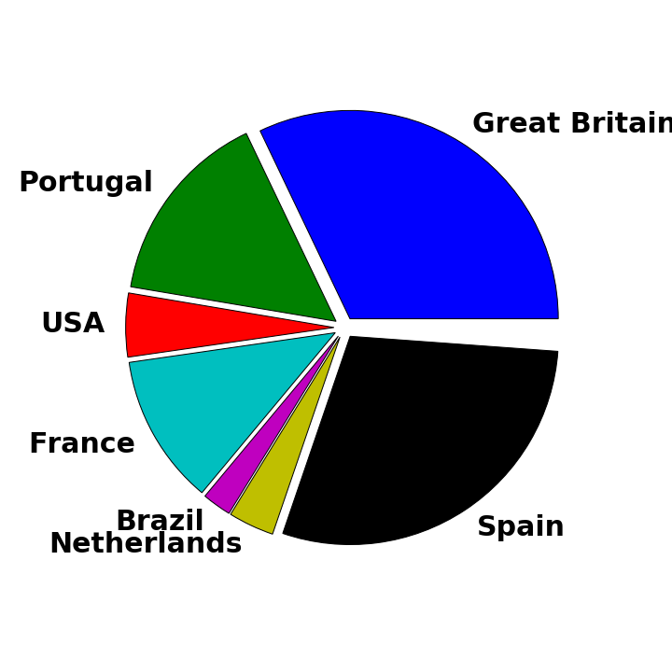

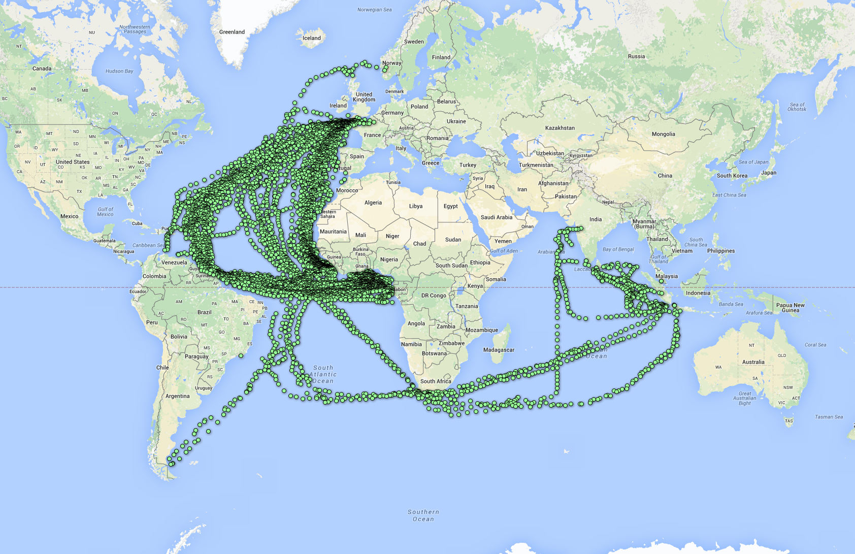
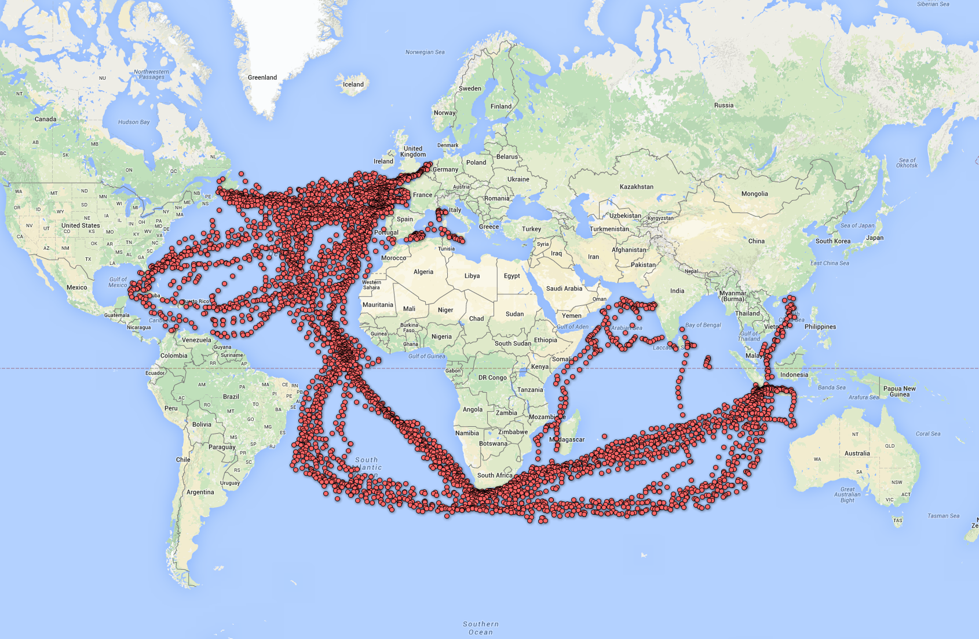
QUANTIFYING THE SLAVE TRADE THROUGH SHIP LOGS
Alicia Clark
Department of
Mechanical Engineering
CSE 599B
Software Engineering
for Data Scientists
Winter 2016
Emma Cotter
Department of
Mechanical Engineering
Zehua Wei
Department of
Chemical Engineering
MOTIVATION
CLASSIFICATION
17th and 18th century ship logs contain extensive information about weather, historical events, and cultural phenomena
Many of these ship logs have been translated into databases for historical or scientific research
Databases are typically formulated with one research goal in mind – i.e. studying climate change or trends in the slave trade
Our goal is to find out if information from a database of ship logs collected to study climate change can be used to also study the slave trade
Training Data
Naïve Bayes Classification
Decision Trees Classification
Positive Training Data - 80% of the entries from the slave voyages database
Negative Training Data - Entries from the CLIWOC data with ship names proven to not be involved with the slave trade (mainly naval ships
A decision tree (a predictive model) was also fitted to the data using scikit-learn
A simplified example of how a decision tree works is shown below
Year
Zoomed view
Full view
Not
Slave Ship
London
Ship Type
Frigate
Dutch
Slave Ship
THE DATA SETS
Nationality
Spanish
Departure Port
Not
Slave Ship
Validation Data
Implemented using scikit-learn) was tested for classification of the data
This probabilistic model fits a probability distribution to each class of data and determines the probability that a new point belongs to each class
Ship Type
French
Slave Ship
Paris
Remaining 20% of entries from the slave voyages data
Entries from the CLIWOC data with logbook text that explicitly mentions slaves
Climatological Database for the Worlds Oceans (CLIWOC)
Cape of Good Hope
Slave Ship
Departure Port
Database focuses on understanding climate change through weather observations
Contains raw logbook text
280,290 transcribed logs
1651 individual voyages
Includes latitude and longitude for every log entry
Schooner
Brussels
Not
Slave Ship
Nationalities that compose more than 1% of the data
Departure Year of Voyages
RESULTS
FUTURE WORK
Trans-Atlantic Slave Trade Database
Naïve Bayes
Decision Trees
The classification algorithms used did not effectively classify ships as related or unrelated to the slave trade. Several future improvements could help to resolve this issue:
Addition of more negative training data – The training data for non-slave trade related voyages was much smaller than the slave-trade related voyages data. There are ongoing data collection projects that could provide this data.
Translation – The logs are in different languages. Use of the google-translate API (which is not free to use) could do a better job at matching similar voyages than fuzzy string matching
Location – Latitude and longitude of voyages could be used as an additional classification parameter
Database focuses on quantifying the slave trade
Includes entries for each voyage (not every individual log entry)
58,957 voyages documented
100% of validation set 1 were classified correctly
0% of validation set 2 were classified correctly
99% of validation set 1 were classified correctly
5.6% of validation set 2 were classified correctly
Nationalities that compose more than 1% of the data
Departure Year of Voyages
DATA CLEANING
Trajectories of CLIWOC ships with logs that directly mentioned slaves
1. Clean CLIWOC Data
Removed repeating logbook entries so that there was only one entry per voyage
Isolated the columns of interest to be used in the classification
Used fuzzy logic to rename strings to their corresponding ‘match’ in the slave trade data set
2. Clean Trans-Atlantic Slave Trade Data
Explored the different columns to find columns that were also in the CLIWOC data
Isolated the columns of interest to be used in the classification
REFERENCES
3. Join two data sets
Joined the two data sets and cleaned
⌲ converted all strings to lower case
⌲ removed trailing whitespace
⌲ matched column names
CLIWOC Database: http://pendientedemigracion.ucm.es/info/cliwoc
Trans-Atlantic Slave Trade Database: www.slavevoyages.org
Code Repository: https://github.com/clarka34/exploring-ship-logbooks
Trajectories of CLIWOC ships classified as slave ships by decision trees classifier
4. Encode data for classification
Encoded the data using either a label encoder or a one hot encoder depending on the classification algorithm used

