Slide 1
Studying the Slave Trade using Ship Logbooks
Emma Cotter
Alicia Clark
Wedward Wei

Slide 2
Project Motivation
Many slave logs have been transcribed
Large data set used explicitly to study slave trade
Could augment this with data set used to study climate change?
Want to identify ships related to slave trade in climate data set.

Slide 3
What do we need to do this?
Encode categorical data for classification
Machine-learning classifier
Visualization

Slide 4
Encoding (Alicia)

Slide 5
Classification (Emma)
Scikit learn
Benefits: Already implemented classifier, already using for encoding, well documented, works with python 3.5
Challenges: Does a lot of the work on classification for us, so need to read more on what is actually happening to decide what settings to use, etc.
Explain what classifiers we looked at (Decision trees, naïve bayes, multinomial naïve bayes)
Decision trees not good for categorical data
Naïve bayes can overfit small training data (check this)

Slide 6
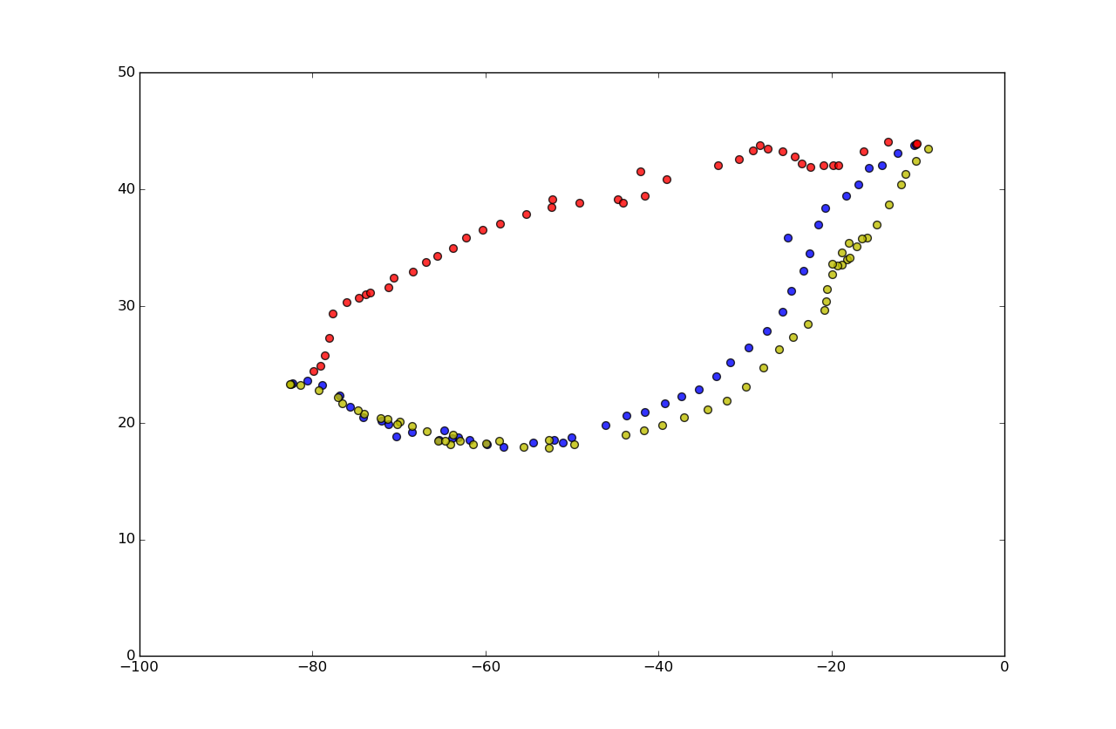
Visualization (Wedward)
Matplotlib Scatter
Basemap
Fusion Table’s Map
import matplotlib.pyplot as plt
position_list = list(zip(position["Lat3"],position["Lon3"]))
plt.xlim(-100,0)
plt.ylim(0,50)
plt.figure(figsize=(40, 20))
for i in position_list:
plt.scatter(i[1], i[0],s=100,c=colors[color],alpha=0.8)
plt.show()

Slide 7
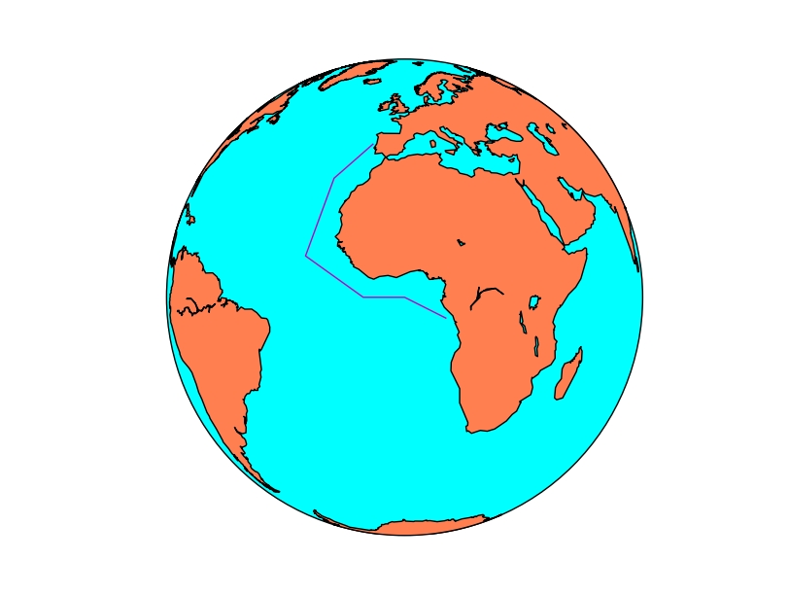
Visualization (Wedward)
Matplotlib Scatter
Basemap
Fusion Table’s Map
from mpl_toolkits.basemap import Basemap
import matplotlib.pyplot as plt
map = Basemap(projection='ortho',
lat_0=0, lon_0=0)
map.drawmapboundary(fill_color='aqua')
map.fillcontinents(color='coral',lake_color='aqua')
map.drawcoastlines()
Lons = [-10, -20, -25, -10, 0, 10]
lats = [40, 30, 10, 0, 0, -5]
x, y = map(lons, lats)
map.plot(x, y, marker=None,color='m')
plt.show()
https://basemaptutorial.readthedocs.org/en/latest/plotting_data.html

Slide 8
Visualization (Wedward)
Matplotlib Scatter
Basemap
Fusion Table’s Map
https://www.google.com/fusiontables/embedviz?q=select+col7+from+1m9rD4onw6XZD_mwaqPHq5CC-aUrIq4ZuuIJSrtdr+where+col9+%3E%3D+0+and+col9+%3C%3D+1757&viz=MAP&h=false&lat=31.859404045459222&lng=-34.5449375&t=1&z=3&l=col7&y=2&tmplt=2&hml=TWO_COL_LAT_LNG
https://www.google.com/fusiontables/DataSource?docid=1m9rD4onw6XZD_mwaqPHq5CC-aUrIq4ZuuIJSrtdr

Slide 9
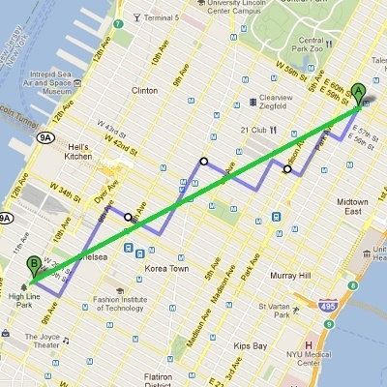
Distance Function (Wedward)
Measuring similarity or distance between two data points is very fundamental to many Machine Learning algorithms such as K-Nearest-Neighbor, Clustering ... etc.
Depends on the nature of the data point, various measurement can be used.
When the dimension of data point is numeric, the general form is called Minkowski distance
( (x₁ - x₂)^{p} + (y₁ - y₂)^{p} )^{1/p}
When p = 2, this is equivalent to Euclidean distance.
When p = 1, this is equivalent to Manhattan distance.
http://horicky.blogspot.com/2012/08/measuring-similarity-and-distance.html

Slide 10
Distance Function (Wedward)
The earth mover's distance (EMD) is a measure of the distance between two probability distributions over a region D. In mathematics, this is known as the Wasserstein metric.
pyemd 0.2.0 Usage Sample
>>> from pyemd import emd
>>> import numpy as np
>>> first = np.array([0.0, 1.0])
>>> second = np.array([5.0, 3.0])
>>> emd(first, second)
Route1 Blue
Route2 Red
Route3 Yellow
EMD(Route1,Route2) = 11.8620852635
EMD(Route1,Route3) = 3.66804849504
EMD(Route1,Route3) < EMD(Route1,Route2)
https://pypi.python.org/pypi/pyemd/0.2.0

