Slide 1
Studying the Slave Trade using Ship Logbooks
Emma Cotter
Alicia Clark
Wedward Wei

Slide 2

Project Motivation
Many slave logs have been transcribed
Large data set used explicitly to study slave trade
Want to use this data set to predict if ships were involved in the slave trade in other available data sets
Goal: Identify ships related to the slave trade in the climate data set

Slide 3
How are we going to do this?
Join data sets
Encode categorical data
Train classifier to detect slave ships
Visualize trends in classified data

Slide 4
Encoding (Alicia) – Label Encoder
Original Categorical Labels
Paris
Paris
Assign a Numerical Value to Each Category
Paris = 0
Amsterdam =1
Transform the Labels to Numerical Labels
0
Amsterdam
Tokyo
Tokyo = 2
0
1
2

Slide 5
Encoding (Alicia) – One Hot Encoder
Paris Paris Amsterdam Tokyo 0 0 1 2
Paris 1 1 0 0
Amsterdam 0 0 1 0
Tokyo 0 0 0 1

Slide 6
Classification Requirements
Data
- Categorical
Small number of characteristics
Relatively large training data set
Software
- Python 3.5
Well-documented
SciKitLearn
Multinomial
Naïve
Bates
Notes:
Scikit learn
Benefits: Already implemented classifier, already using for encoding, well documented, works with python 3.5
Challenges: Does a lot of the work on classification for us, so need to read more on what is actually happening to decide what settings to use, etc.
Explain what classifiers we looked at (Decision trees, naïve bayes, multinomial naïve bayes)
Decision trees not good for categorical data
Naïve bayes can overfit small training data (check this)

Slide 7
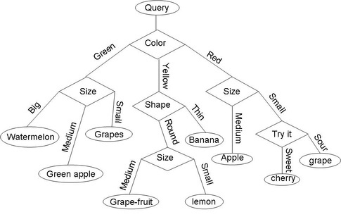
Classifier Options
Decision Trees
Naïve bayes
Gaussian
Multinomial
Source: qph.is.quoracdn.net
Notes:
Decision trees – overfitting is hazard. Do not have a strong validation data set
Naïve bayes – multinomial likely better fit than normal distribution

Slide 8
Multinomial Naïve Bayes Classification
Commonly used in real-world classification:
Document classification
Spam filtering
Assumes all data are independent – but still performs well when this is not true

Slide 9
Target Classification
Year
Ship Type
Notes:
Why radius neighbors classifier:
Non parametric (small initial data set)
Can handle outliers
Can weight different features
Can prioritize different data points

Slide 10
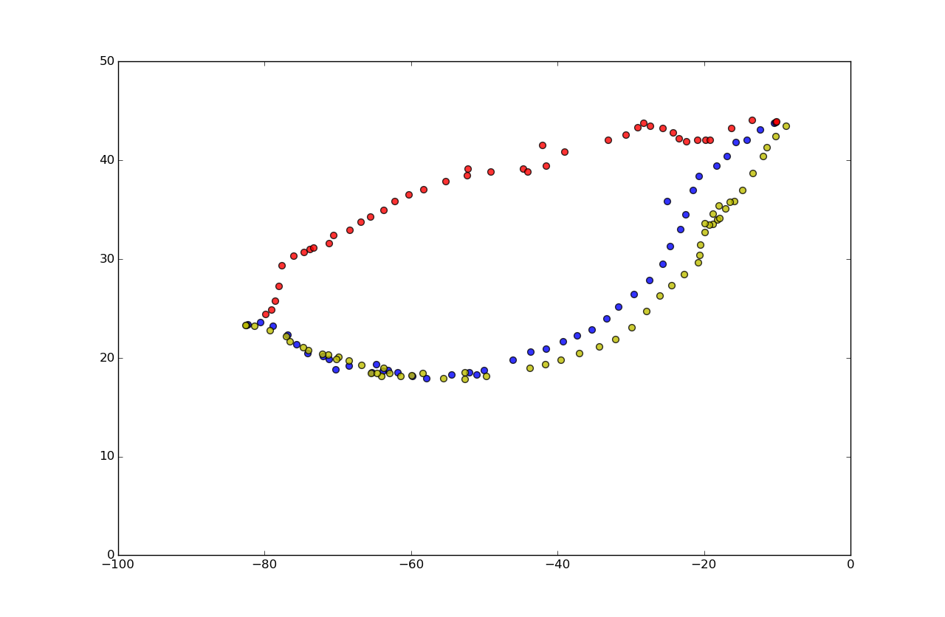
Visualization (Wedward)
Matplotlib Scatter
Basemap
Fusion Table’s Map
import matplotlib.pyplot as plt
position_list = list(zip(position["Lat3"],position["Lon3"]))
plt.xlim(-100,0)
plt.ylim(0,50)
plt.figure(figsize=(40, 20))
for i in position_list:
plt.scatter(i[1], i[0],s=100,c=colors[color],alpha=0.8)
plt.show()

Slide 11
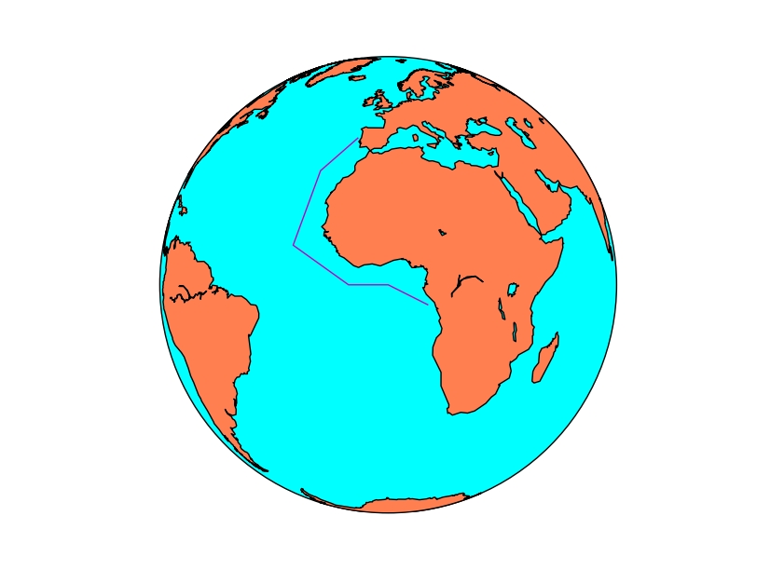
Visualization (Wedward)
Matplotlib Scatter
Basemap
Fusion Table’s Map
from mpl_toolkits.basemap import Basemap
import matplotlib.pyplot as plt
map = Basemap(projection='ortho',
lat_0=0, lon_0=0)
map.drawmapboundary(fill_color='aqua')
map.fillcontinents(color='coral',lake_color='aqua')
map.drawcoastlines()
Lons = [-10, -20, -25, -10, 0, 10]
lats = [40, 30, 10, 0, 0, -5]
x, y = map(lons, lats)
map.plot(x, y, marker=None,color='m')
plt.show()
https://basemaptutorial.readthedocs.org/en/latest/plotting_data.html

Slide 12
Visualization (Wedward)
Matplotlib Scatter
Basemap
Fusion Table’s Map
https://www.google.com/fusiontables/embedviz?q=select+col7+from+1m9rD4onw6XZD_mwaqPHq5CC-aUrIq4ZuuIJSrtdr+where+col9+%3E%3D+0+and+col9+%3C%3D+1757&viz=MAP&h=false&lat=31.859404045459222&lng=-34.5449375&t=1&z=3&l=col7&y=2&tmplt=2&hml=TWO_COL_LAT_LNG
https://www.google.com/fusiontables/DataSource?docid=1m9rD4onw6XZD_mwaqPHq5CC-aUrIq4ZuuIJSrtdr

Slide 13
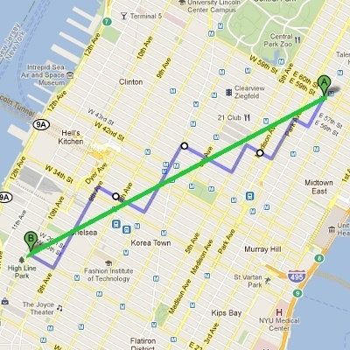
Distance Function (Wedward)
Measuring similarity or distance between two data points is very fundamental to many Machine Learning algorithms such as K-Nearest-Neighbor, Clustering ... etc.
Depends on the nature of the data point, various measurement can be used.
When the dimension of data point is numeric, the general form is called Minkowski distance
( (x₁ - x₂)^{p} + (y₁ - y₂)^{p} )^{1/p}
When p = 2, this is equivalent to Euclidean distance.
When p = 1, this is equivalent to Manhattan distance.
http://horicky.blogspot.com/2012/08/measuring-similarity-and-distance.html

Slide 14
Distance Function (Wedward)
The earth mover's distance (EMD) is a measure of the distance between two probability distributions over a region D. In mathematics, this is known as the Wasserstein metric.
pyemd 0.2.0 Usage Sample
>>> from pyemd import emd
>>> import numpy as np
>>> first = np.array([0.0, 1.0])
>>> second = np.array([5.0, 3.0])
>>> emd(first, second)
Route1 Blue
Route2 Red
Route3 Yellow
EMD(Route1,Route2) = 11.8620852635
EMD(Route1,Route3) = 3.66804849504
EMD(Route1,Route3) < EMD(Route1,Route2)
https://pypi.python.org/pypi/pyemd/0.2.0

