Slide 1
Studying the Slave Trade using Ship Logbooks
Emma Cotter
Alicia Clark
Wedward Wei

Slide 2
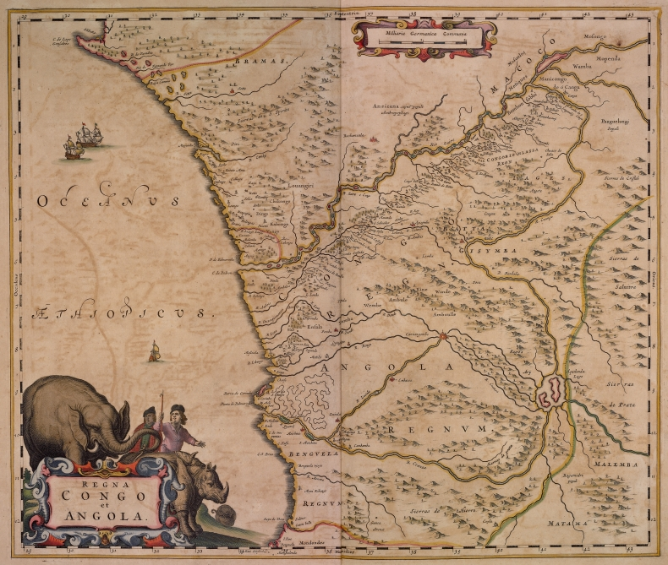
Project Motivation
Many slave logs have been transcribed
Large data set used explicitly to study slave trade
Could augment this with data set used to study climate change?
Want to identify ships related to slave trade in climate data set.

Slide 3
How are we going to do this?
Join data sets
Encode categorical data
Train classifier to detect slave ships
Visualize trends in classified data

Slide 4
Encoding (Alicia)

Slide 5
Classification Requirements
Data
- Categorical
Small number of characteristics
Relatively large training data set
Software
- Python 3.5
Well-documented
SciKitLearn
Multinomial
Naïve
Bates
Notes:
Scikit learn
Benefits: Already implemented classifier, already using for encoding, well documented, works with python 3.5
Challenges: Does a lot of the work on classification for us, so need to read more on what is actually happening to decide what settings to use, etc.
Explain what classifiers we looked at (Decision trees, naïve bayes, multinomial naïve bayes)
Decision trees not good for categorical data
Naïve bayes can overfit small training data (check this)

Slide 6
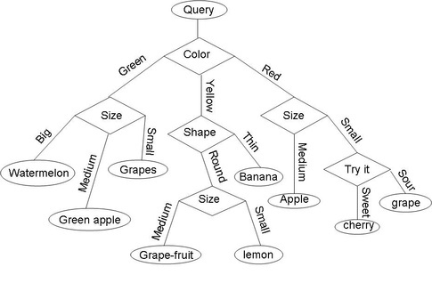
Classifier Options
Decision Trees
Naïve bayes
Gaussian
Multinomial
Source: qph.is.quoracdn.net
Notes:
Decision trees – overfitting is hazard. Do not have a strong validation data set
Naïve bayes – multinomial likely better fit than normal distribution

Slide 7
Multinomial Naïve Bayes Classification
Commonly used in real-world classification:
Document classification
Spam filtering
Assumes all data are independent – but still performs well when this is not true

Slide 8
Target Classification
Year
Ship Type
Notes:
Why radius neighbors classifier:
Non parametric (small initial data set)
Can handle outliers
Can weight different features
Can prioritize different data points

Slide 10
Visualization (Wedward)

