Slide 1


ReactJS Web-UI development
Duration: 2 hours

Slide 2
Requirements
Programming Skills
Basic understanding of HTML tags
Basic JavaScript programming knowledge
Software
VScode IDE

Slide 3
Outcomes
Set up the IDE for React.JS web development.
Understand how the react framework works.
Create a web-ui using the react library.
Serve applications locally for development.

Slide 4
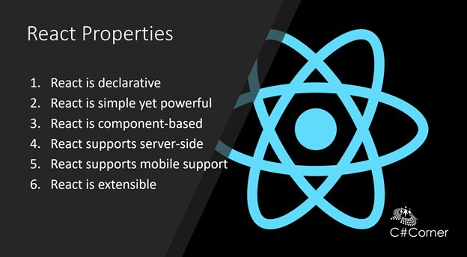
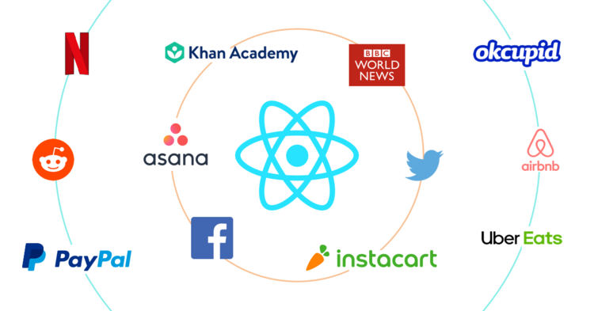
What is React ?
React. js is an open-source JavaScript library, used for building UI’s, specifically single-page applications. React allows developers to create large web applications that can change data, without reloading the entire page. The main purpose of React is to be fast, scalable, and simple.

Slide 5
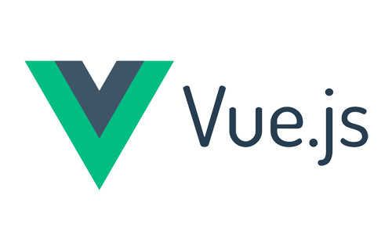




Other Front-End languages
Vue.JS
Angular (by Google)
Svelte
JQuery
Backbone.JS

Slide 6
ReactJS Advantages
Easy to Learn and Use.
Easier Creating Dynamic Web Applications.
Reusable Components.
Performance Enhancement.
The Support of Handy Tools.
Known to be SEO Friendly.
The Benefit of Having JavaScript Library.
Scope for Testing the Codes.

Slide 7
ReactJS Disadvantages
The high pace of development.
JSX is difficult to understand.

Slide 8
History
React was created by Jordan Walke, a software engineer at Facebook, who released an early prototype of React called "FaxJS. He was influenced by XHP, an HTML component library for PHP. It was first deployed on Facebook's News Feed in 2011 and later Instagram in 2012. It was open-sourced at the JavaScript Conference US in May 2013.
React Native, which enables native Android, IOS, and UWP development with React, was announced at Facebook's React Conf in February 2015 and open-sourced in March 2015.
On April 18, 2017, Facebook announced React Fiber, a new set of internal algorithms for rendering, as opposed to React's old rendering algorithm, Stack. . React's old rendering system, Stack, was developed at a time when the focus of the system on dynamic change was not understood. Stack was slow to draw complex animation, for example, trying to accomplish all of it in one chunk. Fiber breaks down animation into segments that can be spread out over multiple frames. Likewise, the structure of a page can be broken into segments that may be maintained and updated separately. JavaScript functions and virtual DOM objects are called "fibers", and each can be operated and updated separately, allowing for smoother on-screen rendering.
On September 26, 2017, React 16.0 was released to the public.
On February 16, 2019, React 16.8 was released to the public (Hooks).

Slide 9
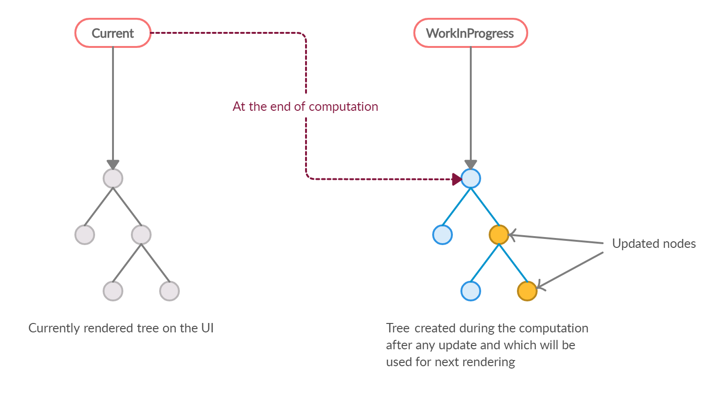
React Fibers

Slide 10
JavaScript Functions
A JavaScript function is a block of code designed to perform a particular task. A function in JavaScript is like a procedure, a set of statements that perform tasks or calculate values. For a procedure to qualify as a function, it should take some input and return an output where there is a relationship between the input and the output. To use a function, you must define it somewhere in the scope from which you wish to call it.
Examples

Slide 11
React Hooks
Basic Hooks
- useState
- useEffect
Additional Hooks
- useReducer
- useMemo
- useRef
- useContext
- useImperativeHandle
- useLayoutEffect
- useDebugValue

Slide 12
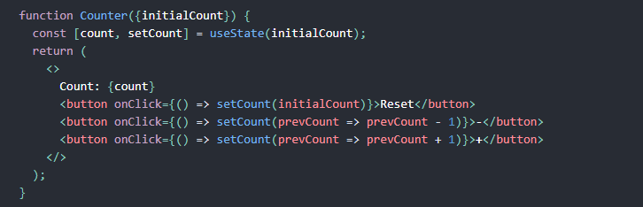
UseState
The setState function is used to update the state of a variable. It accepts a new state value and enqueues a re-render of the component.
Syntax
const [state, setState] = useState(initialState);
setState(newState);
Example

Slide 13
UseEffect
The setState function is used to update the state. It accepts a new state value and enqueues a re-render of the component.
Syntax
const [state, setState] = useState(initialState);
setState(newState);
Example

Slide 14
JSX (JavaScript XML)
This funny tag syntax is neither a string nor HTML.
JSX is a syntax extension of javaScript that describes what the UI looks like.
JSX produces React “elements”.

Slide 15
Download and Install NodeJS
https://nodejs.org/en/download/

Slide 16
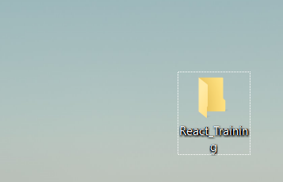
Create your first react app
1) Create a new folder, rename the folder.
2) Rename the folder “React_Training”.

Slide 17
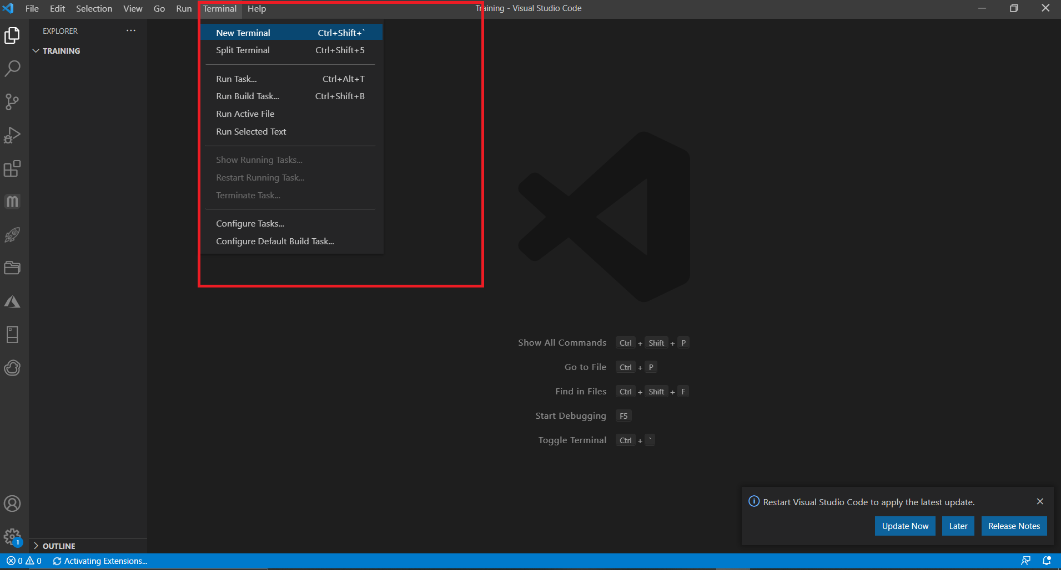
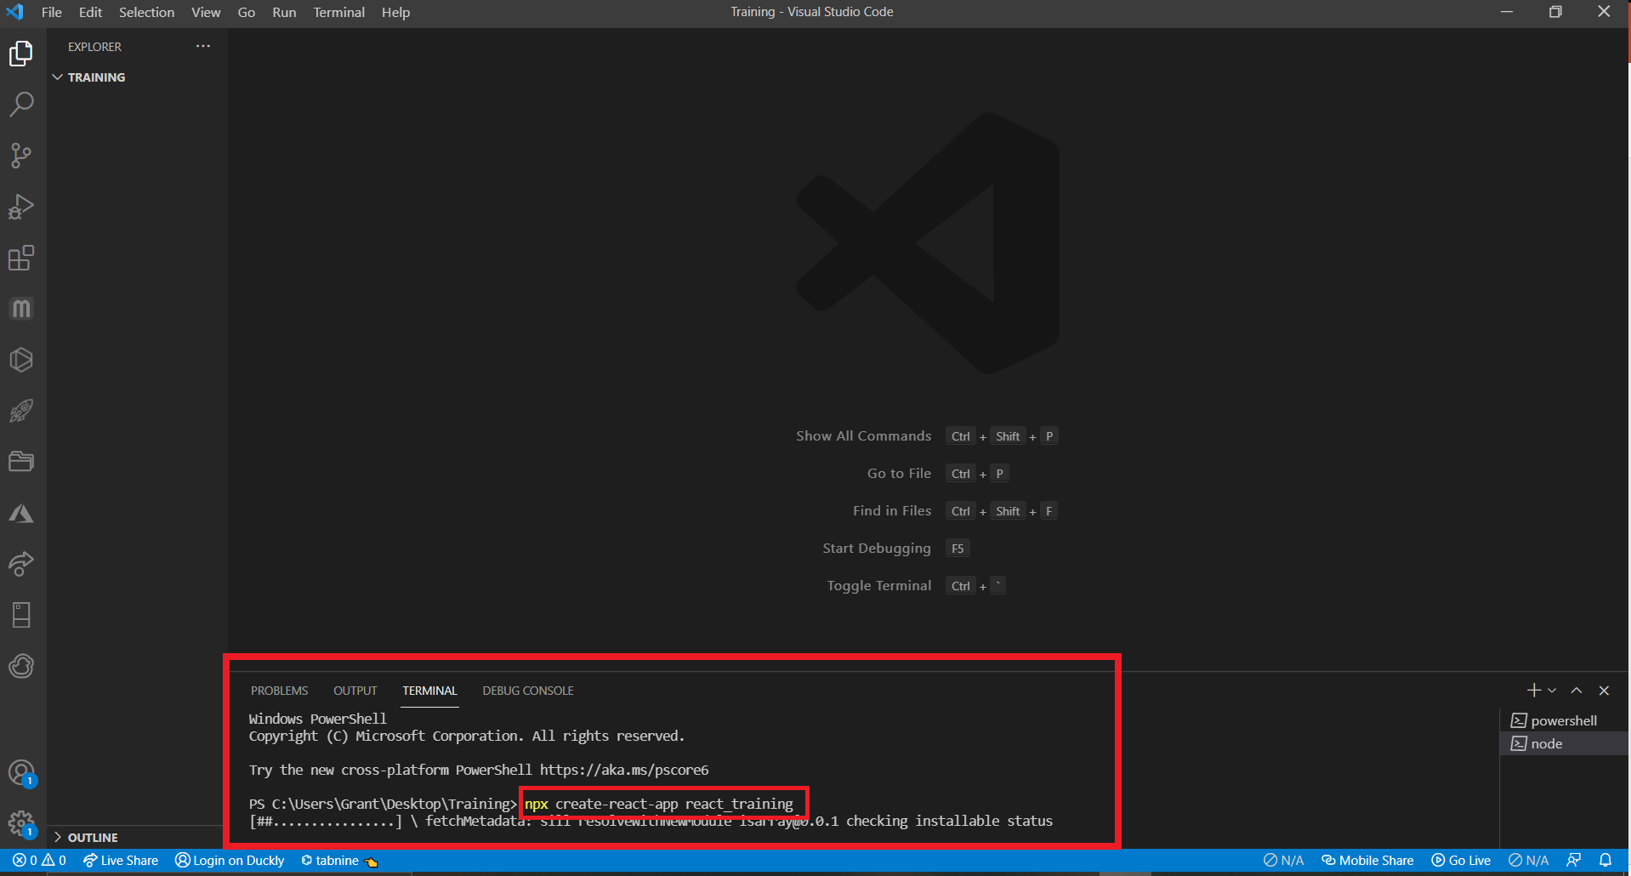
Create react-app template
3) Open the newly created folder in Vscode.
4) Open a new terminal.
5) Run "npx create-react-app my-app“ to create the basic react app template and download dependencies.

Slide 18
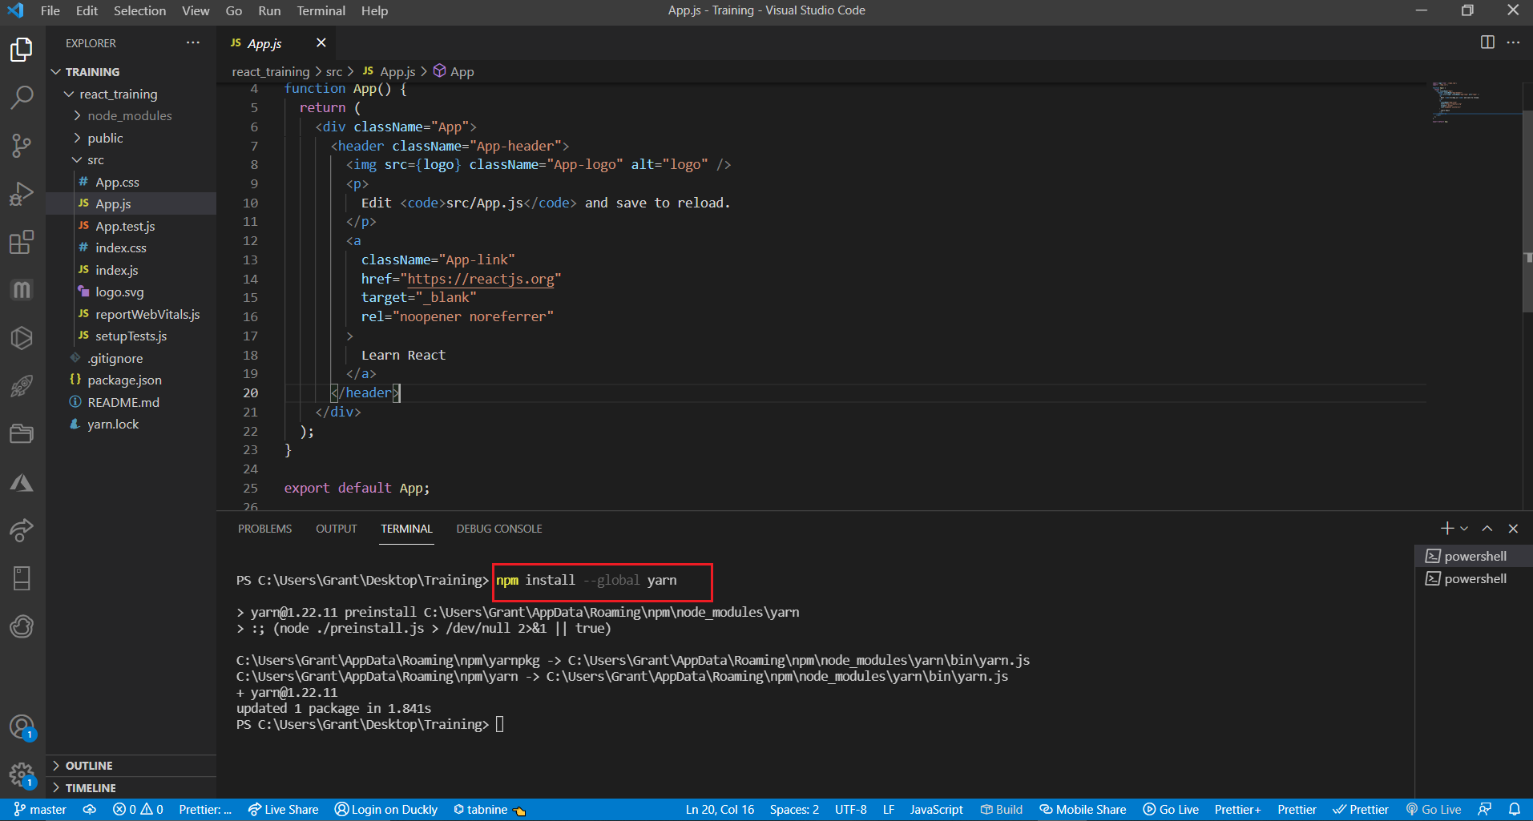
Install package manager (Yarn)
In a terminal run "npm install --global yarn“.
For more information on yarn visit: https://yarnpkg.com/lang/en/docs/install/

Slide 19
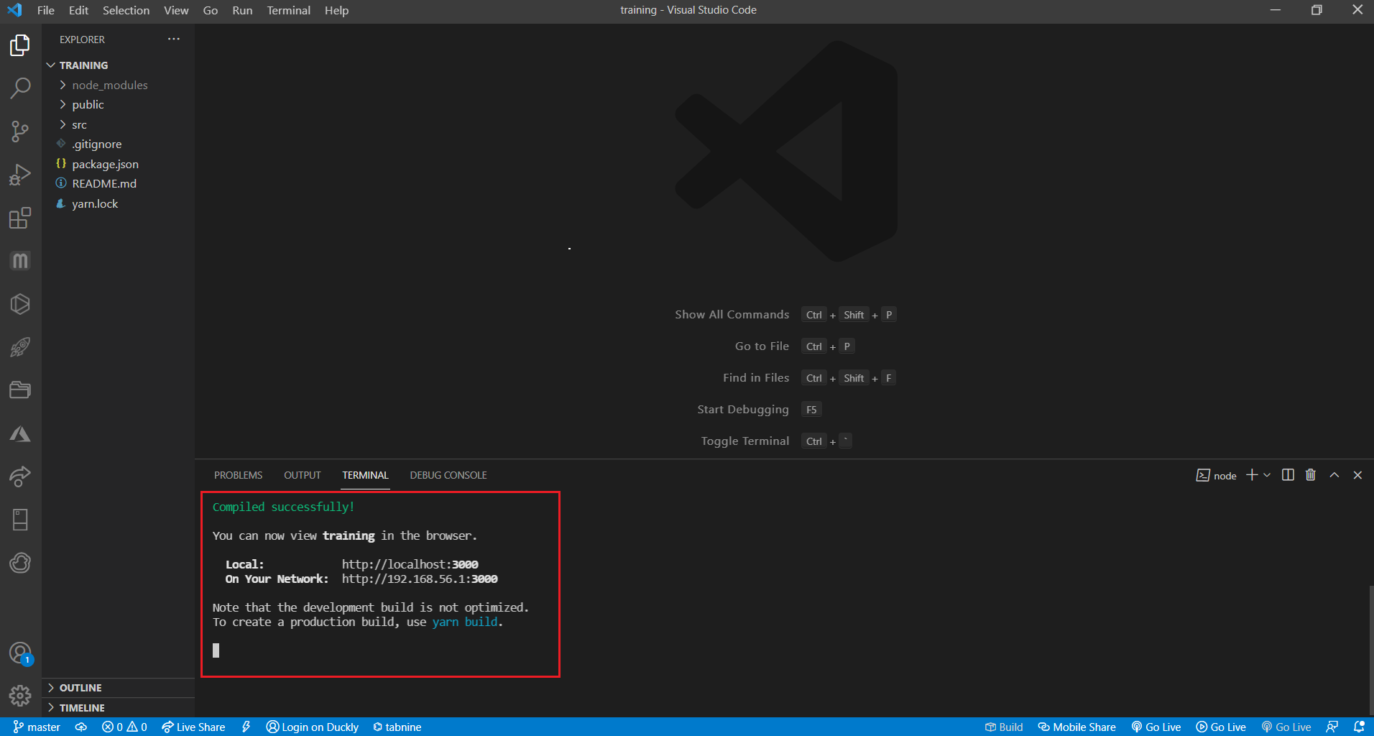
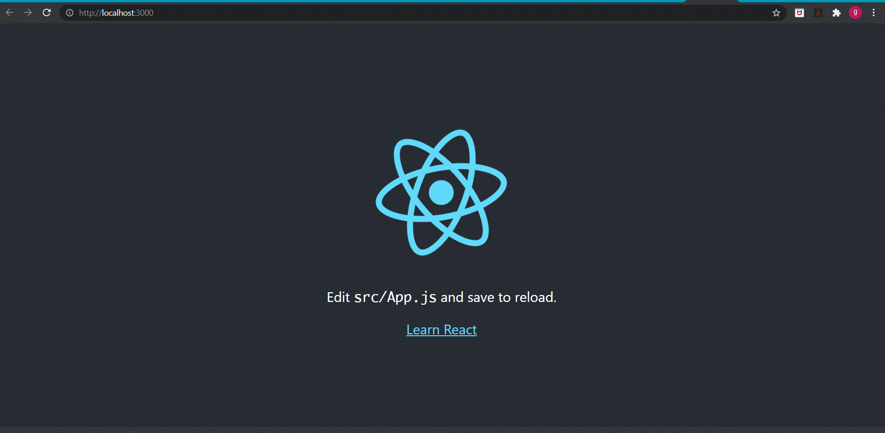
Install package manager
In the terminal run “yarn”
In the terminal run “yarn start”, after a few seconds the browser should open at http://localhost:####.

Slide 20
Install dependencies (Components)
In a terminal run “yarn add @mui/material @emotion/react @emotion/styled”
Also run “yarn add @mui/material @mui/styled-engine-sc styled-components”
Also run “yarn add @mui/icons-material”
This library comes with a variety of useful components such as Buttons, Accordions, Text Fields etc, necessary for the development of the web-site.

Slide 21
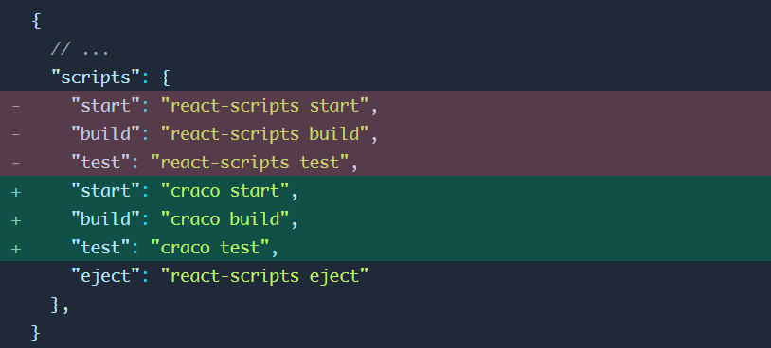
Install Tailwind(Styling)
https://tailwindcss.com/docs/guides/create-react-app
Yarn add tailwindcss/postcss7-compat postcss@^7 autoprefixer@^9
Yarn add @craco/craco
Edit scripts in package.json

Slide 22
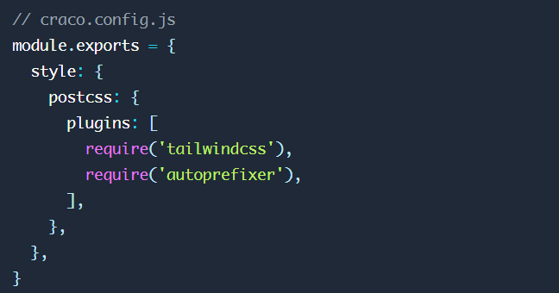
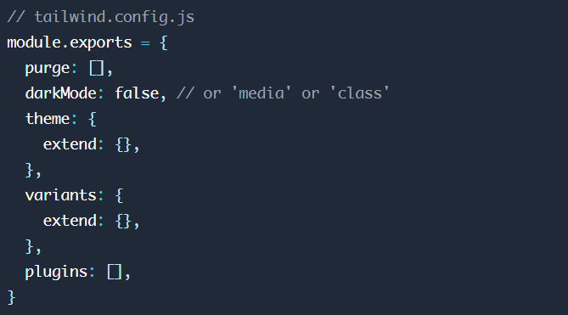
Install Tailwind(Styling)
Create craco.config.js and add plugins
Create tailwind.config.js

Slide 23
Install react-router-dom
In the terminal Run “yarn add react-router-dom”

Slide 24
Creating your first web page

