Slide 1


Booking Services Project
Grapes

Slide 2


Introduction
Maksim Sharoika
Taiwo Akinwale
Favor Fasunwon

Slide 3


Problem
The operators at the RFB are currently struggling with a high call volume and are concerned on how the information from individuals can be retrieved without the rise of duplicates. Since these operators are not robots, we must consider high stress levels and other amenities which will inhibit their ability to take calls.

Slide 4
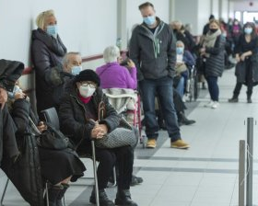
NorthStar Customer
We consider the NorthStar customers to be the chronic users of the RFB. The carryover customers would be the operators, episodic users, and any foundations working with the RFB. This is because the chronic users are the regular individuals who call to make an appointment for a hamper; thus, they will require constant appointments being made

Slide 5
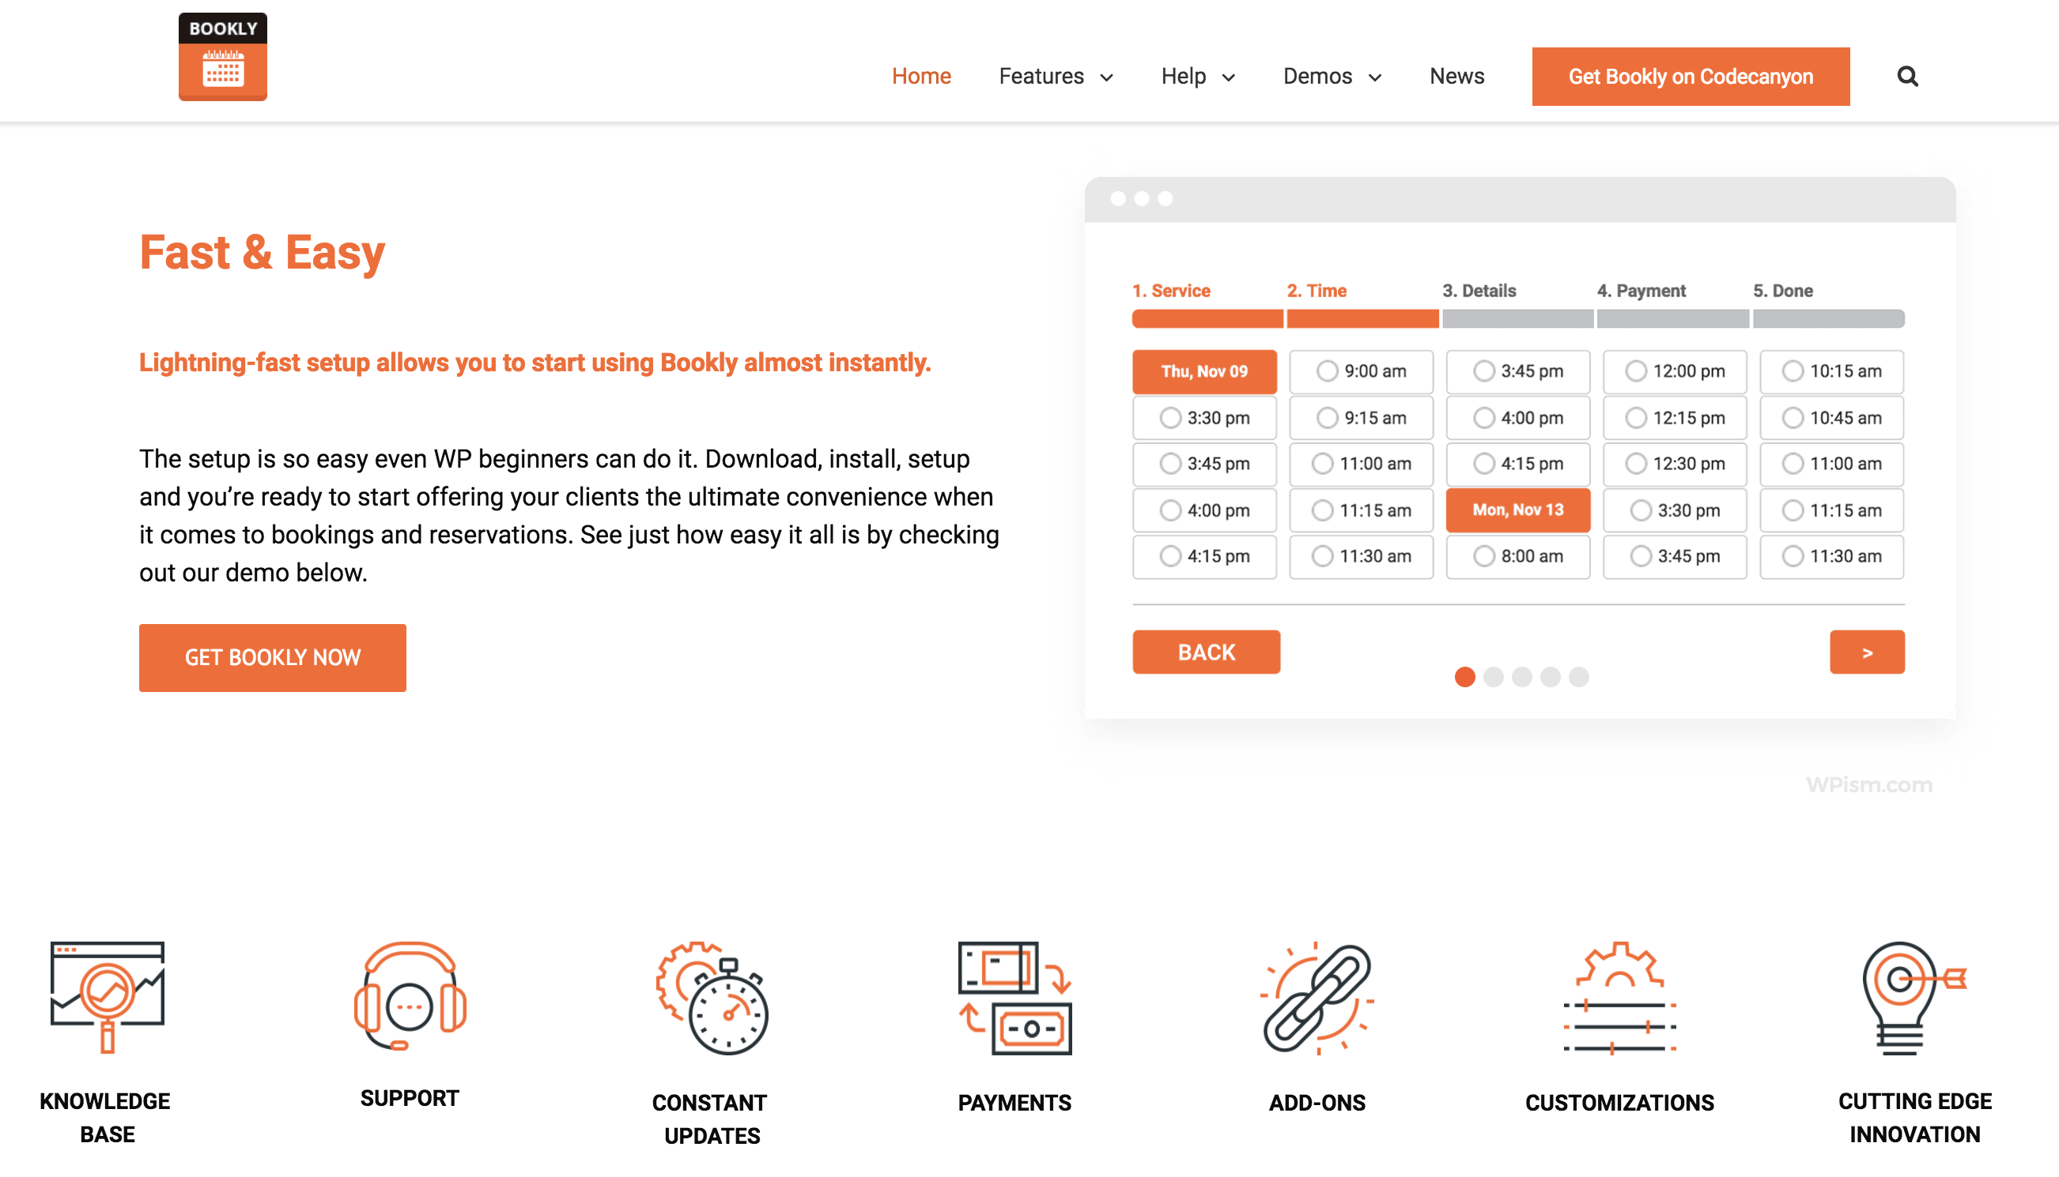
WordPress Configuration
Salon Booking System
The plugin is used for account management and as a booking system, it facilitates client-side and admin-side interfaces and management.

Slide 6
WordPress Demo
Demo

Slide 7
Questions?

