Slide 1
Matrice Initiale
Matrice de Différence
t = 0 t = 1 t = 2
t = 0 t = 1 t = 2
0 | 1 | 0 | 0
0 | 1 | 1 | 0
1 | 0 | 0 | 0
0 | 0 | 0 | 0
1 | 1 | 0 | 0
1 | 0 | 1 | 0
1 | 0 | 0 | 0
0 | 0 | 0 | 0
1 | 1 | 0 | 0
1 | 0 | 1 | 0
1 | 0 | 0 | 0
0 | 0 | 1 | 0
0 | 1 | 0 | 0
0 | 1 | 1 | 0
1 | 0 | 0 | 0
0 | 0 | 0 | 0
1 | 0 | 0 | 0
1 | 1 | 0 | 0
0 | 0 | 0 | 0
0 | 0 | 0 | 0
0 | 0 | 0 | 0
0 | 1 | 0 | 0
0 | 0 | 0 | 0
0 | 0 | 1 | 0
T =
L =
111 111 111 001
011 111 011 100 000 000 111 000 111 000 000 000 000 000 001 000
111 100 100 001
010 100 010 111 0 0 1 0 1 0 0 0 0 0 1 0
T =
L =
Taille (T + L) = 60 bits
Taille (T + L) = 36 bits

Slide 2
2
4
3
1
 |  | S1 | S2 | S3 | S4
initialisation | h1 | ∞ | ∞ | ∞ | ∞
 | h2 | ∞ | ∞ | ∞ | ∞
Itération 01 | h1 | 2 | ∞ | ∞ | 2
 | h2 | 2 | ∞ | ∞ | 2
Itération 02 | h1 | 2 | ∞ | 3 | 2
 | h2 | 2 | ∞ | 1 | 2
Itération 03 | h1 | 2 | 4 | 3 | 2
 | h2 | 2 | 3 | 1 | 2
Itération 04 | h1 | 1 | 4 | 1 | 1
 | h2 | 2 | 3 | 1 | 2
x | Liste d’adjacence
1 | S1={1, 4}
2 | S2={3}
3 | S3={2, 4}
4 | S4={1, 3, 4}
 | S1 | S2 | S3 | S4
1 | 1 | 0 | 0 | 1
2 | 0 | 0 | 1 | 0
3 | 0 | 1 | 0 | 1
4 | 1 | 0 | 1 | 1
h1 | h2
2 | 2
3 | 1
4 | 3
1 | 2
Matrice Caractéristique
Étape de calcul de la Matrice des Signatures

Slide 3
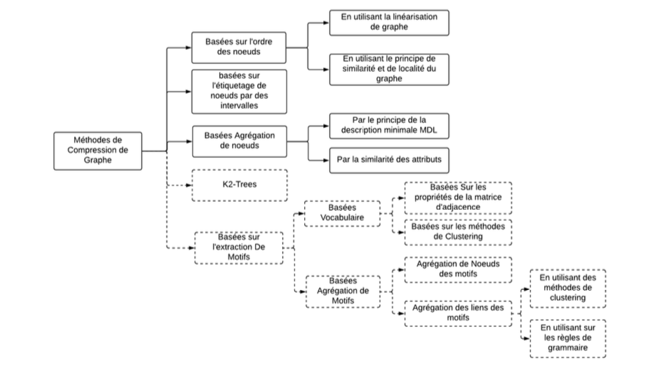

Slide 4
Méthodes de compression basées sur l’extraction de Motifs
Des liens des motifs
Agrégation
Des nœuds des motifs

Slide 5
G
Compression
G’
G’
Décompression
G
G
Compression
G’
G’
Décompression
G’’

Slide 6
1 | 2 | 3 | 4 | 5 | 6 | 7 | 8
1 | 2 | 3 | 4 | 5 | 6 | 7 | 8
1
2
3
4
5
6
7
8
1 | 1 | 0 | 0 | 1 | 1 | 0 | 0
1 | 1 | 0 | 0 | 1 | 1 | 0 | 0
0 | 0 | 1 | 1 | 0 | 0 | 1 | 1
0 | 0 | 1 | 0 | 0 | 0 | 1 | 0
1 | 1 | 0 | 0 | 1 | 1 | 0 | 0
1 | 1 | 0 | 0 | 1 | 1 | 0 | 0
0 | 0 | 1 | 1 | 0 | 0 | 1 | 1
0 | 0 | 1 | 0 | 0 | 0 | 1 | 0
1
2
3
4
5
6
7
8
1 | 1 | 0 | 0 | 1 | 1 | 0 | 0
0 | 1 | 0 | 0 | 1 | 1 | 0 | 0
0 | 0 | 1 | 1 | 0 | 0 | 1 | 1
0 | 0 | 0 | 0 | 0 | 0 | 1 | 0
0 | 0 | 0 | 0 | 1 | 1 | 0 | 0
0 | 0 | 0 | 0 | 0 | 1 | 0 | 0
0 | 0 | 0 | 0 | 0 | 0 | 1 | 1
0 | 0 | 0 | 0 | 0 | 0 | 0 | 0
T= 1111 1001 1001 1001 1001
L= 1111 1110 1111 1110 1111 1110
1111 1110
T= 1101 1001 1001 1001
L= 1111 1110 1111 1110 1111 1110
Taille(T + L) = 52 bits
Taille(T + L) = 40 bits

