Slide 1
Detecting Community Structure in Networks

Slide 2
Outline
Introduction
Community Detection Algorithms
  Edge Betweenness algorithm
  Bridge Cut Algorithm
  Newman Fast algorithm
  Local-Modularity-based algorithm
Summary

Slide 3
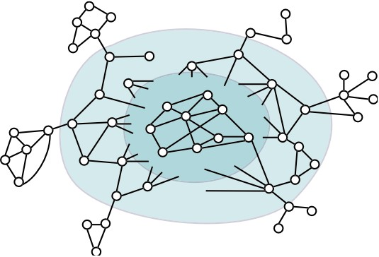
Introduction: Real World Networks
Lots of “networks” !!
technological networks
  AS, power-grid, road networks
biological networks
  food-web, protein networks
social networks
  collaboration networks, friendships
information networks
  co-citation, blog cross-postings, advertiser-bidded phrase graphs...
language networks
  semantic networks...
...
Interaction graph model of networks:
Nodes represent “entities”
Edges represent “interaction” between pairs of entities

Slide 4
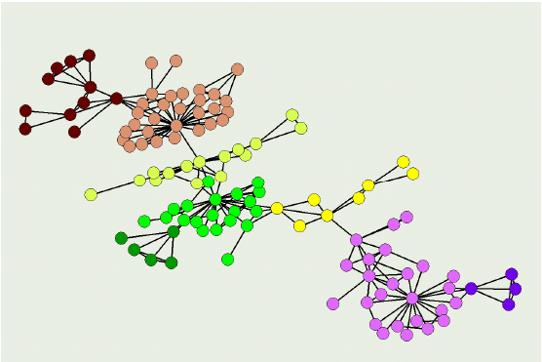
Scientific collaboration network
Real-world network : scientific collaboration network
  – Nodes : Scientists
  – Edges : Collaboration between Scientists
Communities : Groups of scientists with same research interest or research background

Slide 5
Communities in real-world networks
Real-world network : World Wide Web
  – Nodes : web pages
  – Edges : hyper-references
Communities : Nodes on related topics
Real-world network : Metabolic networks
  – Nodes : metabolites
  – Edges : participation in a chemical reaction
Communities : Functional modules

Slide 6
What is Community structure?
Groups of vertices within which connections are dense but between which they are sparser.
  Within-group( intra-group) edges.
    High density
  Between-group( inter-group) edges.
    Low density.

Slide 7
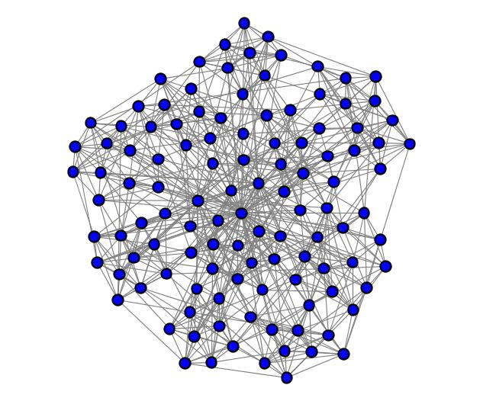
Especially where the community structure isn’t apparent or the networks are large
is there community structure?

Slide 8
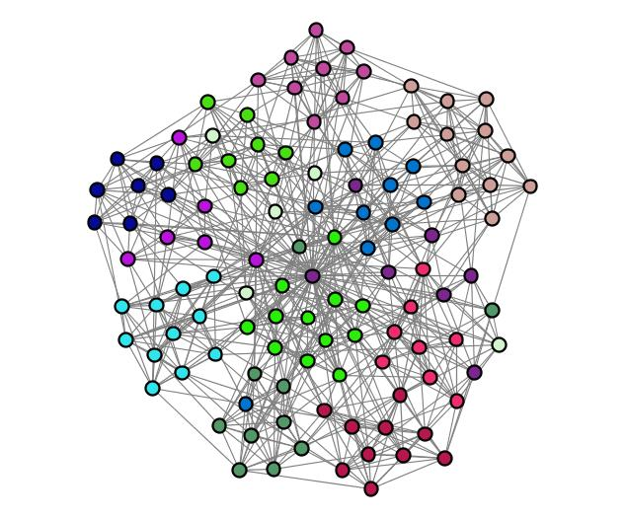
Football conferences
Edges: teams that played each other

Slide 9
k-cores
Each node within a group is connected to k other nodes in the group
4 core
3 core
but even this is too stringent of a requirement for identifying natural communities
4 core
2 core

Slide 10
Community Detection Problem
• Input: A network G(n, m)
• Output:
  – Number of communities
  – Classification of nodes into these communities
Notes:
Input;
Output:

Slide 11
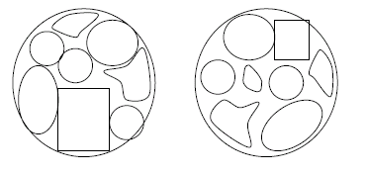
Strength of Communities
Many possible divisions could be done.
We need a good division.
How to check the strength of a particular division?
  We need measurement !!
Global Measurement
VS Local Measurement
Notes:
Input;
Output:

Slide 12
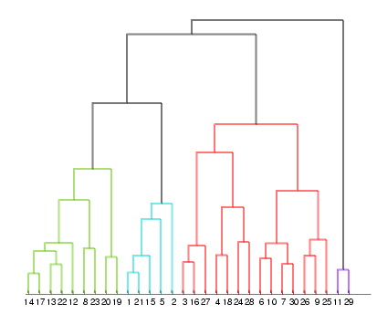
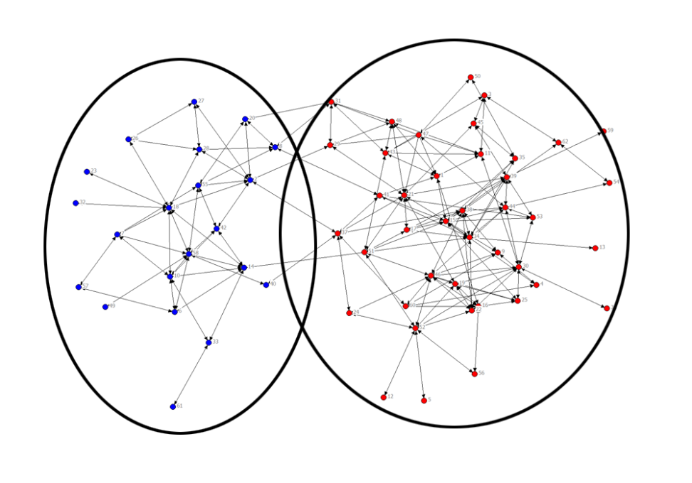
Community Structure Detection Approaches
Hierarchical methods
  Top-down and bottom-up
  common in the social sciences
Graph partitioning methods
  Define “edge counting” metric -- conductance, expansion, modularity, etc. – in interaction graph, then optimize!

Slide 13
Newman & Girvan Edge betweenness algorithm
Extend the concept of betweenness for nodes
Idea: If a network contains communities or groups that are only loosely connected by a few inter-group edges, then all shortest paths between different communities must go along one of these edges.
Edge betweennes of an edge:
the number of shortest paths between pairs of nodes that run along it.
Notes:
Gerelateerd aan spectral clustering, maar dat reikt hier te ver

Slide 14
Newman & Girvan Edge betweenness algorithm
Edges that are the most ‘between’ connect large parts of the graph
  Calculate edge betweenness A_{ij} in n x n matrix A
  Remove edge with highest score
  Recalculate edge betweenness for affected edges
  Goto 2 until no edges remain
O(m²n), may be smaller on graphs with strong clustering
Notes:
Gerelateerd aan spectral clustering, maar dat reikt hier te ver

Slide 15
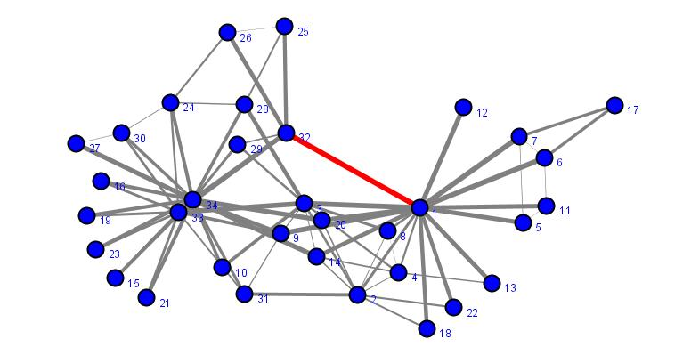
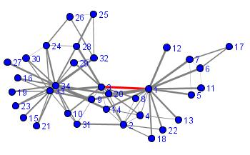
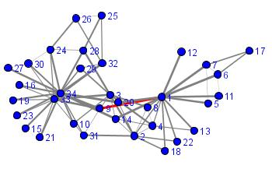
illustration of the algorithm

Slide 16
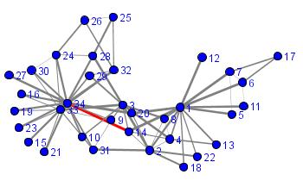
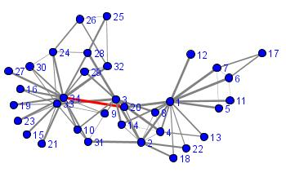
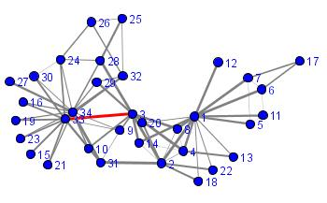
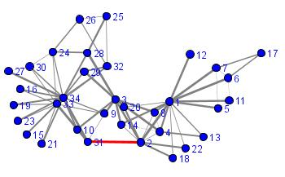
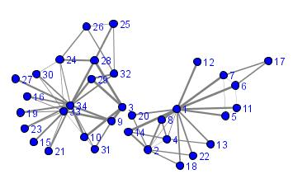
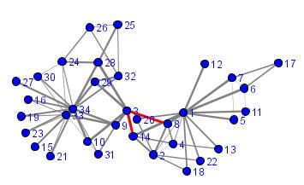
+ deletion of the edge 2-3
separation complete

Slide 17
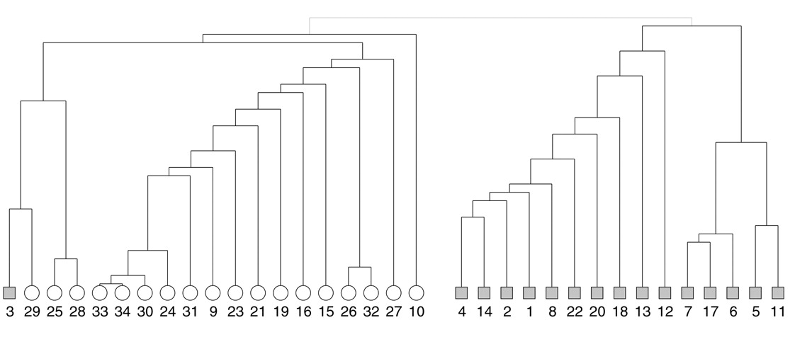
betweenness clustering algorithm & the karate club data set

Slide 18
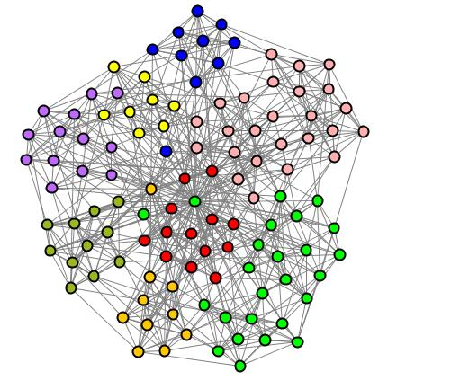
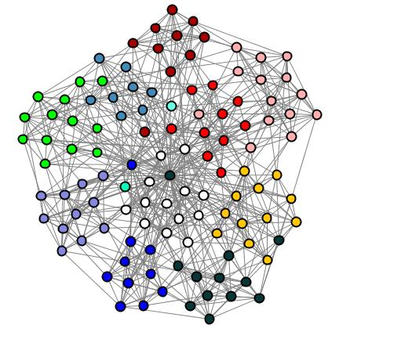
betweenness clustering and the karate club data
8 clusters
12 clusters
better partitioning, but also create some isolates

Slide 19
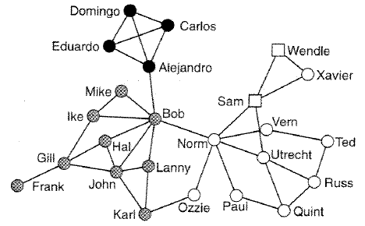
Bridges
Bridge – an edge, that when removed, splits off a community
Bridges can act as bottlenecks for information flow
younger & Spanish speaking
younger & English speaking
bridges
older & English speaking
union negotiators
network of striking employees

Slide 20
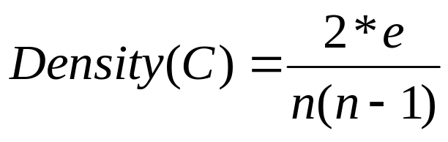
Bridge Cut Algorithm
Iterative Graph Partitioning Algorithm
Compute Bridging Centrality for each edge
Cut the highest bridging edge
Identify an isolated module as a cluster if the density of the isolated module is greater than a threshold.
Density:
n is the number of nodes and e is the number of edges in a sub graph C of a network.

Slide 21
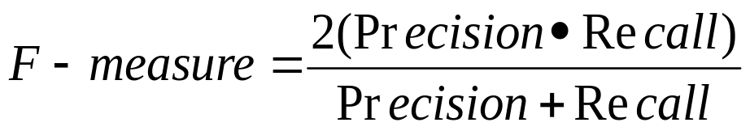
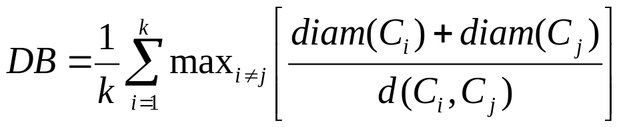
Clustering Validation
F-measure
Davies-Bouldin Index
where diam(C_{i}) is the diameter of cluster C_{i} and d(C_{i} ;C_{j}) is the distance between cluster C_{i} and C_{j} . So, d(C_{i} ;C_{j}) is small if cluster i and j are compact and theirs centers are far away from each other. Therefore, DB will have small values for a good clustering.

Slide 22
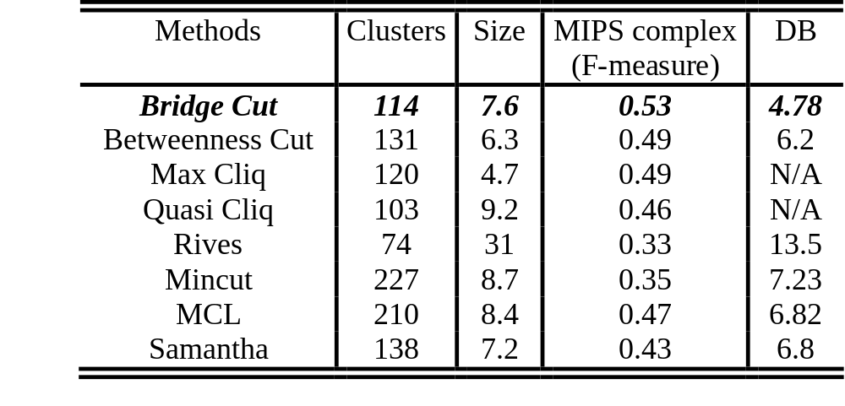
Table: Comparative analysis. Performance of bridge cut method on DIP PPI dataset (2339 nodes, 5595 edges) is compared with seven graph clustering approaches (Maximal clique, quasi clique, Rives, minimum cut, Markov clustering, Samanta). The fourth column represents the average F-measure of the clusters for MIPS complex modules. The fifth column indicates the Davies-Bouldin cluster quality index. Comparisons are performed on the clusters with 4 or more components.

Slide 23
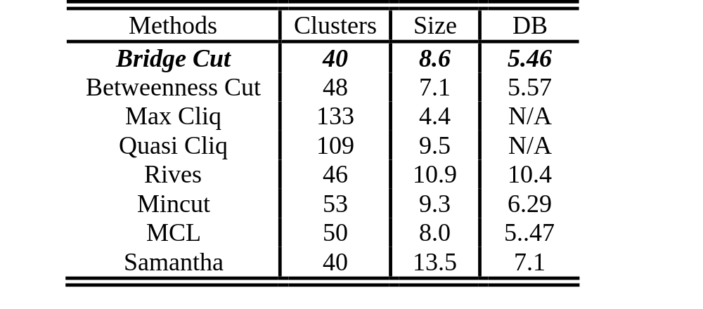
Table. Comparative analysis. Performance of bridge cut method on the school friendship dataset (551 nodes, 2066 edges) is compared with seven graph clustering approaches (Maximal clique, quasi clique, Rives, minimum cut, Markov clustering, Samanta). Column descriptions are the same as Table 1

Slide 24
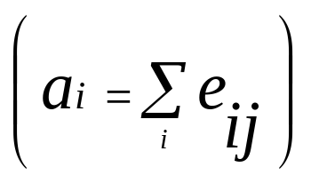
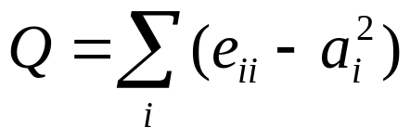
Newman Fast Algorithm: Modularity Measure
Suppose number of communities = k, we define a k*k matrix E, in which e_{ij} means the percentage of edges between community i and j
Modularity Measure :
  Involve percentage of edges within a single community
  Involve percentage of edges between different communities
  Global measure !
  Q = 0 : no community structure.
  Q →1 : significant community structure.
  Greedy approach to maximize Q
Notes:
eij: fraction of total links starting at a node
in partition i and ending at a node in
partition j
• ai: fraction of links connected to i
• ai(2):number of intracommunity links

Slide 25
Modularity Measure: Example
2
1
3
m = 20
e₁₁ = 7/20 , e₂₂= 6/20 , e₃₃= 4/20
e₁₂ = e₂₁= 1/20 , e₁₃= e₃₁= 1/20 , e₂₃= e₃₂= 1/20
Q = e₁₁ – (e₁₂+ e₁₃) ² + e₂₂ – (e₂₁ + e₂₃ )² + e₃₃ – (e₃₁ + e₃₂ ) ²
= 0.8425

Slide 26
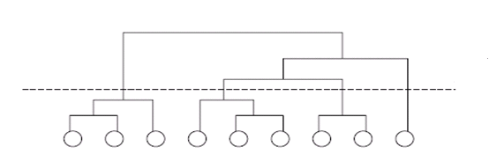
Newman Fast Algorithm (Greedy method)
Separate each vertex solely into n communities.
Calculate the increase and decrease of modularity measure Q for all possible community pairs.
Merge the pairs with greatest increase (or smallest decrease) in Q.
Repeat 2 & 3 until all communities merged in one community.
Cross cut the dendrogram where Q is maximum
Maximum Q
Notes:
Begin with each node in n different
communities.
• Join two communities that gives the maximum
increase (or smallest decrease) in Q
Q
Q
An example of small hierarchical tree. The circles at the bottom represent the vertices in the network, and the tree shows the order in which they join together to form communities for a given definition of the weight of connections between vertex pairs.

Slide 27
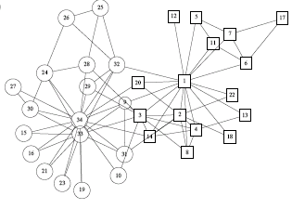
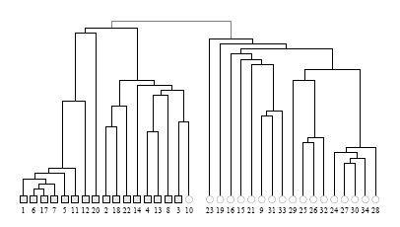
Newman Fast Algorithm Application: Karate Club
Q=0.381

Slide 28
Newman Fast Algorithm: Features
Agglomerative Hierarchical clustering method
Time complexity (m = |E| and n = |V|):
  Worst case: O((m+n)n) -> O(n²) for sparse graphs
Give good divisions especially for dense graph
No need a prior knowledge of the community sizes
No need a prior knowledge of the number of communities
Require global knowledge for network
  Modularity Measurement Q

Slide 29
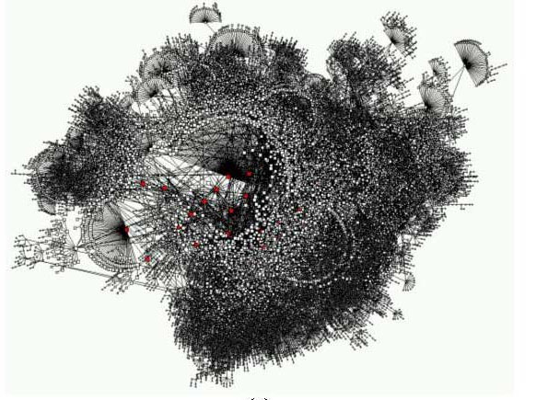
Difficult to Get The Entire Structure……
Notes:
For some graphs, it is difficult to get the entire structure of the graph. Take the world wide web for example, for practical reason ,it is too large and dynamic. Or there maybe other networks that are too large for Newman’s algorithm to accommodate.
In this case, we still need to make quantitative statement about community structure, although we are only restricted to some limited region. For instance, we might like to know the local communities of a person given their social network, or a particular website given its local topology of the world wide web.

Slide 30
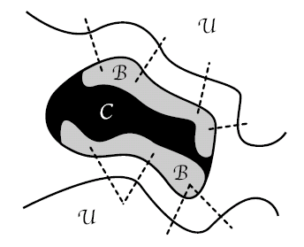
Local Modularity (Aaron Clauset)
Graph Definitions:
G: global graph
C: partially explored portion known to us
U: a set of vertices that are adjacent to C
B: Boundary of C
Notes:
Further more, let’s assume that the only way we may gain additional knowledge about G is by visiting some vertex ui in U, as a result, Ui becomes a member of C, addition unknown vertex maybe added to U.
This is analogous to the manner in which spider or crawler programs harvest the hyperlink structure of world wide web.
Sizeof C >= sizeof U, the partition is always good.

Slide 31


Local Modularity
Adjacency matrix of C:
Quality of C as a community:
  # of edges internal to C/# of total known edges

Slide 32


Local Modularity
Boundary - Adjacency matrix of C:
Local modularity R:
  R = # of edges internal to C (I) / # of edges with at least one point in B(T)
Notes:
A few assumptions:
0<R<1, value proportional to the sharpness of B

Slide 33
Local Modularity: example
What is the
“Local modularity”
of these communities?
  I: # of edges internal to C
  T: # of edges with at least one point in B
  R = I/T

Slide 34
Local Modularity: example
What is the
“Local modularity”
of these communities?
  I: # of edges internal to C
  T: # of edges with at least one point in B
  R = I/T
I=6, T=10,R=0.6

Slide 35
Local Modularity: example
What is the
“Local modularity”
of these communities?
  I: # of edges with neither point in U
  T: # of edges with at least one point in B
  R = I/T
Bad community
I=6, T=10,R=0.6
Best community
I=7,T=5,R=1.4
Better community
I=5,T=5,R=1

Slide 36
Local Modularity: example
What is the
“Local modularity”
of these communities?
  I: # of edges internal to C
  T: # of edges with at least one point in B
  R = I/T
Bad community
I=6, T=10,R=0.6
Better community
I=5,T=5,R=1

Slide 37
Local Modularity: example
What is the
“Local modularity”
of these communities?
  I: # of edges with neither point in U
  T: # of edges with at least one point in B
  R = I/T
Best community
I=7,T=5,R=1.4
Better community
I=5,T=5,R=1

Slide 38
Local- Modularity - Based Algorithm
Inputs:
the explored portion of the graph G
# of vertices in the explored portion of the graph: K
Source vertex : V₀
Outputs:
Vertices are divided into two sets: 1) those vertices considered a part of same local community structure as the source vertex and 2) those vertices that are considered outside it.
Notes:
Begin with each node in n different
communities.
• Join two communities that gives the maximum
increase (or smallest decrease) in Q
Q
Q
An example of small hierarchical tree. The circles at the bottom represent the vertices in the network, and the tree shows the order in which they join together to form communities for a given definition of the weight Wij of connections between vertex pairs.

Slide 39




Local- Modularity - Based Algorithm
Initialize:
Set C = NULL
add V₀ to C
add all neighbors of V₀ to U
set B = V₀
begin
while |C| < k do
for each V_{j} U do
compute R_{j}
end for
find V_{j} such that R_{j} is maximum
add that V_{j} to C
add all new neighbors of that V_{j} to U
update R and B
end while
end
Find max Rj
Update C,U,B
Notes:
Begin with each node in n different
communities.
• Join two communities that gives the maximum
increase (or smallest decrease) in Q
Q
Q
An example of small hierarchical tree. The circles at the bottom represent the vertices in the network, and the tree shows the order in which they join together to form communities for a given definition of the weight Wij of connections between vertex pairs.

Slide 40
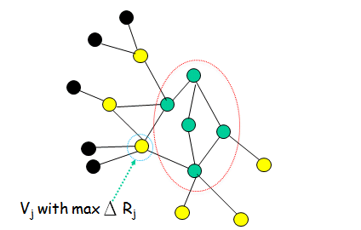
Local-Modularity-Based Algorithm: Example
At step t, we have network like:
C: U: Unknown:

Slide 41
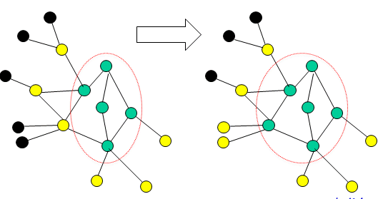
Local-Modularity-Based Algorithm: Example
Step t: Step t+1:
C: U: Unknown:

Slide 42
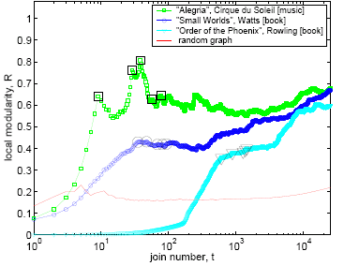
Application: Recommender Network From Amazon.com
Nodes: items on Amazon; edges: frequently co-purchased item pairs
n= 409 687, m =2 464 630, mean degree =12.03
Choose three source vertices:
1. Compact disk Alegria with degree: 15
2.The book Small Worlds with degree: 19
3.The book Harry Potter and the Order of the Phoenix with degree: 3117

Slide 43
Local-Modularity-Based Algorithm: Features
Does not require global knowledge for network
Propose a measure of local community structure
Greedy , agglomerative
Suggest inverse relationship between degree of source vertex and the strength of it s surrounding community structure

Slide 44
Local-Modularity-Based Algorithm: Features
Time complexity: O(k²d)
  k = number of vertices to be explored;
  d = mean degree.
When k << n, it is more efficient to use this algorithm to find divisions than other methods that applied to whole graph with size n.

Slide 45
Summary
Community Structure is an important feature of real world networks.
Some metrics are developed to evaluate the strength of a community.
Based on global modularity, Newman Fast algorithm can detect community structures quickly than previous divisive method.
Local-modularity-based algorithm can detect the hierarchy of communities that enclose a given vertex by exploring the graph one vertex at a time.

Slide 46
Reference
Aaron Clauset ,”Finding local community structure in networks”,
M.E.J. Newman, “Fast algorithm for detecting community structure in networks”, Phys. Rev. E 69, 066133, 2004.

