Slide 1
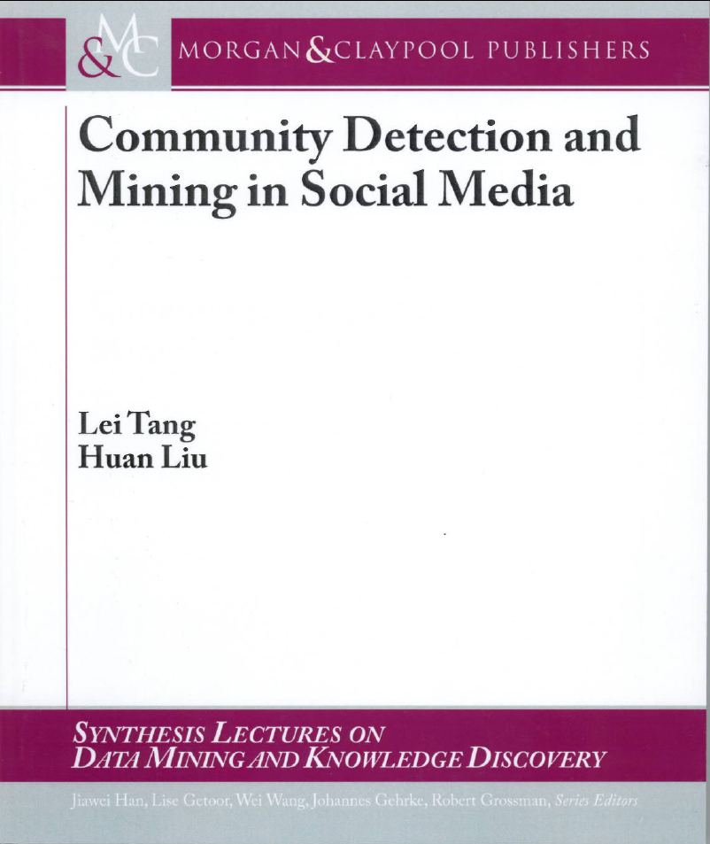
Community Detection and Graph-based Clustering
Adapted from Chapter 3
Of
Lei Tang and Huan Liu’s Book
Chapter 3, Community Detection and Mining in Social Media. Lei Tang and Huan Liu, Morgan & Claypool, September, 2010.

Slide 2
Community
Community: It is formed by individuals such that those within a group interact with each other more frequently than with those outside the group
  a.k.a. group, cluster, cohesive subgroup, module in different contexts
Community detection: discovering groups in a network where individuals’ group memberships are not explicitly given
Why communities in social media?
  Human beings are social
  Easy-to-use social media allows people to extend their social life in unprecedented ways
  Difficult to meet friends in the physical world, but much easier to find friend online with similar interests
  Interactions between nodes can help determine communities
Notes:
The categorization are not necessarily disjoint
; social media is becoming an aspect of the physical world

Slide 3
Communities in Social Media
Two types of groups in social media
  Explicit Groups: formed by user subscriptions
  Implicit Groups: implicitly formed by social interactions
Some social media sites allow people to join groups, is it necessary to extract groups based on network topology?
  Not all sites provide community platform
  Not all people want to make effort to join groups
  Groups can change dynamically
Network interaction provides rich information about the relationship between users
  Can complement other kinds of information, e.g. user profile
  Help network visualization and navigation
  Provide basic information for other tasks, e.g. recommendation
  Note that each of the above three points can be a research topic.
Notes:
Groups are not active: the group members seldom talk to each other
Explicitly vs. implicitly formed groups

Slide 4
COMMUNITY DETECTION

Slide 5
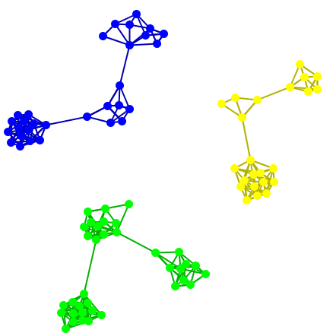
Subjectivity of Community Definition
Each component is a community
A densely-knit community
Definition of a community
can be subjective.
(unsupervised learning)
Notes:
No objective definition for a community
Visualization might help, but only for small networks
Real-world networks tend to be noisy
Need a proper criteria

Slide 6
Taxonomy of Community Criteria
Criteria vary depending on the tasks
Roughly, community detection methods can be divided into 4 categories (not exclusive):
Node-Centric Community
  Each node in a group satisfies certain properties
Group-Centric Community
  Consider the connections within a group as a whole. The group has to satisfy certain properties without zooming into node-level
Network-Centric Community
  Partition the whole network into several disjoint sets
Hierarchy-Centric Community
  Construct a hierarchical structure of communities

Slide 7
Node-Centric Community Detection
Nodes satisfy different properties
  Complete Mutuality
    cliques
  Reachability of members
    k-clique, k-clan, k-club
  Nodal degrees
    k-plex, k-core
  Relative frequency of Within-Outside Ties
    LS sets, Lambda sets
Commonly used in traditional social network analysis
Here, we discuss some representative ones

Slide 8
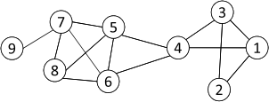
Complete Mutuality: Cliques
Clique: a maximum complete subgraph in which all nodes are adjacent to each other
NP-hard to find the maximum clique in a network
Straightforward implementation to find cliques is very expensive in time complexity
Nodes 5, 6, 7 and 8 form a clique

Slide 9
Finding the Maximum Clique
In a clique of size k, each node maintains degree >= k-1
  Nodes with degree < k-1 will not be included in the maximum clique
Recursively apply the following pruning procedure
  Sample a sub-network from the given network, and find a clique in the sub-network, say, by a greedy approach
  Suppose the clique above is size k, in order to find out a larger clique, all nodes with degree <= k-1 should be removed.
Repeat until the network is small enough
Many nodes will be pruned as social media networks follow a power law distribution for node degrees

Slide 10
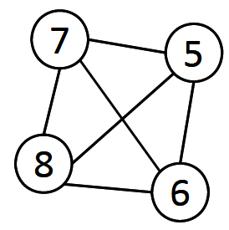
Maximum Clique Example
Suppose we sample a sub-network with nodes {1-9} and find a clique {1, 2, 3} of size 3
In order to find a clique >3, remove all nodes with degree <=3-1=2
  Remove nodes 2 and 9
  Remove nodes 1 and 3
  Remove node 4

Slide 11
Clique Percolation Method (CPM)
Clique is a very strict definition, unstable
Normally use cliques as a core or a seed to find larger communities
CPM is such a method to find overlapping communities
  Input
    A parameter k, and a network
  Procedure
    Find out all cliques of size k in a given network
    Construct a clique graph. Two cliques are adjacent if they share k-1 nodes
    Each connected components in the clique graph form a community

Slide 12
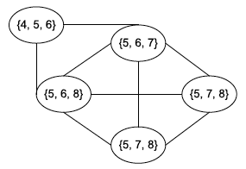

CPM Example
Cliques of size 3:
{1, 2, 3}, {1, 3, 4}, {4, 5, 6}, {5, 6, 7}, {5, 6, 8}, {5, 7, 8},
{6, 7, 8}
Communities:
{1, 2, 3, 4}
{4, 5, 6, 7, 8}

Slide 13
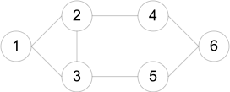
Reachability : k-clique, k-club
Any node in a group should be reachable in k hops
k-clique: a maximal subgraph in which the largest geodesic distance between any two nodes <= k
k-club: a substructure of diameter <= k
A k-clique might have diameter larger than k in the subgraph
  E.g. {1, 2, 3, 4, 5}
Commonly used in traditional SNA
Often involves combinatorial optimization
Cliques: {1, 2, 3}
2-cliques: {1, 2, 3, 4, 5}, {2, 3, 4, 5, 6}
2-clubs: {1,2,3,4}, {1, 2, 3, 5}, {2, 3, 4, 5, 6}

Slide 14
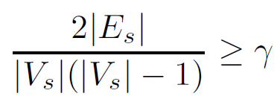

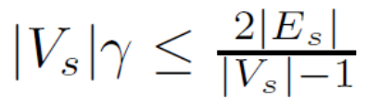
Group-Centric Community Detection: Density-Based Groups
The group-centric criterion requires the whole group to satisfy a certain condition
  E.g., the group density >= a given threshold
A subgraph is a quasi-clique if
  where the denominator is the maximum number of degrees.
A similar strategy to that of cliques can be used
  Sample a subgraph, and find a maximal quasi-clique (say, of size )
  Remove nodes with degree less than the average degree
,
<

Slide 15
Network-Centric Community Detection
Network-centric criterion needs to consider the connections within a network globally
Goal: partition nodes of a network into disjoint sets
Approaches:
  (1) Clustering based on vertex similarity
  (2) Latent space models (multi-dimensional scaling )
  (3) Block model approximation
  (4) Spectral clustering
  (5) Modularity maximization
Notes:
A typical goal is to partition a network into disjoint sets. But that can be extended to soft clustering as well

Slide 16
(1) Clustering based on vertex similarity
Clustering based on Vertex Similarity
Apply k-means or similarity-based clustering to nodes
Vertex similarity is defined in terms of the similarity of their neighborhood
Structural equivalence: two nodes are structurally equivalent iff they are connecting to the same set of actors
Structural equivalence is too restrict for practical use.
Nodes 1 and 3 are structurally equivalent;
So are nodes 5 and 6.

Slide 17

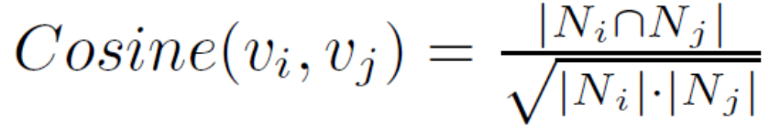


(1) Clustering based on vertex similarity
Vertex Similarity
Jaccard Similarity
Cosine similarity

Slide 18


(2) Latent space models
Latent Space Models
Map nodes into a low-dimensional space such that the proximity between nodes based on network connectivity is preserved in the new space, then apply k-means clustering
Multi-dimensional scaling (MDS)
  Given a network, construct a proximity matrix P representing the pairwise distance between nodes (e.g., geodesic distance)
  Let denote the coordinates of nodes in the low-dimensional space
  Objective function:
  Solution:
  V is the top eigenvectors of , and is a diagonal matrix of top eigenvalues
Centered matrix
Reference: http://www.cse.ust.hk/~weikep/notes/MDS.pdf
Notes:
\widetilde{P} is introduced for notational convenience. It can be constructed based on the proximity matrix P.

Slide 19
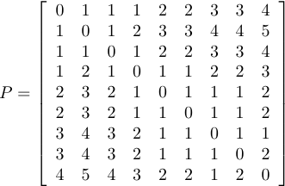
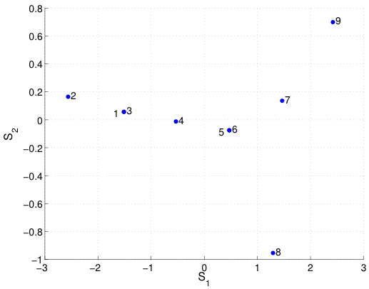
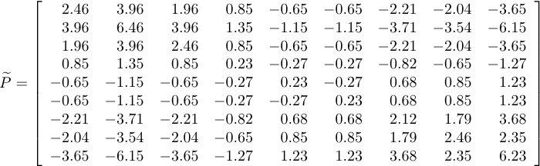
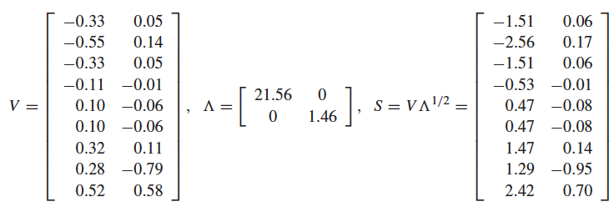
(2) Latent space models
MDS Example
geodesic
distance
Two communities:
{1, 2, 3, 4} and {5, 6, 7, 8, 9}

Slide 20
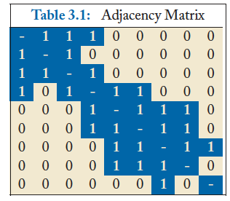
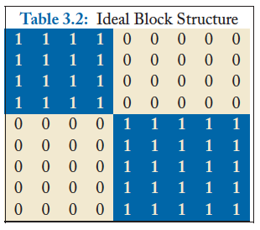
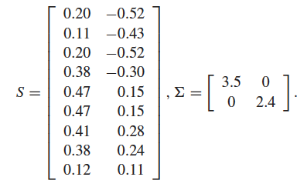
(3) Block model approximation
Block Models
S is the community indicator matrix (group memberships)
Relax S to be numerical values, then the optimal solution corresponds to the top eigenvectors of A
Two communities:
{1, 2, 3, 4} and {5, 6, 7, 8, 9}

Slide 21
(4) Spectral clustering
Cut
Most interactions are within group whereas interactions between groups are few
community detection → minimum cut problem
Cut: A partition of vertices of a graph into two disjoint sets
Minimum cut problem: find a graph partition such that the number of edges between the two sets is minimized

Slide 22
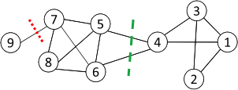


(4) Spectral clustering
Ratio Cut & Normalized Cut
Minimum cut often returns an imbalanced partition, with one set being a singleton, e.g. node 9
Change the objective function to consider community size
C_{i,}: a community
|C_{i}|: number of nodes in C_{i}
vol(C_{i}): sum of degrees in C_{i}

Slide 23


(4) Spectral clustering
Ratio Cut & Normalized Cut Example
For partition in red:
For partition in green:
Both ratio cut and normalized cut prefer a balanced partition

Slide 24



(4) Spectral clustering
Spectral Clustering
Both ratio cut and normalized cut can be reformulated as
Where
Spectral relaxation:
Optimal solution: top eigenvectors with the smallest eigenvalues
graph Laplacian for ratio cut
normalized graph Laplacian
A diagonal matrix of degrees
Reference: http://www.cse.ust.hk/~weikep/notes/clustering.pdf

Slide 25
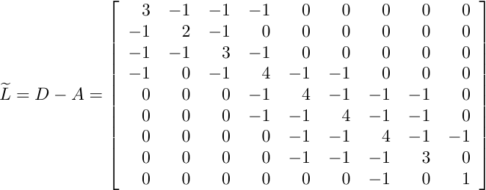
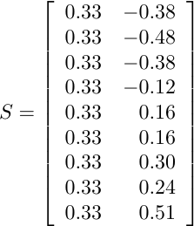
(4) Spectral clustering
Spectral Clustering Example
Two communities:
{1, 2, 3, 4} and {5, 6, 7, 8, 9}
The 1st eigenvector means all nodes belong to the same cluster, no use
k-means
Centered matrix
Notes:
The 1st eigenvector is discarded

Slide 26


(5) Modularity maximization
Modularity Maximization
Modularity measures the strength of a community partition by taking into account the degree distribution
Given a network with m edges, the expected number of edges between two nodes with degrees d_{i} and d_{j} is
Strength of a community:
Modularity:
A larger value indicates a good community structure
The expected number of edges between nodes 1 and 2 is
3*2/ (2*14) = 3/14
Given the degree distribution

Slide 27

(5) Modularity maximization
Modularity Matrix
Centered matrix
Modularity matrix:
Similar to spectral clustering, Modularity maximization can be reformulated as
Optimal solution: top eigenvectors of the modularity matrix
Apply k-means to S as a post-processing step to obtain community partition

Slide 28
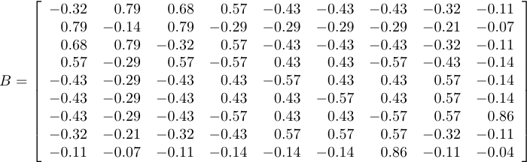
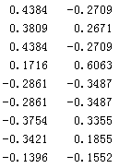
(5) Modularity maximization
Modularity Maximization Example
Two Communities:
{1, 2, 3, 4} and {5, 6, 7, 8, 9}
k-means
Modularity Matrix

Slide 29
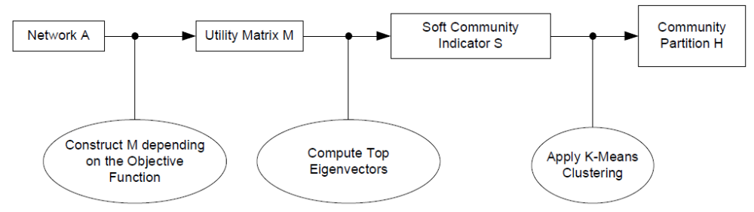

A Unified View for Community Partition
Latent space models, block models, spectral clustering, and modularity maximization can be unified as
Reference: http://www.cse.ust.hk/~weikep/notes/Script_community_detection.m

Slide 30
Hierarchy-Centric Community Detection
Goal: build a hierarchical structure of communities based on network topology
Allow the analysis of a network at different resolutions
Representative approaches:
  Divisive Hierarchical Clustering (top-down)
  Agglomerative Hierarchical clustering (bottom-up)

Slide 31
Divisive Hierarchical Clustering
Divisive clustering
  Partition nodes into several sets
  Each set is further divided into smaller ones
  Network-centric partition can be applied for the partition
One particular example: recursively remove the “weakest” tie
  Find the edge with the least strength
  Remove the edge and update the corresponding strength of each edge
Recursively apply the above two steps until a network is decomposed into desired number of connected components.
Each component forms a community

Slide 32
Edge Betweenness
The strength of a tie can be measured by edge betweenness
Edge betweenness: the number of shortest paths that pass along with the edge
The edge with higher betweenness tends to be the bridge between two communities.
The edge betweenness of e(1, 2) is 4 (=6/2 + 1), as all the shortest paths from 2 to {4, 5, 6, 7, 8, 9} have to either pass e(1, 2) or e(2, 3), and e(1,2) is the shortest path between 1 and 2
Notes:
Nodes 4-9 have two paths to reach Node2: e(1,2) and e(2,3), hence, 6/2 = 3, Node 3 can reach Node 2 directly, and Node 1 reaches Node 2 via e(1,2). Hence, edge betweenness of e(1,2) is 4.

Slide 33
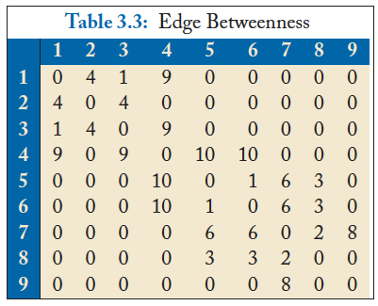
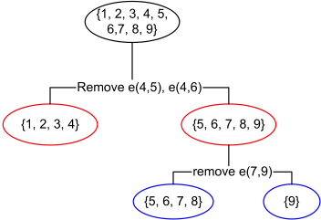
Divisive clustering based on edge betweenness
Initial betweenness value
After remove e(4,5), the betweenness of e(4, 6) becomes 20, which is the highest;
After remove e(4,6), the edge e(7,9) has the highest betweenness value 4, and should be removed.
Idea: progressively removing edges with the highest betweenness

Slide 34
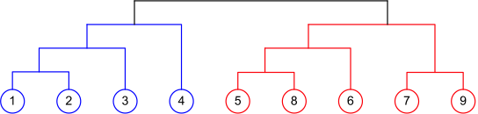
Agglomerative Hierarchical Clustering
Initialize each node as a community
Merge communities successively into larger communities following a certain criterion
  E.g., based on modularity increase
Dendrogram according to Agglomerative Clustering based on Modularity

Slide 35
Summary of Community Detection
Node-Centric Community Detection
  cliques, k-cliques, k-clubs
Group-Centric Community Detection
  quasi-cliques
Network-Centric Community Detection
  Clustering based on vertex similarity
  Latent space models, block models, spectral clustering, modularity maximization
Hierarchy-Centric Community Detection
  Divisive clustering
  Agglomerative clustering

Slide 36
COMMUNITY EVALUATION

Slide 37
Evaluating Community Detection (1)
For groups with clear definitions
  E.g., Cliques, k-cliques, k-clubs, quasi-cliques
  Verify whether extracted communities satisfy the definition
For networks with ground truth information
  Normalized mutual information
  Accuracy of pairwise community memberships

Slide 38
Measuring a Clustering Result
1, 2, 3
4, 5, 6
1, 3
2
4, 5, 6
Ground Truth
Clustering Result
How to measure the
clustering quality?
The number of communities after grouping can be different from the ground truth
No clear community correspondence between clustering result and the ground truth
Normalized Mutual Information can be used
Notes:
Normalized mutual information considers all the possible community matching between the ground truth and the clustering result

Slide 39

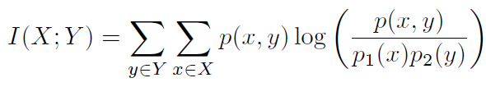

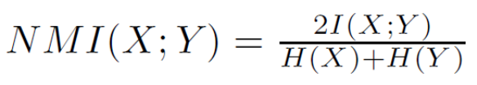
Normalized Mutual Information
Entropy: the information contained in a distribution
Mutual Information: the shared information between two distributions
Normalized Mutual Information (between 0 and 1)
Consider a partition as a distribution (probability of one node falling into one community), we can compute the matching between the clustering result and the ground truth
JMLR03, Strehl
or
KDD04, Dhilon
Notes:
We normalize MI so that we can compare more than two clusterings, e.g., clusterings A, B, C

Slide 40



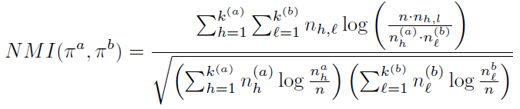
NMI
Notes:
Pi_a, Pi_b denote different partitions.
n_h^a is the number of nodes in Partition a assigned to h-th community;
n_l^b is the number of nodes in Partition b assigned to l-th community;
n_h, l is the number of nodes assigned to h-th community in partitition a, and l-th community in partition b.
k^{(a)} is the number of communities in partition a,
k^{(b)} is the number of communities in partition b.

Slide 41



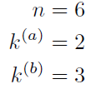
NMI-Example
Partition a: [1, 1, 1, 2, 2, 2]
Partition b: [1, 2, 1, 3, 3, 3]
1, 2, 3
4, 5, 6
1, 3
2
4, 5,6
h=1 | 3
h=2 | 3
l=1 | 2
l=2 | 1
l=3 | 3
 | l=1 | l=2 | l=3
h=1 | 2 | 1 | 0
h=2 | 0 | 0 | 3
contingency table or confusion matrix
=0.8278
Reference: http://www.cse.ust.hk/~weikep/notes/NormalizedMI.m

Slide 42
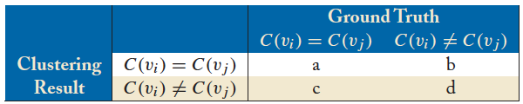

Accuracy of Pairwise Community Memberships
Consider all the possible pairs of nodes and check whether they reside in the same community
An error occurs if
  Two nodes belonging to the same community are assigned to different communities after clustering
  Two nodes belonging to different communities are assigned to the same community
Construct a contingency table or confusion matrix

Slide 43
Accuracy Example
1, 2, 3
4, 5, 6
1, 3
2
4, 5, 6
Ground Truth
Clustering Result
 |  | Ground Truth
 |  | C(v_{i}) = C(v_{j}) | C(v_{i}) != C(v_{j})
Clustering Result | C(v_{i}) = C(v_{j}) | 4 | 0
 | C(v_{i}) != C(v_{j}) | 2 | 9
Accuracy = (4+9)/ (4+2+9+0) = 13/15

Slide 44
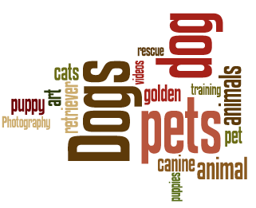

Evaluation using Semantics
For networks with semantics
  Networks come with semantic or attribute information of nodes or connections
  Human subjects can verify whether the extracted communities are coherent
Evaluation is qualitative
It is also intuitive and helps understand a community
An animal
community
A health
community

Slide 45
Evaluation without Ground Truth
For networks without ground truth or semantic information
This is the most common situation
An option is to resort to cross-validation
  Extract communities from a (training) network
  Evaluate the quality of the community structure on a network constructed from a different date or based on a related type of interaction
Quantitative evaluation functions
  Modularity (M.Newman. Modularity and community structure in networks. PNAS 06.)
  Link prediction (the predicted network is compared with the true network)

Slide 46
Book Available at
Morgan & claypool Publishers
Amazon
If you have any comments, please feel free to contact:
Lei Tang, Yahoo! Labs, ltang@yahoo-inc.com
Huan Liu, ASU huanliu@asu.edu

