Slide 1
Lecture 18
Community structures
Slides modified from Huan Liu, Lei Tang, Nitin Agarwal

Slide 2
Community Detection
A community is a set of nodes between which the interactions are (relatively) frequent
  a.k.a. group, subgroup, module, cluster
Community detection
  a.k.a. grouping, clustering, finding cohesive subgroups
  Given: a social network
  Output: community membership of (some) actors
Applications
  Understanding the interactions between people
  Visualizing and navigating huge networks
  Forming the basis for other tasks such as data mining

Slide 3
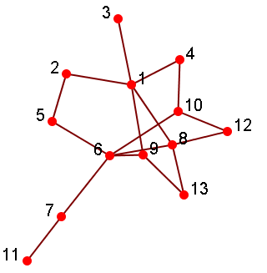
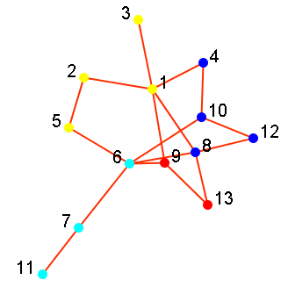
Visualization after Grouping
4 Groups:
{1,2,3,5}
{4,8,10,12}
{6,7,11}
{9,13}
(Nodes colored by
Community Membership)
Notes:
Modularity

Slide 4
Classification
User Preference or Behavior can be represented as class labels
  Whether or not clicking on an ad
  Whether or not interested in certain topics
  Subscribed to certain political views
  Like/Dislike a product
Given
  A social network
  Labels of some actors in the network
Output
  Labels of remaining actors in the network

Slide 5
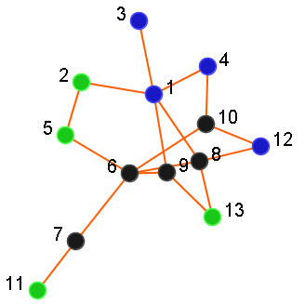
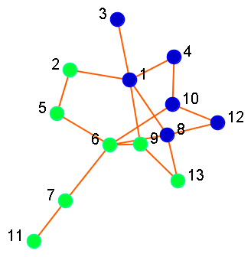
Visualization after Prediction
Predictions
6: Non-Smoking
7: Non-Smoking
8: Smoking
9: Non-Smoking
10: Smoking
: Smoking
: Non-Smoking
: ? Unknown

Slide 6
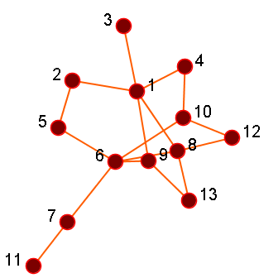
Link Prediction
Given a social network, predict which nodes are likely to get connected
Output a list of (ranked) pairs of nodes
Example: Friend recommendation in Facebook
(2, 3)
(4, 12)
(5, 7)
(7, 13)

Slide 7
Viral Marketing/Outbreak Detection
Users have different social capital (or network values) within a social network, hence, how can one make best use of this information?
Viral Marketing: find out a set of users to provide coupons and promotions to influence other people in the network so my benefit is maximized
Outbreak Detection: monitor a set of nodes that can help detect outbreaks or interrupt the infection spreading (e.g., H1N1 flu)
Goal: given a limited budget, how to maximize the overall benefit?

Slide 8
An Example of Viral Marketing
Find the coverage of the whole network of nodes with the minimum number of nodes
How to realize it – an example
  Basic Greedy Selection: Select the node that maximizes the utility, remove the node and then repeat
Select Node 1
Select Node 8
Select Node 7
Node 7 is not a node with
high centrality!

Slide 9

PRINCIPLES OF
COMMUNITY DETECTION

Slide 10
Communities
Community: “subsets of actors among whom there are relatively strong, direct, intense, frequent or positive ties.”
    -- Wasserman and Faust, Social Network Analysis, Methods and Applications
Community is a set of actors interacting with each other frequently
A set of people without interaction is NOT a community
  e.g. people waiting for a bus at station but don’t talk to each other

Slide 11


Example of Communities
Communities from
Facebook
Communities from
Flickr

Slide 12
Community Detection
Community Detection: “formalize the strong social groups based on the social network properties”
Some social media sites allow people to join groups
  Not all sites provide community platform
  Not all people join groups
Network interaction provides rich information about the relationship between users
  Is it necessary to extract groups based on network topology?
  Groups are implicitly formed
  Can complement other kinds of information
  Provide basic information for other tasks
Notes:
Groups are not active: the group members seldom talk to each other
Explicitly vs. implicitly formed groups

Slide 13
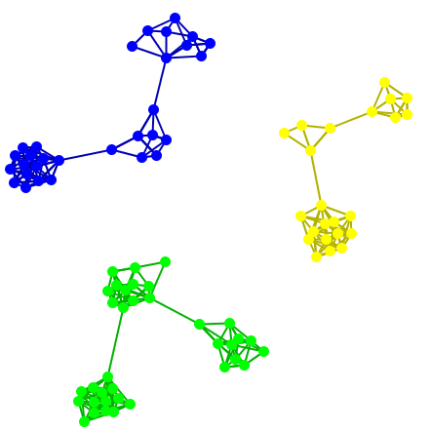
Subjectivity of Community Definition
Each component is a community
A densely-knit community
Definition of a community
can be subjective.
Notes:
No objective definition for a community
Visualization might help, but only for small networks
Real-world networks tend to be noisy
Need a proper criteria

Slide 14
Taxonomy of Community Criteria
Criteria vary depending on the tasks
Roughly, community detection methods can be divided into 4 categories (not exclusive):
Node-Centric Community
  Each node in a group satisfies certain properties
Group-Centric Community
  Consider the connections within a group as a whole. The group has to satisfy certain properties without zooming into node-level
Network-Centric Community
  Partition the whole network into several disjoint sets
Hierarchy-Centric Community
  Construct a hierarchical structure of communities

Slide 15
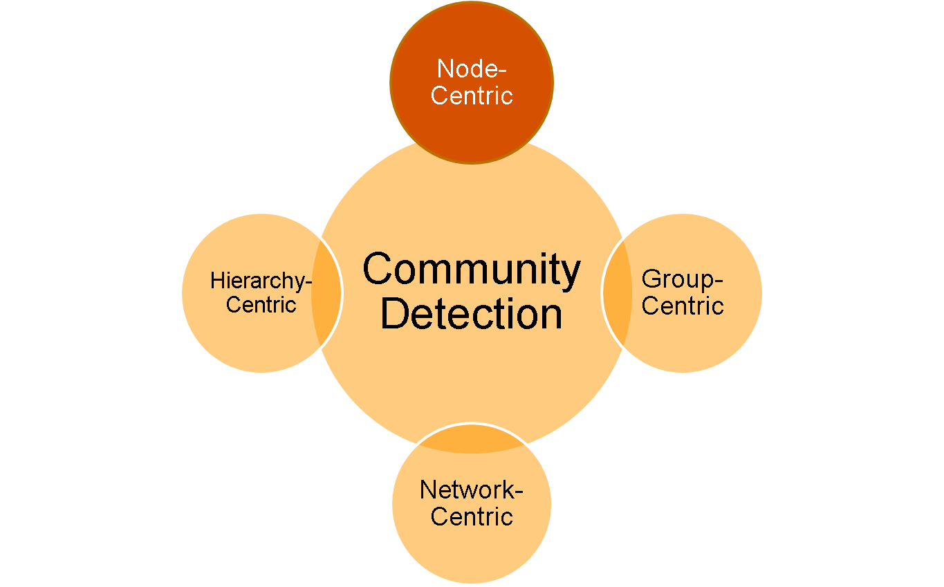
Node-Centric Community Detection

Slide 16
Node-Centric Community Detection
Nodes satisfy different properties
  Complete Mutuality
    cliques
  Reachability of members
    k-clique, k-clan, k-club
  Nodal degrees
    k-plex, k-core
  Relative frequency of Within-Outside Ties
    LS sets, Lambda sets
Commonly used in traditional social network analysis

Slide 17
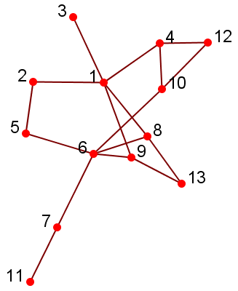
Complete Mutuality: Clique
A maximal complete subgraph of three or more nodes all of which are adjacent to each other
NP-hard to find the maximal clique
Recursive pruning: To find a clique of size k, remove those nodes with less than k-1 degrees
Normally use cliques as a core or seed to explore larger communities

Slide 18
Geodesic
Reachability is calibrated by the Geodesic distance
Geodesic: a shortest path between two nodes (12 and 6)
  Two paths: 12-4-1-2-5-6, 12-10-6
  12-10-6 is a geodesic
Geodesic distance: #hops in geodesic between two nodes
  e.g., d(12, 6) = 2, d(3, 11)=5
Diameter: the maximal geodesic distance for any 2 nodes in a network
  #hops of the longest shortest path
Diameter = 5
Notes:
6 degrees of separation is the average distance, not the maximum one.

Slide 19
Reachability: k-clique, k-club
Any node in a group should be reachable in k hops
k-clique: a maximal subgraph in which the largest geodesic distance between any nodes <= k
A k-clique can have diameter larger than k within the subgraph
  e.g., 2-clique {12, 4, 10, 1, 6}
  Within the subgraph d(1, 6) = 3
k-club: a substructure of diameter <= k
  e.g., {1,2,5,6,8,9}, {12, 4, 10, 1} are 2-clubs
Notes:
V1, v2, v3, v4, v5 is also a 3-clan
Both k-clans and k-clubs are k-cliques.
Node-centric community definition are either too strict , or it is too time-consuming to find the groups.

Slide 20
Nodal Degrees: k-core, k-plex
Each node should have a certain number of connections to nodes within the group
  k-core: a substracture that each node connects to at least k members within the group
  k-plex: for a group with n_{s} nodes, each node should be adjacent no fewer than n_{s}-k in the group
The definitions are complementary
  A k-core is a (n_{s}-k)-plex
Notes:
The union of k-core is still a k-core.

Slide 21
Within-Outside Ties: LS sets
LS sets: Any of its proper subsets has more ties to other nodes in the group than outside the group
Too strict, not reasonable for network analysis
A relaxed definition is Lambda sets
  Require the computation of edge-connectivity between any pair of nodes via minimum-cut, maximum-flow algorithm

Slide 22
Recap of Node-Centric Communities
Each node has to satisfy certain properties
  Complete mutuality
  Reachability
  Nodal degrees
  Within-Outside Ties
Limitations:
  Too strict, but can be used as the core of a community
  Not scalable, commonly used in network analysis with small-size network
  Sometimes not consistent with property of large-scale networks
    e.g., nodal degrees for scale-free networks

Slide 23
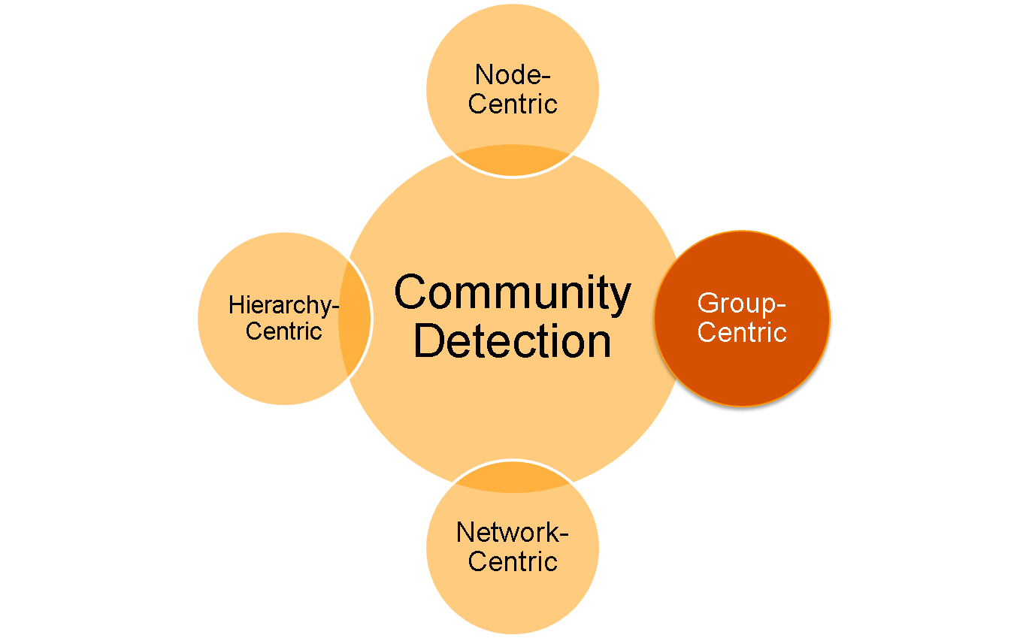
Group-Centric Community Detection

Slide 24
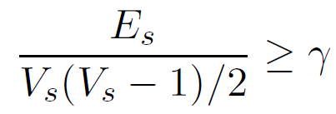
Group-Centric Community Detection
Consider the connections within a group as whole,
Some nodes may have low connectivity
A subgraph with V_{s} nodes and E_{s} edges is a γ-dense quasi-clique if
Recursive pruning:
  Sample a subgraph, find a maximal γ-dense quasi-clique
    the resultant size = k
  Remove the nodes that
    whose degree < k^{γ}
    all their neighbors with degree < k^{γ}
Notes:
A greedy algorithm is adopted to find a maximal quasi-clique
Starting from the node with largest degree, expanding it with nodes that are likely to contribute to a larger quasi-clique
Continue until no more nodes can be added

Slide 25
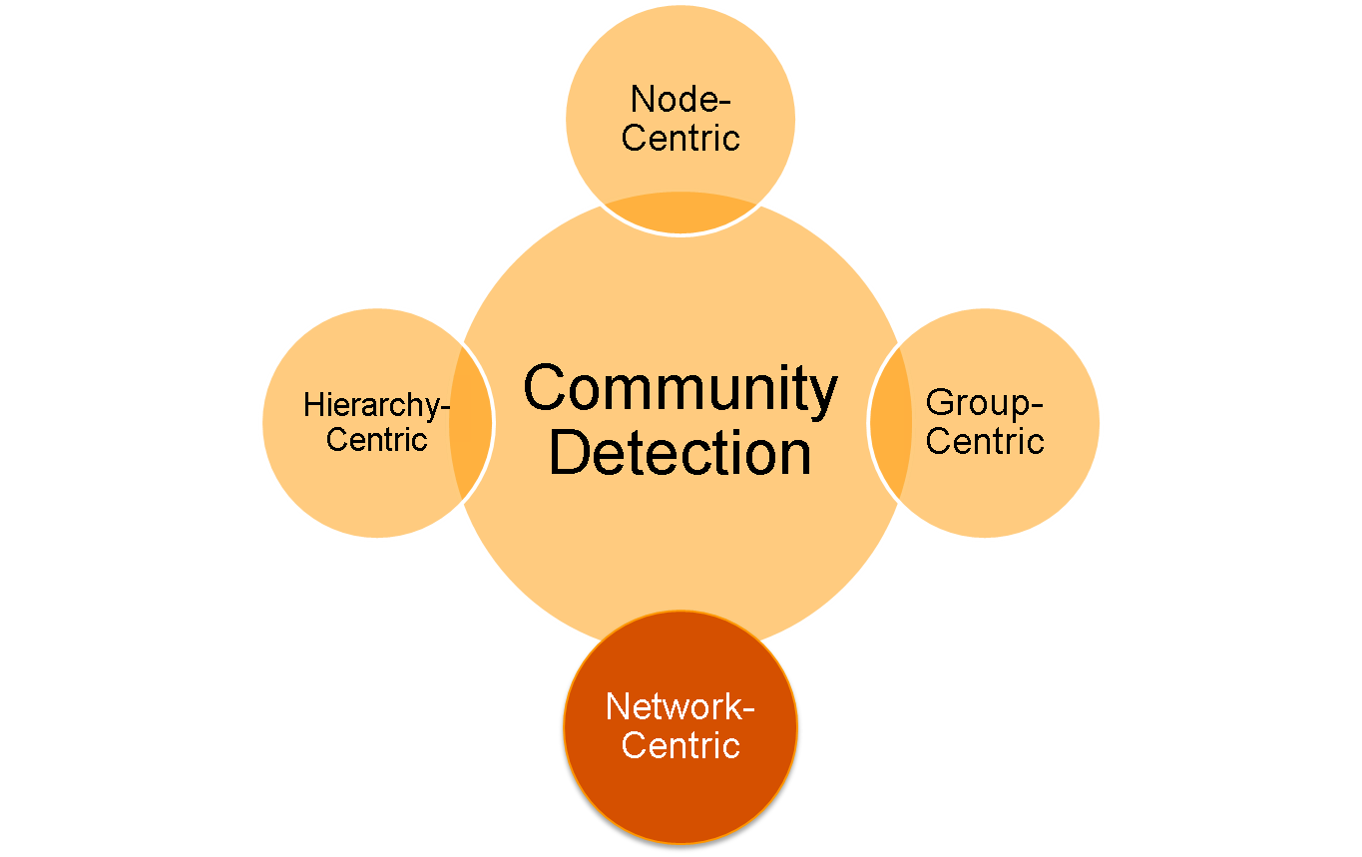
Network-Centric Community Detection

Slide 26
Network-Centric Community Detection
To form a group, we need to consider the connections of the nodes globally.
Goal: partition the network into disjoint sets
Groups based on
  Node Similarity
  Latent Space Model
  Block Model Approximation
  Cut Minimization
  Modularity Maximization

Slide 27
Node Similarity
Node similarity is defined by how similar their interaction patterns are
Two nodes are structurally equivalent if they connect to the same set of actors
  e.g., nodes 8 and 9 are structurally equivalent
Groups are defined over equivalent nodes
  Too strict
  Rarely occur in a large-scale
  Relaxed equivalence class is difficult to compute
In practice, use vector similarity
  e.g., cosine similarity, Jaccard similarity
Notes:
Related to positional analysis

Slide 28

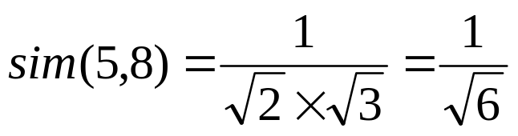

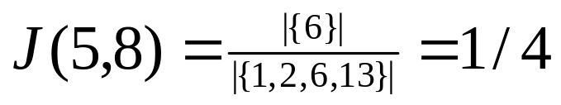
Vector Similarity
 | 1 | 2 | 3 | 4 | 5 | 6 | 7 | 8 | 9 | 10 | 11 | 12 | 13
5 |  | 1 |  |  |  | 1
8 | 1 |  |  |  |  | 1 |  |  |  |  |  |  | 1
9 | 1 |  |  |  |  | 1 |  |  |  |  |  |  | 1
a vector
structurally
equivalent
Cosine Similarity:
Jaccard Similarity:

Slide 29
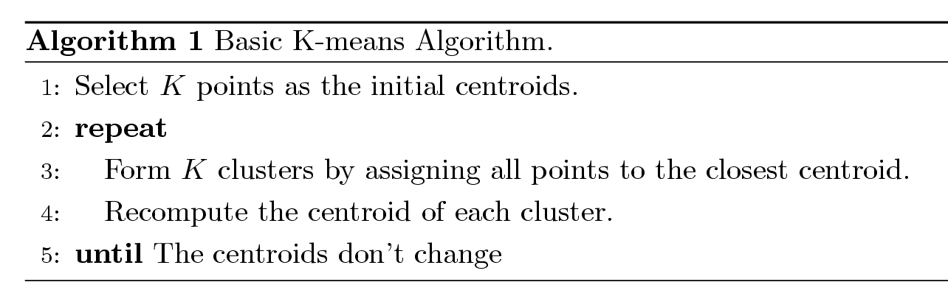
Clustering based on Node Similarity
For practical use with huge networks:
  Consider the connections as features
  Use Cosine or Jaccard similarity to compute vertex similarity
  Apply classical k-means clustering Algorithm
K-means Clustering Algorithm
  Each cluster is associated with a centroid (center point)
  Each node is assigned to the cluster with the closest centroid

Slide 30

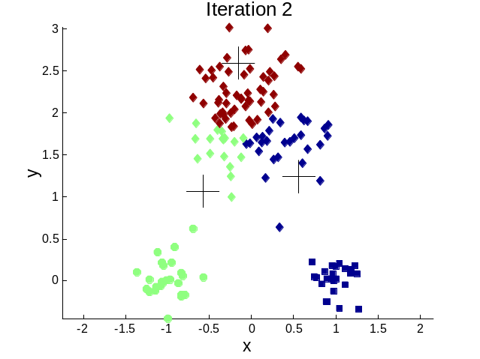




Illustration of k-means clustering

Slide 31
Shingling
Pair-wise computation of similarity can be time consuming with millions of nodes
Shingling can be exploited
  Mapping each vector into multiple shingles so the Jaccard similarity between two vectors can be computed by comparing the shingles
  Implemented using a quick hash function
  Similar vectors share more shingles after transformation
Nodes of the same shingle can be considered belonging to one community
In reality, we can apply 2-level shingling

Slide 32
Fast Two-Level Shingling
Nodes
1
2
3
4
5
6
1st level
shingling
Shingles
2nd level
shingling
Meta-Shingles
1, 2, 3, 4
2, 3, 4, 5, 6

Slide 33

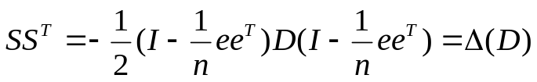



Groups on Latent-Space Models
Latent-space models: Transform the nodes in a network into a lower-dimensional space such that the distance or similarity between nodes are kept in the Euclidean space
Multidimensional Scaling (MDS)
  Given a network, construct a proximity matrix to denote the distance between nodes (e.g. geodesic distance)
  Let D denotes the square distance between nodes
  denotes the coordinates in the lower-dimensional space
  Objective: minimize the difference
  Let (the top-k eigenvalues of ), V the top-k eigenvectors
  Solution:
Apply k-means to S to obtain clusters

Slide 34
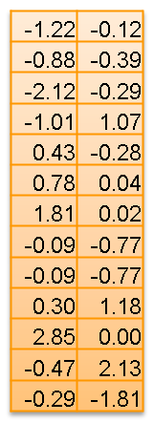
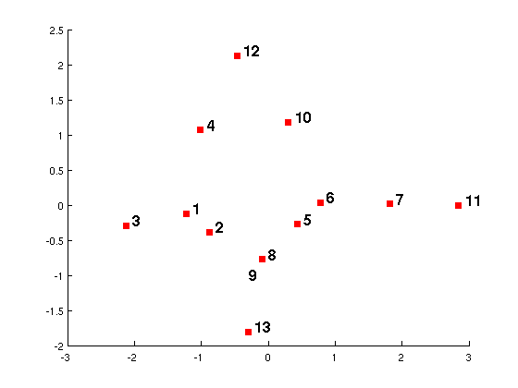
MDS-example
1, 2, 3, 4, 10, 12
5, 6, 7, 8, 9, 11, 13
k-means
S
Geodesic Distance Matrix
 | 1 | 2 | 3 | 4 | 5 | 6 | 7 | 8 | 9 | 10 | 11 | 12 | 13
1 | 0 | 1 | 1 | 1 | 2 | 2 | 3 | 1 | 1 | 2 | 4 | 2 | 2
2 | 1 | 0 | 2 | 2 | 1 | 2 | 3 | 2 | 2 | 3 | 4 | 3 | 3
3 | 1 | 2 | 0 | 2 | 3 | 3 | 4 | 2 | 2 | 3 | 5 | 3 | 3
4 | 1 | 2 | 2 | 0 | 3 | 2 | 3 | 2 | 2 | 1 | 4 | 1 | 3
5 | 2 | 1 | 3 | 3 | 0 | 1 | 2 | 2 | 2 | 2 | 3 | 3 | 3
6 | 2 | 2 | 3 | 2 | 1 | 0 | 1 | 1 | 1 | 1 | 2 | 2 | 2
7 | 3 | 3 | 4 | 3 | 2 | 1 | 0 | 2 | 2 | 2 | 1 | 3 | 3
8 | 1 | 2 | 2 | 2 | 2 | 1 | 2 | 0 | 2 | 2 | 3 | 3 | 1
9 | 1 | 2 | 2 | 2 | 2 | 1 | 2 | 2 | 0 | 2 | 3 | 3 | 1
10 | 2 | 3 | 3 | 1 | 2 | 1 | 2 | 2 | 2 | 0 | 3 | 1 | 3
11 | 4 | 4 | 5 | 4 | 3 | 2 | 1 | 3 | 3 | 3 | 0 | 4 | 4
12 | 2 | 3 | 3 | 1 | 3 | 2 | 3 | 3 | 3 | 1 | 4 | 0 | 4
13 | 2 | 3 | 3 | 3 | 3 | 2 | 3 | 1 | 1 | 3 | 4 | 4 | 0
MDS
Notes:
Node 3 and 11 are furthest, so in the mapped space, 3 and 11 are far away.
For nodes 8 and 9, they map to exactly the same location as the distance to all the other nodes are the same.

Slide 35
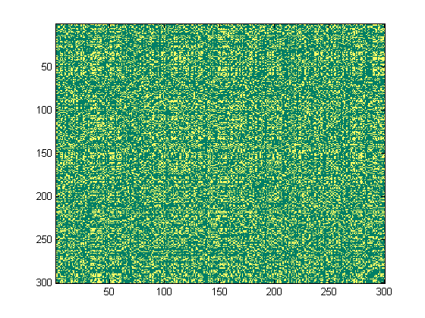
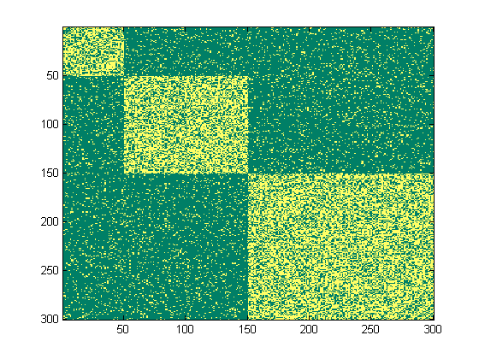


Block-Model Approximation
After
Reordering
Network Interaction Matrix
Block Structure
Objective: Minimize the difference between an interaction matrix and a block structure
Challenge: S is discrete, difficult to solve
Relaxation: Allow S to be continuous satisfying
Solution: the top eigenvectors of A
Post-Processing: Apply k-means to S to find the partition
S is a community indicator matrix
Notes:
L is the loss function, A is the network interaction matrix, \sigma is a diagonal matrix represents the interaction density, and S is the indicator matrix
Need to introduce the community indicator here

Slide 36



Cut-Minimization
Between-group interactions should be infrequent
Cut: number of edges between two sets of nodes
Objective: minimize the cut
  Limitations: often find communities of
  only one node
  Need to consider the group size
Two commonly-used variants:
Cut=2
Number of nodes in a community
Cut =1
Number of within-group Interactions

Slide 37

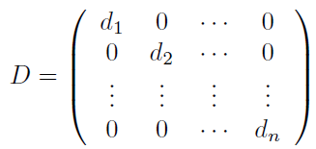

Graph Laplacian
Cut-minimization can be relaxed into the following min-trace problem
L is the (normalized) Graph Laplacian
Solution: S are the eigenvectors of L with smallest eigenvalues (except the first one)
Post-Processing: apply k-means to S
  a.k.a. Spectral Clustering
Notes:
The first eigenvectors essentially represents all the nodes belong to one community, not very interesting

Slide 38


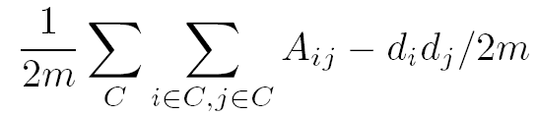
Modularity Maximization
Modularity measures the group interactions compared with the expected random connections in the group
In a network with m edges, for two nodes with degree d_{i} and d_{j ,} expected random connections between them are
The interaction utility in a group:
To partition the group into
multiple groups, we maximize
Expected Number of
edges between 6 and 9 is
5*3/(2*17) = 15/34
Notes:
Most previous methods do not consider the degree distribution of nodes.
2m is added to normalize the modularity between -1 and 1.
Larger modularity means the interaction is substantiallyfrquent than random. Thus, should be a community.

Slide 39


Modularity Matrix
The modularity maximization can also be formulated in matrix form
B is the modularity matrix
Solution: top eigenvectors of the modularity matrix

Slide 40
Properties of Modularity
Properties of modularity:
  Between (-1, 1)
  Modularity = 0 If all nodes are clustered into one group
  Can automatically determine optimal number of clusters
Resolution limit of modularity
  Modularity maximization might return a community consisting multiple small modules

Slide 41
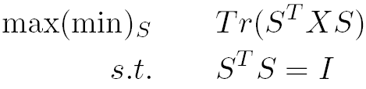
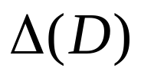
Matrix Factorization Form
For latent space models, block models, spectral clustering and modularity maximization
All can be formulated as
(Latent Space Models)
Sociomatrix (Block Model Approximation)
Graph Laplacian (Cut Minimization)
Modularity Matrix (Modularity maximization)
X=

Slide 42
Recap of Network-Centric Community
Network-Centric Community Detection
  Groups based on
    Node Similarity
    Latent Space Models
    Cut Minimization
    Block-Model Approximation
    Modularity maximization
Goal: Partition network nodes into several disjoint sets
Limitation: Require the user to specify the number of communities beforehand

Slide 43
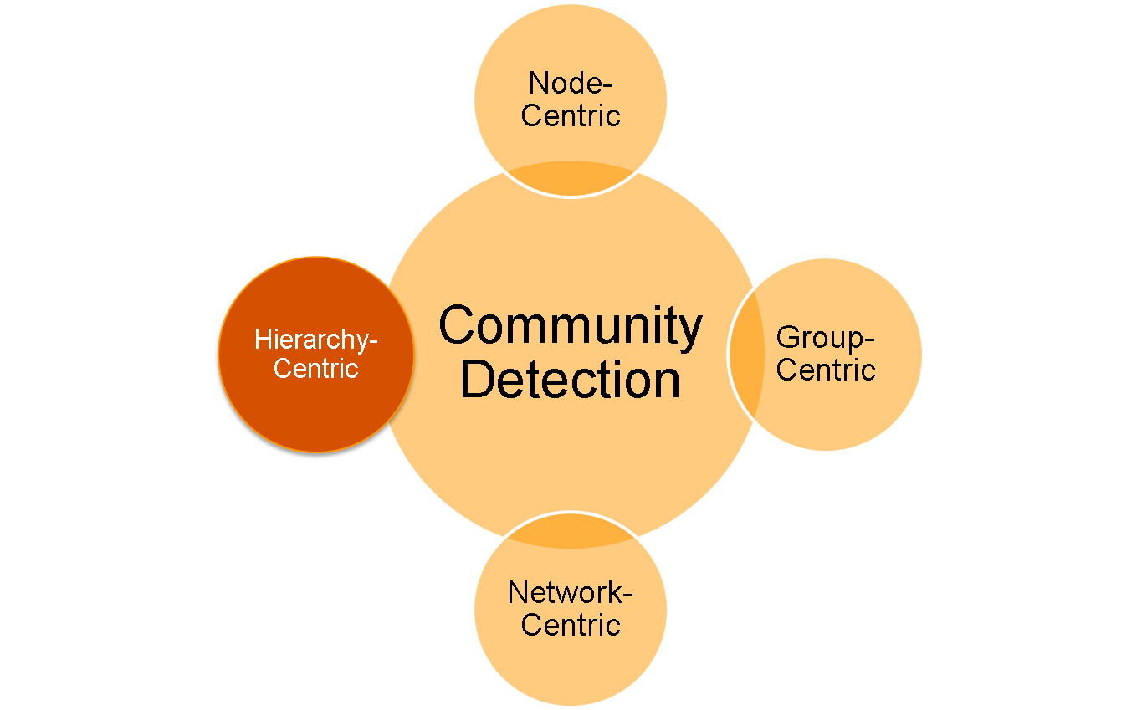
Hierarchy-Centric Community Detection

Slide 44
Hierarchy-Centric Community Detection
Goal: Build a hierarchical structure of communities based on network topology
Facilitate the analysis at different resolutions
Representative Approaches:
  Divisive Hierarchical Clustering
  Agglomerative Hierarchical Clustering

Slide 45
Divisive Hierarchical Clustering
Divisive Hierarchical Clustering
  Partition the nodes into several sets
  Each set is further partitioned into smaller sets
Network-centric methods can be applied for partition
One particular example is based on edge-betweenness
  Edge-Betweenness: Number of shortest paths between any pair of nodes that pass through the edge
Between-group edges tend to have larger edge-betweenness

Slide 46
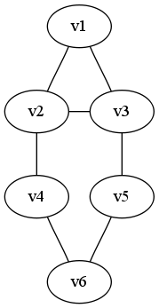
Divisive clustering on Edge-Betweenness
Progressively remove edges with the highest betweenness
  Remove e(2,4), e(3, 5)
  Remove e(4,6), e(5,6)
  Remove e(1,2), e(2,3), e(3,1)
3
3
3
5
5
4
4
root
V1,v2,v3
V4, v5, v6
v1
v2
v3
v4
v5
v6

Slide 47
Agglomerative Hierarchical Clustering
Initialize each node as a community
Choose two communities satisfying certain criteria and merge them into larger ones
  Maximum Modularity Increase
  Maximum Node Similarity
root
V1, v2, v3
V4, v5, v6
V1,v2
v3
v4
V1,v2
v1
v2
(Based on Jaccard Similarity)
v5
v6
Notes:
A Hierarchy constructed based on Jaccard similarity

Slide 48
Recap of Hierarchical Clustering
Most hierarchical clustering algorithm output a binary tree
  Each node has two children nodes
  Might be highly imbalanced
Agglomerative clustering can be very sensitive to the nodes processing order and merging criteria adopted.
Divisive clustering is more stable, but generally more computationally expensive

Slide 49
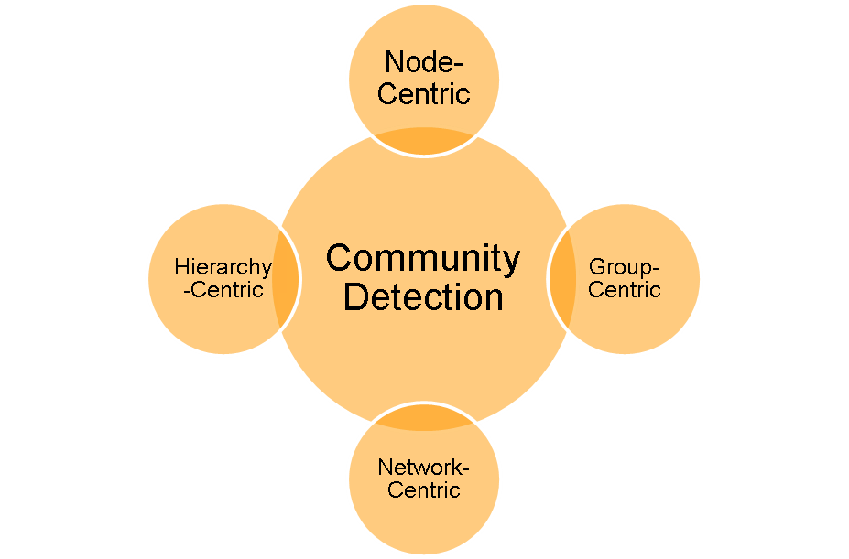
Summary of Community Detection
The Optimal Method?
  It varies depending on applications, networks, computational resources etc.
Other lines of research
  Communities in directed networks
  Overlapping communities
  Community evolution
  Group profiling and interpretation

