Slide 1
Community Detection Algorithms: A Comparative Analysis
Authors:
A. Lancichinetti and S. Fortunato
Presented by:
Ravi Tiwari

Slide 2
Motivation
Evaluation of performances of existing algorithms for community detection algorithms.
Existing evaluation tests and benchmarks involves:
  Small networks with known community structure.
  Artificial graphs with simplified structure.

Slide 3
Contribution
Introduced a new class of benchmark graphs Lancichinetti-Fortunato-Radicchi (LFR).
Introduced a method for comparing two community structures (based on Normalized Mutual Information).
Evaluated the performances of a large number of existing algorithms based on:
  LFR benchmark graphs
  Girvan and Newman (GN) benchmark graphs
  Random Graphs

Slide 4
Planted l-partition model
Partition the graph with N nodes into N/l
Partitions. Each node has a probability p_{in} of
being connected to nodes of its group and a
probability p_{out} of being connected to nodes of
different groups. As long as p_{in}≥p_{out} the graph
has a community structure else it’s a Random
Graph.

Slide 5
GN benchmark
A version of Planted l-partition model.
Benchmark Graphs consist of 128 nodes with expected degree 16, which are divided into four groups of size 32 each.
Drawbacks:
  All nodes have the same expected degree
  All communities have equal size.

Slide 6
LFR Benchmark
A special case of Planted l-partition model, in which groups have different size and nodes have different degrees.
Node degree distribution based on power law with exponent τ₁. (τ₁ =-2 in experiments)
Community size also obeys power law distribution with exponent τ_{2.} (τ₂ =-1 in experiments)

Slide 7
Construction of LFR Benchmark Graphs
Each node receives its degree which remains the same throughout.
Mixing parameter μ, is the ratio of external degree of a node with respect to its community and the total degree of the node.
For simplicity all nodes have the same μ.
Algorithm to generate the benchmark graphs is O(E).

Slide 8
Construction of LFR Benchmark Graphs (Contd)
Based on power law distribution with exponent τ₂ the sizes of the communities are assigned (Sum matches the size N of the network).
Each community is treated as an isolated graph.
  Assign degree k_{i} to a node i based on power law distribution with exponent τ_{1.}
  Assign internal degree (1- μ) k_{i} to node i.

Slide 9
Construction of LFR Benchmark Graphs (Contd)
  Using Configuration model [5], each node i is connected to (1- μ) k_{i} nodes in its community.
Each node is assigned μk_{i} out degree.
Using Configuration model [5], each node is connected μk_{i} nodes outside its community.
The final graph satisfies the conditions imposed on the distribution of degree and sized of the community.

Slide 10
LFR Benchmark (Contd)
Groups are communities when p_{in}≥p_{out.}
The above condition can be translated on μ as
μ<(N-n_{c})/N or μ<(N-n^{max}_{c})/N, when communities have different sizes.

Slide 11
LFR Benchmark (Contd)
Problem in GN benchmark based on μ
  Based on the above condition on μ, when n_{c}=32 and N=128, μ=3/4.
  Interestingly, most works using GN benchmark assumes communities are there as long as μ < ½ and for μ ≥ ½ they are not well defined.
  Instead, at least in principle, communities exist up till μ = ¾.
  Therefore, even if communities are there but benchmark itself may not detect them.

Slide 12
LFR Benchmark (Contd)
The reason is, due to the fluctuations in distribution of the links the modeled graph may look similar to random graph.
On large networks when N>>n_{c}, the limiting value for μ becomes 1.
Inference: LFR can work for higher values of μ because power law distribution is used for node degree distribution and community size.

Slide 13

Comparing Two Community Structures
Based on Information Theory, a method to evaluate the goodness of the result is provided by an algorithm.
The mutual information I(X,Y), measures how much we learn about X if we know Y.
It is given as

Slide 14
An Example
1
5
7
8
6
2
9
3
4
10
 | 1 | 2 | 3 | 4 | 5 | 6 | 7 | 8 | 9 | 10
X | 1 | 1 | 1 | 1 | 1 | 1 | 2 | 2 | 2 | 2
Y₁ | 1 | 1 | 1 | 2 | 2 | 2 | 3 | 3 | 3 | 3
Y₂ | 1 | 1 | 1 | 2 | 2 | 2 | 3 | 3 | 4 | 4

Slide 15

Comparing Two Community Structures
The mutual information is not ideal as a similarity measure:
  Given a partition Χ, all the partitions derived from Χ by further partitioning (some of) its clusters would have the same mutual information with X even they could be very different from X.
Hence, normalized mutual information I_{norm}(X,Y) is used:

Slide 16

Comparing Two Community Structures
H(X) is the entropy for random variable X.
I_{norm}(X,Y) is 1 if the community structure are identical and is 0 if the community structures are independent.
Authors have proposed another measure in [12] for computing normalized mutual information:

Slide 17
Algorithms analyzed
Algorithm of Girvan and Newman (GN)[3,24]
Fast greedy modularity optimization by Clauset et. al.[11]
Exhaustive modularity optimization via simulated annealing (Sim. ann.).[29]
Fast modularity optimization by Blondel et. al.[30]
Algorithm by Radicchi et. al.[31]

Slide 18
Algorithms analyzed (Contd)
Cfinder[8]
Structural algorithm by Rosvall and Bergstrom (Infomod).[34]
Dynamic algorithm by Rosvall and Bergstrom (Infomap). [35]
Spectral algorithm by Donetti and Munoz (DM). [38]
Expectation-maximization algorithm by Newman and Leicht (EM). [40]

Slide 19
Algorithms analyzed (Contd)
Potts model approach by Ronhovde and Nussinov (RN). [42]

Slide 20
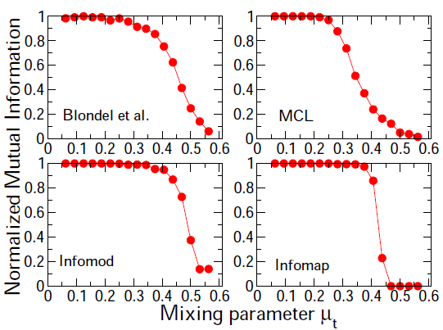
Testing on GN Benchmark

Slide 21
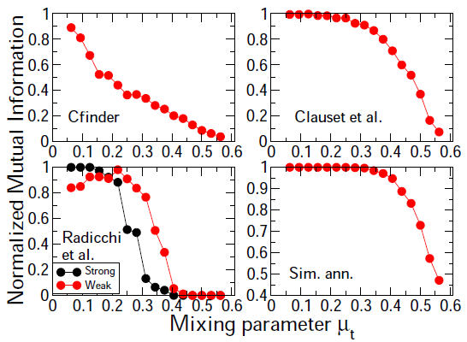
Testing on GN Benchmark (Contd)

Slide 22
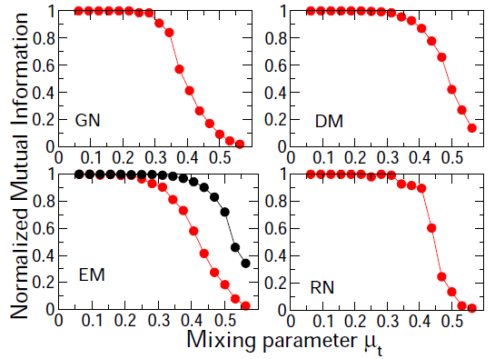
Testing on GN Benchmark (Contd)

Slide 23
Testing on GN Benchmark (Contd)
Most of the method perform well, although all of them starts to fail much earlier than the expected threshold of ¾ .

Slide 24
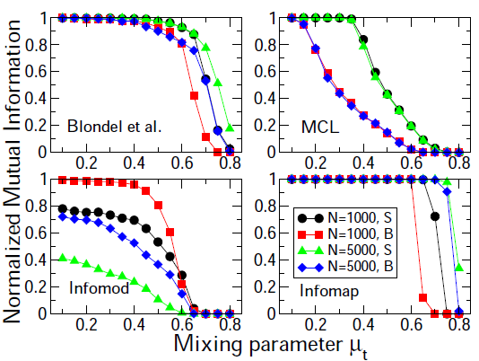
Testing on LFR Benchmark

Slide 25
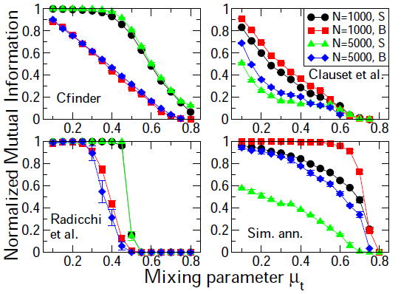
Testing on LFR Benchmark (Contd)

Slide 26
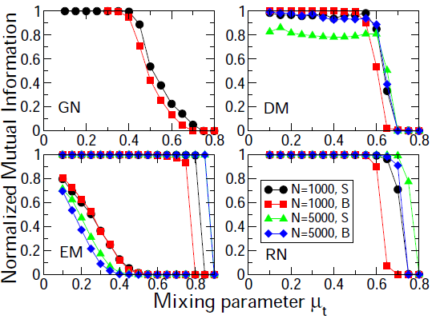
Testing on LFR Benchmark (Contd)

Slide 27
Testing on LFR Benchmark (Contd)
LFR benchmark enables to discriminate the performance much better than GN benchmark.
Modularity based method have rather poor performance, which worsens for large systems and smaller communities due to the well known resolution limits. Blondel et. al. is an exception.
Infomap, RN and Blondel et. al. have the best performance.

Slide 28
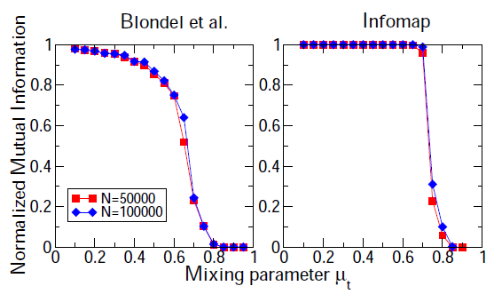
Testing on large LFR Benchmark

Slide 29
Testing on large LFR Benchmark (Contd)
Infomap and Blondel et. al. are very fast algorithms, so they were tested for large benchmark graphs.
The performance of Blondel et. al. is worse than on smaller graphs, whereas Infomap was stable.

Slide 30
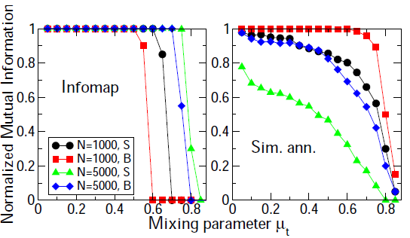
Testing on directed LFR Benchmark

Slide 31
Testing on directed LFR Benchmark (Contd)
LFR benchmark were extended to directed graphs, previously no directed benchmarks were available.
Only five algorithms: Clauset et al, Simulated annealing, Cfinder, Infomap, and EM can handle directed graphs.
Simulated annealing and Infomap were tested.
No change in EM and Infomap was still stable.

Slide 32
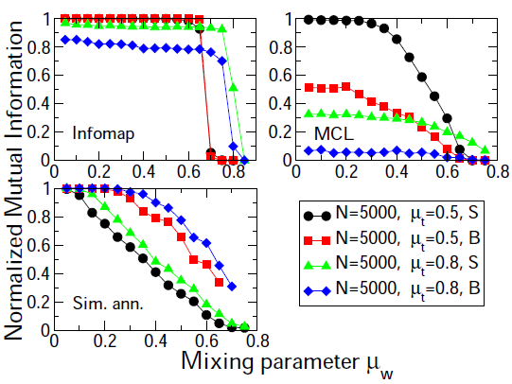
Testing on weighted LFR Benchmark

Slide 33
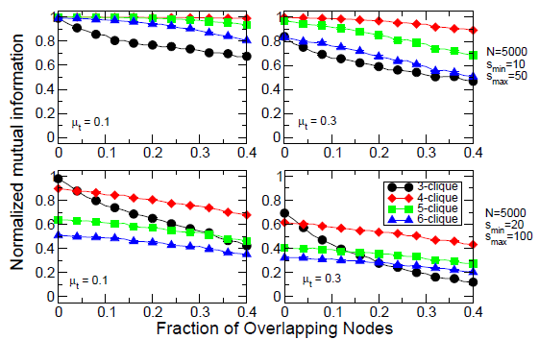
Testing Cfinder on overlapping LFR Benchmark

Slide 34
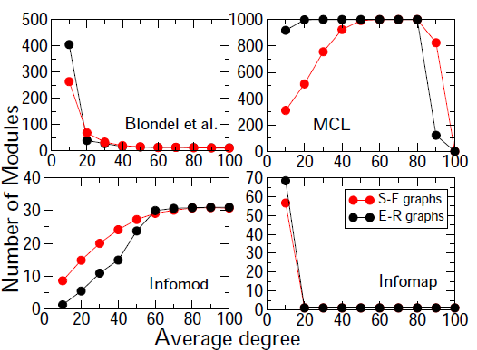
Tests on Random Graphs

Slide 35
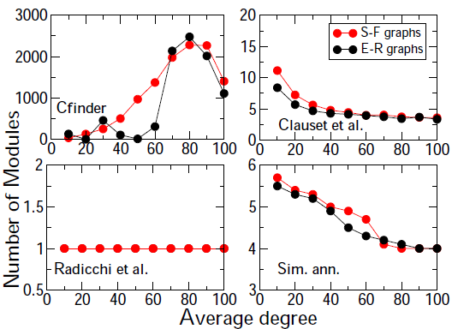
Tests on Random Graphs (Contd)

Slide 36
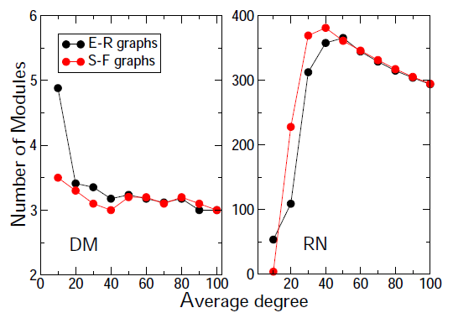
Tests on Random Graphs (Contd)

Slide 37
Tests on Random Graphs (Contd)
In Random graphs the linking probabilities of nodes are independent of each other. Hence, there should be no communities in it.
Random graphs may display pseudo-communities. Good method should distinguish them.
ER random graphs having binomial distribution and random graph with power law distribution, with exponent -2, were tested.

Slide 38
Tests on Random Graphs (Contd)
The best performance is of Radicchi et al, which always finds a single community.

Slide 39
Summary
Comparative analysis of performances of some algorithms for community detection tested on GN benchmark, LFR benchmark and Random graphs.
The Infomap algorithm by Rosvall and Bergstrom [35] has the best performance.
LFR benchmark is more efficient in showing the reliability of a community detection algorithm for real applications.

Slide 40
Questions?????????

