Slide 1

Overlapping Community Detection in Networks
Nan Du

Slide 2
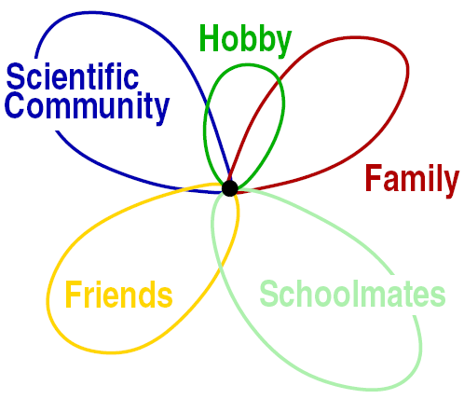
Overlapping Community Detection
It is possible for each individual to have many communities simultaneously.
Question: how can we develop an algorithm to find overlapping communities ?
Related work
  Palla’s CPM algorithm 2006
  GN-extensions :
    CONGA, P&W, 2007
    fuzzy k-means 2007

Slide 3
Overlapping Community Detection
Palla’s CPM algorithm, 2005
  Well-defined k-clique community
  Required user input parameter k
  Can not cover all the vertices in the given network
CONGA, 2007
  Based on defined splitting betweenness to decide when to split vertices, what vertex to split and how to split them
  Low efficiency on large graph O(m³)
P&W, 2007
  Based on both of the edge betweenness and vertex betweenness to decide whether to split a vertex or remove an edge, which requires a user input parameter to assess the similarity between pairs of vertices
Fuzzy clustering, 2007
  requires a user input parameter to indicate an upper bound of the community's number, which is often hard to give in real networks

Slide 4
Overlapping Community Detection
A novel algorithm COCD (Clique-based Overlapping Community Detection) is proposed
  Can cover all the vertices of the given network
  Free of user input parameters
  Efficient and scalable

Slide 5
Overlapping Community Detection
COCD consists of 3 basic steps
  Maximal clique enumeration
    Peamc on sparse graphs
  Core formation
    a core is the set of all closely related maximal cliques
  Clustering
    Freeman Centrality is used to assign the left vertices to the cores

Slide 6

Overlapping Community Detection
Core Formation
  A core is defined as a set of closely related maximal cliques
  How to decide whether to merge two cores once they share some common vertices?
  Solution : Closeness Function

Slide 7








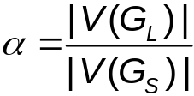

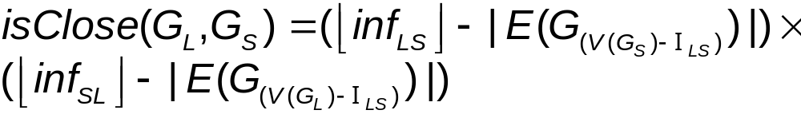
Overlapping Community Detection
COCD algorithm
  Core formation (whether to merge two cores ?)
    Closeness Function
    and are the set of maximal cliques containing ,
    and are the induced sub-graphs
    is the set of edges between and

Slide 8
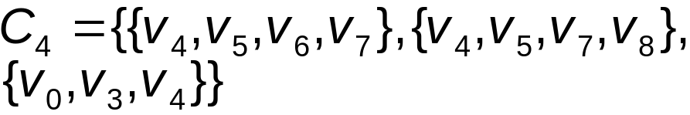

Overlapping Community Detection
COCD algorithm
  Core formation
V1
V0
V5
V6
V7
V4
V2
V3
V8

Slide 9
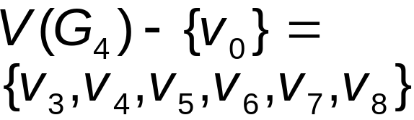

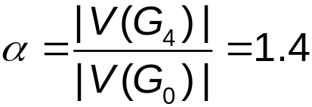
Overlapping Community Detection
COCD algorithm
  Core formation
V1
V5
V6
V7
V4
V2
V3
V8

Slide 10



Overlapping Community Detection
COCD algorithm
  Core formation
V1
V0
V5
V6
V7
V2
V3
V8

Slide 11
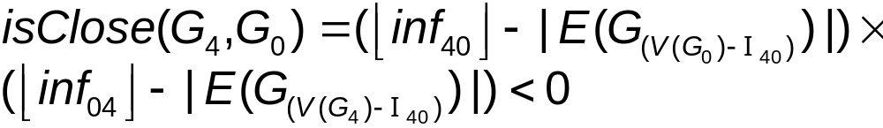
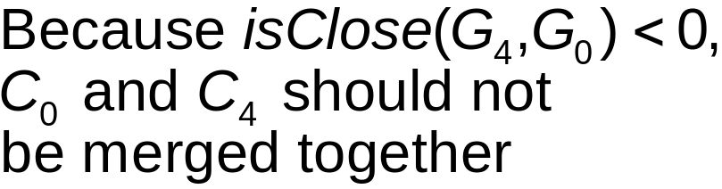
Overlapping Community Detection
COCD algorithm
  Core formation
V1
V0
V5
V6
V7
V4
V2
V3
V8

Slide 12
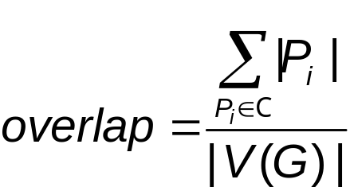
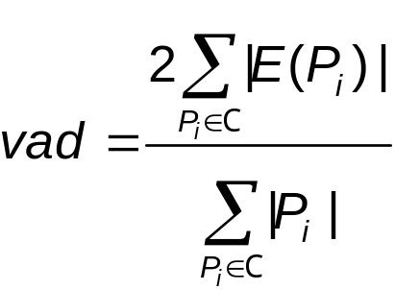
Overlapping Community Detection
Experimental Evaluation
  On networks with known community structures
    precision : the fraction of vertex pairs in the same cluster that also belong to the same community
    recall : the fraction of vertex pairs belonging to the same community that are also in the same cluster
  On networks with unknown community structures
    overlap coefficient & vertex average degree (vad)

Slide 13
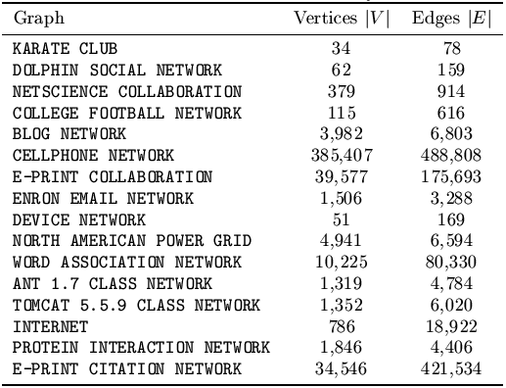
Overlapping Community Detection
Experimental Evaluation
16 Real datasets from different domains

Slide 14
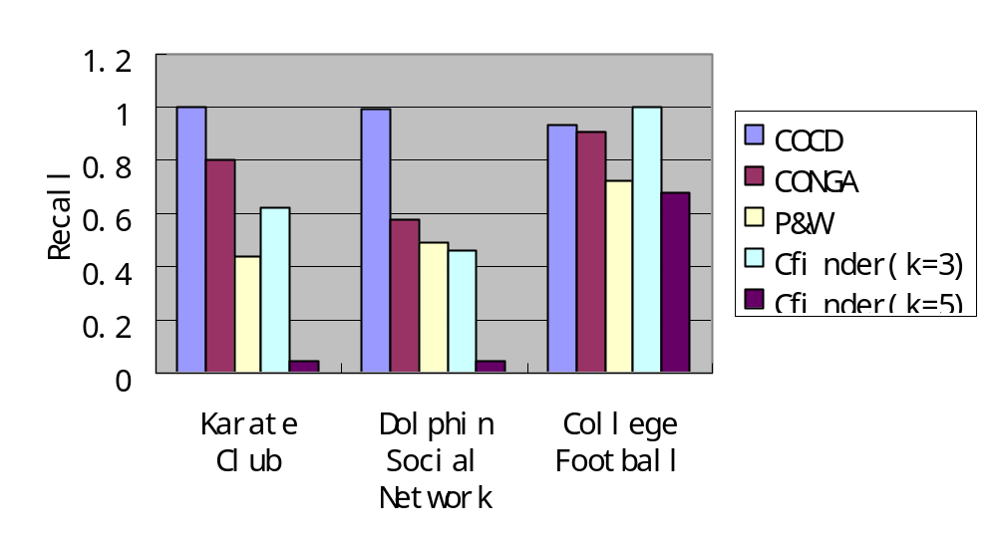
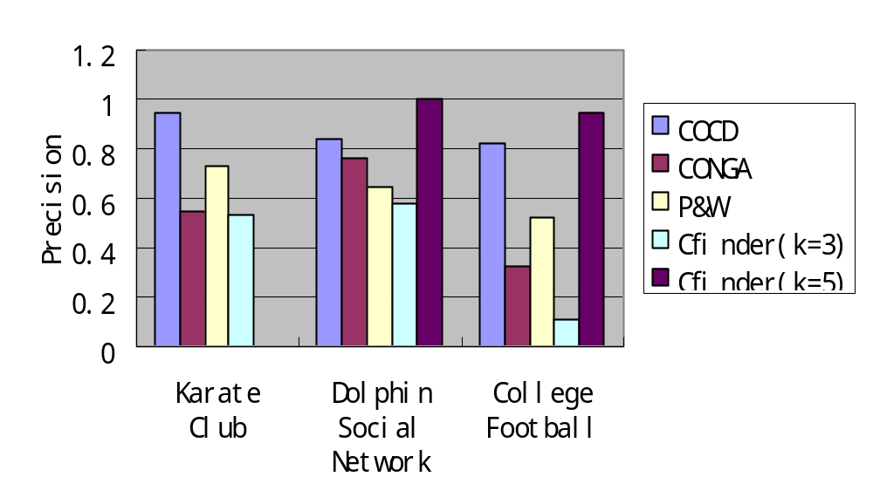
Overlapping Community Detection
Experimental Evaluation

Slide 15
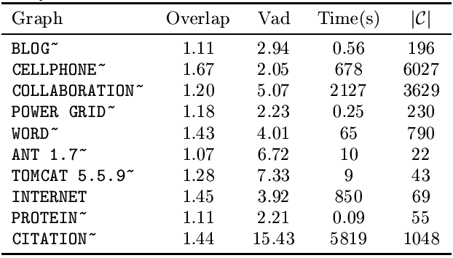
Overlapping Community Detection
Experimental Evaluation
1.67
1.43
1.45
1.44
Results on networks with unknown community structures

Slide 16
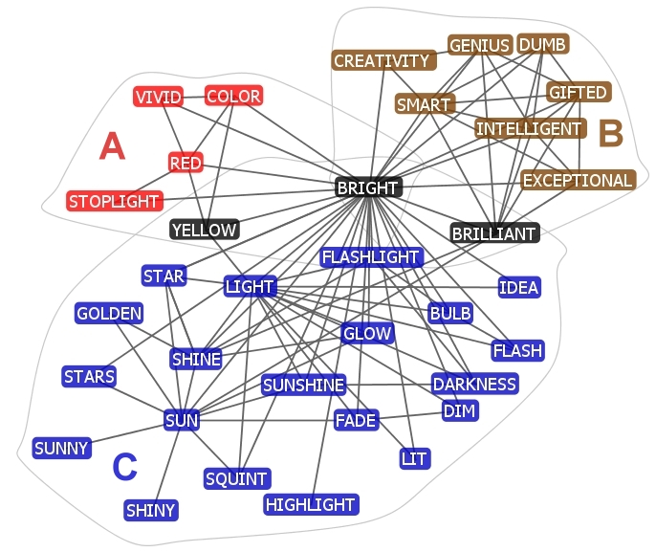
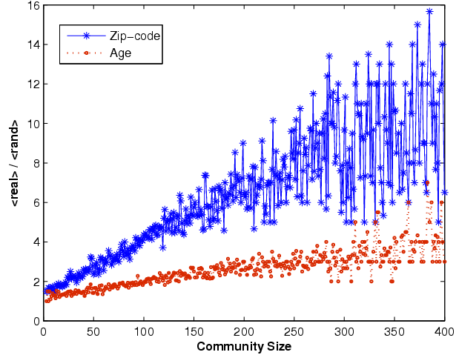
Community Detection
Experimental Evaluation
Communities of word association network
Communities of cell phone network

Slide 17
References
S. Gregory. An algorithm to find overlapping community structure in networks. In The PKDD, pages 91-102, 2007
G. Palla, I. Dernyi, and I. Farkas. Uncovering the overlapping community structure of complex network in nature and society. Nature, 435(7043):814-818, June 2005
J. Pinney and D. Westhead. Betweenness-based decomposition methods for social and biological networks. Leeds University Press
S. Zhang, R. S. Wang, and X. S. Zhang. Identificationof overlapping community structure in complex networks using fuzzy c-means clustering. PHYSICA, 374(1)
N. Du, B. Wu, and B. Wang. A parallel algorithm for enumerating all maximal cliques in complex networks. In ICDM Mining Complex Datd Workshop, pages 320-324, December 2006.

