Slide 1
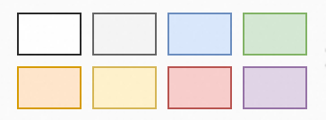





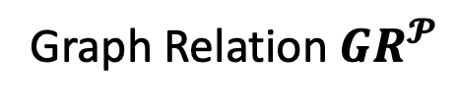






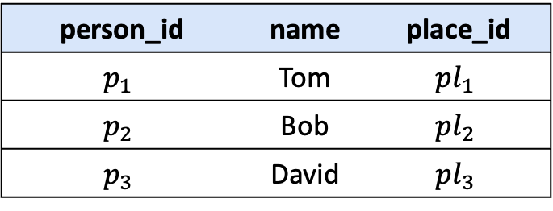










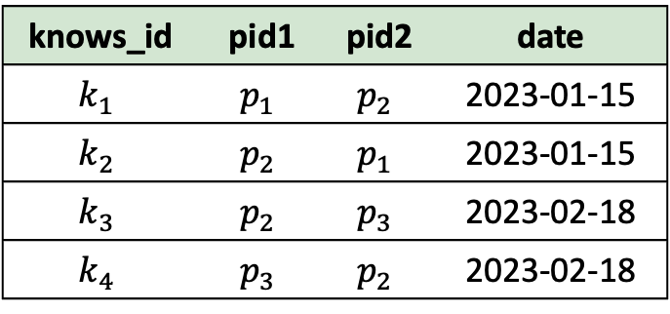





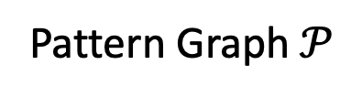






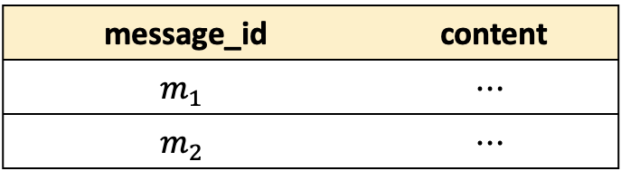



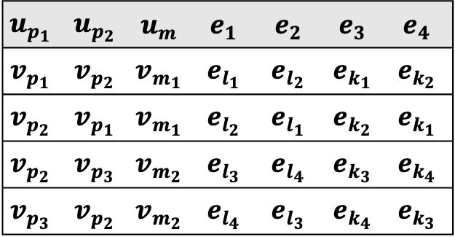



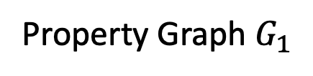















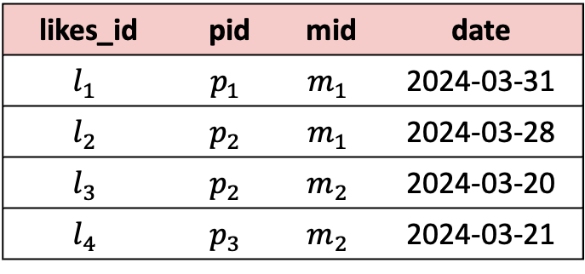
Person
Person
Vertex
Message
Vertex
$$e_{k_{1}}$$
$$e_{k_{2}}$$
person_id | name | place_id
$$p_{1}$$ | Tom | $${pl}_{1}$$
$$p_{2}$$ | Bob | $${pl}_{2}$$
$$p_{3}$$ | David | $${pl}_{3}$$
Pattern Matching
$$v_{p_{1}}$$
$$e_{k_{2}}$$
$$v_{p_{2}}$$
$$v_{p_{2}}$$
$$e_{k_{1}}$$
$$v_{p_{1}}$$
Likes Edge
Knows Edge
Tom
$$e_{k_{1}}$$
$$e_{k_{3}}$$
$$e_{l_{1}}$$
$$e_{l_{2}}$$
$$e_{l_{2}}$$
$$e_{l_{1}}$$
$$v_{p_{1}}$$
$$e_{k_{2}}$$
$$v_{p_{2}}$$
$$e_{k_{4}}$$
$$v_{p_{3}}$$
$$e_{1}$$
$$v_{m_{1}}$$
$$v_{m_{1}}$$
Messages
$$u_{p_{1}}$$
$$u_{p_{2}}$$
$$e_{k_{3}}$$
$$e_{k_{4}}$$
message_id | content
$$m_{1}$$ | $$⋯$$
$$m_{2}$$ | $$⋯$$
$$e_{l_{1}}$$
$$e_{l_{2}}$$
$$e_{l_{3}}$$
$$e_{l_{4}}$$
$$e_{2}$$
$$v_{p_{2}}$$
$$e_{k_{4}}$$
$$v_{p_{3}}$$
$$v_{p_{3}}$$
$$e_{k_{3}}$$
$$v_{p_{2}}$$
$$v_{m_{1}}$$
$$v_{m_{2}}$$
$$e_{3}$$
$$e_{4}$$
Likes
$$u_{m}$$
$$e_{l_{3}}$$
$$e_{l_{4}}$$
$$e_{l_{4}}$$
$$e_{l_{3}}$$
likes_id | pid | mid | date
$$l_{1}$$ | $$p_{1}$$ | $$m_{1}$$ | 2024-03-31
$$l_{2}$$ | $$p_{2}$$ | $$m_{1}$$ | 2024-03-28
$$l_{3}$$ | $$p_{2}$$ | $$m_{2}$$ | 2024-03-20
$$l_{4}$$ | $$p_{3}$$ | $$m_{2}$$ | 2024-03-21
Property Graph $G_{1}$
RGMapping
$$v_{m_{2}}$$
$$v_{m_{2}}$$
CREATE PROPERTY GRAPH G1
VERTEX TABLES (
Person PROPERTIES(person_id, name),
Message PROPERTIES(message_id, content)
)
EDGE TABLES (
Likes
SOURCE KEY (pid) REFERENCE Person (person_id)
DESTINATION KEY(mid) REFERENCE Message (message_id)
PROPERTIES (date),
Knows
SOURCE KEY (pid1) REFERENCE Person (person_id)
DESTINATION KEY(pid2) REFERENCE Person (person_id)
)
Pattern Graph$𝒫$
Matched Subgraphs
Conceptualize
Knows
$$u_{p_{1}}$$ | $$u_{p_{2}}$$ | $$u_{m}$$ | $$e_{1}$$ | $$e_{2}$$ | $$e_{3}$$ | $$e_{4}$$
$$v_{p_{1}}$$ | $$v_{p_{2}}$$ | $$v_{m_{1}}$$ | $$e_{l_{1}}$$ | $$e_{l_{2}}$$ | $$e_{k_{1}}$$ | $$e_{k_{2}}$$
$$v_{p_{2}}$$ | $$v_{p_{1}}$$ | $$v_{m_{1}}$$ | $$e_{l_{2}}$$ | $$e_{l_{1}}$$ | $$e_{k_{2}}$$ | $$e_{k_{1}}$$
$$v_{p_{2}}$$ | $$v_{p_{3}}$$ | $$v_{m_{2}}$$ | $$e_{l_{3}}$$ | $$e_{l_{4}}$$ | $$e_{k_{3}}$$ | $$e_{k_{4}}$$
$$v_{p_{3}}$$ | $$v_{p_{2}}$$ | $$v_{m_{2}}$$ | $$e_{l_{4}}$$ | $$e_{l_{3}}$$ | $$e_{k_{4}}$$ | $$e_{k_{3}}$$
knows_id | pid1 | pid2 | date
$$k_{1}$$ | $$p_{1}$$ | $$p_{2}$$ | 2023-01-15
$$k_{2}$$ | $$p_{2}$$ | $$p_{1}$$ | 2023-01-15
$$k_{3}$$ | $$p_{2}$$ | $$p_{3}$$ | 2023-02-18
$$k_{4}$$ | $$p_{3}$$ | $$p_{2}$$ | 2023-02-18
Schemas
Graph Relation $GR^{𝓟}$
Relations
RGMapping Sentence
$$({ τ}_{l_{1}}.mid=τ_{m_{1}}.m_id)$$
$$ξ_{v}(τ_{p_{1}})$$
……
$$(τ_{l_{1}}.pid=τ_{p_{1}}.p_id)$$
$$λ_{Likes}^{s}$$
$$ξ_{e}(τ_{l_{1}})$$
$$λ_{Likes}^{t}$$

Slide 2
CREATE PROPERTY GRAPH G1
VERTEX TABLES (
Person PROPERTIES(person_id, name),
Message PROPERTIES(message_id, content)
)
EDGE TABLES (
Likes
SOURCE KEY (pid) REFERENCE Person (person_id)
DESTINATION KEY(mid) REFERENCE Message (message_id)
PROPERTIES (date),
Knows
SOURCE KEY (pid1) REFERENCE Person (person_id)
DESTINATION KEY(pid2) REFERENCE Person (person_id)
)
Sentence to Create Property Graph
Person (person_id, name, place_id)
Message (message_id, content)
Place (place_id, place_name)
Likes (likes_id, pid, mid, date)
Knows (knows_id, pid1, pid2, date)
Schemas

