Slide 1
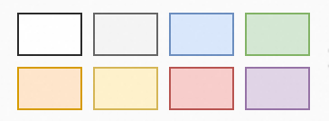




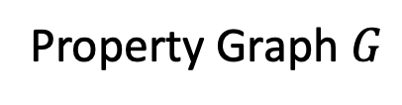







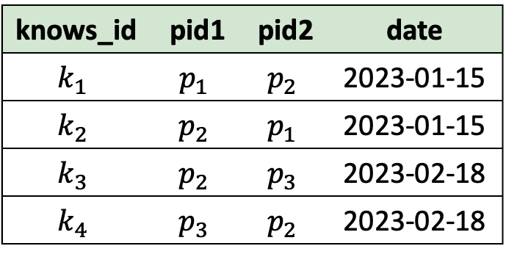





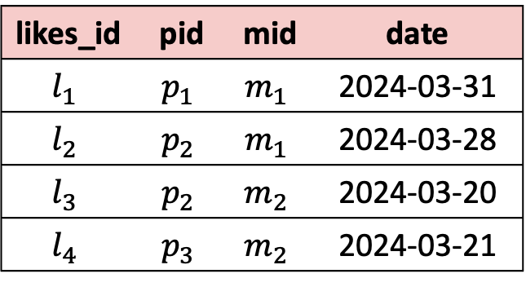



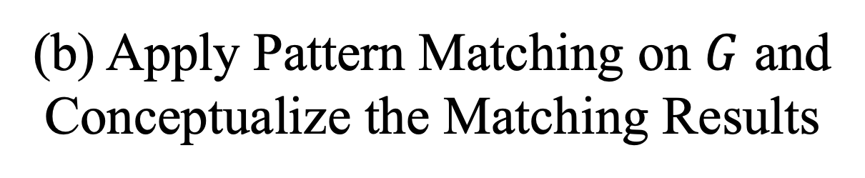



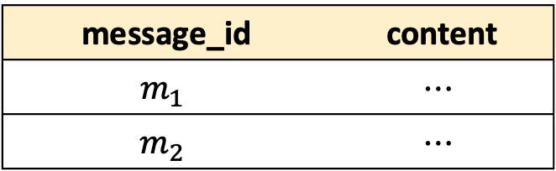



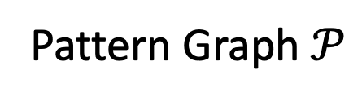


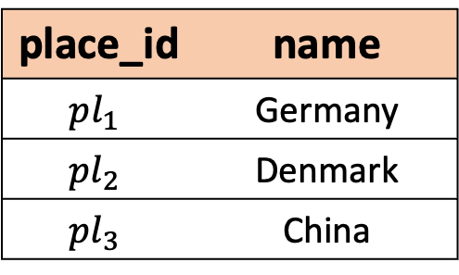

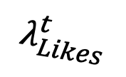




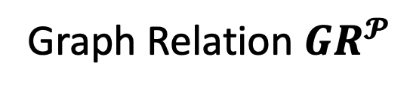




Knows
Person
Person
Vertex
Message
Vertex
$$v_{p_{1}}$$
$$e_{k_{1}}$$
$$v_{p_{2}}$$
Graph Component
Relational Component
knows_id | pid1 | pid2 | date
$$k_{1}$$ | $$p_{1}$$ | $$p_{2}$$ | 2023-01-15
$$k_{2}$$ | $$p_{2}$$ | $$p_{1}$$ | 2023-01-15
$$k_{3}$$ | $$p_{2}$$ | $$p_{3}$$ | 2023-02-18
$$k_{4}$$ | $$p_{3}$$ | $$p_{2}$$ | 2023-02-18
person_id | name | place_id
$$p_{1}$$ | Tom | $${pl}_{1}$$
$$p_{2}$$ | Bob | $${pl}_{2}$$
$$p_{3}$$ | David | $${pl}_{3}$$
Likes Edge
Knows Edge
vertex mapping
Tom
$$e_{k_{1}}$$
$$e_{k_{3}}$$
$$e_{l_{1}}$$
$$e_{l_{2}}$$
Projection
p2.name place.name
name | place_name
Bob | Germany
RGMapping
$$v_{p_{1}}$$
$$e_{k_{2}}$$
$$v_{p_{2}}$$
$$e_{k_{4}}$$
$$v_{p_{3}}$$
Pattern Matching
$$v_{m_{1}}$$
Likes
……
Message
likes_id | pid | mid | date
$$l_{1}$$ | $$p_{1}$$ | $$m_{1}$$ | 2024-03-31
$$l_{2}$$ | $$p_{2}$$ | $$m_{1}$$ | 2024-03-28
$$l_{3}$$ | $$p_{2}$$ | $$m_{2}$$ | 2024-03-20
$$l_{4}$$ | $$p_{3}$$ | $$m_{2}$$ | 2024-03-21
$$λ_{Likes}^{s}$$
$$e_{l_{1}}$$
$$e_{l_{2}}$$
$$e_{l_{3}}$$
$$e_{l_{4}}$$
$$u_{p_{1}}$$
$$e_{1}$$
$$u_{p_{2}}$$
$$v_{p_{3}}$$
$$e_{k_{3}}$$
$$v_{p_{2}}$$
Selection
p1.name = “Tom”
message_id | content
$$m_{1}$$ | $$⋯$$
$$m_{2}$$ | $$⋯$$
edge mapping
$$v_{m_{1}}$$
$$e_{2}$$
$$e_{3}$$
$$λ_{Likes}^{t}$$
$$v_{m_{2}}$$
$$u_{m}$$
$$e_{l_{4}}$$
$$e_{l_{3}}$$
Property Graph $G$
$$v_{m_{2}}$$
Join
p1.place_id = place_id
Knows
knows_id (PK) pid1 (FK) pid2 (FK) date
CREATE PROPERTY GRAPH G
VERTEX TABLES (
Person PROPERTIES(person_id, name),
Message PROPERTIES(message_id, content)
)
EDGE TABLES (
Likes
SOURCE KEY (pid) REFERENCE Person (person_id)
DESTINATION KEY(mid) REFERENCE Message (message_id)
PROPERTIES (date),
Knows
SOURCE KEY (pid1) REFERENCE Person (person_id)
DESTINATION KEY(pid2) REFERENCE Person (person_id)
)
Pattern Graph$𝒫$
ER Diagram
Matched Subgraphs
Projection
p1.name p1.place_id
p2.name
place_id | name
$${pl}_{1}$$ | Germany
$${pl}_{2}$$ | Denmark
$${pl}_{3}$$ | China
Likes
likes_id (PK) pid (FK) mid (FK) date
Message
message_id (PK) content
Conceptualize
$$u_{p_{1}}$$ | $$u_{p_{2}}$$ | $$u_{m}$$ | $$e_{1}$$ | $$e_{2}$$ | $$e_{3}$$
$$v_{p_{1}}$$ | $$v_{p_{2}}$$ | $$v_{m_{1}}$$ | $$e_{k_{1}}$$ | $$e_{l_{1}}$$ | $$e_{l_{2}}$$
$$v_{p_{2}}$$ | $$v_{p_{1}}$$ | $$v_{m_{1}}$$ | $$e_{k_{2}}$$ | $$e_{l_{2}}$$ | $$e_{l_{1}}$$
$$v_{p_{2}}$$ | $$v_{p_{3}}$$ | $$v_{m_{2}}$$ | $$e_{k_{3}}$$ | $$e_{l_{3}}$$ | $$e_{l_{4}}$$
$$v_{p_{3}}$$ | $$v_{p_{2}}$$ | $$v_{m_{2}}$$ | $$e_{k_{4}}$$ | $$e_{l_{4}}$$ | $$e_{l_{3}}$$
Person
person_id (PK) name place_id
Place
PK: Primary Key
FK: Foreign Key
Match
Relations
RGMapping Sentence
Graph Relation $GR^{𝓟}$
(a) The Process of RGMapping
(b) Apply Pattern Matching on $G$ and
Conceptualize the Matching Results
(c) The SPJM Query
$$({ τ}_{l_{1}}.mid=τ_{m_{1}}.m_id)$$
$$(τ_{l_{1}}.pid=τ_{p_{1}}.p_id)$$
……

Slide 2







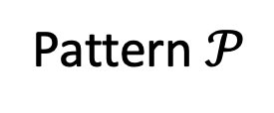































$$u_{p_{1}}$$
$$e_{k_{1}}$$
$$u_{p_{2}}$$
$$Join_{2}$$
$$\hat{⋈}$$
$$Join_{1}$$
Filtered Intermediate Sub-patterns
$$e_{l_{1}}$$
$$u_{m}$$
$$e_{l_{2}}$$
$$\hat{⋈}$$
$${ℳ(𝒫}_{2})$$
Containing edges but not all adjacent vertices
Intermediate
Pattern
Pattern $𝒫$
$${ℳ(𝒫}_{3})$$
$${ℳ(𝒫}_{4})$$
Logical Plan
$$u_{p_{1}}$$
$$u_{m}$$
$$u_{p_{1}}$$
Complete-star
Pattern
$$u_{p_{1}}$$
$$u_{p_{2}}$$
$$u_{p_{1}}$$
$$u_{m}$$
$$u_{p_{2}}$$
$$⋯$$
Pattern $𝒫_{1}$
Pattern $𝒫_{2}$
Not an induced subgraph
Single-edge
Pattern
$$u_{p_{1}}$$
$$u_{p_{2}}$$
$$u_{p_{1}}$$
$$u_{p_{2}}$$
$$u_{p_{1}}$$
$$u_{p_{2}}$$
$$u_{m}$$
$$u_{p_{1}}$$
Single-vertex
Pattern
Pattern $𝒫_{3}$
Pattern $𝒫_{4}$
$$u_{p_{1}}$$
$$u_{m}$$
$$u_{p_{2}}$$
$$⋯$$
Decompose Process

Slide 3
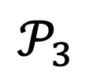
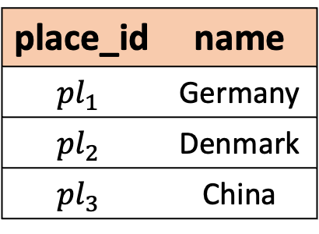



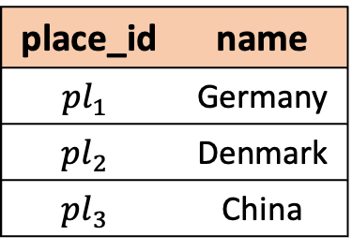

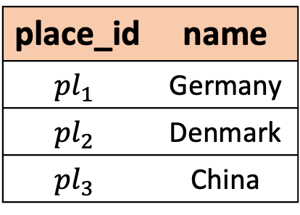

Core Workflow
Projection
p2.name place.name
PROJECTION
p2.name place.name
Projection
p2.name place.name
place_id | name
$${pl}_{1}$$ | Germany
$${pl}_{2}$$ | Denmark
$${pl}_{3}$$ | China
Projection
p2.name place.name
$$𝒫_{1}$$
Join
p1.place_id = place_id
HASH_JOIN
p1.place_id = place_id
Place
(place_id, name)
Selection
p1.name = “Tom”
$$\hat{⋈}$$
$$𝒫_{2}$$
Place
SCAN_TABLE
Join
p1.place_id = place_id
Join
p1.place_id = place_id
PROJECTION*
p1.place_id p2.name
PROJECTION*
p1.place_id p2.name
FilterIntoMatch
Projection
p1.place_id
p2.name
place_id | name
$${pl}_{1}$$ | Germany
$${pl}_{2}$$ | Denmark
$${pl}_{3}$$ | China
Graph
Optimization
Relational
Optimization
Projection
p1.name p1.place_id
p2.name
place_id | name
$${pl}_{1}$$ | Germany
$${pl}_{2}$$ | Denmark
$${pl}_{3}$$ | China
EXPAND_INTERSECT m
EXPAND_INTERSECT m
Place
GET_VERTEX
Place
Match
TrimAndFuse
EXPAND p2
EXPAND p2
Tom
EXPAND_EDGE
Match
SCAN p1 (name = “Tom”)
SCAN p1 (name = “Tom”)
(b) Optimized SPJM
$$𝒫_{3}$$
SCAN_GRAPH_TABLE
SCAN_GRAPH_TABLE
(a) SPJM
$$𝒫_{4}$$
$$\hat{⋈}$$
(d) Optimized Execution Plan
(c) SPJ with Scan Graph Table

Slide 4




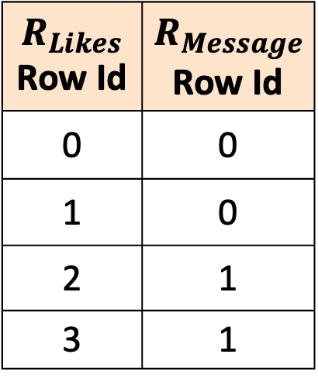


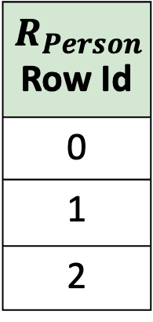


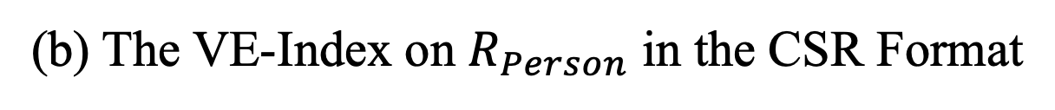

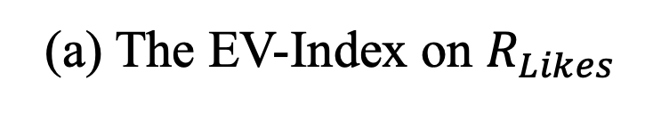


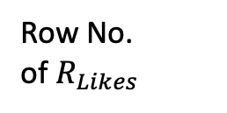


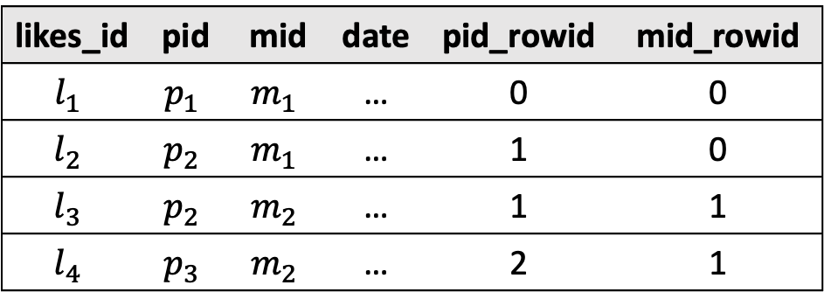

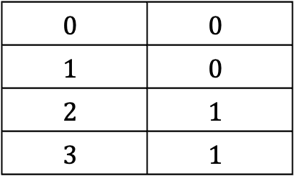




$$R_{Person}$$ Row Id
0
1
2
$$R_{Likes}$$ Row Id | $$R_{Message}$$ Row Id
0 | 0
1 | 0
2 | 1
3 | 1
likes_id | pid | mid | date | pid_rowid | mid_rowid
$$l_{1}$$ | $$p_{1}$$ | $$m_{1}$$ | … | 0 | 0
$$l_{2}$$ | $$p_{2}$$ | $$m_{1}$$ | … | 1 | 0
$$l_{3}$$ | $$p_{2}$$ | $$m_{2}$$ | … | 1 | 1
$$l_{4}$$ | $$p_{3}$$ | $$m_{2}$$ | … | 2 | 1
$$v_{p_{1}}$$
$$v_{p_{1}}$$
$$v_{m_{1}}$$
$$v_{p_{2}}$$
$$v_{p_{2}}$$
$$v_{m_{1}}$$
Row No.
of $R_{Person}$
Row No.
of $R_{Likes}$
Row No.
of $R_{Message}$
$$v_{p_{3}}$$
$$v_{p_{2}}$$
$$v_{m_{2}}$$
$$v_{p_{3}}$$
$$v_{m_{2}}$$
$$0$$
$$1$$
$$2$$
$$0$$ | $$0$$
$$1$$ | $$0$$
$$2$$ | $$1$$
$$3$$ | $$1$$
(a) The EV-Index on $R_{Likes}$
(b) The VE-Index on $R_{Person}$ in the CSR Format
$$v_{p_{2}}$$
$$v_{m_{1}}$$
$$v_{p_{2}}$$
$$v_{m_{2}}$$
$$v_{p_{3}}$$
$$v_{m_{2}}$$
(b)

Slide 5
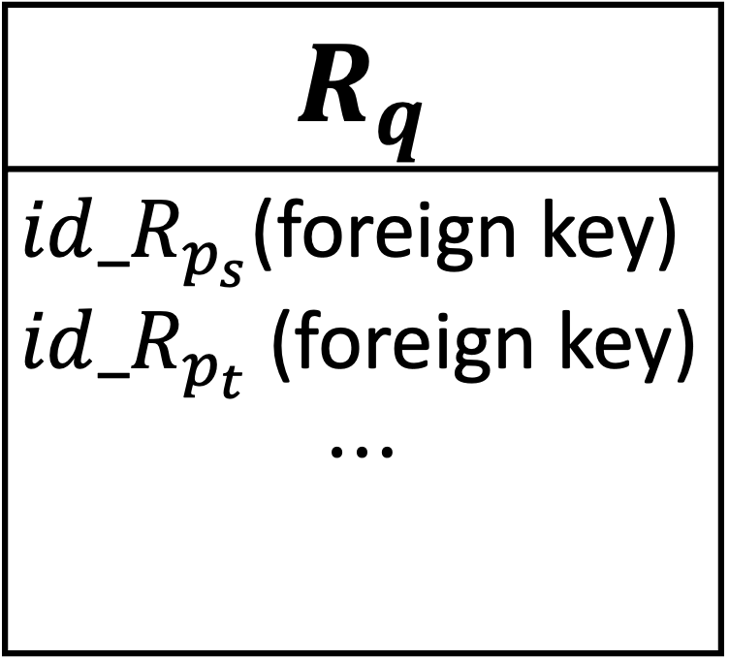
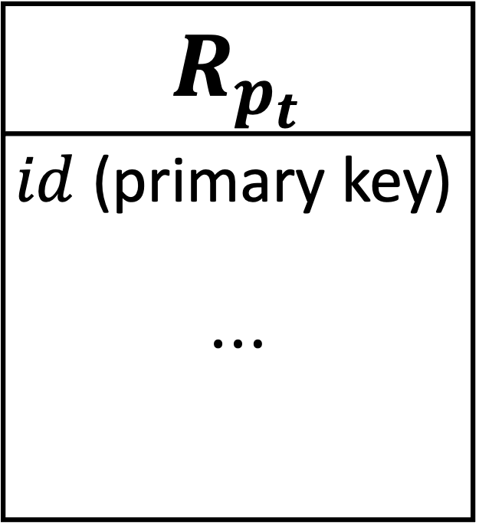
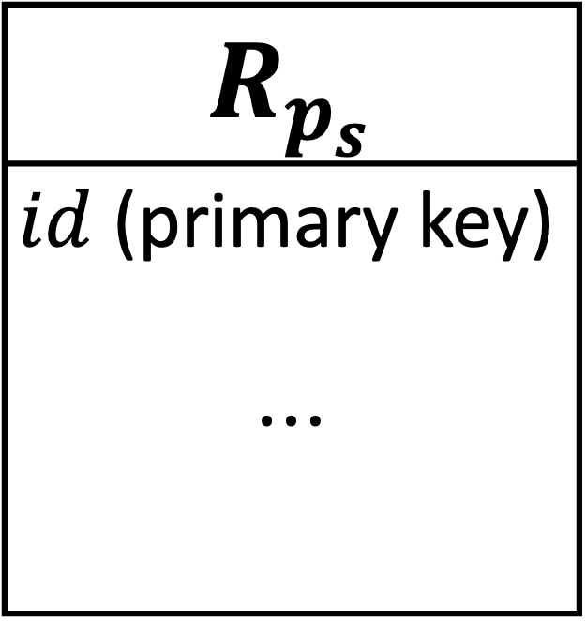
$$R_{p_{s}}$$
$id$ (primary key) $$⋯$$
$$R_{q}$$
$id_R_{p_{s}}$(foreign key) $id_R_{p_{t}}$ (foreign key) $$⋯$$
$$R_{p_{t}}$$
$id$ (primary key) $$⋯$$

Slide 6



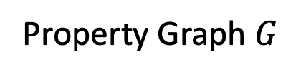
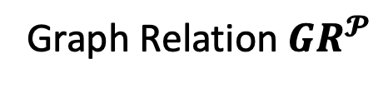


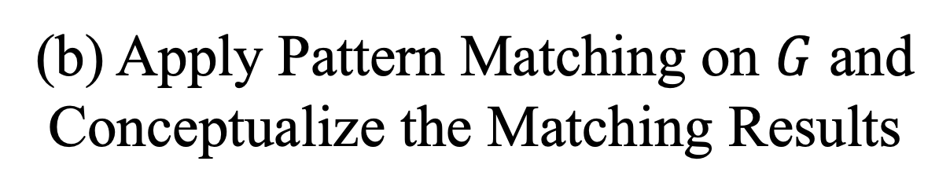











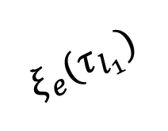

























Person
Person
Vertex
Message
Vertex
$$v_{p_{1}}$$
$$e_{k_{1}}$$
$$v_{p_{2}}$$
Graph Component
Relational Component
person_id | name | place_id
$$p_{1}$$ | Tom | $${pl}_{1}$$
$$p_{2}$$ | Bob | $${pl}_{2}$$
$$p_{3}$$ | David | $${pl}_{3}$$
Likes Edge
Knows Edge
$$ξ_{v}(τ_{p_{1}})$$
Tom
$$e_{k_{1}}$$
$$e_{k_{3}}$$
$$e_{l_{1}}$$
$$e_{l_{2}}$$
Projection
p2.name place.name
name | place_name
Bob | Germany
$$v_{p_{1}}$$
$$e_{k_{2}}$$
$$v_{p_{2}}$$
$$e_{k_{4}}$$
$$v_{p_{3}}$$
Pattern Matching
$$v_{m_{1}}$$
Message
RGMapping
$$e_{l_{1}}$$
$$e_{l_{2}}$$
$$e_{l_{3}}$$
$$e_{l_{4}}$$
$$e_{1}$$
……
Selection
p1.name = “Tom”
message_id | content
$$m_{1}$$ | $$⋯$$
$$m_{2}$$ | $$⋯$$
$$λ_{Likes}^{s}$$
$$u_{p_{1}}$$
$$u_{p_{2}}$$
$$v_{p_{3}}$$
$$e_{k_{3}}$$
$$v_{p_{2}}$$
$$ξ_{e}(τ_{l_{1}})$$
$$v_{m_{1}}$$
$$v_{m_{2}}$$
$$e_{2}$$
$$u_{m}$$
$$e_{3}$$
Likes
$$λ_{Likes}^{t}$$
Property Graph $G$
$$e_{l_{4}}$$
$$e_{l_{3}}$$
Join
p1.place_id = place_id
likes_id | pid | mid | date
$$l_{1}$$ | $$p_{1}$$ | $$m_{1}$$ | 2024-03-31
$$l_{2}$$ | $$p_{2}$$ | $$m_{1}$$ | 2024-03-28
$$l_{3}$$ | $$p_{2}$$ | $$m_{2}$$ | 2024-03-20
$$l_{4}$$ | $$p_{3}$$ | $$m_{2}$$ | 2024-03-21
Pattern Graph$𝒫$
$$v_{m_{2}}$$
CREATE PROPERTY GRAPH G
VERTEX TABLES (
Person PROPERTIES(person_id, name),
Message PROPERTIES(message_id, content)
)
EDGE TABLES (
Likes
SOURCE KEY (pid) REFERENCE Person (person_id)
DESTINATION KEY(mid) REFERENCE Message (message_id)
PROPERTIES (date),
Knows
SOURCE KEY (pid1) REFERENCE Person (person_id)
DESTINATION KEY(pid2) REFERENCE Person (person_id)
)
Matched Subgraphs
Projection
p1.name p1.place_id
p2.name
place_id | name
$${pl}_{1}$$ | Germany
$${pl}_{2}$$ | Denmark
$${pl}_{3}$$ | China
Knows
Conceptualize
knows_id | pid1 | pid2 | date
$$k_{1}$$ | $$p_{1}$$ | $$p_{2}$$ | 2023-01-15
$$k_{2}$$ | $$p_{2}$$ | $$p_{1}$$ | 2023-01-15
$$k_{3}$$ | $$p_{2}$$ | $$p_{3}$$ | 2023-02-18
$$k_{4}$$ | $$p_{3}$$ | $$p_{2}$$ | 2023-02-18
$$u_{p_{1}}$$ | $$u_{p_{2}}$$ | $$u_{m}$$ | $$e_{1}$$ | $$e_{2}$$ | $$e_{3}$$
$$v_{p_{1}}$$ | $$v_{p_{2}}$$ | $$v_{m_{1}}$$ | $$e_{k_{1}}$$ | $$e_{l_{1}}$$ | $$e_{l_{2}}$$
$$v_{p_{2}}$$ | $$v_{p_{1}}$$ | $$v_{m_{1}}$$ | $$e_{k_{2}}$$ | $$e_{l_{2}}$$ | $$e_{l_{1}}$$
$$v_{p_{2}}$$ | $$v_{p_{3}}$$ | $$v_{m_{2}}$$ | $$e_{k_{3}}$$ | $$e_{l_{3}}$$ | $$e_{l_{4}}$$
$$v_{p_{3}}$$ | $$v_{p_{2}}$$ | $$v_{m_{2}}$$ | $$e_{k_{4}}$$ | $$e_{l_{4}}$$ | $$e_{l_{3}}$$
Place
Schemas
Match
Relations
RGMapping Sentence
Graph Relation $GR^{𝓟}$
(a) The Process of RGMapping
(b) Apply Pattern Matching on $G$ and
Conceptualize the Matching Results
(c) The SPJM Query
$$({ τ}_{l_{1}}.mid=τ_{m_{1}}.m_id)$$
$$(τ_{l_{1}}.pid=τ_{p_{1}}.p_id)$$
……

Slide 7



















































































$$u_{p_{1}}$$
$$u_{p_{2}}$$
Person
Message
Follows
Likes
$$u_{m_{1}}$$
$$u_{m_{2}}$$
Post
CommentOf
Pattern $𝒫_{0}$
Schema
$$u_{p_{1}}$$
$$u_{p_{2}}$$
$$\hat{⋈}$$
$$Join_{1}$$
$$Join_{2}$$
$$\hat{⋈}$$
$${ℳ(𝒫}_{2})$$
Intermediate
Pattern
$$u_{m_{1}}$$
$$u_{p_{1}}$$
$$u_{p_{2}}$$
$$u_{m_{1}}$$
$$u_{m_{2}}$$
$$u_{p_{2}}$$
$$u_{m}$$
$${ℳ(𝒫}_{3})$$
$${ℳ(𝒫}_{4})$$
Pattern $𝒫_{1}$
Pattern $𝒫_{2}$
Pattern $𝒫$
Logical Plan
Complete-star
Pattern
$$Join_{4}$$
$$\hat{⋈}$$
$$u_{p_{1}}$$
$$u_{p_{2}}$$
$$u_{p_{1}}$$
$$u_{m}$$
$$u_{p_{2}}$$
$$u_{m_{1}}$$
$$u_{p_{1}}$$
$$u_{p_{1}}$$
$$u_{p_{2}}$$
Pattern $𝒫_{1}$
Pattern $𝒫_{2}$
Single-edge
Pattern
Pattern $𝒫_{3}$
Pattern $𝒫_{4}$
$$Join_{3}$$
$$\hat{⋈}$$
$${ℳ(𝒫}_{2})$$
$$u_{m_{1}}$$
$$u_{p_{1}}$$
$$Join_{1}$$
$$Join_{2}$$
$$u_{p_{1}}$$
$$u_{p_{1}}$$
$$u_{p_{2}}$$
Single-vertex
Pattern
$$u_{m_{1}}$$
$$u_{p_{1}}$$
$$\hat{⋈}$$
$$\hat{⋈}$$
Pattern $𝒫_{3}$
Pattern $𝒫_{4}$
$$𝒫_{5}$$
$$u_{p_{1}}$$
$$𝒫_{7}$$
$$u_{p_{2}}$$
Decompose Process
$$𝒫_{6}$$
$$𝒫_{8}$$
$${ℳ(𝒫}_{5})$$
$${ℳ(𝒫}_{6})$$
$${ℳ(𝒫}_{7})$$
$${ℳ(𝒫}_{8})$$
Decompose Process
Logical Plan
$$u_{p_{1}}$$
$$u_{p_{2}}$$
$$Join_{2}$$
$$\hat{⋈}$$
$$Join_{1}$$
$$\hat{⋈}$$
$${ℳ(𝒫}_{2})$$
$$u_{m}$$
$${ℳ(𝒫}_{3})$$
$${ℳ(𝒫}_{4})$$
Pattern $𝒫$
Logical Plan
$$u_{p_{1}}$$
$$u_{p_{2}}$$
$$u_{p_{1}}$$
$$u_{m}$$
$$u_{p_{2}}$$
Pattern $𝒫_{1}$
Pattern $𝒫_{2}$
$$u_{p_{1}}$$
$$u_{p_{1}}$$
$$u_{p_{2}}$$
Pattern $𝒫_{3}$
Pattern $𝒫_{4}$
Decompose Process

Slide 8
















likes_id | pid | mid | date | pid_rowid | mid_rowid
$$l_{1}$$ | $$p_{1}$$ | $$m_{1}$$ | 2024-03-31 | 0 | 0
$$l_{2}$$ | $$p_{2}$$ | $$m_{1}$$ | 2024-03-28 | 1 | 0
$$l_{3}$$ | $$p_{2}$$ | $$m_{2}$$ | 2024-03-20 | 1 | 1
$$l_{4}$$ | $$p_{3}$$ | $$m_{2}$$ | 2024-03-21 | 2 | 1
Row No.
of $R_{Person}$
Row No.
of $R_{Likes}$
Row No.
of $R_{Message}$
$$0$$
$$1$$
$$2$$
$$0$$ | $$0$$
$$1$$ | $$0$$
$$2$$ | $$1$$
$$3$$ | $$1$$
(a) The EV-Index on $R_{Likes}$
$$v_{p_{2}}$$
$$v_{m_{1}}$$
$$v_{p_{2}}$$
$$v_{m_{2}}$$
$$R_{Person}$$ Row Id
0
1
2
$$R_{Likes}$$ Row Id | $$R_{Message}$$ Row Id
0 | 0
1 | 0
2 | 1
3 | 1
$$v_{p_{3}}$$
$$v_{m_{2}}$$
$$v_{p_{1}}$$
$$v_{p_{1}}$$
$$v_{m_{1}}$$
$$v_{p_{2}}$$
$$v_{p_{2}}$$
$$v_{m_{1}}$$
$$v_{p_{3}}$$
$$v_{p_{2}}$$
$$v_{m_{2}}$$
(b)
$$v_{p_{3}}$$
$$v_{m_{2}}$$
(b) The VE-Index on $R_{Person}$ in the CSR Format

Slide 9







Core Workflow
Projection
p2.name place.name
PROJECTION
p2.name place.name
Projection
p2.name place.name
place_id | name
$${pl}_{1}$$ | Germany
$${pl}_{2}$$ | Denmark
$${pl}_{3}$$ | China
Projection
p2.name place.name
$$𝒫_{1}$$
Join
p1.place_id = place_id
HASH_JOIN
p1.place_id = place_id
Place
(place_id, name)
Selection
p1.name = “Tom”
$$\hat{⋈}$$
$$𝒫_{2}$$
Place
SCAN_TABLE
Join
p1.place_id = place_id
Join
p1.place_id = place_id
PROJECTION*
p1.place_id p2.name
PROJECTION*
p1.place_id p2.name
FilterIntoMatch
Projection
p1.place_id
p2.name
place_id | name
$${pl}_{1}$$ | Germany
$${pl}_{2}$$ | Denmark
$${pl}_{3}$$ | China
Graph
Optimization
Relational
Optimization
Projection
p1.name p1.place_id
p2.name
place_id | name
$${pl}_{1}$$ | Germany
$${pl}_{2}$$ | Denmark
$${pl}_{3}$$ | China
EXPAND_INTERSECT m
EXPAND_INTERSECT m
Place
GET_VERTEX
Match
EXPAND p2
EXPAND p2
Place
Tom
TrimAndFuse
EXPAND_EDGE
Match
(b) Optimized SPJM
SCAN p1 (name = “Tom”)
SCAN p1 (name = “Tom”)
$$𝒫_{3}$$
SCAN_GRAPH_TABLE
SCAN_GRAPH_TABLE
(a) SPJM
$$𝒫_{4}$$
$$\hat{⋈}$$
(d) Optimized Execution Plan
(c) SPJ with Scan Graph Table

Slide 10











































SELECT f.pn1, f.pn2
FROM GRAPH_TABLE (G1
MATCH (p1: Person) - [:Likes]->(m1: Message)<-[:Likes]-( p2:Person),
(p1)-L:Knows]->(p2)，
(p2)-[: Knows]->(p1)
COLUMNS (
p1.name as pn1, p1.place_id as ppid, p2. name as pn2)
) f, Place pl
WHERE f.ppid = pl.place_id
AND pl.p1_name = 'Germany';
CREATE PROPERTY GRAPH G1
VERTEX TABLES (
Person PROPERTIES(person_id, name),
Message PROPERTIES(message_id, content)
)
EDGE TABLES (
Likes
SOURCE KEY (pid) REFERENCE Person (person_id)
DESTINATION KEY(mid) REFERENCE Message (message_id)
PROPERTIES (date),
Knows
SOURCE KEY (pid1) REFERENCE Person (person_id)
DESTINATION KEY(pid2) REFERENCE Person (person_id)
)
Pattern Matching
$$e_{k_{1}}$$
$$e_{k_{2}}$$
$$v_{p_{1}}$$
$$e_{k_{2}}$$
$$v_{p_{2}}$$
$$v_{p_{2}}$$
$$e_{k_{1}}$$
$$v_{p_{1}}$$
$$e_{l_{1}}$$
$$e_{l_{2}}$$
$$e_{l_{2}}$$
$$e_{l_{1}}$$
$$e_{1}$$
$$v_{m_{1}}$$
$$v_{m_{1}}$$
$$u_{p_{1}}$$
$$e_{2}$$
$$u_{p_{2}}$$
$$e_{k_{3}}$$
$$e_{k_{4}}$$
Sentence to Create Property Graph
$$e_{3}$$
$$e_{4}$$
$$v_{p_{2}}$$
$$e_{k_{4}}$$
$$v_{p_{3}}$$
$$v_{p_{3}}$$
$$e_{k_{3}}$$
$$v_{p_{2}}$$
$$u_{m}$$
$$e_{l_{3}}$$
$$e_{l_{4}}$$
$$e_{l_{4}}$$
$$e_{l_{3}}$$
Person (person_id, name, place_id)
Message (message_id, content)
Place (place_id, place_name)
Likes (likes_id, pid, mid, date)
Knows (knows_id, pid1, pid2, date)
Pattern Graph$𝒫$
$$v_{m_{2}}$$
$$v_{m_{2}}$$
name1 | name2
Tom | Bob
Matched Subgraphs
Project p1.name, p2.name
Conceptualize
Schemas
name1 | plid1 | name2 | place_id | pl_name
Tom | $${pl}_{1}$$ | Bob | $${pl}_{1}$$ | Germany
$$u_{p_{1}}$$ | $$u_{p_{2}}$$ | $$u_{m}$$ | $$e_{1}$$ | $$e_{2}$$ | $$e_{3}$$ | $$e_{4}$$
$$v_{p_{1}}$$ | $$v_{p_{2}}$$ | $$v_{m_{1}}$$ | $$e_{l_{1}}$$ | $$e_{l_{2}}$$ | $$e_{k_{1}}$$ | $$e_{k_{2}}$$
$$v_{p_{2}}$$ | $$v_{p_{1}}$$ | $$v_{m_{1}}$$ | $$e_{l_{2}}$$ | $$e_{l_{1}}$$ | $$e_{k_{2}}$$ | $$e_{k_{1}}$$
$$v_{p_{2}}$$ | $$v_{p_{3}}$$ | $$v_{m_{2}}$$ | $$e_{l_{3}}$$ | $$e_{l_{4}}$$ | $$e_{k_{3}}$$ | $$e_{k_{4}}$$
$$v_{p_{3}}$$ | $$v_{p_{2}}$$ | $$v_{m_{2}}$$ | $$e_{l_{4}}$$ | $$e_{l_{3}}$$ | $$e_{k_{4}}$$ | $$e_{k_{3}}$$
Select pl.name = “Germany”
pn1 | ppid | pn2 | place_id | pl_name
Tom | $${pl}_{1}$$ | Bob | $${pl}_{1}$$ | Germany
Bob | $${pl}_{2}$$ | Tom | $${pl}_{2}$$ | Denmark
Bob | $${pl}_{2}$$ | David | $${pl}_{2}$$ | Denmark
David | $${pl}_{3}$$ | Bob | $${pl}_{3}$$ | China
Graph Relation $GR^{𝓟}$
Join p1.place_id = place_id
Projection
p1.name
p1.place_id
p2.name
Projection
p1_name | p1_plid | p2_name
Tom | $${pl}_{1}$$ | Bob
Bob | $${pl}_{2}$$ | Tom
Bob | $${pl}_{2}$$ | David
David | $${pl}_{3}$$ | Bob
place_id | pl_name
$${pl}_{1}$$ | Germany
$${pl}_{2}$$ | Denmark
$${pl}_{3}$$ | China
Selection
$u_{p_{1}}$.name
$u_{p_{1}}$.place_id
$u_{p_{2}}$.name
Relation $R_{M}$
Relation Place
p1.name = “Germany”
Join
p1.place_id = place_id
Projection
Place
Match

Slide 11




























$$u_{p_{1}}$$
$$u_{p_{2}}$$
$$Join_{2}$$
$$\hat{⋈}$$
$$Join_{1}$$
$$u_{m}$$
$$\hat{⋈}$$
$${ℳ(𝒫}_{2})$$
Person1
Pattern $𝒫$
$${ℳ(𝒫}_{3})$$
$${ℳ(𝒫}_{4})$$
Logical Plan
person_id | name | place_id
…… | …… | ……
Person2
$$u_{p_{1}}$$
$$u_{p_{2}}$$
$$u_{p_{1}}$$
$$u_{m}$$
$$u_{p_{2}}$$
person_id | name | place_id
…… | …… | ……
Graph Aware
Message
Pattern $𝒫_{1}$
Pattern $𝒫_{2}$
message_id | content
…… | …...
$$u_{p_{1}}$$
$$u_{p_{2}}$$
$$⋈$$
$$u_{m}$$
$$u_{p_{1}}$$
$$u_{p_{1}}$$
$$u_{p_{2}}$$
Likes1
Pattern $𝒫_{3}$
Pattern $𝒫_{4}$
likes_id | pid | mid | date
…… | …… | …… | ……
Pattern $𝒫$
Decompose Process
Likes2
Graph Agnostic
likes_id | pid | mid | date
…… | …… | …… | ……
Knows
$$⋈$$
$$⋈$$
knows_id | pid1 | pid2 | date
…… | …… | …… | ……
Determine Join Order
$$⋈$$
Person2
Person1
$$⋈$$
Person1
Knows
Knows
Person2

Slide 12


