Slide 1
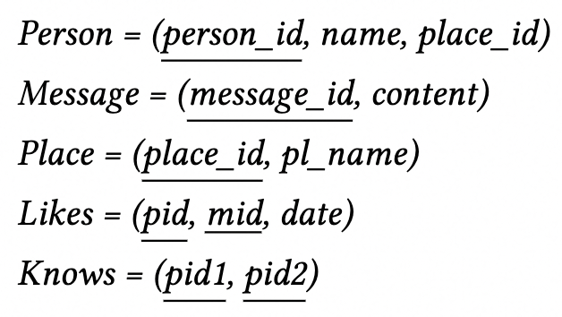
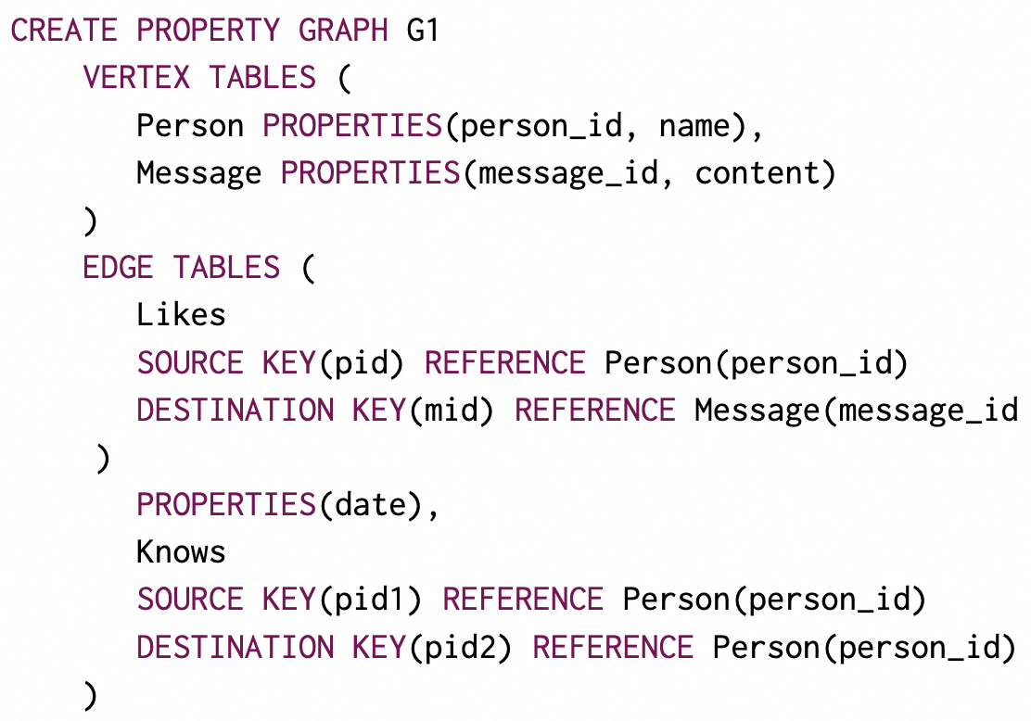
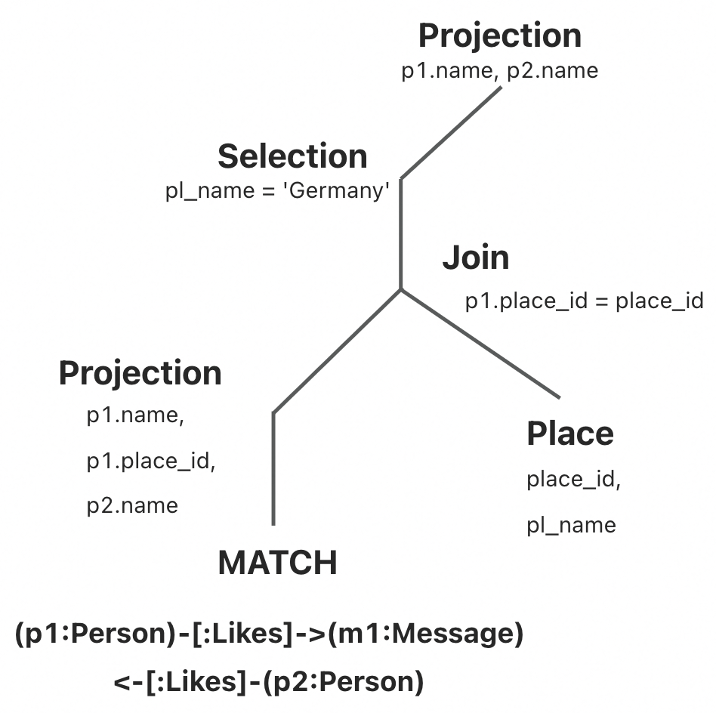
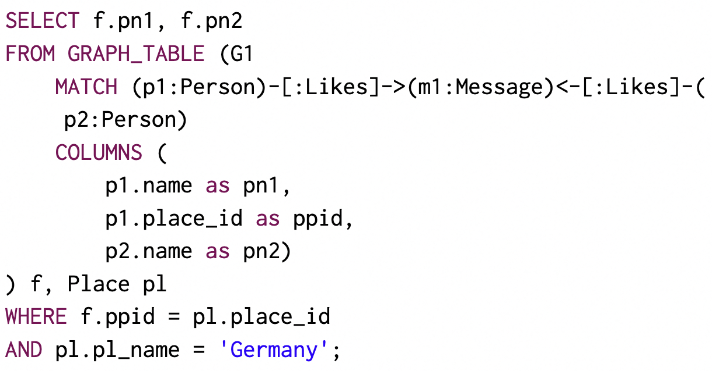







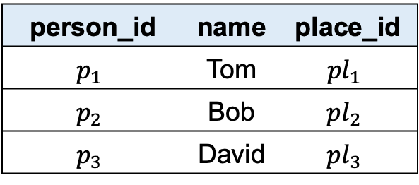







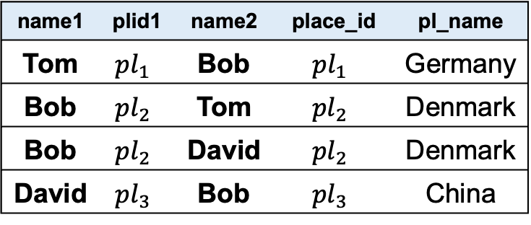






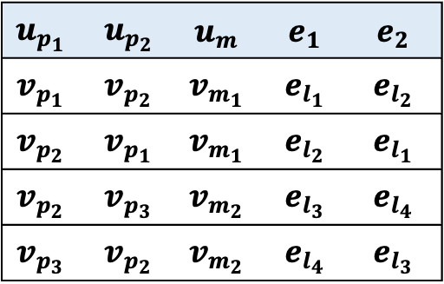

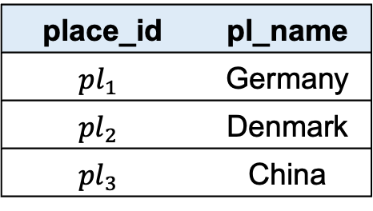
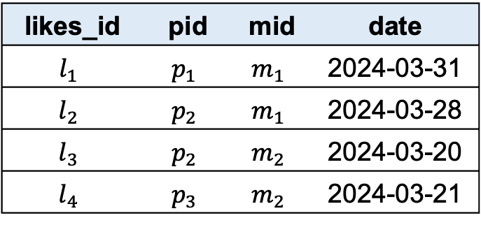

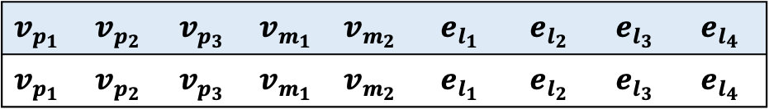




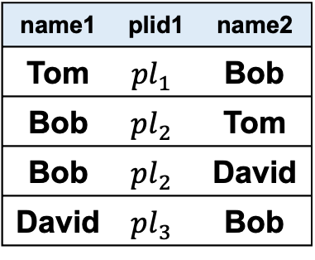

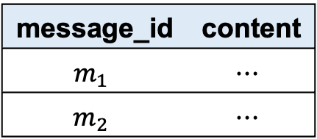





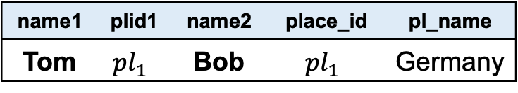



Relations
RGMapping
Property Graph G1
Set of Subgraphs
$$v_{p_{1}}$$
Pattern Matching
person_id | name | place_id
$$p_{1}$$ | Tom | $${pl}_{1}$$
$$p_{2}$$ | Bob | $${pl}_{2}$$
$$p_{3}$$ | David | $${pl}_{3}$$
$$v_{p_{2}}$$
$$v_{p_{1}}$$
$$v_{p_{1}}$$
$$v_{p_{2}}$$
$$v_{p_{2}}$$
$$v_{p_{3}}$$
$$v_{p_{3}}$$
$$v_{p_{2}}$$
Person
$$v_{p_{2}}$$
$$e_{l_{1}}$$
$$v_{p_{3}}$$
$$e_{l_{2}}$$
$$e_{l_{1}}$$
$$e_{l_{1}}$$
$$e_{l_{2}}$$
$$e_{l_{3}}$$
$$e_{l_{4}}$$
$$e_{l_{4}}$$
$$e_{l_{3}}$$
$$e_{l_{2}}$$
$$e_{l_{3}}$$
$$e_{l_{4}}$$
$$u_{p_{1}}$$
$$u_{p_{2}}$$
$$v_{m_{1}}$$
$$v_{m_{1}}$$
$$v_{m_{2}}$$
$$v_{m_{2}}$$
Message
message_id | content
$$m_{1}$$ | $$⋯$$
$$m_{2}$$ | $$⋯$$
$$v_{m_{1}}$$
$$e_{1}$$
$$e_{2}$$
$$v_{m_{2}}$$
$$u_{m}$$
Conceptualize
likes_id | pid | mid | date
$$l_{1}$$ | $$p_{1}$$ | $$m_{1}$$ | 2024-03-31
$$l_{2}$$ | $$p_{2}$$ | $$m_{1}$$ | 2024-03-28
$$l_{3}$$ | $$p_{2}$$ | $$m_{2}$$ | 2024-03-20
$$l_{4}$$ | $$p_{3}$$ | $$m_{2}$$ | 2024-03-21
Conceptualize
Graph Relation $GR^{M}$
name1 | name2
Tom | Bob
Graph Relation $GR^{G1}$
Matching Operator
$$u_{p_{1}}$$ | $$u_{p_{2}}$$ | $$u_{m}$$ | $$e_{1}$$ | $$e_{2}$$
$$v_{p_{1}}$$ | $$v_{p_{2}}$$ | $$v_{m_{1}}$$ | $$e_{l_{1}}$$ | $$e_{l_{2}}$$
$$v_{p_{2}}$$ | $$v_{p_{1}}$$ | $$v_{m_{1}}$$ | $$e_{l_{2}}$$ | $$e_{l_{1}}$$
$$v_{p_{2}}$$ | $$v_{p_{3}}$$ | $$v_{m_{2}}$$ | $$e_{l_{3}}$$ | $$e_{l_{4}}$$
$$v_{p_{3}}$$ | $$v_{p_{2}}$$ | $$v_{m_{2}}$$ | $$e_{l_{4}}$$ | $$e_{l_{3}}$$
Likes
$$v_{p_{1}}$$ | $$v_{p_{2}}$$ | $$v_{p_{3}}$$ | $$v_{m_{1}}$$ | $$v_{m_{2}}$$ | $$e_{l_{1}}$$ | $$e_{l_{2}}$$ | $$e_{l_{3}}$$ | $$e_{l_{4}}$$
$$v_{p_{1}}$$ | $$v_{p_{2}}$$ | $$v_{p_{3}}$$ | $$v_{m_{1}}$$ | $$v_{m_{2}}$$ | $$e_{l_{1}}$$ | $$e_{l_{2}}$$ | $$e_{l_{3}}$$ | $$e_{l_{4}}$$
Project Operator
name1 | plid1 | name2 | place_id | pl_name
Tom | $${pl}_{1}$$ | Bob | $${pl}_{1}$$ | Germany
(b)
Projection Operator ($u_{p_{1}}$.name, $u_{p_{1}}$.place_id, $u_{p_{2}}$.name)
Select Operator
name1 | plid1 | name2
Tom | $${pl}_{1}$$ | Bob
Bob | $${pl}_{2}$$ | Tom
Bob | $${pl}_{2}$$ | David
David | $${pl}_{3}$$ | Bob
name1 | plid1 | name2 | place_id | pl_name
Tom | $${pl}_{1}$$ | Bob | $${pl}_{1}$$ | Germany
Bob | $${pl}_{2}$$ | Tom | $${pl}_{2}$$ | Denmark
Bob | $${pl}_{2}$$ | David | $${pl}_{2}$$ | Denmark
David | $${pl}_{3}$$ | Bob | $${pl}_{3}$$ | China
Join Operator
Place
place_id | pl_name
$${pl}_{1}$$ | Germany
$${pl}_{2}$$ | Denmark
$${pl}_{3}$$ | China
(a)

Slide 2
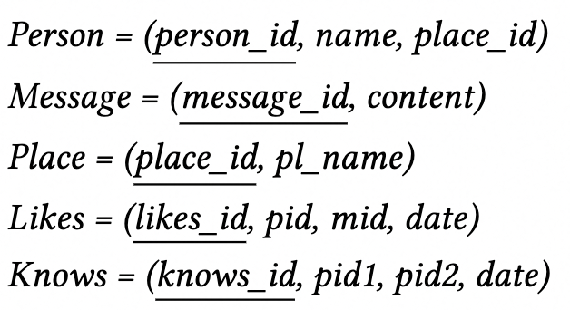
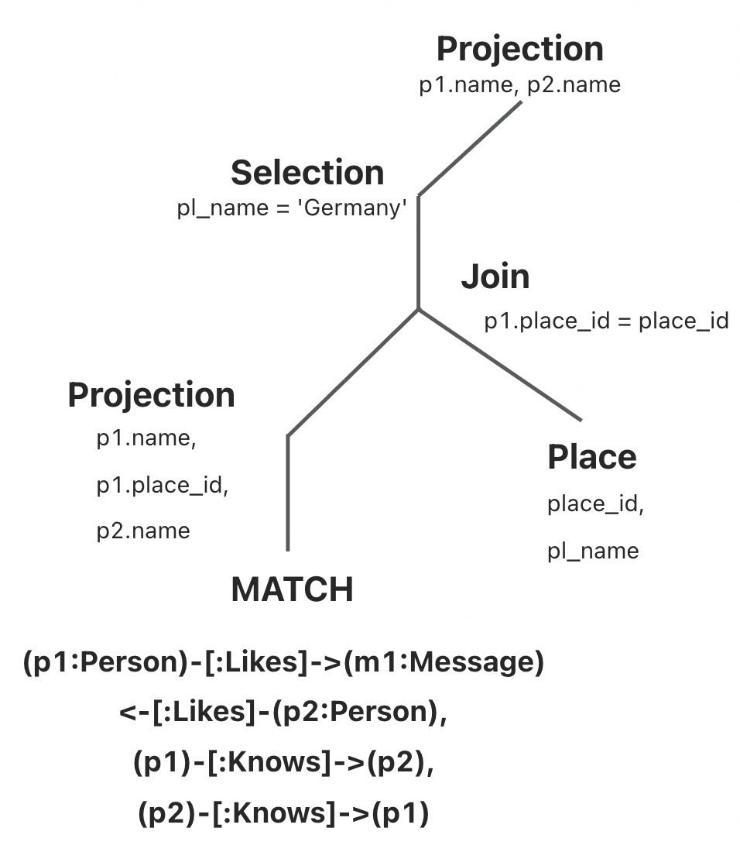
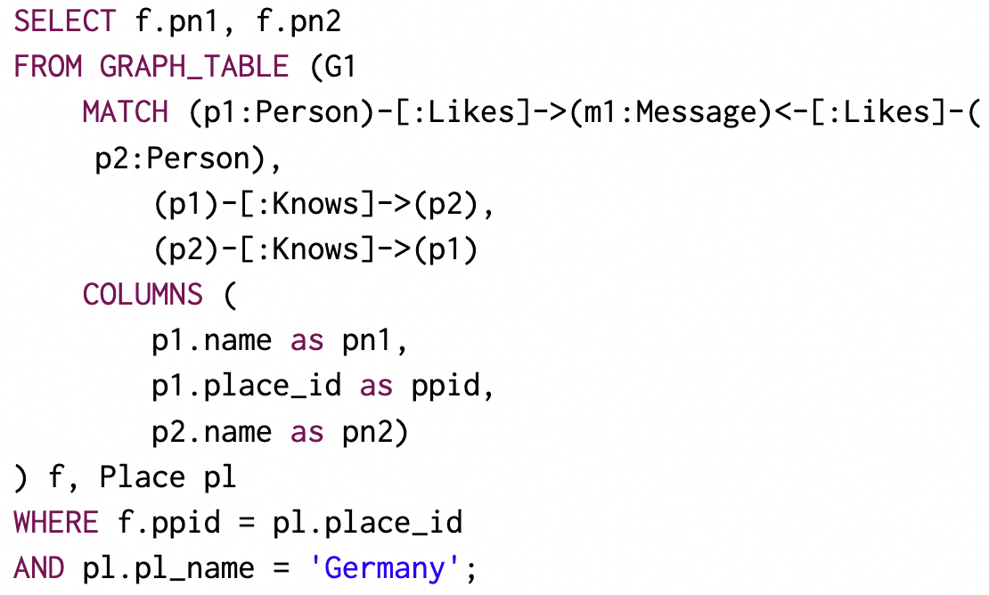




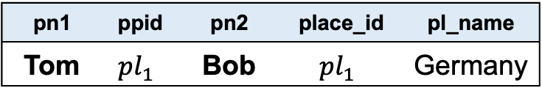










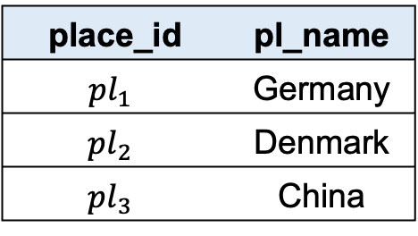



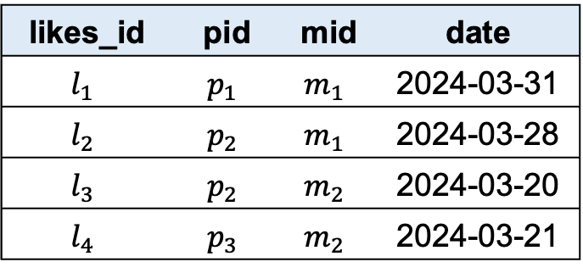











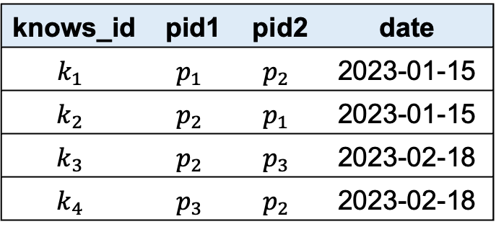






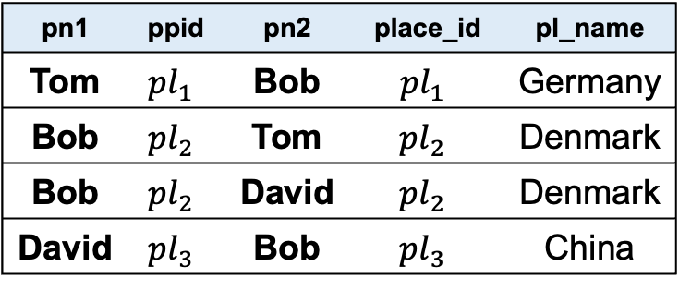

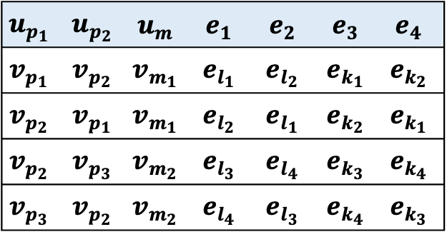




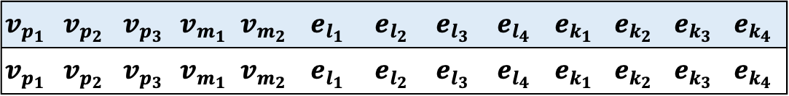






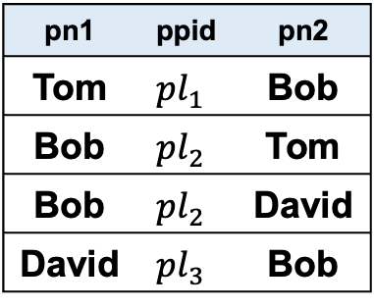


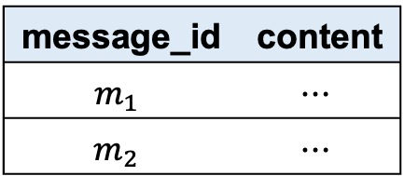




Relations
RGMapping
Property Graph G1
person_id | name | place_id
$$p_{1}$$ | Tom | $${pl}_{1}$$
$$p_{2}$$ | Bob | $${pl}_{2}$$
$$p_{3}$$ | David | $${pl}_{3}$$
$$v_{p_{1}}$$
$$e_{k_{2}}$$
$$e_{k_{1}}$$
$$e_{k_{1}}$$
Set of Subgraphs
Person
$$e_{k_{3}}$$
Pattern Matching
$$e_{k_{2}}$$
$$e_{k_{3}}$$
$$e_{k_{4}}$$
$$v_{p_{2}}$$
$$e_{k_{4}}$$
$$v_{p_{3}}$$
$$v_{p_{1}}$$
$$v_{p_{2}}$$
$$v_{p_{2}}$$
$$v_{p_{1}}$$
$$v_{p_{2}}$$
$$v_{p_{3}}$$
$$v_{p_{3}}$$
$$v_{p_{2}}$$
$$e_{l_{4}}$$
$$e_{k_{2}}$$
$$e_{k_{1}}$$
$$e_{k_{4}}$$
$$e_{k_{3}}$$
message_id | content
$$m_{1}$$ | $$⋯$$
$$m_{2}$$ | $$⋯$$
$$e_{l_{2}}$$
$$e_{l_{1}}$$
$$e_{l_{3}}$$
$$e_{1}$$
$$e_{l_{1}}$$
$$e_{l_{2}}$$
$$e_{l_{2}}$$
$$e_{l_{1}}$$
$$e_{l_{3}}$$
$$e_{l_{4}}$$
$$e_{l_{4}}$$
$$e_{l_{3}}$$
Message
$$v_{m_{1}}$$
$$u_{p_{1}}$$
$$u_{p_{2}}$$
$$v_{m_{1}}$$
$$v_{m_{2}}$$
$$e_{2}$$
$$v_{m_{1}}$$
$$v_{m_{2}}$$
$$v_{m_{2}}$$
likes_id | pid | mid | date
$$l_{1}$$ | $$p_{1}$$ | $$m_{1}$$ | 2024-03-31
$$l_{2}$$ | $$p_{2}$$ | $$m_{1}$$ | 2024-03-28
$$l_{3}$$ | $$p_{2}$$ | $$m_{2}$$ | 2024-03-20
$$l_{4}$$ | $$p_{3}$$ | $$m_{2}$$ | 2024-03-21
$$e_{3}$$
$$e_{4}$$
Conceptualize
$$u_{m}$$
Conceptualize
Likes
Pattern Graph $𝒫$
Graph Relation $GR^{𝓟}$
Matching Operator
$$u_{p_{1}}$$ | $$u_{p_{2}}$$ | $$u_{m}$$ | $$e_{1}$$ | $$e_{2}$$ | $$e_{3}$$ | $$e_{4}$$
$$v_{p_{1}}$$ | $$v_{p_{2}}$$ | $$v_{m_{1}}$$ | $$e_{l_{1}}$$ | $$e_{l_{2}}$$ | $$e_{k_{1}}$$ | $$e_{k_{2}}$$
$$v_{p_{2}}$$ | $$v_{p_{1}}$$ | $$v_{m_{1}}$$ | $$e_{l_{2}}$$ | $$e_{l_{1}}$$ | $$e_{k_{2}}$$ | $$e_{k_{1}}$$
$$v_{p_{2}}$$ | $$v_{p_{3}}$$ | $$v_{m_{2}}$$ | $$e_{l_{3}}$$ | $$e_{l_{4}}$$ | $$e_{k_{3}}$$ | $$e_{k_{4}}$$
$$v_{p_{3}}$$ | $$v_{p_{2}}$$ | $$v_{m_{2}}$$ | $$e_{l_{4}}$$ | $$e_{l_{3}}$$ | $$e_{k_{4}}$$ | $$e_{k_{3}}$$
Graph Relation $GR^{G1}$
knows_id | pid1 | pid2 | date
$$k_{1}$$ | $$p_{1}$$ | $$p_{2}$$ | 2023-01-15
$$k_{2}$$ | $$p_{2}$$ | $$p_{1}$$ | 2023-01-15
$$k_{3}$$ | $$p_{2}$$ | $$p_{3}$$ | 2023-02-18
$$k_{4}$$ | $$p_{3}$$ | $$p_{2}$$ | 2023-02-18
$$v_{p_{1}}$$ | $$v_{p_{2}}$$ | $$v_{p_{3}}$$ | $$v_{m_{1}}$$ | $$v_{m_{2}}$$ | $$e_{l_{1}}$$ | $$e_{l_{2}}$$ | $$e_{l_{3}}$$ | $$e_{l_{4}}$$ | $$e_{k_{1}}$$ | $$e_{k_{2}}$$ | $$e_{k_{3}}$$ | $$e_{k_{4}}$$
$$v_{p_{1}}$$ | $$v_{p_{2}}$$ | $$v_{p_{3}}$$ | $$v_{m_{1}}$$ | $$v_{m_{2}}$$ | $$e_{l_{1}}$$ | $$e_{l_{2}}$$ | $$e_{l_{3}}$$ | $$e_{l_{4}}$$ | $$e_{k_{1}}$$ | $$e_{k_{2}}$$ | $$e_{k_{3}}$$ | $$e_{k_{4}}$$
Knows
(b)
(a)
$$R_{M}$$
Projection Operator ($u_{p_{1}}$.name, $u_{p_{1}}$.place_id, $u_{p_{2}}$.name)
pn1 | ppid | pn2
Tom | $${pl}_{1}$$ | Bob
Bob | $${pl}_{2}$$ | Tom
Bob | $${pl}_{2}$$ | David
David | $${pl}_{3}$$ | Bob
pn1 | ppid | pn2 | place_id | pl_name
Tom | $${pl}_{1}$$ | Bob | $${pl}_{1}$$ | Germany
Bob | $${pl}_{2}$$ | Tom | $${pl}_{2}$$ | Denmark
Bob | $${pl}_{2}$$ | David | $${pl}_{2}$$ | Denmark
David | $${pl}_{3}$$ | Bob | $${pl}_{3}$$ | China
Join Operator
Place
place_id | pl_name
$${pl}_{1}$$ | Germany
$${pl}_{2}$$ | Denmark
$${pl}_{3}$$ | China
Select Operator
pn1 | ppid | pn2 | place_id | pl_name
Tom | $${pl}_{1}$$ | Bob | $${pl}_{1}$$ | Germany
Project Operator
(c)
pn1 | pn2
Tom | Bob

Slide 3


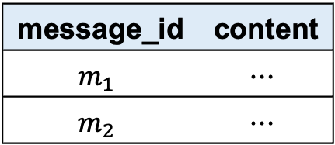








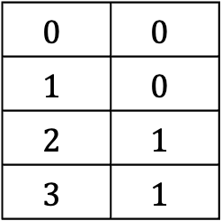
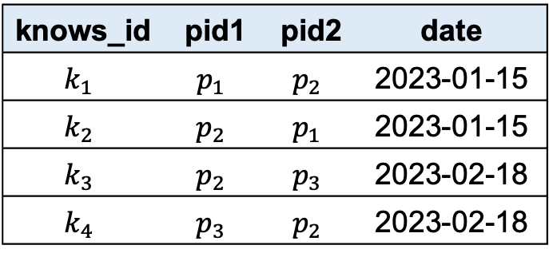






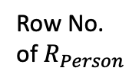


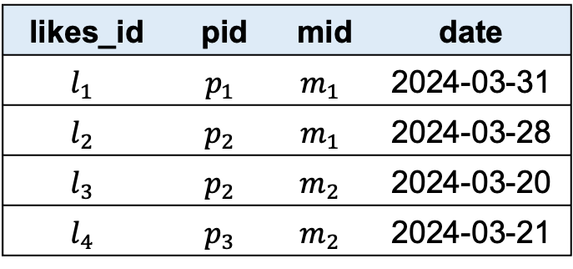
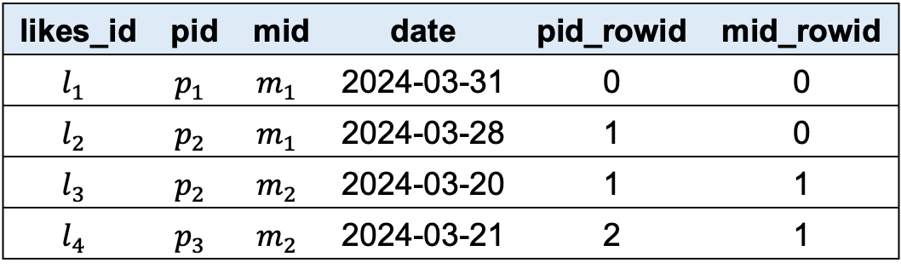



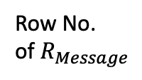


Property Graph G1
$$v_{p_{1}}$$
$$e_{k_{2}}$$
$$e_{k_{1}}$$
$$e_{k_{3}}$$
$$v_{p_{2}}$$
$$e_{k_{4}}$$
$$v_{p_{3}}$$
$$e_{l_{2}}$$
$$e_{l_{3}}$$
$$e_{l_{4}}$$
$$e_{l_{1}}$$
$$v_{m_{1}}$$
$$v_{m_{2}}$$
person_id | name | place_id
$$p_{1}$$ | Tom | $${pl}_{1}$$
$$p_{2}$$ | Bob | $${pl}_{2}$$
$$p_{3}$$ | David | $${pl}_{3}$$
message_id | content
$$m_{1}$$ | $$⋯$$
$$m_{2}$$ | $$⋯$$
Row No.
of $R_{Likes}$
Row No.
of $R_{Message}$
likes_id | pid | mid | date
$$l_{1}$$ | $$p_{1}$$ | $$m_{1}$$ | 2024-03-31
$$l_{2}$$ | $$p_{2}$$ | $$m_{1}$$ | 2024-03-28
$$l_{3}$$ | $$p_{2}$$ | $$m_{2}$$ | 2024-03-20
$$l_{4}$$ | $$p_{3}$$ | $$m_{2}$$ | 2024-03-21
likes_id | pid | mid | date | pid_rowid | mid_rowid
$$l_{1}$$ | $$p_{1}$$ | $$m_{1}$$ | 2024-03-31 | 0 | 0
$$l_{2}$$ | $$p_{2}$$ | $$m_{1}$$ | 2024-03-28 | 1 | 0
$$l_{3}$$ | $$p_{2}$$ | $$m_{2}$$ | 2024-03-20 | 1 | 1
$$l_{4}$$ | $$p_{3}$$ | $$m_{2}$$ | 2024-03-21 | 2 | 1
Row No.
of $R_{Person}$
$$v_{p_{1}}$$
$$v_{m_{1}}$$
$$0$$
$$1$$
$$2$$
$$0$$ | $$0$$
$$1$$ | $$0$$
$$2$$ | $$1$$
$$3$$ | $$1$$
$$v_{m_{1}}$$
$$v_{p_{2}}$$
$$v_{p_{2}}$$
$$v_{m_{2}}$$
$$v_{p_{3}}$$
$$v_{m_{2}}$$
knows_id | pid1 | pid2 | date
$$k_{1}$$ | $$p_{1}$$ | $$p_{2}$$ | 2023-01-15
$$k_{2}$$ | $$p_{2}$$ | $$p_{1}$$ | 2023-01-15
$$k_{3}$$ | $$p_{2}$$ | $$p_{3}$$ | 2023-02-18
$$k_{4}$$ | $$p_{3}$$ | $$p_{2}$$ | 2023-02-18
(a)
(b)

Slide 4






















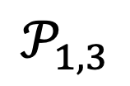




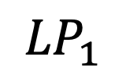






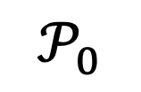

































MATCH
$$v_{p_{1}}$$
$$v_{p_{2}}$$
Person
Follows
Person
Likes
Post
$$v_{m_{1}}$$
CommentOf
$$v_{m_{2}}$$
Message
Message
$$𝒫_{0}$$
$$v_{p_{1}}$$
$$v_{p_{2}}$$
MATCH
MATCH
Person
Person
$$v_{p_{1}}$$
$$v_{p_{2}}$$
Person
Follows
Person
Likes
Post
$$\hat{⋈}$$
$$Join_{1}$$
$$𝒫_{1,1}$$
$${ℳ(𝒫}_{1,1})$$
$$\hat{⋈}$$
$$Join_{2}$$
$$v_{m_{1}}$$
CommentOf
$$v_{m_{2}}$$
Message
Message
$$v_{p_{1}}$$
Decompose
$$𝒫_{1,2}$$
$${ℳ(𝒫}_{1,3})$$
$${ℳ(𝒫}_{1,4})$$
$$e_{k_{2}}$$
$$e_{k_{1}}$$
$$e_{k_{3}}$$
$${LP}_{1}$$
$$v_{p_{2}}$$
$$e_{k_{4}}$$
$$v_{p_{3}}$$
$$e_{l_{2}}$$
$$e_{l_{3}}$$
$$e_{l_{4}}$$
MATCH
MATCH
$$e_{l_{1}}$$
$$v_{m_{1}}$$
$$v_{p_{2}}$$
$$v_{m_{1}}$$
MATCH
$$v_{p_{1}}$$
$$v_{m_{2}}$$
Person
Likes
Message
Person
$$v_{p_{1}}$$
$$v_{p_{2}}$$
Person
Follows
Person
Post
$$𝒫_{1,3}$$
$$v_{m_{1}}$$
$$v_{m_{2}}$$
Message
CommentOf
Message
Likes
Post
$$T_{1}$$
$$𝒫_{1,4}$$
$$v_{m_{1}}$$
CommentOf
$$v_{m_{2}}$$
Message
Message
$$𝒫_{0}$$
Decompose
MATCH
$$v_{p_{1}}$$
$$v_{p_{2}}$$
Person
Follows
Person
Likes
Post
$$v_{m_{1}}$$
CommentOf
$$v_{m_{2}}$$
Message
Message
$$𝒫_{0}$$
$$\hat{⋈}$$
$$Join_{3}$$
$$Join_{4}$$
$$\hat{⋈}$$
$${ℳ(𝒫}_{2,2})$$
MATCH
MATCH
$$v_{p_{1}}$$
$$v_{p_{2}}$$
$$v_{p_{2}}$$
$${ℳ(𝒫}_{2,3})$$
$${ℳ(𝒫}_{2,4})$$
Person
Follows
Person
Person
$${LP}_{2}$$
Post
Likes
$$v_{m_{1}}$$
$$v_{m_{2}}$$
Message
CommentOf
Message
$$v_{m_{1}}$$
$$𝒫_{2,2}$$
Message
$$𝒫_{2,1}$$
MATCH
MATCH
$$v_{p_{1}}$$
$$v_{p_{2}}$$
$$v_{p_{1}}$$
$$v_{m_{1}}$$
Person
Follows
Person
Person
Likes
Message
$$𝒫_{2,3}$$
$$𝒫_{2,4}$$
$$T_{2}$$

Slide 5






























MATCH
$$v_{p_{1}}$$
$$v_{p_{2}}$$
Person
Follows
Person
Likes
Post
$$v_{m_{1}}$$
CommentOf
$$v_{m_{2}}$$
Message
Message
MATCH
$$𝒫_{0}$$
$$v_{p_{1}}$$
$$v_{p_{2}}$$
Follows
$$\hat{⋈}$$
$$Join_{3}$$
Person
Person
Decompose
$$Join_{4}$$
$$\hat{⋈}$$
$${ℳ(𝒫}_{2,2})$$
Likes
Post
MATCH
MATCH
$$v_{p_{1}}$$
$$v_{p_{2}}$$
$$v_{p_{2}}$$
$${ℳ(𝒫}_{2,3})$$
$${ℳ(𝒫}_{2,4})$$
$$v_{m_{1}}$$
CommentOf
$$v_{m_{2}}$$
Person
Follows
Person
Person
Message
Message
$${LP}_{2}$$
Post
$$𝒫_{0}$$
$$v_{m_{1}}$$
$$v_{m_{2}}$$
Likes
Message
CommentOf
Message
$$v_{m_{1}}$$
$$𝒫_{2,2}$$
Message
$$𝒫_{2,1}$$
MATCH
MATCH
$$v_{p_{1}}$$
$$v_{p_{2}}$$
$$v_{p_{1}}$$
$$v_{m_{1}}$$
Person
Follows
Person
Person
Likes
Message
$$𝒫_{2,3}$$
$$𝒫_{2,4}$$
$$T_{2}$$

