Slide 1

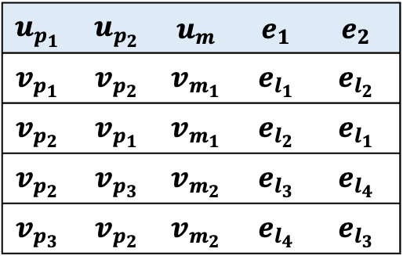










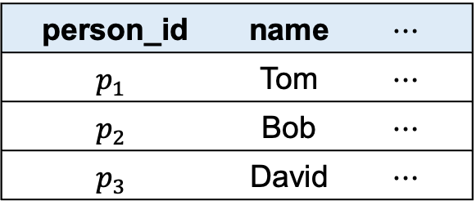

















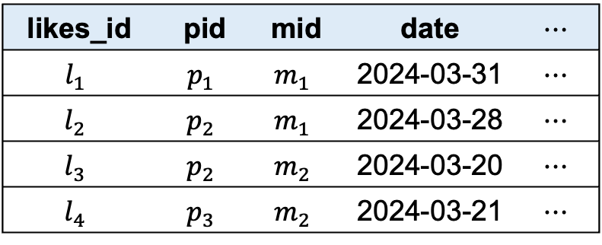

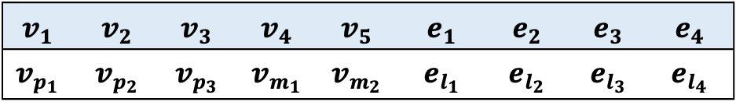





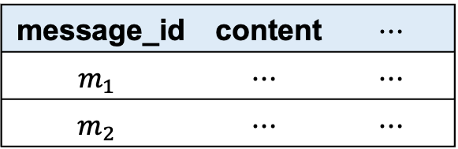
Relations
RGMapping
Property Graph
Property Graphs
$$v_{p_{1}}$$
Homomorphic Pattern Matching
person_id | name | $$⋯$$
$$p_{1}$$ | Tom | $$⋯$$
$$p_{2}$$ | Bob | $$⋯$$
$$p_{3}$$ | David | $$⋯$$
$$v_{p_{2}}$$
$$v_{p_{1}}$$
$$v_{p_{1}}$$
$$v_{p_{2}}$$
$$v_{p_{2}}$$
$$v_{p_{3}}$$
$$v_{p_{3}}$$
$$v_{p_{2}}$$
$$e_{l_{1}}$$
$$v_{p_{2}}$$
$$v_{p_{3}}$$
$$e_{l_{2}}$$
$$e_{l_{1}}$$
$$e_{l_{1}}$$
$$e_{l_{2}}$$
$$e_{l_{3}}$$
$$e_{l_{4}}$$
$$e_{l_{4}}$$
$$e_{l_{3}}$$
$$e_{l_{3}}$$
$$e_{l_{4}}$$
$$e_{l_{2}}$$
$$u_{p_{1}}$$
$$u_{p_{2}}$$
$$v_{m_{1}}$$
$$v_{m_{1}}$$
$$v_{m_{2}}$$
$$v_{m_{2}}$$
message_id | content | $$⋯$$
$$m_{1}$$ | $$⋯$$ | $$⋯$$
$$m_{2}$$ | $$⋯$$ | $$⋯$$
$$v_{m_{1}}$$
$$e_{1}$$
$$e_{2}$$
$$v_{m_{2}}$$
Trivial Conversion
$$u_{m}$$
Trivial Conversion
Graph Relation
likes_id | pid | mid | date | $$⋯$$
$$l_{1}$$ | $$p_{1}$$ | $$m_{1}$$ | 2024-03-31 | $$⋯$$
$$l_{2}$$ | $$p_{2}$$ | $$m_{1}$$ | 2024-03-28 | $$⋯$$
$$l_{3}$$ | $$p_{2}$$ | $$m_{2}$$ | 2024-03-20 | $$⋯$$
$$l_{4}$$ | $$p_{3}$$ | $$m_{2}$$ | 2024-03-21 | $$⋯$$
Graph Relation
Matching Operator
$$u_{p_{1}}$$ | $$u_{p_{2}}$$ | $$u_{m}$$ | $$e_{1}$$ | $$e_{2}$$
$$v_{p_{1}}$$ | $$v_{p_{2}}$$ | $$v_{m_{1}}$$ | $$e_{l_{1}}$$ | $$e_{l_{2}}$$
$$v_{p_{2}}$$ | $$v_{p_{1}}$$ | $$v_{m_{1}}$$ | $$e_{l_{2}}$$ | $$e_{l_{1}}$$
$$v_{p_{2}}$$ | $$v_{p_{3}}$$ | $$v_{m_{2}}$$ | $$e_{l_{3}}$$ | $$e_{l_{4}}$$
$$v_{p_{3}}$$ | $$v_{p_{2}}$$ | $$v_{m_{2}}$$ | $$e_{l_{4}}$$ | $$e_{l_{3}}$$
$$v_{1}$$ | $$v_{2}$$ | $$v_{3}$$ | $$v_{4}$$ | $$v_{5}$$ | $$e_{1}$$ | $$e_{2}$$ | $$e_{3}$$ | $$e_{4}$$
$$v_{p_{1}}$$ | $$v_{p_{2}}$$ | $$v_{p_{3}}$$ | $$v_{m_{1}}$$ | $$v_{m_{2}}$$ | $$e_{l_{1}}$$ | $$e_{l_{2}}$$ | $$e_{l_{3}}$$ | $$e_{l_{4}}$$

