Slide 1
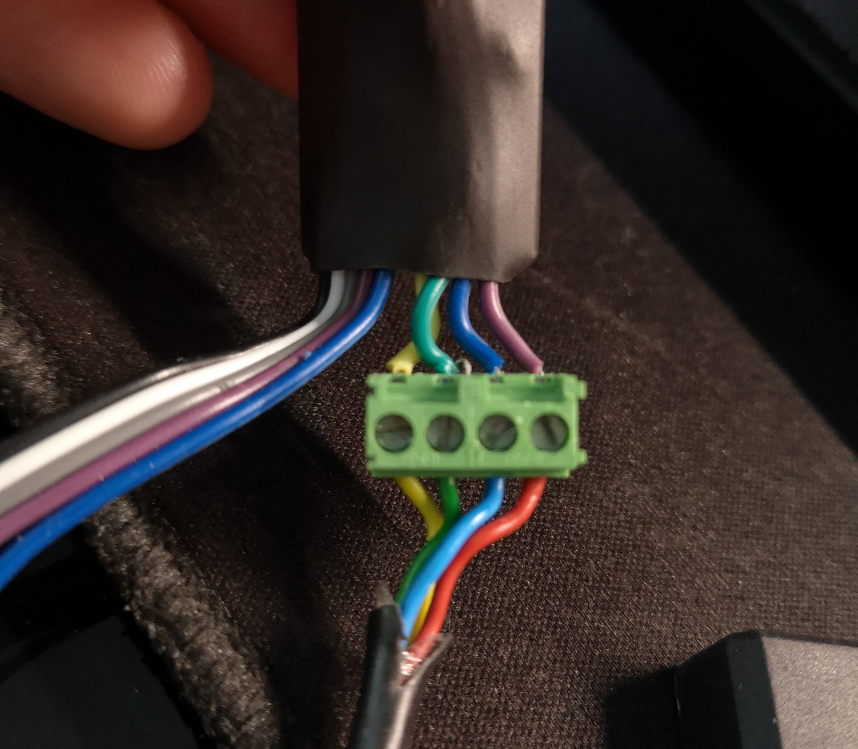
RELAY | TEMP | VCC | GND

