Slide 1
Institutional Review | KHZ ROUNDTRIP MARKER 2026-08-31
SYNTHETIC TEST DATA
Notes:
SYNTHETIC TEST DATA - speaker notes for compatibility testing.

Slide 2
Agenda
Operations
Finance
Quality
Next steps
Notes:
SYNTHETIC TEST DATA - speaker notes for compatibility testing.

Slide 3
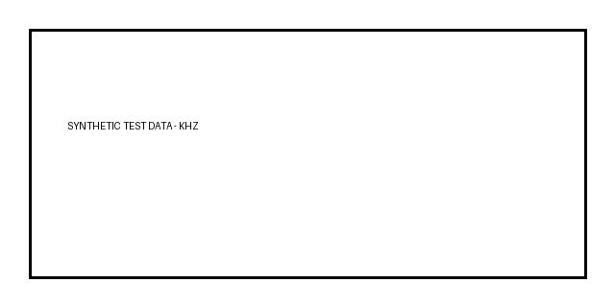
Local-first evidence
Notes:
SYNTHETIC TEST DATA - speaker notes for compatibility testing.

Slide 4
Synthetic Metrics
Notes:
SYNTHETIC TEST DATA - speaker notes for compatibility testing.

Slide 5
Risk Register
Risk | Owner | Status
Unexpected egress | Security | Blocked
Data loss | Operations | Mitigated
Model overreach | Product | AI OFF
Notes:
SYNTHETIC TEST DATA - speaker notes for compatibility testing.

Slide 6
Decision
Preserve user data
Verify before claiming success
Notes:
SYNTHETIC TEST DATA - speaker notes for compatibility testing.

