Slide 1
Modeling the
Activities of the
Daily Living
Define the effect
of disabilities into
activities
Assess
Scenarios
Adequation
By Running
Stand alone
Simulations
SociaAAL ML
Scenario & AAL solution
definition
3D Simulation
without
Android Devices
Defining the
Physical
Environment
Identifying the
AAL devices and
binding them to
Simulated actors or
Physical objects
3D Simulation
with
Android Devices
APKs
Develop the
Sofware for
Android Devices

Slide 2
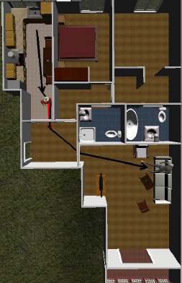
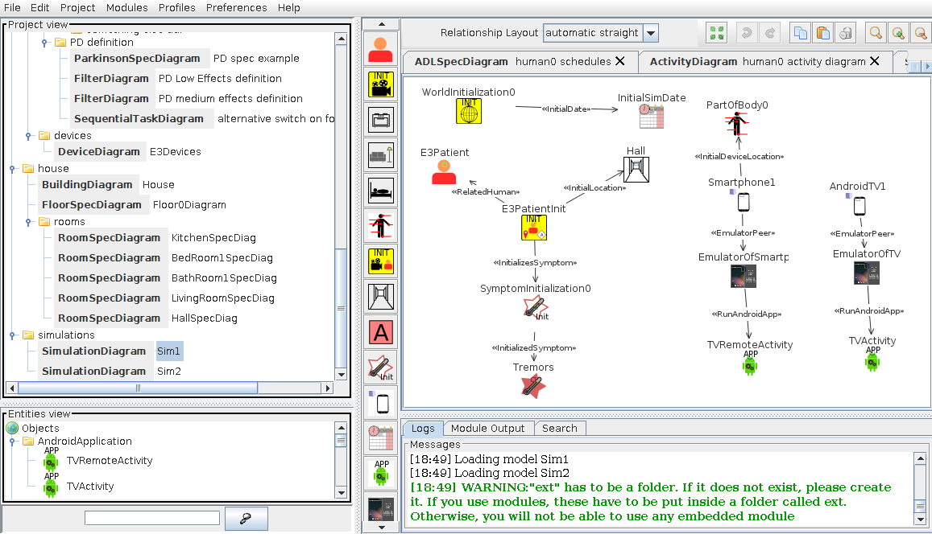
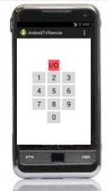
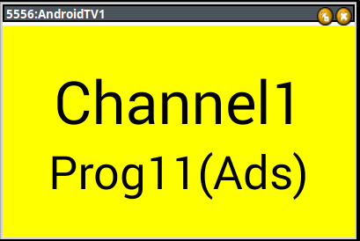
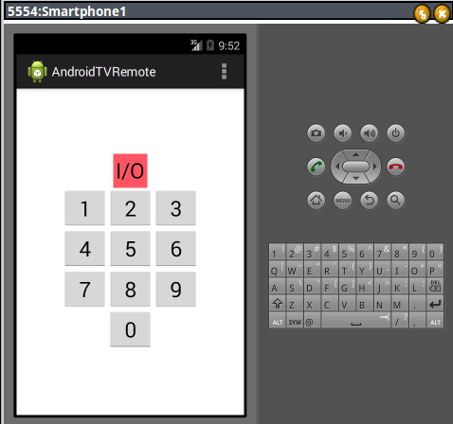
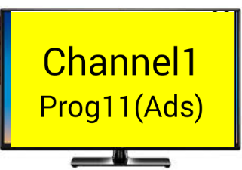
Capture the Activities, how disabilities affect them,
and the house setup with SociAAL Modeling Language
Render the specifications into different 3D simulations,
one per intended scenario, with PHAT framework
Combine
Them to
Provide a full
AmI simulation
Involving the software
You created
Development of AmI Software with jALI
and Android SDK
Run this software directly
into your Androd device

