Slide 1
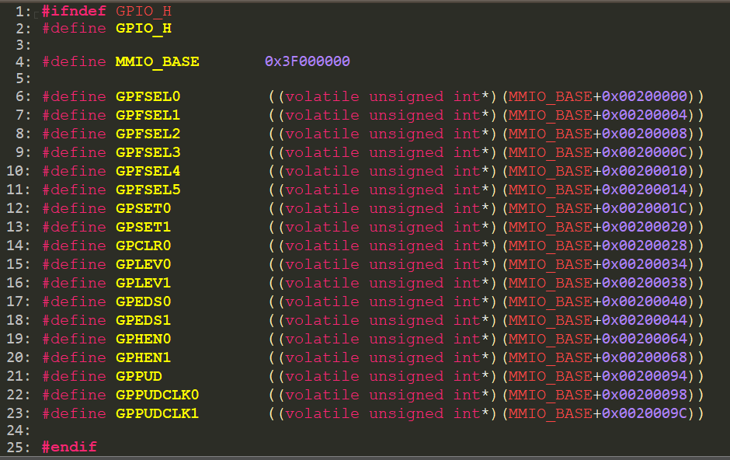
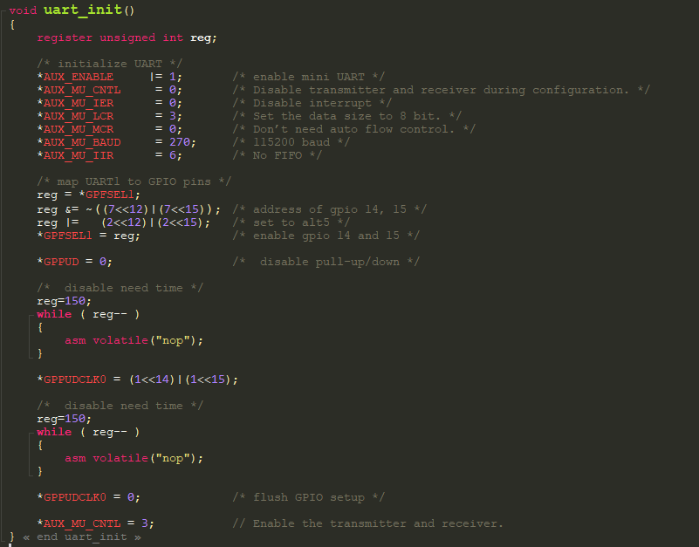
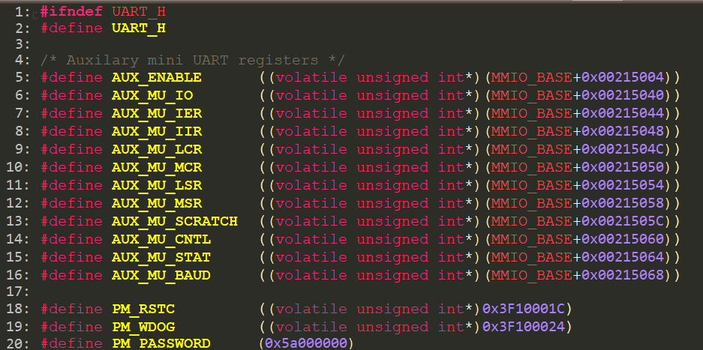
uart_init()

Slide 2
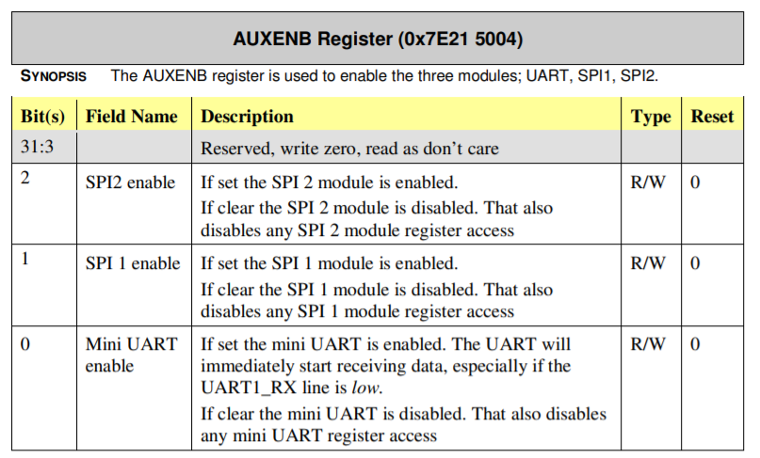
*AUX_ENABLE |= 1; /* enable mini UART */

Slide 3
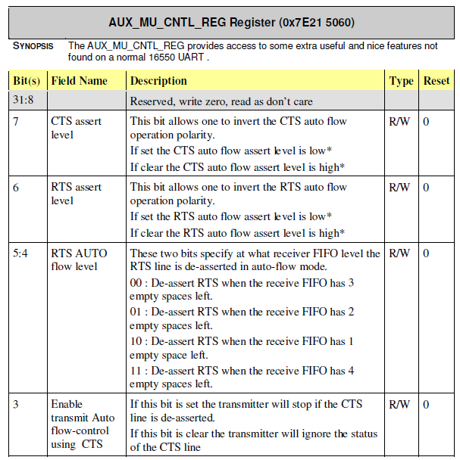
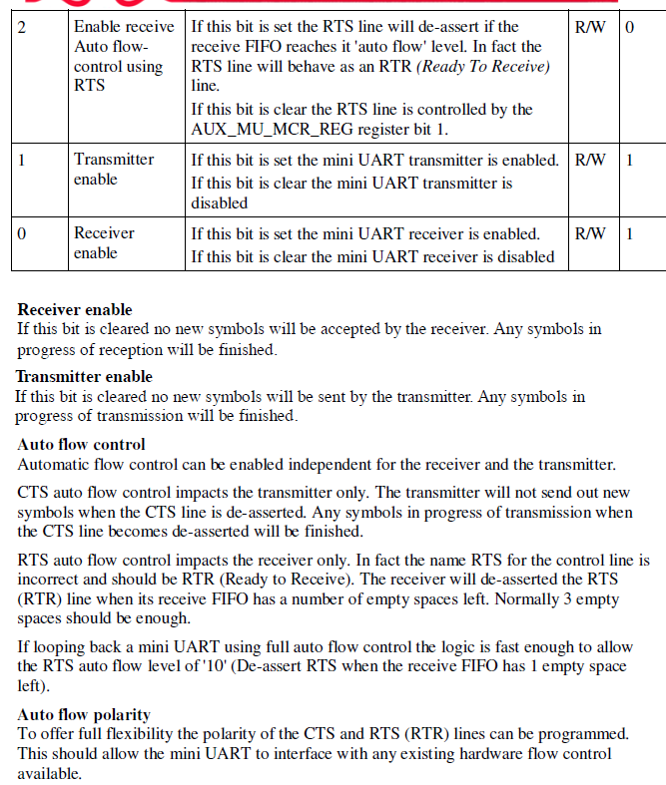
*AUX_MU_CNTL = 0; /* Disable transmitter and receiver during configuration. */
/*Ignore the status of the CTS line*/

Slide 4
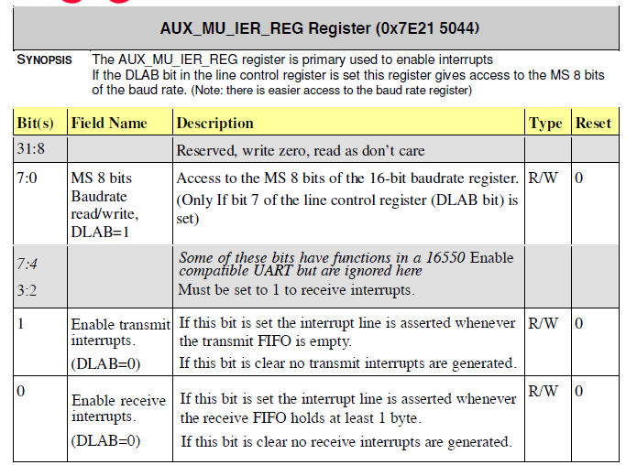
*AUX_MU_IER = 0; /* Disable interrupt */

Slide 5
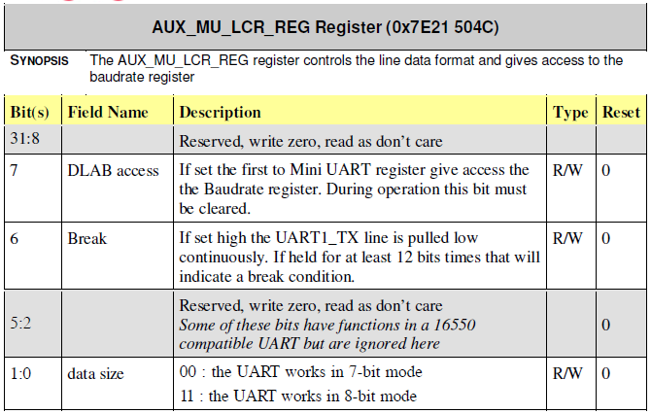
*AUX_MU_LCR = 3; /* Set the data size to 8 bit. */
3=0000000000011

Slide 6
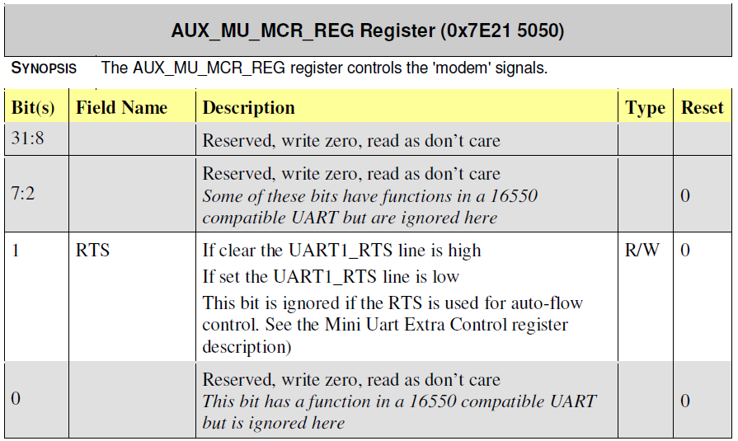
*AUX_MU_MCR = 0; /* Don’t need auto flow control. */

Slide 7
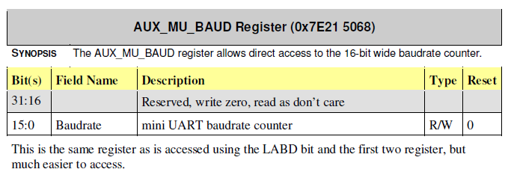
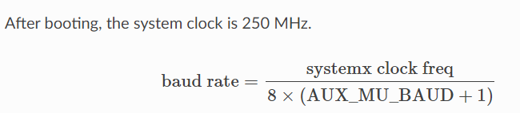
*AUX_MU_BAUD = 270; /* 115200 baud */

Slide 8
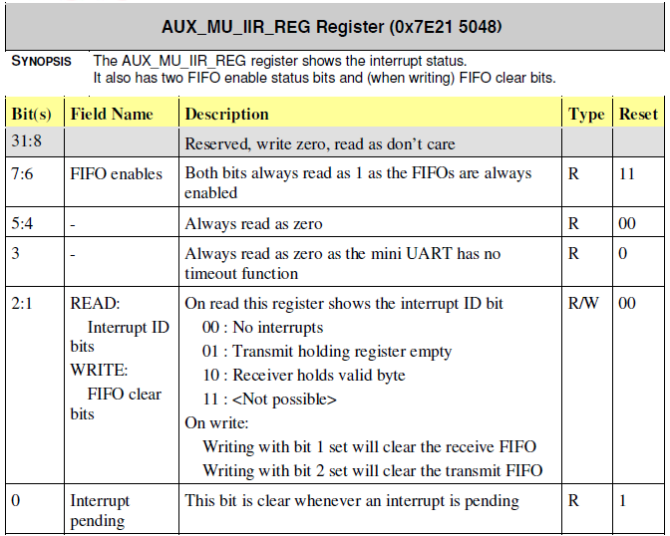
*AUX_MU_IIR = 6; /* No FIFO */
6 = 00000000000000000000000000000110

Slide 9
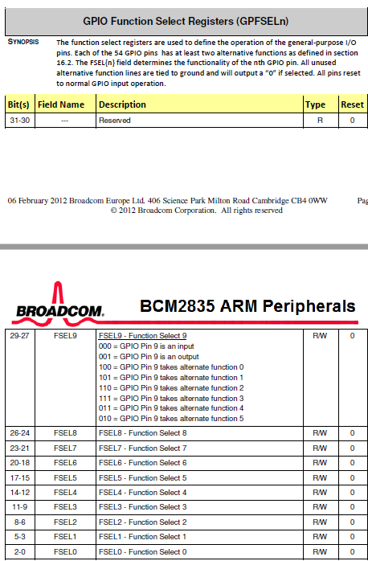
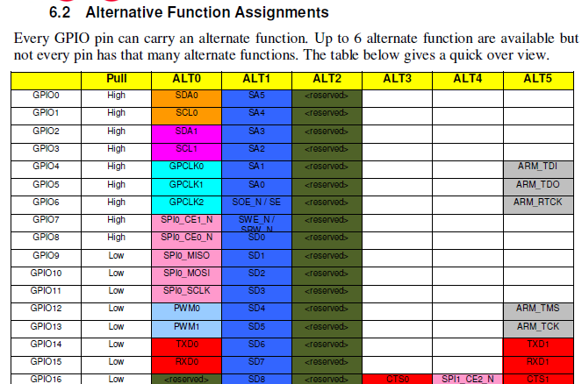
/* map UART1 to GPIO pins */
reg = *GPFSEL1;
reg &= ~((7<<12)|(7<<15)); /* address of gpio 14, 15 */
reg |= (2<<12)|(2<<15); /* set to alt5 */
*GPFSEL1 = reg; /* enable gpio 14 and 15 */

Slide 10
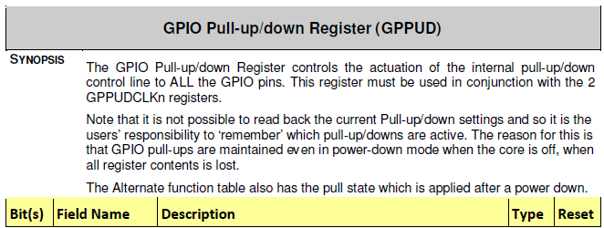
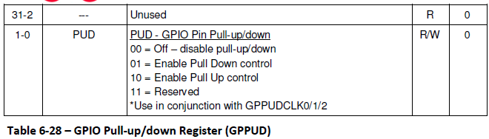
*GPPUD = 0; /* disable pull-up/down */
/* disable need time */
reg=150;
while ( reg-- )
{
asm volatile("nop");
}

Slide 11
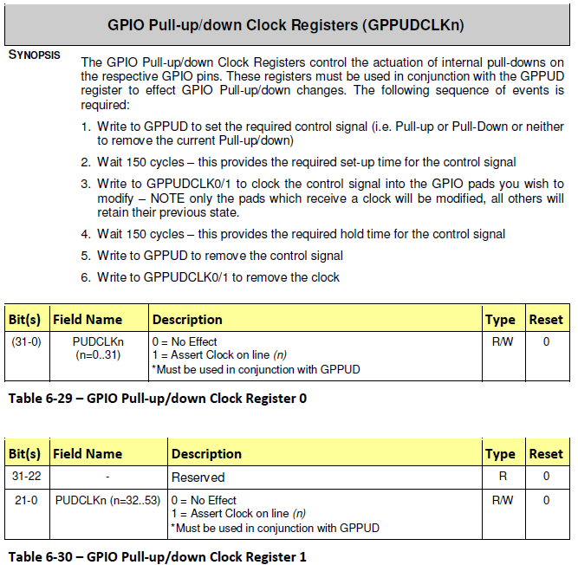
*GPPUDCLK0 = (1<<14)|(1<<15);
/* disable need time */
reg=150;
while ( reg-- )
{
asm volatile("nop");
}
*GPPUDCLK0 = 0; /* flush GPIO setup */

Slide 12
*AUX_MU_CNTL = 3; /* Enable the transmitter and receiver. */
3 = 00000000000000000000000000000011

Slide 13
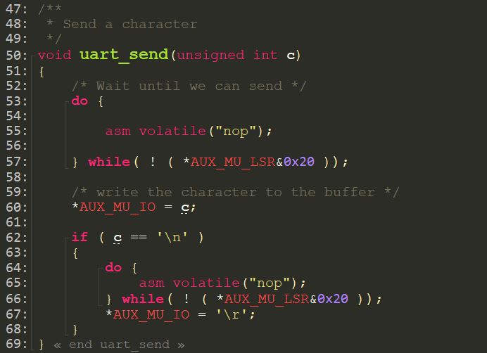
uart_send()

Slide 14
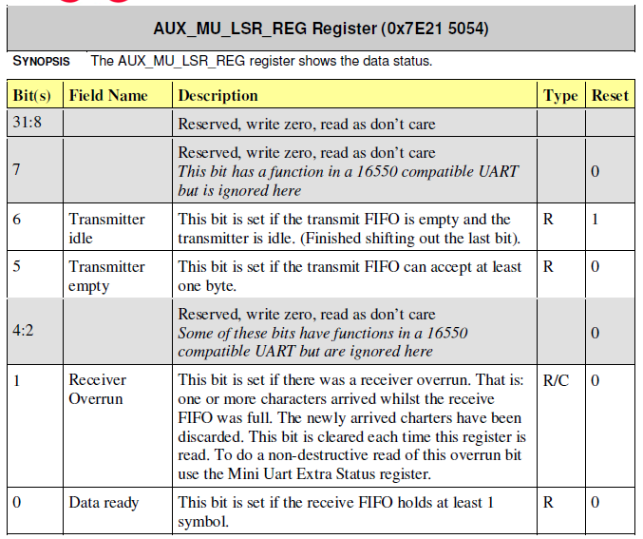
/* Wait until we can send */
do {
asm volatile("nop");
} while( ! ( *AUX_MU_LSR&0x20 ));
0x20 = 00100000

Slide 15
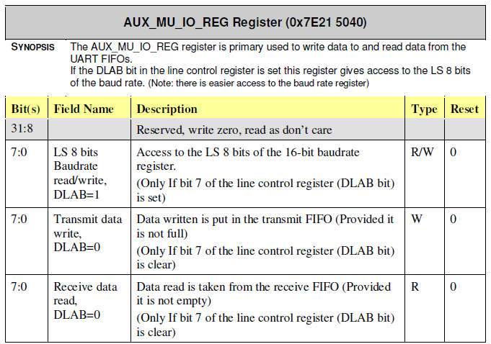
/* write the character to the buffer */
*AUX_MU_IO = c;

Slide 16
if ( c == '\n' )
{
do {
asm volatile("nop");
} while( ! ( *AUX_MU_LSR&0x20 ));
*AUX_MU_IO = '\r';
}
0x20 = 00100000

Slide 17
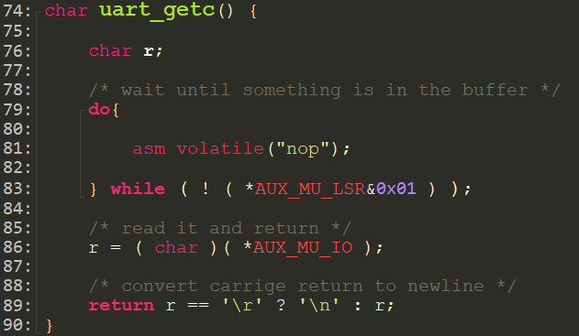
uart_getc()

Slide 18
/* wait until something is in the buffer */
do{
asm volatile("nop");
} while ( ! ( *AUX_MU_LSR&0x01 ) );
0x01 = 00000001

Slide 19
/* read it and return */
r = ( char )( *AUX_MU_IO );

Slide 20
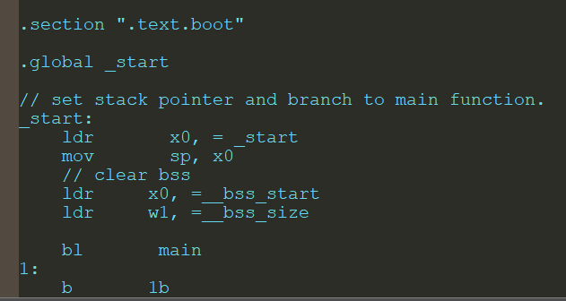
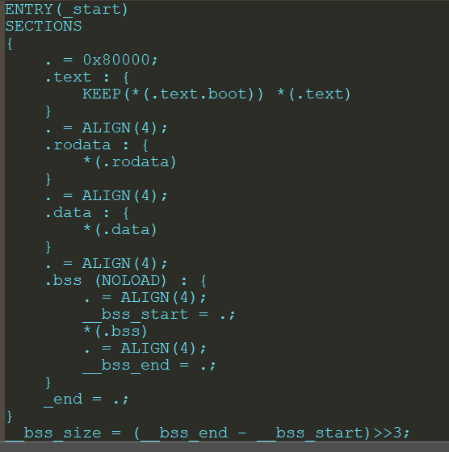
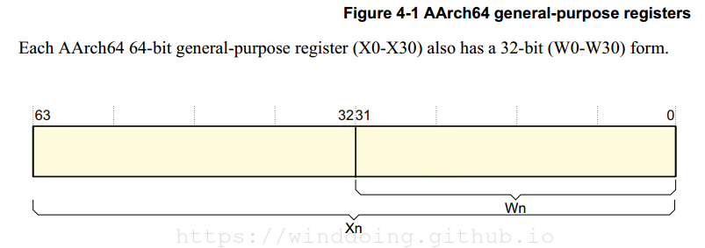
ldr r0, =0x12345678
這樣，就把0x12345678這個地址寫到r0中了。
ldr偽指令和mov是比較相似
mov指令限制了立即數的長度為8位，也就是不能超過512。ldr偽指令沒有這個限制。

