Slide 1
Chapter 1
Computer Networks and the Internet
Computer Networking: A Top Down Approach ,
7th edition.
Jim Kurose, Keith Ross
Addison-Wesley.
Zhu Li
Based on Jim Kurose, Keith Ross’s slides
1-<number>

Slide 2
Chapter 1: Introduction
Overview:
what’s the Internet?
what’s a protocol?
network edge; hosts, access net, physical media
network core: packet/circuit switching, Internet structure
performance: loss, delay, throughput
security
protocol layers, service models
history
Our goal:
get “feel” and terminology
more depth, detail later in course
approach:
  use Internet as example
1-<number>

Slide 3
What’s the Internet
The Internet is a world-wide computer network
The Internet is a public network
  A network that interconnects millions of computing devices throughout the world
Internet Architecture: edges,core and links
  Hardware
    Ends systems
    Core:routers
    links
  Software
    Protocols & App.
    Networking OS
1-<number>

Slide 4





What’s the Internet: “nuts and bolts” view
PC
millions of connected computing devices: hosts = end systems
  running network apps
Mobile network
server
Global ISP
wireless
laptop
cellular
handheld
Home network
communication links
  fiber, copper, radio, satellite, LAN
  transmission rate = bandwidth
Regional ISP
access
points
Institutional network
wired
links
routers: forward packets (chunks of data)
router
1-<number>

Slide 5


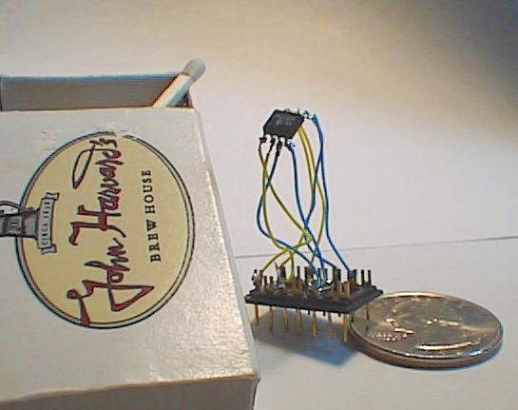

“Cool” Internet Appliances
Web-enabled toaster +
weather forecaster
IP picture frame
http://www.ceiva.com/
World’s smallest web server
http://www-ccs.cs.umass.edu/~shri/iPic.html
Internet phones
Introduction
1-<number>

Slide 6
What’s the Internet: “nuts and bolts” view
protocols control sending, forwarding,receiving of msgs
  e.g., TCP, IP, HTTP, Skype, Ethernet
Internet: “network of networks”
  loosely hierarchical
  public Internet versus private intranet
Internet standards
  RFC: Request for comments
  IETF: Internet Engineering Task Force
Mobile network
Global ISP
Home network
Regional ISP
Institutional network
1-<number>

Slide 7
What’s the Internet: a service view
communication infrastructure enables distributed applications:
  Web, VoIP, email, games, e-commerce, file sharing
communication services provided to apps:
  reliable data delivery from source to destination
  “best effort” (unreliable) data delivery
1-<number>

Slide 8
What’s a protocol?
protocols define format, order of msgs and actions taken on msg transmission, receipt
Protocol={format, order, actions}
={syntax,semantic,rules}
network protocols:
machines rather than humans
all communication activity in Internet governed by protocols
Protocols are running everywhere in the Internet, different protocols are used to accomplish different communication tasks
1-<number>

Slide 9
A closer look at network structure:
network edge: applications and hosts
access networks, physical media: wired, wireless communication links
network core:
  interconnected routers
  network of networks
1-<number>

Slide 10
The network edge:
end systems (hosts):
  run application programs
  e.g. Web, email
  at “edge of network”
peer-peer
client/server model
  client host requests, receives service from always-on server
  e.g. Web browser/server; email client/server
client/server
peer-peer model:
  minimal (or no) use of dedicated servers
  e.g. Skype, BitTorrent
1-<number>

Slide 11
Access networks and physical media
Q: How to connect end systems to edge router?
residential access nets
institutional access networks (school, company)
mobile access networks
Keep in mind:
bandwidth (bits per second) of access network?
shared or dedicated?
1-<number>

Slide 12
Dial-up Modem
central
office
telephone
network
Internet
home
PC
home
dial-up
modem
ISP
modem
(e.g., AOL)
Uses existing telephony infrastructure
  Home is connected to central office
up to 56Kbps direct access to router (often less)
Can’t surf and phone at same time: not “always on”
1-<number>

Slide 13

Asymmetric Digital Subscriber Line (ADSL)
Existing phone line:
0-4KHz phone; 4-50KHz upstream data; 50KHz-1MHz downstream data
Internet
home
phone
DSLAM:
Digital Subscriber Line Access Multiplexer
DSLAM
telephone
network
splitter
DSL
modem
central
office
home
PC
  Also uses existing telephone infrastructure
  up to 1 Mbps upstream (today typically < 256 kbps)
  up to 8 Mbps downstream (today typically < 1 Mbps)
  dedicated physical line to telephone central office
1-<number>

Slide 14
Residential access: HFC
HFC: hybrid fiber coax
  asymmetric: up to 30Mbps downstream, 2 Mbps upstream
network of cable and fiber attaches homes to ISP router
  homes share access to router
  unlike DSL, which has dedicated access
1-<number>

Slide 15
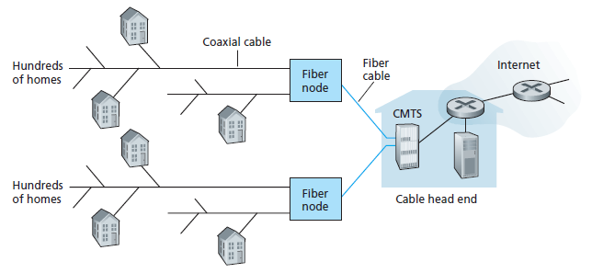
Residential access: HFC
CMTS:cable modem termination system
1-<number>

Slide 16
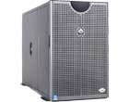

HFC Architecture: Overview
server(s)
cable headend
cable distribution
network
home
1-<number>

Slide 17
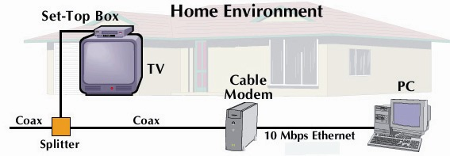
HFC: Overview
cable headend
cable distribution
network (simplified)
home
1-<number>

Slide 18
FTTH:Fiber to the Home
Optical network terminal
ONT
optical line terminal
optical
fibers
Internet
optical
fiber
ONT
OLT
optical
splitter
central office
ONT
Optical links from central office to the home
Two competing optical technologies:
  Passive Optical network:PON, no power supply
  Active Optical Network:AON
Much higher Internet rates; fiber also carries television and phone services
1-<number>

Slide 19
Ethernet Internet access
100 Mbps
Institutional
router
Ethernet
switch
To Institution’s
ISP
100 Mbps
1 Gbps
100 Mbps
server
Typically used in companies, universities, etc
  10 Mbs, 100Mbps, 1Gbps, 10Gbps Ethernet
  Today, end systems typically connect into Ethernet switch
1-<number>

Slide 20
Wireless access networks
shared wireless access network connects end system to router
  via base station aka “access point”
wireless LANs:
  802.11b/g (Wi-Fi): 11, 54 ,300,1G Mbps
wider-area wireless access
  provided by telco operator
  100M-XGbps over cellular system (4G,5G)
  next up (?): 6G, bandwidth: 100G+
router
base
station
mobile
hosts
1-<number>

Slide 21

Physical Media
Twisted Pair (TP)
two insulated copper wires
  Category 3: traditional phone wires, 10 Mbps Ethernet
  C5, C5+, C6
Bit: propagates between
transmitter/rcvr pairs
physical link: what lies between transmitter & receiver
guided media:
  signals propagate in solid media: copper, fiber, coax
unguided media:
  signals propagate freely, e.g., radio
1-<number>

Slide 22

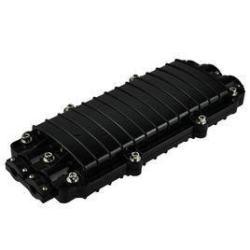

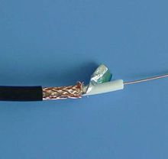
Physical Media: coax, fiber
Fiber optic cable:
glass fiber carrying light pulses, each pulse a bit
high-speed operation:
  high-speed point-to-point transmission (e.g., 10’s-100’s Gps)
low error rate: repeaters spaced far apart ; immune to electromagnetic noise
Coaxial cable:
two concentric copper conductors
bidirectional
baseband:
  single channel on cable
  legacy Ethernet
broadband:
  multiple channels on cable
  HFC
1-<number>

Slide 23
Physical media: radio
signal carried in electromagnetic spectrum
no physical “wire”
bidirectional
propagation environment effects:
  reflection
  obstruction by objects
  interference
Radio link types:
terrestrial microwave
  e.g. up to 45 Mbps channels
WLAN (e.g., Wifi)
  11Mbps, 54 Mbps,300+Mbps
wide-area (e.g., cellular)
  4G/5G cellular: 1G-10+Gbps
satellite
  Kbps to 45Mbps channel (or multiple smaller channels)
  270 msec end-end delay
  geosynchronous versus low altitude
1-<number>

Slide 24
The Network Core
mesh of interconnected routers
the fundamental question: how is data transferred through net?
  circuit switching: dedicated circuit per call: telephone net
  packet-switching: data sent thru net in discrete “chunks”
1-<number>

Slide 25
Network Core: Circuit Switching
End-end resources reserved for “call”
link bandwidth, switch capacity
dedicated resources: no sharing
circuit-like (guaranteed) performance
call setup required
1-<number>

Slide 26
Network Core: Circuit Switching
Different network, different resource using mode
network resources (e.g., bandwidth) may be divided into “pieces”
pieces allocated to calls
resource piece idle if not used by owning call (no sharing)
dividing link bandwidth into “pieces”
  FDMA:frequency division multiplex access
    HDTV,ADSL,WLAN
  TDMA:time division multiplex access
    telephone
  CDMA
  WDM
1-<number>

Slide 27
Circuit Switching: FDM and TDM
Example:
FDM
4 users
frequency
time
TDM
frequency
time
1-<number>
Notes:
Two simple multiple access control techniques.
Each mobile’s share of the bandwidth is divided into portions for the uplink and the downlink. Also, possibly, out of band signaling.
As we will see, used in AMPS, GSM, IS-54/136

Slide 28
Numerical example
How long does it take to send a file of 640,000 bits from host A to host B over a circuit-switched network?
  All links are 1.536 Mbps
  Each link uses TDM with 24 slots/sec
  500 msec to establish end-to-end circuit
Let’s work it out!
640000/(1.536Mbps/24)=10 (s)
1-<number>

Slide 29
Network Core: Packet Switching
each end-end data stream divided into packets
All packets from all users share network resources
each packet uses full link bandwidth
resources used as needed
resource contention:
aggregate resource demand can exceed amount available
congestion: packets queue, wait for link use
store and forward: packets move one hop at a time
  Node receives complete packet before forwarding
Bandwidth division into “pieces”
Dedicated allocation
Resource reservation
1-<number>

Slide 30
Packet Switching: Statistical Multiplexing
100 Mb/s
Ethernet
A
C
statistical multiplexing
1.5 Mb/s
B
queue of packets
waiting for output
link
1Gbps
100 Mbps
D
E
Sequence of A & B packets does not have fixed pattern, bandwidth shared on demand ➔ statistical multiplexing.
1-<number>

Slide 31
Packet-switching: store-and-forward
L
R
R
R
takes L/R seconds to transmit (push out) packet of L bits on to link at R bps
store and forward: entire packet must arrive at router before it can be transmitted on next link
delay = 3L/R (assuming zero propagation delay)
Example:
L = 7.5 Mbits
R = 1.5 Mbps
transmission delay = 15 sec
more on delay shortly …
1-<number>

Slide 32
Packet switching versus circuit switching
Packet switching allows more users to use network!
1 Mb/s link
each user:
  100 kb/s when “active”
  active 10% of time
circuit-switching:
  10 users
packet switching:
  with 35 users, probability for 10 active at same time is less than .0004
N users
1 Mbps link
ATM:Virtual circuit?
1-<number>

Slide 33
Packet switching versus circuit switching
Is packet switching a “slam dunk winner?”
great for bursty data
resource sharing/utilization better
simpler, no call setup
More users carried
excessive congestion: packet delay and loss
  protocols needed for reliable data transfer, congestion control
Poor real time
  Store and forward
1-<number>

Slide 34
Internet structure: network of networks
roughly hierarchical
at center: “tier-1” ISPs (e.g., Verizon, Sprint, AT&T, Cable and Wireless), national/international coverage
  treat each other as equals
Tier-1 providers interconnect (peer) privately
Tier 1 ISP
Tier 1 ISP
Tier 1 ISP
1-<number>

Slide 35
Internet structure: network of networks
“Tier-2” ISPs: smaller (often regional) ISPs
  Connect to one or more tier-1 ISPs, possibly other tier-2 ISPs
Tier-2 ISPs also peer privately with each other.
Tier-2 ISP pays tier-1 ISP for connectivity to rest of Internet
tier-2 ISP is customer of
tier-1 provider
Tier-2 ISP
Tier-2 ISP
Tier 1 ISP
Tier 1 ISP
Tier 1 ISP
Tier-2 ISP
Tier-2 ISP
Tier-2 ISP
1-<number>

Slide 36
Internet structure: network of networks
“Tier-3” ISPs and local ISPs
  last hop (“access”) network (closest to end systems)
local
ISP
Tier 3
ISP
local
ISP
local
ISP
local
ISP
Local and tier- 3 ISPs are customers of
higher tier ISPs
connecting them to rest of Internet
Tier-2 ISP
Tier-2 ISP
Tier 1 ISP
Tier 1 ISP
Tier 1 ISP
Tier-2 ISP
Tier-2 ISP
Tier-2 ISP
local
ISP
local
ISP
local
ISP
local
ISP
1-<number>

Slide 37
Internet structure: network of networks
a packet passes through many networks!
local
ISP
Tier 3
ISP
local
ISP
local
ISP
local
ISP
Tier-2 ISP
Tier-2 ISP
Tier 1 ISP
Tier 1 ISP
Tier 1 ISP
Tier-2 ISP
Tier-2 ISP
Tier-2 ISP
local
ISP
local
ISP
local
ISP
local
ISP
1-<number>

Slide 38
How do loss and delay occur?
packets queue in router buffers
packet arrival rate to link exceeds output link capacity
packets queue, wait for turn
packet being transmitted (delay)
A
B
packets queueing (delay)
free (available) buffers: arriving packets
dropped (loss) if no free buffers
1-<number>

Slide 39
Delay in packet-switched networks
1. nodal processing:
  check bit errors
  determine output link
3. Transmission delay:
  R=link bandwidth (bps)
  L=packet length (bits)
  time to send bits into link = L/R
2. queueing
  time waiting at output link for transmission
  depends on congestion level of router
4. Propagation delay :
  d = length of physical link
  s = propagation speed in medium (~3x10⁸ m/sec)
  propagation delay = d/s
transmission
A
propagation
B
nodal
processing
queueing
1-<number>

Slide 40
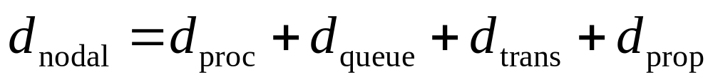
Nodal delay
d_{proc} = processing delay
  typically a few microsecs or less
d_{queue} = queuing delay
  depends on congestion
d_{trans} = transmission delay
  = L/R, significant for low-speed links
d_{prop} = propagation delay
  a few microsecs to hundreds of msecs
1-<number>

Slide 41

Queueing delay (revisited)
R=link bandwidth (bps)
L=packet length (bits)
a=average packet arrival rate
traffic intensity = La/R
La/R ~ 0: average queueing delay small
La/R -> 1: delays become large
La/R > 1: more “work” arriving than can be serviced, average delay infinite!
1-<number>

Slide 42
Experiment1: Internet delays and routes
ping hostname or IP address
Tracert 202.117.1.13
For all i:
  sends three packets that will reach router i on path towards destination
  router i will return packets to sender
  sender records time interval between transmission and reply.
3 probes
3 probes
3 probes
1-<number>

Slide 43
Throughput
throughput: rate (bits/time unit) at which bits transferred between sender/receiver
  instantaneous: rate at given point in time
  average: rate over longer period of time
link capacity
R_{s} bits/sec
link capacity
R_{c} bits/sec
server, with
file of F bits
to send to client
pipe that can carry
fluid at rate
R_{s} bits/sec)
pipe that can carry
fluid at rate
R_{c} bits/sec)
server sends bits
(fluid) into pipe
1-<number>

Slide 44
Throughput (more)
R_{s} < R_{c} What is average end-end throughput?
R
R_{s} bits/sec
R_{c} bits/sec
R_{s} > R_{c} What is average end-end throughput?
R_{s} bits/sec
R_{c} bits/sec
bottleneck link
link on end-end path that constrains end-end throughput
1-<number>

Slide 45
Throughput: Internet scenario
R_{s}
per-connection end-end throughput: min(R_{c},R_{s},R/10)
in practice: R or R_{s} is often bottleneck
R_{s}
R_{s}
R
R_{c}
R_{c}
R_{c}
10 connections (fairly) share backbone bottleneck link R bits/sec
1-<number>

Slide 46
Protocol “Layers”
Networks are complex!
many “pieces”:
  hosts
  routers
  links of various media
  applications
  protocols
  hardware, software
Hierarchical Organizing
1-<number>

Slide 47
Why layering?
Dealing with complex systems:
explicit structure allows identification, relationship of complex system’s pieces
modularization eases maintenance, updating of system
  change of implementation of layer’s service transparent to rest of system
layering considered harmful?
1-<number>

Slide 48
Internet protocol stack-TCP/IP
application: supporting network applications
  FTP, SMTP, HTTP, apps,…
transport: process-process data transfer
  TCP, UDP
network: routing of datagrams from source to destination
  IP, routing protocols,…
link: data transfer between neighboring network elements
  PPP, Ethernet,ADSL,FTTH,WI-Fi,…
physical: bits “on the wire”
application
transport
network
link
physical
Sandglass Model
1-<number>

Slide 49
ISO/OSI reference model
presentation: allow applications to interpret meaning of data, e.g., encryption, compression, machine-specific conventions
session: synchronization, checkpointing, recovery of data exchange
Internet stack “missing” these layers!
  these services, if needed, must be implemented in application
  needed?
application
presentation
session
transport
network
link
physical
1-<number>

Slide 50
Encapsulation
source
message
M
application
transport
network
link
physical
segment
H_{t}
M
H_{t}
datagram
H_{n}
H_{n}
H_{t}
M
frame
H_{l}
H_{n}
H_{t}
M
bit
link
physical
PDU
switch
destination
H_{n}
H_{t}
M
network
link
physical
M
application
transport
network
link
physical
H_{l}
H_{n}
H_{t}
M
H_{n}
H_{t}
M
H_{t}
M
H_{n}
H_{t}
M
H_{l}
H_{n}
H_{t}
M
router
Introduction
1-<number>

Slide 51

Internet History
1961-1972: Early packet-switching principles
1961: Kleinrock - queueing theory shows effectiveness of packet-switching
1964: Baran - packet-switching in military nets
1967: ARPAnet conceived by Advanced Research Projects Agency
1969: first ARPAnet node operational
1972:
  ARPAnet public demonstration
  NCP (Network Control Protocol) first host-host protocol
  first e-mail program
  ARPAnet has 15 nodes
Introduction
1-<number>

Slide 52
Internet History
1972-1980: Internetworking, new and proprietary nets
1970: ALOHAnet satellite network in Hawaii
1974: Cerf and Kahn - architecture for interconnecting networks
1976: Ethernet at Xerox PARC
late70’s: proprietary architectures: DECnet, SNA, XNA
late 70’s: switching fixed length packets (ATM precursor)
1979: ARPAnet has 200 nodes
Cerf and Kahn’s internetworking principles:
  minimalism, autonomy - no internal changes required to interconnect networks
  best effort service model
  stateless routers
  decentralized control
define today’s Internet architecture
Introduction
1-<number>

Slide 53
Internet History
1980-1990: new protocols, a proliferation of networks
1983: deployment of TCP/IP
1982: smtp e-mail protocol defined
1983: DNS defined for name-to-IP-address translation
1985: ftp protocol defined
1988: TCP congestion control
new national networks: Csnet, BITnet, NSFnet, Minitel
100,000 hosts connected to confederation of networks
Introduction
1-<number>

Slide 54
Internet History
2007:
~500 million hosts
Voice, Video over IP
P2P applications: BitTorrent (file sharing) Skype (VoIP), PPLive (video)
more applications: YouTube, gaming
wireless, mobility
Introduction
1-<number>

Slide 55
Introduction: Summary
Covered a “ton” of material!
Internet overview
what’s a protocol?
network edge, core, access network
  packet-switching versus circuit-switching
  Internet structure
performance: loss, delay, throughput
layering, service models
security
history
You now have:
context, overview, “feel” of networking
more depth, detail to follow!
Introduction
1-<number>

Slide 56
Exercises
In a new network installation, the network administrator has decided to use a medium that is not affected by electrical noise. Which cable type will best meet this standard?
a) coaxial b) screened twisted pair
c) shielded twisted pair d) unshielded twisted pair
e) fiber optic
Select the necessary information that is required to compute the estimated time it would take to transfer data from one location to another. (Choose two.)
a) file size b) data format c) network in use
d) type of medium e) bandwidth of the link
Which protocol functions at the internet layer of the TCP/IP protocol suite?
a) File Transfer Protocol (FTP) b) Trivial File Transfer Protocol (TFTP) c) Transmission Control Protocol (TCP)
d) Internet Protocol (IP) e) User Datagram Protocol (UDP) f) Simple Mail Transport Protocol (SMTP)

Slide 57
Exercises
Which of the following is the Layer 4 PDU?
a) bit b) frame c) packet d) segment
Which OSI layer encapsulates data into packets?
a) session b) transport
c) network d) data link
Why are internets necessary? (Choose three.)
a) to overcome LAN scalability limitations b) to overcome LAN speed limitations
c) to overcome LAN distance limitations
d) to prevent collision and congestion conditions
e) to network networks

Slide 58
Submitting Exercises
Explain precisely following abbreviations:
  TCP, HTTP, SMTP,DNS,FTP,ATM,ISDN,ADSL,HFC,ISP,
  LAN,WAN,MAN,WLAN,ISO,OSI
Explain following concepts:
  TCP/IP
  Circuit switching,Packet switching,Message switching,Virtual circuits
Page 95,review questions: R4,R8,R13,R18;
Page 100,problems: P12,P25.

