Slide 1
Chapter 3: Transport Layer
Our goals goals:
understand principles behind transport layer services:
  multiplexing/demultiplexing
  reliable data transfer
  flow control
  congestion control
instantiation and implementation in the Internet
Overview:
transport layer services
multiplexing/demultiplexing
connectionless transport: UDP
principles of reliable data transfer
connection-oriented transport: TCP
  reliable transfer
  flow control
  connection management
principles of congestion control
TCP congestion control
3: Transport Layer
3-<number>

Slide 2





Transport services
application
transport
network
data link
physical
provide logical communication between app’ processes running on different hosts
  Rely on network layer
Provide multiplexing/de multiplexing services
Reliability control
  Error checking
  Retansmitting the lost segments
logical pro-pro transport
application
transport
network
data link
physical
3: Transport Layer
3-<number>

Slide 3


Transport-layer protocols(TCP,UDP)
Internet transport services:
reliable, in-order unicast delivery (TCP)
  congestion control
  flow control
  connection management
unreliable (“best-effort”), unordered unicast or multicast delivery: UDP
Both use error checking included in their headers
services not available:
  real-time
  bandwidth guarantees
application
transport
network
data link
physical
network
data link
physical
network
data link
physical
network
data link
physical
logical pro-pro transport
network
data link
physical
network
data link
physical
application
transport
network
data link
physical
3: Transport Layer
3-<number>

Slide 4
Multiplexing/demultiplexing
segment - unit of data exchanged between transport layer entities
  TPDU: transport protocol data unit
Demultiplexing: delivering
received segments to
correct app layer processes
receiver
P3
P4
application-layer
data
M
M
application
transport
network
segment
header
P1
P2
M
M
application
transport
network
application
transport
network
segment
H
t
M
H
segment
n
3: Transport Layer
3-<number>

Slide 5
Multiplexing/demultiplexing
Multiplexing:
gathering data from multiple
app processes, enveloping
data with header to create segments and passing the segments to IP layer
32 bits
source port #
dest port #
other header fields
multiplexing/demultiplexing:
based on sender, receiver port numbers, IP addresses
  source, destination port #s in each segment
  recall: well-known port numbers for specific applications (http:80,ftp 21,telnet 23)
application
data
(message)
TCP/UDP segment format
3: Transport Layer
3-<number>

Slide 6
Multiplexing/demultiplexing: examples
Different processes use different source port in a client
Web client
host C
source port: x
dest. port: 23
host A
server B
Source IP: C
Dest IP: B
source port: y
dest. port: 80
Source IP: C
Dest IP: B
source port: x
dest. port: 80
source port:23
dest. port: x
port use: simple telnet app
Source IP: A
Dest IP: B
source port: x
dest. port: 80
Web
server B
Web client
host A
port use: Web server
3: Transport Layer
3-<number>

Slide 7
UDP multiplexing/demultiplexing
Port number:1024~65535
Typically,port number of client application may be assigned automatically; server port number is specified
P2
P1
P3
P1
SP: 6428
SP: 6428
DP: 9157
DP: 5775
SP: 9157
SP: 5775
client
IP: A
DP: 6428
server
IP: C
DP: 6428
Client
IP:B
3: Transport Layer
3-<number>

Slide 8
TCP multiplexing/demultiplexing
Four-tuple needed
  source IP addr,destination ip addr.
  Source Port number,destination port number
Every client application with port number directs to a socket on server
P1
P4
P5
P6
P2
P1
P3
SP: 5775
DP: 80
S-IP: B
D-IP:C
SP: 9157
SP: 9157
client
IP: A
DP: 80
server
IP: C
DP: 80
Client
IP:B
S-IP: A
S-IP: B
D-IP:C
D-IP:C
3: Transport Layer
3-<number>

Slide 9
UDP: User Datagram Protocol [RFC 768]
“no frills,” “bare bones” Internet transport protocol
  Multiplexing/demultimplexing
  Error-checking
  Transfer:the application is almost directly talking with IP
“best effort” service, UDP segments may be:
  Lost,error,delivered out of order to app
connectionless:
  no handshaking between UDP sender, receiver
  each UDP segment handled independently of others
3: Transport Layer
3-<number>

Slide 10
UDP Applications
Typically applications
Features of UDP
simple: no connection state at sender, receiver
  No buffers,no cc parameters
  No sn, no ack number
small segment header(8 Bytes)
Fast: no controls:
  UDP can blast away as fast as desired,best effort
  no connection establishment
  No any control
Remote file server (NFS)
Streaming multimedia
Internet telephony
Network management
Routing protocol(RIP)
Name translation (DNS)
Multicasting
Real-time involved apps(RTP)
TFTP
DHCP
3: Transport Layer
3-<number>

Slide 11
UDP segment structure(RFC 768)
8 bytes header
  Source port
  Destination port
  Length
  checksum
Data field
32 bits
Length, in
bytes of UDP
segment,
including
header
source port #
dest port #
length
checksum
Application
data
(message)
UDP segment format
3: Transport Layer
3-<number>

Slide 12
UDP checksum
Goal: detect “errors” (e.g., flipped bits) in transmitted segment
Receiver:
compute checksum of received segment
check if computed checksum equals checksum field value:
  NO - error detected
  YES - no error detected
  But, does not correct it
Sender:
treat segment contents as sequence of 16-bit integers
checksum: addition (1’s complement sum) of segment contents,negating Bit
sender puts checksum value into UDP checksum field
3: Transport Layer
3-<number>

Slide 13
Example for checksum
Sender:
  3 16-bit words:
  0110011001100110
  + 0101010101010101
  0000111100001111
  1100101011001010
  0←→1:
  0011010100110101
  put this value into checksum field
Receiver:
  ∑ all words and checksum:
  0110011001100110
  + 0101010101010101
  0000111100001111
  0011010100110101
  1111111111111111
If the sum<> all 1, means at least an error occurs
All 1 means no errors?
3: Transport Layer
3-<number>

Slide 14

Principles of Reliable data transfer
May be implemented in app., transport, link layers
characteristics of unreliable channel will determine complexity of reliable data transfer protocol (rdt)
unreliable data transfer protocol (udt)
3: Transport Layer
3-<number>

Slide 15

Building reliable data transfer protocol
rdt_send(): called from above, (e.g., by app.). Passed data to
deliver to receiver upper layer
deliver_data(): called by rdt to deliver data to upper
sending
side
receiving
side
udt_send(): called by rdt,
to transfer packet over
unreliable channel to receiver
udt_rcv(): called when packet arrives on rcv-side of channel
3: Transport Layer
3-<number>

Slide 16
Building reliable data transfer protocol
We will specify the rdt from simpleness to complexity
incrementally develop sender, receiver sides of reliable data transfer protocol (rdt)
consider only unidirectional data transfer
  but control info will flow on both directions!
use finite state machines (FSM) to specify sender, receiver
event causing state transition
actions taken on state transition
state: when in this “state” next state uniquely determined by next event
state
1
state
2
event
actions
3: Transport Layer
3-<number>

Slide 17
Rdt1.0: reliable transfer over a reliable channel
underlying channel perfectly reliable
  no bit errors
  no loss of packets
separate FSMs for sender, receiver:
  sender sends data into underlying channel
  receiver read data from underlying channel
Unidirectional channel,no feedback is needed
Wait for call from above
rdt_send(data)
Wait for call from below
rdt_rcv(packet)
extract (packet,data)
deliver_data(data)
packet = make_pkt(data)
udt_send(packet)
sender
receiver
3: Transport Layer
3-<number>

Slide 18
Rdt2.0: channel with bit errors
underlying channel may flip bits in packet
  Can detect but cannot correct:checksum
the question: how to recover from errors:
  acknowledgements (ACKs): receiver explicitly tells sender that pkt received OK
  negative acknowledgements (NAKs): receiver explicitly tells sender that pkt had errors
  sender retransmits pkt on receipt of NAK
  1 bit long data may be sufficient:0 for NAK and 1 for ACK
new mechanisms in rdt2.0:
  error detection
  receiver feedback: control msgs (ACK,NAK) rcvr->sender
  Retransmission
  This is the known ARQ—automatic Repeat request!
3: Transport Layer
3-<number>

Slide 19
rdt2.0: FSM specification
rdt_send(data)
sndpkt = make_pkt(data, checksum)
udt_send(sndpkt)
receiver
rdt_rcv(rcvpkt) &&
isNAK(rcvpkt)
Wait for call from above
Wait for ACK or NAK
rdt_rcv(rcvpkt) &&
corrupt(rcvpkt)
udt_send(sndpkt)
udt_send(NAK)
rdt_rcv(rcvpkt) && isACK(rcvpkt)
Λ
Wait for call from below
sender
udt_re-send(sndpkt)
rdt_rcv(rcvpkt) &&
notcorrupt(rcvpkt)
extract(rcvpkt,data)
deliver_data(data)
udt_send(ACK)
3: Transport Layer
3-<number>

Slide 20
rdt2.0: operation with no errors
rdt_send(data)
snkpkt = make_pkt(data, checksum)
udt_send(sndpkt)
rdt_rcv(rcvpkt) &&
isNAK(rcvpkt)
Wait for call from above
Wait for ACK or NAK
rdt_rcv(rcvpkt) &&
corrupt(rcvpkt)
udt_send(sndpkt)
udt_send(NAK)
rdt_rcv(rcvpkt) && isACK(rcvpkt)
Wait for call from below
Λ
rdt_rcv(rcvpkt) &&
notcorrupt(rcvpkt)
extract(rcvpkt,data)
deliver_data(data)
udt_send(ACK)
3: Transport Layer
3-<number>

Slide 21
rdt2.0: error scenario
rdt_send(data)
snkpkt = make_pkt(data, checksum)
udt_send(sndpkt)
rdt_rcv(rcvpkt) &&
isNAK(rcvpkt)
Wait for call from above
Wait for ACK or NAK
rdt_rcv(rcvpkt) &&
corrupt(rcvpkt)
udt_send(sndpkt)
udt_send(NAK)
rdt_rcv(rcvpkt) && isACK(rcvpkt)
Wait for call from below
Λ
rdt_rcv(rcvpkt) &&
notcorrupt(rcvpkt)
extract(rcvpkt,data)
deliver_data(data)
udt_send(ACK)
3: Transport Layer
3-<number>

Slide 22
rdt2.0 has a fatal flaw!
What happens if ACK/NAK corrupted?
sender doesn’t know what happened at receiver!
can’t just retransmit: possible duplicate
What to do?
sender ACKs/NAKs receiver’s ACK/NAK? What if sender ACK/NAK lost?
retransmit, but this might cause retransmission of correctly received pkt!
Error correction for bit error
Handling duplicates:
sender adds sequence number to each pkt
sender retransmits current pkt if ACK/NAK garbled
receiver discards (doesn’t deliver up) duplicate pkt
This is rdt2.1
stop and wait
Sender sends one packet,
then waits for receiver
response
3: Transport Layer
3-<number>

Slide 23
rdt2.1: sender, handles garbled ACK/NAKs
rdt_send(data)
sndpkt = make_pkt(0, data, checksum)
udt_send(sndpkt)
rdt_rcv(rcvpkt) &&
( corrupt(rcvpkt) ||
isNAK(rcvpkt) )
Wait for call 0 from above
Wait for ACK or NAK 0
udt_send(sndpkt)
rdt_rcv(rcvpkt)
&& notcorrupt(rcvpkt)
&& isACK(rcvpkt)
rdt_rcv(rcvpkt)
&& notcorrupt(rcvpkt)
&& isACK(rcvpkt)
Λ
Λ
Wait for ACK or NAK 1
Wait for
call 1 from above
rdt_rcv(rcvpkt) &&
( corrupt(rcvpkt) ||
isNAK(rcvpkt) )
rdt_send(data)
udt_send(sndpkt)
sndpkt = make_pkt(1, data, checksum)
udt_send(sndpkt)
3: Transport Layer
3-<number>

Slide 24
rdt2.1: receiver, handles garbled ACK/NAKs
rdt_rcv(rcvpkt) && notcorrupt(rcvpkt)
&& has_seq0(rcvpkt)
rdt_rcv(rcvpkt) &&
corrupt(rcvpkt)
extract(rcvpkt,data)
deliver_data(data)
sndpkt = make_pkt0(ACK, chksum)
udt_send(sndpkt)
rdt_rcv(rcvpkt) &&
corrupt(rcvpkt)
sndpkt = make_pkt0(NAK, chksum)
udt_send(sndpkt)
sndpkt = make_pkt1(NAK, chksum)
udt_send(sndpkt)
Wait for
0 from below
Wait for
1 from below
rdt_rcv(rcvpkt) &&
notcorrupt(rcvpkt) &&
has_seq1(rcvpkt)
rdt_rcv(rcvpkt) &&
notcorrupt(rcvpkt) &&
has_seq0(rcvpkt)
sndpkt = make_pkt1(ACK, chksum)
udt_send(sndpkt)
sndpkt = make_pkt0(ACK, chksum)
udt_send(sndpkt)
rdt_rcv(rcvpkt) && notcorrupt(rcvpkt)
&& has_seq1(rcvpkt)
Discard duplication!
Discard duplication!
extract(rcvpkt,data)
deliver_data(data)
sndpkt = make_pkt1(ACK, chksum)
udt_send(sndpkt)
3: Transport Layer
3-<number>

Slide 25
rdt2.1: discussion
Sender:
seq # added to pkt
two seq. #’s (0,1) will suffice. Why?
must check if received ACK/NAK corrupted
twice as many states
  state must “remember” whether “current” pkt has 0 or 1 seq. #
Receiver:
must check if received packet is duplicate
  state indicates whether 0 or 1 is expected pkt seq #
note: receiver can not know if its last ACK/NAK received OK at sender
3: Transport Layer
3-<number>

Slide 26
rdt2.2: a NAK-free protocol
same functionality as rdt2.1, using ACKs only
instead of NAK, receiver sends ACK for last pkt received OK
    receiver must explicitly include seq # of pkt being ACKed
duplicate ACK at sender results in same action as NAK: retransmit current pkt
3: Transport Layer
3-<number>

Slide 27
rdt2.2: sender
rdt_send(data)
sndpkt = make_pkt(0, data, checksum)
udt_send(sndpkt)
rdt_rcv(rcvpkt) &&
( corrupt(rcvpkt) ||
isACK(rcvpkt,1) )
Wait for call 0 from above
Wait for ACK
0
udt_send(sndpkt)
sender FSM
rdt_rcv(rcvpkt)
&& notcorrupt(rcvpkt)
&& isACK(rcvpkt,1)
rdt_rcv(rcvpkt)
&& notcorrupt(rcvpkt)
&& isACK(rcvpkt,0)
Λ
Λ
Wait for ACK
1
Wait for call 1 from above
rdt_rcv(rcvpkt) &&
( corrupt(rcvpkt) ||
isACK(rcvpkt,0) )
rdt_send(data)
udt_send(sndpkt)
sndpkt = make_pkt(1, data, checksum)
udt_send(sndpkt)
3: Transport Layer
3-<number>

Slide 28
rdt2.2: receiver
rdt_rcv(rcvpkt) && notcorrupt(rcvpkt)
&& has_seq0(rcvpkt)
extract(rcvpkt,data)
deliver_data(data)
sndpkt = make_pkt(ACK0, chksum)
udt_send(sndpkt)
rdt_rcv(rcvpkt) &&
corrupt(rcvpkt)
rdt_rcv(rcvpkt) &&
notcorrupt(rcvpkt) &&
has_seq1(rcvpkt)
udt_send(sndpkt)
Wait for
0 from below
receiver FSM
Wait for
1 from below
rdt_rcv(rcvpkt) &&
notcorrupt(rcvpkt) &&
has_seq0(rcvpkt)
udt_send(sndpkt)
rdt_rcv(rcvpkt) &&
corrupt(rcvpkt)
rdt_rcv(rcvpkt) && notcorrupt(rcvpkt)
&& has_seq1(rcvpkt)
udt_send(sndpkt)
udt_send(sndpkt)
extract(rcvpkt,data)
deliver_data(data)
sndpkt = make_pkt(ACK1, chksum)
udt_send(sndpkt)
3: Transport Layer
3-<number>

Slide 29
rdt3.0: channels with errors and loss
New assumption: underlying channel can also lose packets (data or ACKs)
  checksum, seq. #, ACKs, retransmissions will be of help, but not enough
Q: how to deal with loss?
  sender waits until certain data or ACK lost, then retransmits
  How long time is needed?
Approach: sender waits “reasonable” amount of time for ACK
retransmits if no ACK received in this time
if pkt (or ACK) is just delayed (not lost):
  retransmission will be duplicate, but use of seq. #’s already handles this
  receiver must specify seq # of pkt being ACKed
requires countdown timer
3: Transport Layer
3-<number>

Slide 30
rdt3.0 sender
rdt_send(data)
rdt_rcv(rcvpkt) &&
( corrupt(rcvpkt) ||
isACK(rcvpkt,1) )
Ack(rcvpkt,1)
sndpkt = make_pkt(0, data, checksum)
udt_send(sndpkt)
start_timer
rdt_rcv(rcvpkt)
Λ
Λ
Wait for
call 0from above
Wait for ACK0
timeout
udt_send(sndpkt)
start_timer
rdt_rcv(rcvpkt)
&& notcorrupt(rcvpkt)
&& isACK(rcvpkt,1)
rdt_rcv(rcvpkt)
&& notcorrupt(rcvpkt)
&& isACK(rcvpkt,0)
stop_timer
stop_timer
Wait for ACK1
Wait for
call 1 from above
timeout
udt_send(sndpkt)
start_timer
rdt_rcv(rcvpkt)
rdt_send(data)
Λ
rdt_rcv(rcvpkt) &&
( corrupt(rcvpkt) ||
isACK(rcvpkt,0) )
sndpkt = make_pkt(1, data, checksum)
udt_send(sndpkt)
start_timer
Ack(rcvpkt,0)
Λ
3: Transport Layer
3-<number>

Slide 31
Rdt3.0 receiver
rdt_rcv(rcvpkt) && notcorrupt(rcvpkt)
&& has_seq0(rcvpkt)
extract(rcvpkt,data)
deliver_data(data)
sndpkt = make_pkt(ACK0, chksum)
udt_send(sndpkt)
rdt_rcv(rcvpkt) &&
(corrupt(rcvpkt) ||
has_seq1(rcvpkt))
rdt_rcv(rcvpkt) &&
(corrupt(rcvpkt) ||
has_seq0(rcvpkt))
Wait for
0 from below
receiver FSM
Wait for
1 from below
udt_send(sndpkt)
udt_send(sndpkt)
rdt_rcv(rcvpkt) && notcorrupt(rcvpkt)
&& has_seq1(rcvpkt)
extract(rcvpkt,data)
deliver_data(data)
sndpkt = make_pkt(ACK1, chksum)
udt_send(sndpkt)
3: Transport Layer
3-<number>

Slide 32

rdt3.0 in action
3: Transport Layer
3-<number>

Slide 33

rdt3.0 in action
3: Transport Layer
3-<number>

Slide 34
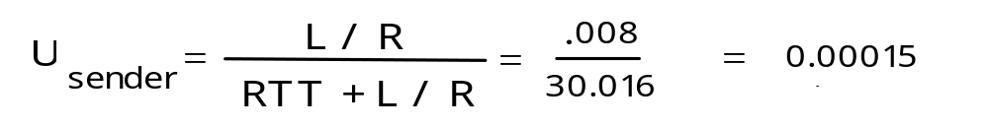
Performance of rdt3.0
rdt3.0 works, but performance stinks
example: 1 Gbps link, 15 ms e-e prop. delay, 1KB packet:
T
=
L (packet length in bits)
8kb/pkt
transmit
=
= 8 microsec
R (transmission rate, bps)
10**9 b/sec
  U _{sender}: utilization – fraction of time sender busy sending
  1KB pkt every 30 msec -> 33kB/sec thruput over 1 Gbps link
    Too much time is spent on waiting for ACK
  network protocol limits use of physical resources!
3: Transport Layer
3-<number>

Slide 35
rdt3.0: stop-and-wait operation
sender
receiver
first packet bit transmitted, t = 0
last packet bit transmitted, t = L / R
first packet bit arrives
RTT
last packet bit arrives, send ACK
ACK arrives, send next
packet, t = RTT + L / R
3: Transport Layer
3-<number>

Slide 36

Pipelined protocols
Pipelining: sender allows multiple, “in-flight”, yet-to-be-acknowledged pkts
  range of sequence numbers must be increased
  buffering at sender and/or receiver
Two generic forms of pipelined protocols: go-Back-N, selective repeat
3: Transport Layer
3-<number>

Slide 37
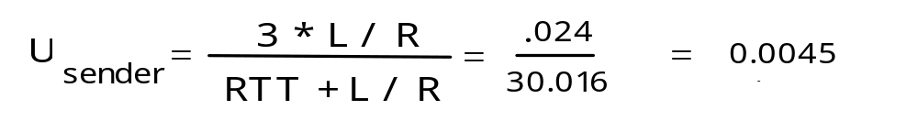
Pipelining: increased utilization
sender
receiver
first packet bit transmitted, t = 0
example: 1 Gbps link, 15 ms e-e prop. delay, 1KB packet
last bit transmitted, t = L / R
first packet bit arrives
RTT
last packet bit arrives, send ACK
last bit of 2nd packet arrives, send ACK
ACK arrives, send next
packet, t = RTT + L / R
last bit of 3rd packet arrives, send ACK
Increase utilization
by a factor of 3!
3: Transport Layer
3-<number>

Slide 38

Go-Back-N
Go-Back-N (GBN): allow the sender to transmit multiple packets without waiting for an acknowledgement,but the number of unacknowledged packets must be <=N
k-bit seq # in pkt header: [0~2^{k}-1] circle
“window” of up to N, consecutive unack’ed pkts allowed
3: Transport Layer
3-<number>

Slide 39
GBN window
Sliding-window protocol
  When an ack. arrives, the base+x and the windows shifts right x times
  When a packet is sent, the nexstseqnum++
  In TCP, the window size is variable
3: Transport Layer
3-<number>

Slide 40
GBN events at sender
Invocation from above
  When rdt_send is called, the sender first checks if the window is full
  If the window is not full, a packet is created and sent, and variables are appropriately updated
  If the window is full, return the data to upper layer or set semaphore
ACK(n): always ACKs the correctly received packet at last- “cumulative ACK”
  If an ack is received, all acks before this are received also
A timer is needed for all in-flight pkts
  timeout(n): retransmit pkt n and all higher seq # pkts in window
    n ≤ x ≤ n+ Windows size
3: Transport Layer
3-<number>

Slide 41
GBN: extended FSM of sender
rdt_send(data)
if (nextseqnum -base < N) {
sndpkt[nextseqnum] = make_pkt(nextseqnum,data,chksum)
udt_send(sndpkt[nextseqnum])
if (base == nextseqnum) // all packets sent have been acked
start_timer
nextseqnum++
}
else
refuse_data(data)
Λ
base=0
nextseqnum=0
timeout
Wait
start_timer
udt_send(sndpkt[base])
udt_send(sndpkt[base+1])
…
udt_send(sndpkt[nextseqnum-1])
rdt_rcv(rcvpkt)
&& corrupt(rcvpkt)
start_timer
udt_send(sndpkt[base])
udt_send(sndpkt[base+1])
…
udt_send(sndpkt[nextseqnum-1])
rdt_rcv(rcvpkt) &&
notcorrupt(rcvpkt)
base = getacknum(rcvpkt)+1
If (base == nextseqnum)
stop_timer
else
start_timer
3: Transport Layer
3-<number>

Slide 42
GBN: extended FSM of receiver
Ack the packet correctly received most recently
default
udt_send(sndpkt)
rdt_rcv(rcvpkt)
&& notcorrupt(rcvpkt)
&& hasseqnum(rcvpkt,expectedseqnum)
Λ
Wait
extract(rcvpkt,data)
deliver_data(data)
sndpkt = make_pkt(expectedseqnum,ACK,chksum)
udt_send(sndpkt)
expectedseqnum++
expectedseqnum=0
ACK-only: always send ACK for correctly-received pkt with highest in-order seq #
  may generate duplicate ACKs when corrupt occurs,because it resends an ack for the most recently received correctly
  need only remember expectedseqnum
out-of-order pkt:
  discard (don’t buffer)
  Re-ACK pkt with highest in-order seq #
3: Transport Layer
3-<number>

Slide 43
Is it silly for discarding out-of-order packets?
In GBN, the receiver discards out-of-order packets in despite of they are received correctly
Suppose that packet n is expected,but packet n+1 arrives,
  buffer it before deliver it to upper layer
  If the packet n arrives in time, it is in good situation
  If packet n is lost or timeout, the sender will retransmit all packets that number>=n as a result of GBN rule,and thus, packet n+1 buffered will be wasteful
In integration considering, discarding is adopted
  Simple：no larger receiver buffer needed
  Dsiadvantage:that packet retransmitted(n+1) may be lost or garbled
3: Transport Layer
3-<number>

Slide 44

GBN in action
N=4
3: Transport Layer
3-<number>

Slide 45
Summary for GBN
GBN protocol incorporates almost all of techniques of rdt-achieves reliability in all costs
  Sequence number
  Cumulative acknowledgement
  Checksum, sender buffer
  Timeout/retransmit operation
TCP has a number of elements of GBN,but not all
TCP is a hybrid of Go-Back-N and selective-repeat protocols
3: Transport Layer
3-<number>

Slide 46
Disadvantage of GBN
GBN protocol is better than stop-and-wait protocols in avoiding the channel utilization problems
But its re-transmitting too much unnecessary packets may suffer from performance problems also
  In particular, when the window size and bandwidth delay are both large,many packets can be in the pipeline and a single error may cause GBN to retransmit a large number of unnecessary packets
  As the probability of channel errors increases,the pipeline may filled with these unnecessary retansmissions. So, new protocol is needed
3: Transport Layer
3-<number>

Slide 47
Selective Repeat
SR: As the name suggests, the sender retransmits only error packets
receiver individually acknowledges all correctly received pkts whether or not it is in order
  buffers pkts, as needed, for eventual in-order delivery to upper layer
sender only resends pkts for which ACK not received
  sender timer for each unACKed pkt
sender window
  N consecutive seq #’s
  again limits seq #s of sent, unACKed pkts
3: Transport Layer
3-<number>

Slide 48

Selective repeat: sender, receiver windows
3: Transport Layer
3-<number>

Slide 49
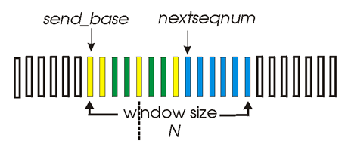
SR—actions of sender
data from above :
When data comes from above,SR sender checks the next available sequence number
if next available seq # is in window, packetize and send pkt
Otherwise,buffer or return it for later transmission
timeout(n): resend pkt(n)
Each packet has its own logical timer, when pkt n is sent or resent, restart timer
ACK(n) in [sendbase,sendbase+N]:
mark pkt n as received
if n is smallest among unACKed pkt(=send-base), advance window base to next unACKed seq #
If the window moves and there are untransmitted packets with sequence numbers in the window, transmit these packets
3: Transport Layer
3-<number>

Slide 50
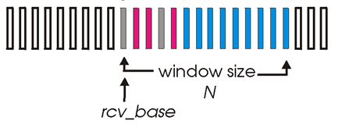
SR-actions of receiver
pkt n in [rcvbase, rcvbase+N-1]: inside the rcv window
send ACK(n)
out-of-order: buffer
in-order(packet number=rcv-base): deliver (also deliver buffered, in-order pkts), advance window to next not-yet-received pkt by the number of packets delivered
pkt n in [rcvbase-N,rcvbase-1]: left of the rcv window
Discard and ACK(n), even though it has previously acknowledged
  This means the ack of packet n is lost, without the re-ack,the sender will resend packet n again and again,its window will not move
otherwise: right of the rcv window
ignore the packet
Because of Rcv-window<send-window, or last cycled pkt
3: Transport Layer
3-<number>

Slide 51

Selective repeat in action
3: Transport Layer
3-<number>

Slide 52

Selective repeat: dilemma
Example:
seq #’s: 0, 1, 2, 3
window size=3
receiver sees no difference in two scenarios!
incorrectly passes duplicate data as new in (a)
Q: what relationship between seq # size and window size?
3: Transport Layer
3-<number>

Slide 53

TCP: Overview ：RFCs: 793, 1122, 1323, 2018, 2581
point-to-point:one sender, one receiver
reliable, in-order byte steam: no “message boundaries”
pipelined:
  TCP congestion and flow control set window size
send & receive buffers
full duplex data:
  bi-directional data flow in same connection
  MSS: maximum segment size (536bytes)
Connection management
Reliability control
Flow&congestion control
3: Transport Layer
3-<number>

Slide 54
TCP segment structure
32 bits
URG: urgent data
(generally not used)
counting
by bytes
of data
(not segments!)
source port #
Dest. port #
ACK: ACK #
valid
sequence number
acknowledgement number
PSH: push data now
(generally not used)
head
len
not
used
U
rcvr window size
A
P
R
S
F
# bytes
rcvr willing
to accept
checksum
ptr urgent data
RST, SYN, FIN:
connection estab
(setup, teardown
commands)
Options (variable length)
MSS
Window scaling factor
timestamp
application
data
(variable length)
Internet
checksum
(as in UDP)
3: Transport Layer
3-<number>

Slide 55
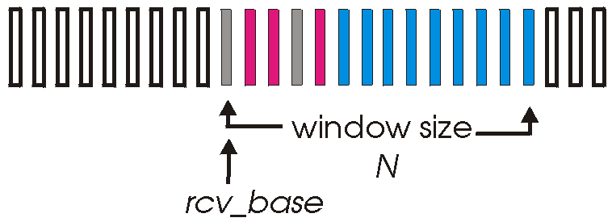
TCP : reliable data transfer
Sender:
Retransmit the lost segments
  Sending buffer needed
How to know segment lost or not?
  Acknowledgement
  Time out
how to know which segments lost?
  Sequence number
Receiver:
ACK expected segments:
Accumulative ACK
3: Transport Layer
3-<number>

Slide 56
TCP seq. #’s and ACKs numbers
Seq. #’s:
  byte stream “number” of first byte in segment’s data
  Randomly choose an initial sequence number
ACKs:
  seq # of next byte expected from other side
  cumulative ACK
Q: how receiver handles out-of-order segments
  A: TCP spec doesn’t say, - up to implementor
    Discarding
    buffering
Host A
Host B
User
types
‘C’
Seq=42, ACK=79, data = ‘C’
host ACKs
receipt of
‘C’, echoes
back ‘C’
Seq=79, ACK=43, data = ‘C’
host ACKs
receipt
of echoed
‘C’
Seq=43, ACK=80
time
simple telnet scenario
3: Transport Layer
3-<number>

Slide 57
TCP: reliable data transfer
event: data received
from application above
simplified sender, assuming
create, send segment
Start_timer
one way data transfer
no flow, congestion control
sendbase = nextseqnum =initial_sequence number
wait
for
event
event: timer timeout for
segment with seq # y
wait
for
event
retransmit segment
Restart_timer
Retransmit the missing segment
Before that segment’timer expires
event: 3ACKs received,
with ACK # y
event: ACK received,
with ACK # y
fast retransmission
Restart_timer
ACK processing
3: Transport Layer
3-<number>

Slide 58
Fast retransmitting
Host A
Host B
seq # x1
seq # x2
seq # x3
X
ACK (x2)
seq # x4
seq # x5
ACK (x2)
ACK (x2)
ACK (x2)
triple
duplicate
ACKs
resend seq X2
timeout
time
3: Transport Layer
3-<number>

Slide 59
TCP: reliable data transfer
00 sendbase = initial_sequence number
01 nextseqnum = initial_sequence number
02
03 loop (forever) {
04 switch(event)
05 event: data received from application above
06 create TCP segment with sequence number nextseqnum
07 start timer for segment nextseqnum
08 pass segment to IP
09 nextseqnum = nextseqnum + length(data)
10 event: timer timeout for segment with sequence number y
11 retransmit segment with sequence number y
12 compute new timeout interval for segment y
13 restart timer for sequence number y
14 event: ACK received, with ACK field value of y
15 if (y > sendbase) { /* cumulative ACK of all data up to y */
16 cancel all timers for segments with sequence numbers < y
17 sendbase = y
18 }
19 else { /* a duplicate ACK for already ACKed segment */
20 increment number of duplicate ACKs received for y
21 if (number of duplicate ACKS received for y == 3) {
22 /* TCP fast retransmit */
23 resend segment with sequence number y
24 restart timer for segment y
25 }
26 }
27 } /* end of loop forever */
Simplified
TCP
sender
a duplicate ACK for
already ACKed segment
3: Transport Layer
3-<number>

Slide 60
TCP ACK generation [RFC 1122, RFC 2581]
Event
in-order segment arrival,
no gaps,
everything else already ACKed
in-order segment arrival,
no gaps,
one delayed ACK pending
out-of-order segment arrival
higher-than-expect seq. #
gap detected
arrival of segment that
partially or completely fills gap
TCP Receiver action
delayed ACK. Wait up to 500ms
for next segment. If no next segment,
send ACK
immediately send single
cumulative ACK
send duplicate ACK, indicating seq. #
of next expected byte
immediately ACK if segment starts
at lower end of gap
Others?
3: Transport Layer
3-<number>

Slide 61
TCP: retransmission scenarios(1,2)
Host A
Host B
Host A
Host B
Seq=92, 8 bytes data
Seq=92, 8 bytes data
Seq=100, 20 bytes data
timeout
ACK=100
Seq=92 timeout
X
ACK=100
Seq=100 timeout
ACK=120
loss
Seq=92, 8 bytes data
Seq=92, 8 bytes data
ACK=120
ACK=100
time
time
premature timeout,
cumulative ACKs
lost ACK scenario
3: Transport Layer
3-<number>

Slide 62
TCP: retransmission scenarios(3)
Host A
Host B
Though the ack of the first packet is lost, before time is out, the ack of the second packet is received, nothing is resent
  The sender knows all data before byte 120 has been received intactly
Seq=92, 8 bytes data
Seq=100, 20 bytes data
ACK=100
timeout
ACK=120
Cumulative ack avoids redundant retransmissions
time
3: Transport Layer
3-<number>

Slide 63
TCP Flow Control
flow control
sender won’t overflow
receiver’s buffer by
transmitting too much,
too fast
receive side of TCP connection has a receive buffer:
(currently)
unused buffer
space
speed-matching service: matching sending rate to receiving application’s drain rate
  Reduce the packet loss at receiver
IP
datagrams
TCP data
(in buffer)
application
process
app process may be slow at reading from buffer
3: Transport Layer
3-<number>

Slide 64

TCP Flow Control
flow control
sender won’t overrun receiver’s buffers by limiting transmitting too much, too fast
RcvBuffer = size of TCP Receive Buffer
RcvWindow = amount of spare room in Buffer
How much reduced?
3: Transport Layer
3-<number>

Slide 65
TCP Flow Control
RcvWindow=RcVBuffer-[LastByteRcvd-LastByteRead]
receiver: explicitly informs sender of (dynamically changing) amount of free buffer space
  RcvWindow field in TCP segment
  Initially, RcvWindow=RcvBuffer
sender: keeps the amount of transmitted, unACKed data less than most recently received RcvWindow
  LastByteSent-LastByteAcked<=RcvWindow
When RcvWindow=0, segments with one byte data are still sent to the receiver
  Avoiding revBuffer=0, communication pause
Q: How about this mechanism?
3: Transport Layer
3-<number>

Slide 66
TCP Round Trip Time and Timeout
Q: how to set TCP timeout value?
longer than RTT
  note: RTT will vary
too short: premature timeout
  unnecessary retransmissions
too long: slow reaction to segment loss and introduce extra delays
estimating RTT
SampleRTT: measured time from segment transmission until ACK receipt
  ignore retransmissions, cumulatively ACKed segments
SampleRTT will vary because of congestion in routers and varying load on end system , so, we want estimated RTT “smoother”
  use several recent measurements, not just current SampleRTT
3: Transport Layer
3-<number>

Slide 67
TCP Round Trip Time and Timeout
EstimatedRTT_{n} = (1- α)*EstimatedRTT_{n-1} + α *SampleRTT
Exponential weighted moving average
influence of given sample decreases exponentially fast
typical value of α : 0.125
Adaptive Setting the timeout
EstimtedRTT plus “safety margin”
large variation in EstimatedRTT -> larger safety margin
Timeout = EstimatedRTT + 4*Deviation
Deviation_{n} = (1- β)*Deviation_{n-1}+β *|SampleRTT-EstimatedRTT|
(typically, β = 0.25)
Fluctuation ↑ Deviation ↑; Fluctuation ↓ Deviation ↓;
3: Transport Layer
3-<number>

Slide 68

Example RTT estimation:
3: Transport Layer
3-<number>

Slide 69
TCP Connection Management
Recall: TCP sender, receiver establish “connection” before exchanging data segments
initialize TCP variables:
  seq. #s
  buffers, flow control info (e.g. RcvWindow)
client: connection initiator
Socket clientSocket = new Socket("hostname","port number");
server: contacted by client
Socket connectionSocket = welcomeSocket.accept();
Three way handshake:
Step 1,sending SYN segment: client end system sends TCP SYN control segment to server
  specifies initial seq #: Client_isn
Step 2,SYNACK: server end system receives SYN, replies with SYNACK control segment
  ACKs received SYN
  allocates buffers and variables
  Client_isn+1
  specifies server-> receiver initial seq. #
3: Transport Layer
3-<number>

Slide 70
TCP Connection Management
Step 3: Client allocate buffers and variables to the connection upon receiving the connection-granted packet
send ack to server
  Server_isn+1
  SYN=0
  may piggyback data
client
server
Connection req.(SYN=1,seq=C_isn)
Connection granted.(SYN=1,seq=S_isn)
Ack=C_isn+1
ACK(SYN=0 seq=C_isn+1)
Ack=S_isn+1
Time
3: Transport Layer
3-<number>

Slide 71
TCP Connection Management (cont.)
Closing a connection:
client closes socket: clientSocket.close();
Step 1: client end system sends TCP FIN control segment to server
Step 2: server receives FIN, replies with ACK. Closes connection, sends FIN.
Step 3: client receives FIN, replies with ACK.
  Enters “timed wait” - will respond with ACK to received FINs
Step 4: server, receives ACK. Connection closed.
client
server
close
FIN
ACK
closing
FIN
ACK
timed wait
closed
closed
3: Transport Layer
3-<number>

Slide 72


TCP Connection Management (cont)
TCP server
lifecycle
TCP client
lifecycle
client
server
close
FIN
ACK
close
FIN
timed wait
ACK
closed
3: Transport Layer
3-<number>

Slide 73
Principles of Congestion Control
Congestion:
informally: “too many sources sending too much data too fast for network to handle”
different from flow control!
manifestations:
  lost packets (buffer overflow at routers)
  long delays (queuing in router buffers)
3: Transport Layer
3-<number>

Slide 74

Causes/costs of congestion: scenario 1
Host A
λ_{in} : original data
λ_{out}
two senders, two receivers
one router, infinite buffers
no retransmission, flow control and congestion control
Host B
unlimited shared output link buffers
large queue and delays when congested
maximum achievable throughput:C/2
3: Transport Layer
3-<number>

Slide 75
Causes/costs of congestion: scenario 2
one router, finite buffers
sender retransmission of lost packet：TCP
Host A
λ_{in} : original data
λ_{out}
λ'_{in} : original data, plus retransmitted data
Host B
finite shared output link buffers
3: Transport Layer
3-<number>

Slide 76
Causes/costs of congestion: scenario 2
λ
λ
always: (goodput)
“perfect” retransmission only when loss:
retransmission of delayed (not lost) packet makes larger (than perfect case) for same
=
in
out
λ
>
λ
in
out
λ
λ
in
out
R/2
R/2
R/2
R/3
λ_{out}
λ_{out}
λ_{out}
R/4
λ_{in}
R/2
λ_{in}
R/2
λ_{in}
R/2
a.
b.
c.
“costs” of congestion:
more work (retrans) for given “goodput”
unneeded retransmissions: link carries multiple copies of pkt
3: Transport Layer
3-<number>

Slide 77
Causes/costs of congestion: scenario 3
λ
four senders
multihop paths
timeout/retransmit
Q: what happens as and increase ?
λ
in
in
Host A
λ_{in} : original data
λ_{out}
λ'_{in} : original data, plus retransmitted data
finite shared output link buffers
Host B
3: Transport Layer
3-<number>

Slide 78

Causes/costs of congestion: scenario 3
Host A
λ_{out}
Host B
Another “cost” of congestion:
For small λ_{in}, an increase in λ_{in} results in an increase in λ_{out}
when packet dropped, any “upstream transmission capacity used for that packet was wasted!
3: Transport Layer
3-<number>

Slide 79
Approaches towards congestion control
Two broad approaches towards congestion control:
Network-assisted congestion control:
routers provide feedback to end systems
  single bit indicating congestion (SNA, DECbit, TCP/IP ECN, ATM ABR)
  explicit rate sender should send at
  Two feedback modes:
    Router→sender
    Router→receiver→sender
End-end congestion control:
no explicit feedback from network
congestion inferred from end-system observed loss, delay
approach taken by TCP
3: Transport Layer
3-<number>

Slide 80

Case study: ATM ABR congestion control
ABR: available bit rate:
“elastic service”
if sender’s path “underloaded”:
  sender should use available bandwidth
if sender’s path congested:
  sender throttled to minimum guaranteed rate
RM (resource management) cells:
sent by sender, interspersed with data cells
bits in RM cell set by switches (“network-assisted”)
RM cells returned to sender by receiver, with bits intact
3: Transport Layer
3-<number>

Slide 81
3 mechanisms for ATM ABR congestion control
CI and NI bits: default number of RM cell: 1/32 data cells
  NI bit: no increase in rate (mild congestion)
  CI bit: congestion indication
ER setting: two-byte ER (explicit rate) field in RM cell
  congested switch may lower ER value in cell
  sender’ rate thus is minimum supportable rate of all switches on the path
EFCI (explicit forward congestion indication)bit in data cells: set to 1 in congested switch
  if most data cell has EFCI set, receiver sets CI bit in returned RM cell
3: Transport Layer
3-<number>

Slide 82
TCP Congestion Control
end-end control (no network assistance)
goal: TCP sender should transmit as fast as possible, but without congesting network
decentralized: each TCP sender sets its own rate, based on implicit feedback:
  ACK: segment received (a good thing!), network not congested, so increase sending rate
  lost segment: assume loss due to congested network, so decrease sending rate
3: Transport Layer
3-<number>

Slide 83
TCP congestion control:
“probing” for usable bandwidth:
  ideally: transmit as fast as possible (Congwin as large as possible) without loss
  increase Congwin until loss (congestion)occurs
  loss: decrease Congwin, then begin probing (increasing) again
two “phases”
  slow start
  congestion avoidance
important variables:
  Congwin
  threshold: defines threshold between two slow start phase, congestion avoidance phase
3: Transport Layer
3-<number>

Slide 84
TCP Slowstart
Host A
Host B
Slowstart algorithm
one segment
initialize: Congwin = 1
for (each segment ACKed)
Congwin++
until (loss event OR
CongWin > =threshold)
RTT
two segments
four segments
exponential increase (per RTT) in window size (not so slow!)
loss event: timeout (Tahoe TCP) and/or or three duplicate ACKs (Reno TCP)
time
3: Transport Layer
3-<number>

Slide 85
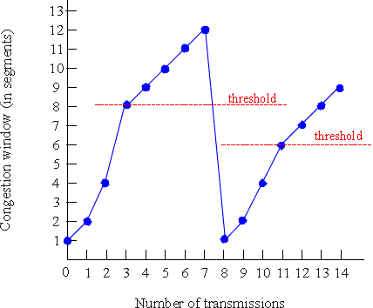
TCP Congestion Avoidance
TCP Tahoe Congestion avoidance
/* slowstart is over */
/* Congwin > threshold */
while (no loss event) {
every w segments ACKed:
Congwin++
}
threshold = Congwin/2
Congwin = 1
perform slowstart
3: Transport Layer
3-<number>

Slide 86
TCP Congestion Avoidance: Reno
TCP Reno Congestion avoidance
three duplicate ACKs (Reno TCP):
some segments are getting through correctly!
don’t “overreact” by decreasing window to 1 as in Tahoe
  decrease window size by half
/* slowstart is over */
/* Congwin > threshold */
while (no loss event) {
every w segments ACKed:
Congwin++
}
threshold = Congwin/2
If (loss detected by timeout) {
Congwin = 1
perform slowstart }
If (loss detected by triple duplicate ACK)
Congwin = Congwin/2
3: Transport Layer
3-<number>

Slide 87


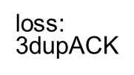
TCP congestion control FSM: overview
slow
Start:
cwnd=2cwnd
cwnd=1
cwnd > ssthresh
congestion
Avoidance:
cwnd++
loss:
timeout
loss:
timeout
loss:
timeout
no loss
loss:
3dupACK
fast
Recovery:
cwnd=1/2cwnd
loss:
3dupACK
completeness?
3: Transport Layer
3-<number>

Slide 88
Congestion Avoidance: Reno
increase window by one per RTT if no loss: Congwin++
decrease window by half on detection of loss by triple duplicate ACK: CongWin = Congwin/2
receiver
W
sender
receiver
W
sender
3: Transport Layer
3-<number>

Slide 89
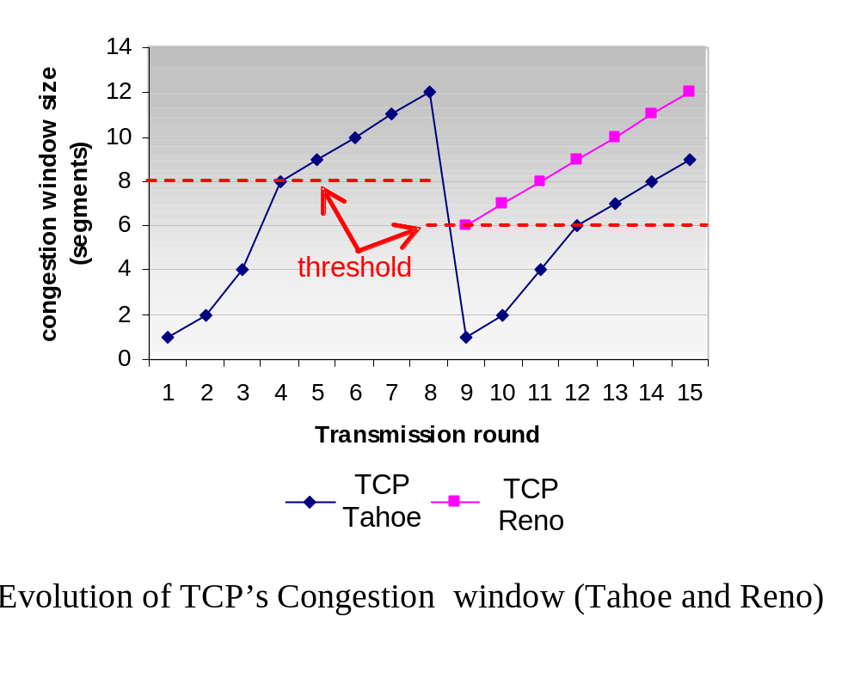
TCP Reno versus TCP Tahoe:
3: Transport Layer
3-<number>

Slide 90
Summary: TCP Congestion Control
when cwnd < ssthresh, sender in slow-start phase, window grows exponentially.
when cwnd >= ssthresh, sender is in congestion-avoidance phase, window grows linearly.
when triple duplicate ACK occurs, ssthresh set to cwnd/2, cwnd set to ~ ssthresh
when timeout occurs, ssthresh set to cwnd/2, cwnd set to 1 MSS.
3: Transport Layer
3-<number>

Slide 91
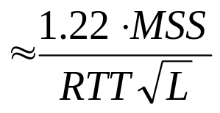
TCP Throughput of Congestion Avoidance
Q: what’s average throughout of TCP as function of window size, RTT?
  ignoring slow start
let W be window size when loss occurs.
  when window is W, throughput is W/RTT
  just after loss, window drops to W/2, throughput to W/(2RTT）.
  average throughput: 0.75 W/RTT
throughput in terms of loss rate: L
3: Transport Layer
3-<number>

Slide 92
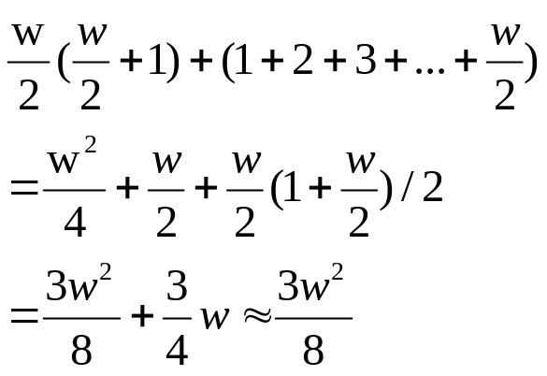
TCP throughput in congestion avoidance period
In congestion avoidance period,sending window size changes from w/2 to w (segments)
  The first RTT, window size=w/2
  The second RTT, window size=w/2+1
  The third RTT, window size=w/2+2
  …
  When packet lost, window size=w/2+w/2
Total segments in this period:
Packet loss rate:
L=8/(3w²)
average throughput=.75 W/RTT
3: Transport Layer
3-<number>

Slide 93
TCP Fairness
AIMD
TCP congestion avoidance:
AIMD: additive increase, multiplicative decrease
  increase window by 1 per RTT
  decrease window by factor of 2 on loss event
Fairness goal: if N TCP sessions share same bottleneck link, each should get 1/N of link capacity-from long run
TCP connection 1
TCP
connection 2
bottleneck
router
capacity R
3: Transport Layer
3-<number>

Slide 94
Why is TCP fair?
Two competing sessions:
Additive increase gives slope of 1, as throughput increases
multiplicative decrease decreases throughput proportionally
R
equal bandwidth share
loss: decrease window by factor of 2
congestion avoidance: additive increase
Connection 2 throughput
loss: decrease window by factor of 2
congestion avoidance: additive increase
Connection 1 throughput
R
3: Transport Layer
3-<number>

Slide 95
On TCP fairness
If n pure TCP services share the bottleneck link, each eventually gets C/n , it is fair
If TCP+UDP share the link, UDP will occupy more bandwidth, it is unfair!
If a user uses multiple parallel connections, such as web browser, even in pure services, it is not fair !
Example:
  A link of rate R supports 9 users, each uses one TCP connection
  If a new user comes in using 11 connections, he will occupy 11/20 bandwidth, it is unfair for others
  There is no critical fairness in the world!
3: Transport Layer
3-<number>

Slide 96
Chapter 3: Summary
principles behind transport layer services:
  multiplexing/demultiplexing
  reliable data transfer
  flow control
  congestion control
instantiation and implementation in the Internet
  UDP
  TCP
Next:
leaving the network “edge” (application, transport layers)
into the network “core”
3: Transport Layer
3-<number>

