Slide 1
Computer Networking
Zhu Li

Slide 2
What is network?
The architecture of interconnecting end systems
  Many types of networks
multiple communication networks:
  Telecommunication networks
  TV networks
  Computer networks
21 century is information time centralized on communication networks
  Digitalizing, networking, intelligence
  Industry economy → knowledge based economy
Internet is the greatest innovation of human communication from printing

Slide 3
What is this course about?
Introductory (first) course in computer networking
learn concepts of computer networking
learn principles of computer networking
learn practice of computer networking
Internet architecture/protocols
    by the time you are finished ……
Goals:
learn a lot (not just concepts, but principles and practice)
have fun (well, it should be interesting, at least)

Slide 4
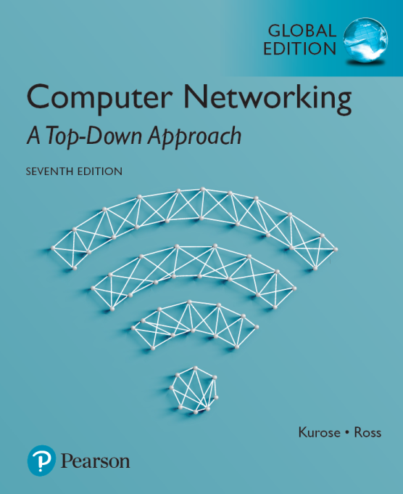
Course Information
Introductory (first) course in computer networking
Who is this course for?
  Undergrads, MS students
Prerequisites:
  Algorithms, Operating Systems, programming skills
Course materials:
  text: Computer Networking: A Top Down Approach, J. Kurose & Keith Ross, Addison Wesley, 2017
  7th edition

Slide 5
Course characteristics and Learning Methods
Course characteristics
  Massive contents
  Scattered in form
  Less math
  Understanding and remembering needed
Learning method
  Selflearning is not encouraged
  No miss the class
  Review in time is needed
  Completing your homework and course design in time
  Frequently ask

Slide 6
About the Exam
Projects design 25%
homework 10%
Participation: 10%
Random test: 5%
final exam 50%

Slide 7
Course Overview:
Part 1: Introduction
What is the Internet, What is a protocol?
Network edge, network core, network access
Physical media
Delay, loss in packet-switched networks
Protocol layers, service models
Internet backbones, NAPs and ISPs
A brief history of networking, Internet

Slide 8





A top-down approach:
We’ll cover networking top-down
end-system applications, end-end transport
network core: routing, hooking nets together
link-level protocols, e.g., Ethernet

Slide 9
Course Overview:
Part 2: Application Layer
Principles of application-layer protocols
The World Wide Web: HTTP
File transfer: FTP
Electronic mail in the Internet
The Internet's directory service: DNS
Socket programming
PROGRAMMING ASSIGNMENT 1
Q:What is the original app. of Internet is ?

Slide 10
Course Overview:
Part 3: Transport Layer
Transport-layer services and principles
Multiplexing and demultiplexing applications
Connectionless transport: UDP
Principles of reliable of data transfer
TCP case study
Principles of congestion control
TCP congestion control

Slide 11
Course Overview:
Part 4: Network Layer
Introduction and network service model
Routing principles
Hierarchical routing
IP: the Internet Protocol
Routing in the Internet
What’s inside a router?

Slide 12
Course Overview:
Part 5: Link Layer, LANs
Introduction, services
Error detection, correction
Multiple access protocols, LANs
LAN addresses, ARP
Ethernet
Hubs, bridges, switches
Wireless LANs: IEEE 802.11
PPP: the Point-to-Point protocol

Slide 13
Course Overview:
Part 6: Wireless and Mobile Networks
  CDMA
  WLAN
  Cellular Internet Access
  Mobility management principle
  Mobile IP
  Managing mobility in cellular Networks

Slide 14
Course Overview:
FINAL EXAM

