Slide 1
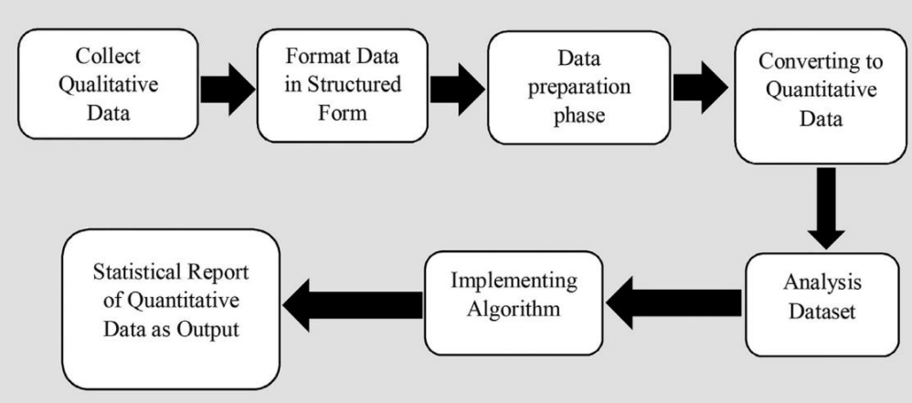


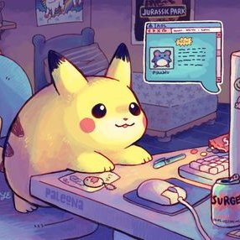

COVID-19 & Mental Health
Survey
Depression Scale
Spend time on the internet
Psychological change
Decreasing productivity
Depressed mood
Effect of depressed mood
Most & average using internet sites
Spending time with the music
Irritability
Image testing
Destructive mentality Increasing depression
More irritable Social anxiety
Decreasing physical contact More time on the internet

