Slide 2
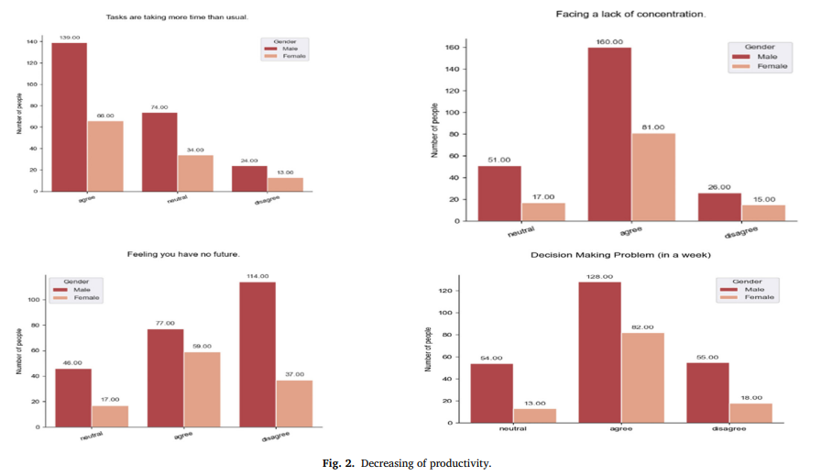
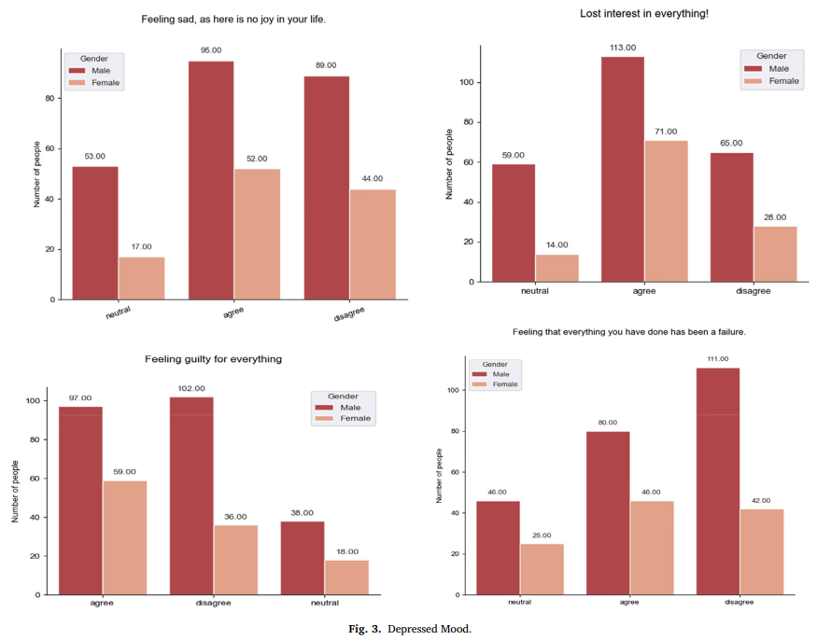
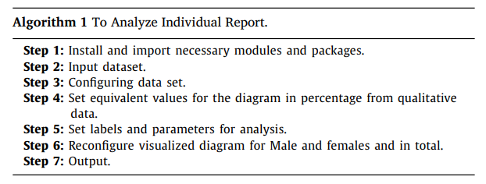
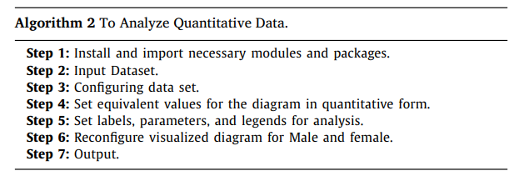
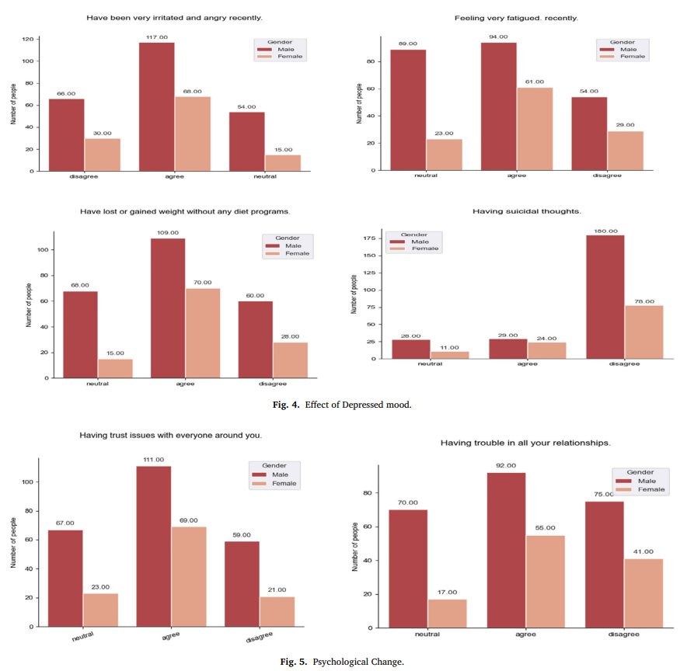
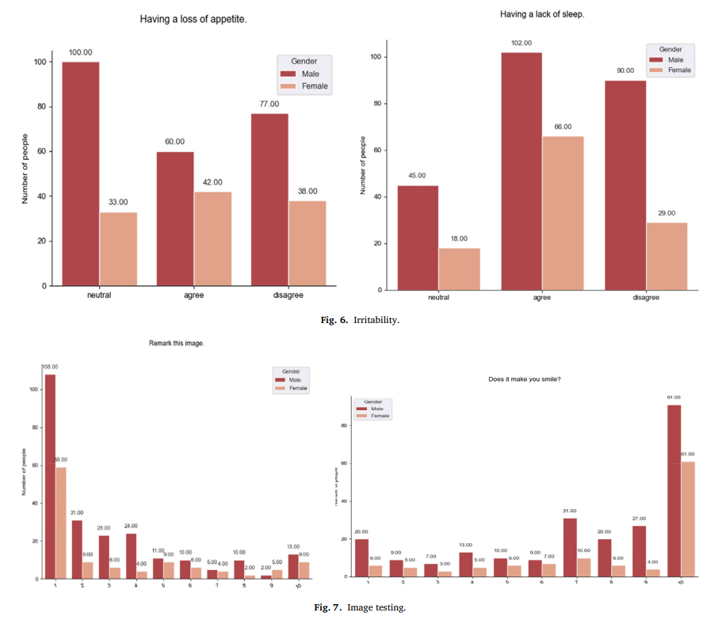
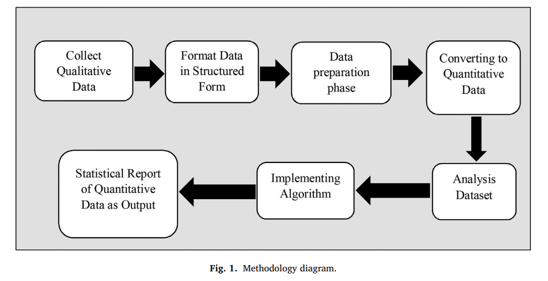

Impact of COVID-19 on mental health
INTRODUCTION
COVID – 19 attacked the whole human civilization with its worst range in both physical and psychological way. Weak Psychological health can be initialized as Anxiety, Depression, Insomnia, Mood Swing, Mind Diversion, and many more. A quantitative report on the anxiety and depression scale based on a collected dataset from various professions on their regular lifestyle, choices, and internet uses phone through simulations and statistical reports.
METHOD
RESULTS
According to the Survey, about 37.2% male, 49.8% female, and in total, 42.78% of people are depressed with their daily life. It can be referred to as the depression scale. According to the internet, we can say most people use all of the social services regularly. As a result, maximum time they stay at home. Mostly 63.7% of Females do not like to go out and then only for an hour (26.5%). On the other hand, 18.6% of male do not like to go out, and 26.5% of males go out for an hour. As a result, compared to the depression scale with the image remarking, we get 16.85% of people’s Psychological condition changes due to the lockdown of COVID-19.
CONCLUSION
COVID-19 has a significant impact on mental health. It is creating a destructive mentality and increasing depression in regular life. As a result, suicidal attempts are increasing. Life of people are becoming more irritable, and people have social anxiety. For COVID-19 social distance has increased. So, physical contact is decreasing. Social colony breakdown is the main reason for this. As people have to stay at home most of the time, they spend their leisure time on the internet. So, the natural lifestyle of humans is being hampered.
Data Collection: The report was gender (male and female) and age-based from age 1 to 60. The data was collected using simple words like agree-disagree-normal and many more. The survey form was divided into three parts to find the psychological condition of humans.
Development and Algorithm: We have used this algorithm to analyze male and female reports in percentages from different perspectives.
DISSCUSSION
We have done some detailed analysis on the questions, and those are represented as visualization reports.
Md. Mosfikur Rahman , Mohd. Saifuzzaman, Akash Ahmed, Mahfuja Ferdousi Mahin, Syeda Farjana Shetu
Department of Computer Science and Engineering, Daffodil International University, Bangladesh

