Slide 1
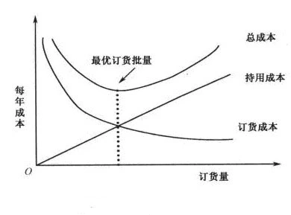
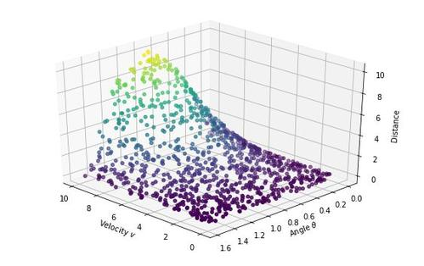
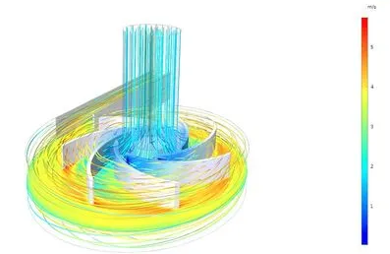
Mathematical modeling
Describing a system using mathematical concepts and language
Purpose
How
Classification
Fields
Used
explain a system
study the effects of different components
make predictions about behavior
Analyze the problem
By information known:
White box model
Grey box model
Black box model
By methods:
Linear vs. nonlinear
Static vs. dynamic
Explicit vs. implicit
Natural sciences
Physics
Biology
Chemistry
Earth science
Engineering disciplines
Computer science
Electrical engineering
Simplify the details
Non-physical systems
(Social sciences, …)
Economics
Psychology
Sociology
Political science
Find equations between variables
Choose appropriate algorithms
Calculate and analyze the results
Notes:
v

